Slide 1
Walking With the Spirit
Fellowship – jealous partnership
God said, “Enough” –
your sins cut you off from God
Destruction of the flesh that the spirit might be saved
Our Advocate
The Holy Spirit is Jesus’ Advocate to us
The Holy Spirit is our Advocate in prayer and worship
Relevant – Revelant

Slide 2
Our Guarantee

Slide 3
I. Earnest Agreement
Ephesians 1:13-14
God identified you as his own
His seal on you
By giving you the Holy Spirit

Slide 4
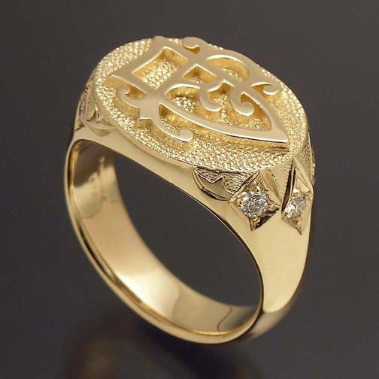
His seal – a medallion or ring featuring a raised or recessed signature or symbol, used to certify or authenticate a letter or document

Slide 5
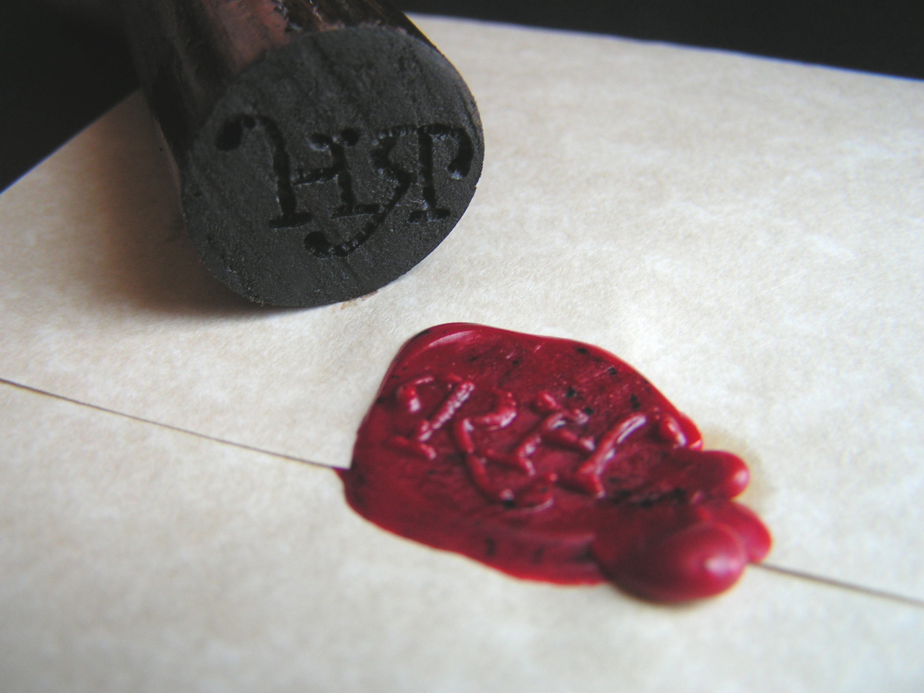

Slide 6
The Spirit is God’s guarantee
Of Hebrew origin; a pledge, that is, part of the purchase money or property given in advance as security for the rest:—earnest.
Earnest - money given by a buyer to a seller to bind a contract.
He will give us the inheritance he promised
He has purchased us to be his own people

Slide 7
2 Corinthian 1:21-22
Identified as God’s own
The Holy Spirit in our hearts
First installment – guarantees everything promised

Slide 8
Hebrews 3:12 - 14 ¹²Be careful then, dear brothers and sisters. Make sure that your own hearts are not evil and unbelieving, turning you away from the living God. ¹³You must warn each other every day, while it is still “today,” so that none of you will be deceived by sin and hardened against God. ¹⁴For if we are faithful to the end, trusting God just as firmly as when we first believed, we will share in all that belongs to Christ.
Galatians 5:16 So I say, let the Holy Spirit guide your lives. Then you won’t be doing what your sinful nature craves.

Slide 9
II. Part of the Full Inheritance
2 Corinthian 5:1-5
God has prepared us to receive new bodies
Our guarantee – the Holy Spirit given us
Grow weary in our present bodies
Want to put on new bodies so these dying bodies will be swallowed up by life

Slide 10
Romans 8:11 The Spirit of God, who raised Jesus from the dead, lives in you. And just as God raised Christ Jesus from the dead, he will give life to your mortal bodies by this same Spirit living within you.

Slide 11
Romans 8:18-25
The Holy Spirit in us – a foretaste of future glory
Full rights of adopted children
Including new bodies
Wait patiently and confidently

Slide 12
III. Our Response
Put in the context of 2 Corinthians 5:6-21
Looking forward to what is ahead
Not going to waste the time – our goal is always to please him
Judged for what we have done while living in this earthly body
Not live for ourselves, but live for Christ
Given the task of reconciling people to God (Ambassadors)

Slide 21
III.

Slide 26
IV.

