Slide 2
Our Advocate
Walking with the Spirit

Slide 3
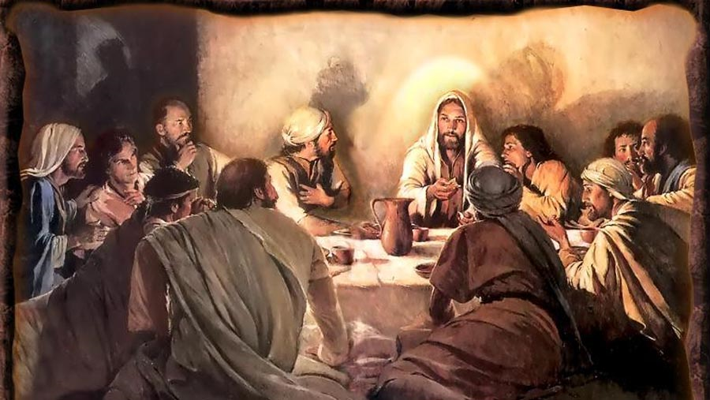
I. Jesus Prepares for Departure

Slide 4
John 14
Going to the Father
Preparing a place for you
I am the way to the Father
You know the Father, you’ve seen him in me
You are going to do the same works I do, because I am going to the Father
Jesus introduces the Holy Spirit
Father will give you another advocate

Slide 5
Advocate - par-ak'-lay-tos
An intercessor, consoler:—advocate, comforter.
A person who pleads for or in behalf of another; intercessor.

Slide 6
Another
Two Greek words for “another”
Allos – one of the very same kind
Heteros – one of another kind, different kind
Allos – another advocate, comforter, intercessor of the same kind as Jesus

Slide 7
Advocate of Jesus
With you always
Lead into all truth
Reveal and represent Jesus
Remind you of Jesus’ words
Intercede for you
World can’t receive him
Lives with you – will be in you

Slide 8
John 15
I will send you the Advocate
He will testify about me
You must also testify about me

Slide 9
John 16
Best for you – to your advantage – that I go away
If I don’t – Advocate won’t come
Advantages
Spiritual rather than physical
In you rather than with you
Unlimited access

Slide 10
The same leadership, advocacy as Jesus
Matthew 28:20 - …And be sure of this: I am with you always, even to the end of the age
Mark 16:20 And the disciples went everywhere and preached, and the Lord worked through them, confirming what they said by many miraculous signs.

Slide 11
He will:
Convict the world of sin, righteousness, judgment
Guide you into all truth
Tell you about the future
Imparting information from Jesus

Slide 12
John 17 – Jesus’ intercessory prayer

Slide 13
II. Advocate in Prayer
Romans 8:26-27
Holy Spirit helps us in our weaknesses
Don’t know what God wants us to pray for
Holy Spirit prays for us
Holy Spirit pleads for us in harmony with God’s will

Slide 14
Hebrews 7:24 - 25 ²⁴But because Jesus lives forever, his priesthood lasts forever. ²⁵Therefore he is able, once and forever, to save those who come to God through him. He lives forever to intercede with God on their behalf.

Slide 15
1 Corinthian 14 (AMP)
One who speaks in an unknown tongue
Speaks to God
In the Holy Spirit he utters secret truths and hidden things not obvious to the understanding
Prayer in unknown tongues
My spirit, by the Holy Spirit in me, prays
My mind is unproductive

Slide 16
Two Conclusions
Conclusion #1 – this is foolishness
1 Corinthians 2:14 But people who aren’t spiritual can’t receive these truths from God’s Spirit. It all sounds foolish to them and they can’t understand it, for only those who are spiritual can understand what the Spirit means.
John 14:17 – the world cannot receive him, isn’t looking, doesn’t recognize
Conclusion #2 – pray and sing with my spirit (the Holy Spirit in me) and with my mind and understanding

