Slide 2
The Story Finding Your Story in God’s Story “New Beginnings”
Series 3 - God Saves His People

Slide 3
Review Chapter 27 “The Resurrection”
Series 3 - God Saves His People

Slide 5
I. You Will Be My Witnesses
Acts 1:1-5, 8

Slide 6
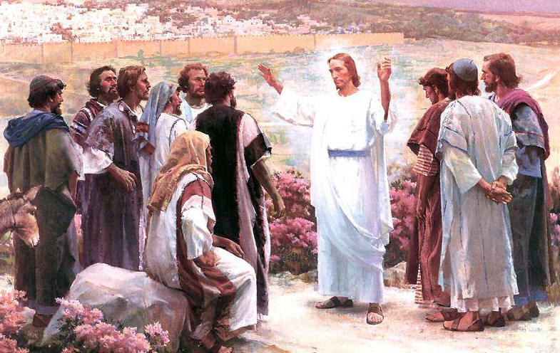
You will be baptized with the Holy Spirit

Slide 7
You will receive power
You will be my witnesses

Slide 8
Luke 24:46-49 (NLT) ⁴⁶ And he said, “Yes, it was written long ago that the Messiah would suffer and die and rise from the dead on the third day. ⁴⁷ It was also written that this message would be proclaimed in the authority of his name to all the nations, beginning in Jerusalem: ‘There is forgiveness of sins for all who repent.’ ⁴⁸ You are witnesses of all these things. ⁴⁹ “And now I will send the Holy Spirit, just as my Father promised. But stay here in the city until the Holy Spirit comes and fills you with power from heaven.”

Slide 9
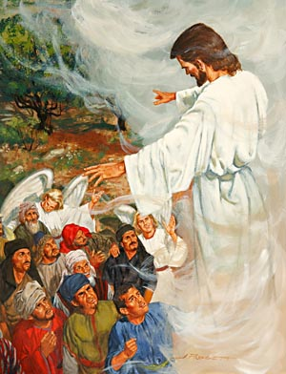
Jesus Ascended to heaven

Slide 10
Acts – the Book of Transitions
From Jesus present to the Holy Spirit indwelling/empowering
From confused followers/deserters to outspoken preachers
From Saul the Pharisee to Paul the Apostle
From witness to Jews to witness to Gentiles
From under the law to the fulfillment of the law

Slide 11
The Day of Pentecost – Acts 2

Slide 12
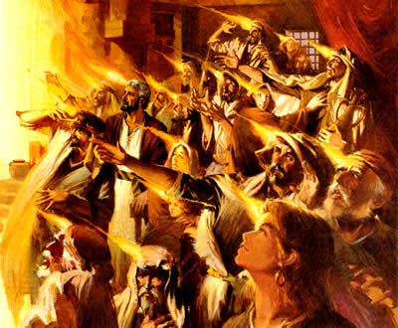
Everyone present was filled with the Holy Spirit
Speaking in other languages as the Holy Spirit gave them this ability

Slide 13
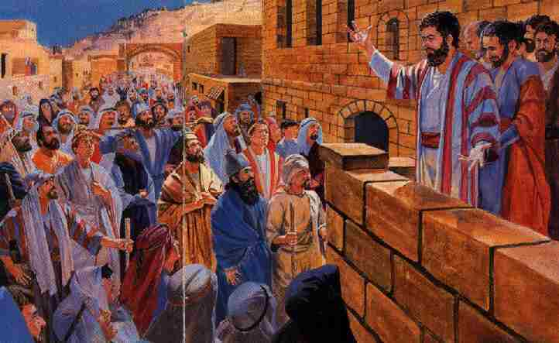
Fulfillment of Joel’s prophecy – “this is that”
Repent, be baptized, receive the Holy Spirit

Slide 14
II. What God Has Cleansed
Acts 10

Slide 15
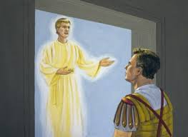
Gentile Cornelius visited by an angel – call for Peter

Slide 16
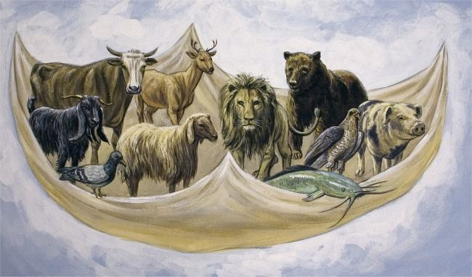
Peter given a vision – eat unclean animals
Do not call something unclean if God has made it clean

Slide 17
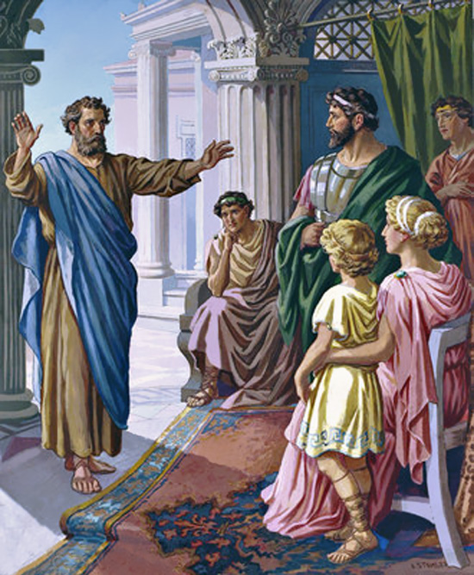
Peter goes to Cornelius’ house
Peter preaches the Good News
Cornelius’ household believes
They are filled with the Holy Spirit
God’s will concerning Gentiles is clearly revealed

Slide 18
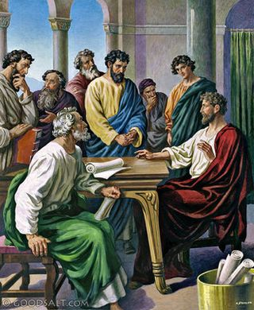
Evidence for the council at Jerusalem

Slide 19
Acts 15:7-11 (NLT) ⁷ At the meeting, after a long discussion, Peter stood and addressed them as follows: “Brothers, you all know that God chose me from among you some time ago to preach to the Gentiles so that they could hear the Good News and believe. ⁸ God knows people’s hearts, and he confirmed that he accepts Gentiles by giving them the Holy Spirit, just as he did to us. ⁹ He made no distinction between us and them, for he cleansed their hearts through faith. ¹⁰ So why are you now challenging God by burdening the Gentile believers with a yoke that neither we nor our ancestors were able to bear? ¹¹ We believe that we are all saved the same way, by the undeserved grace of the Lord Jesus.”

Slide 20
III. The Name of Jesus
Names tied to Character and Purpose
Abraham – father of a multitude
Isaac - laughter

Slide 21
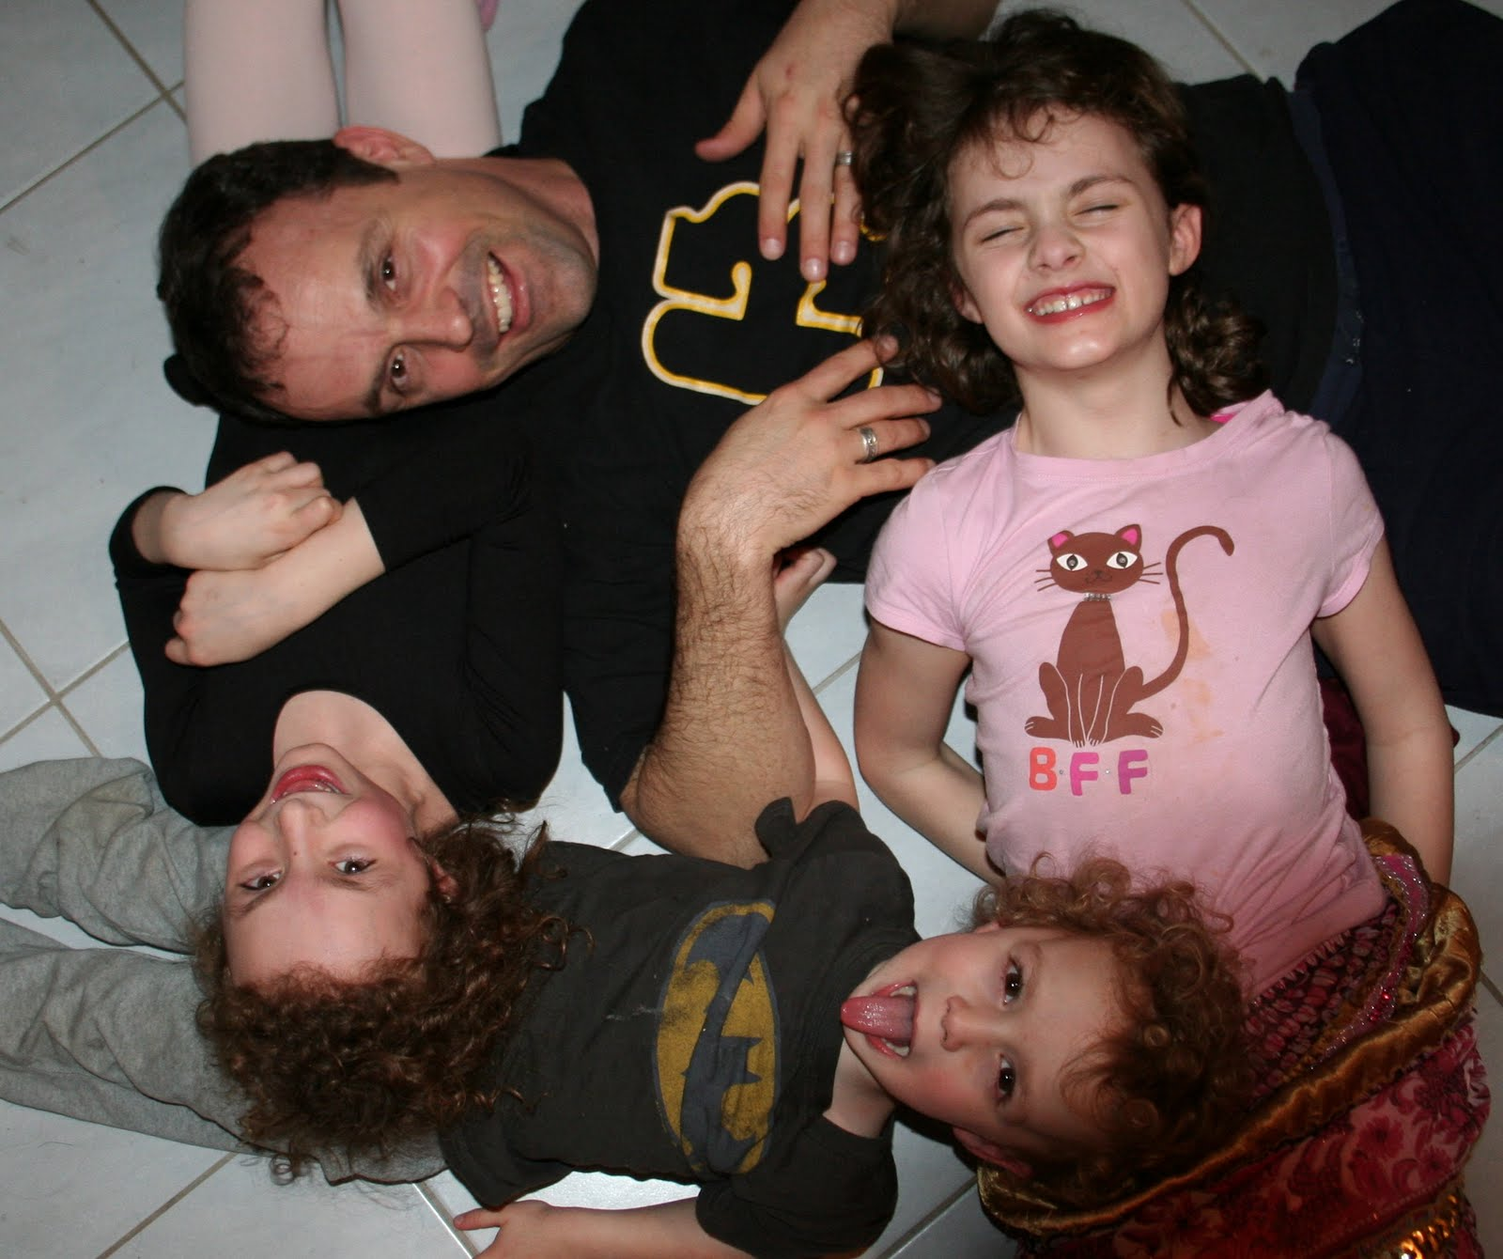

Slide 22
Luke 1:30-31 (NLT) ³⁰ “Don’t be afraid, Mary,” the angel told her, “for you have found favor with God! ³¹ You will conceive and give birth to a son, and you will name him Jesus.
Jesus – Jehoshua – Joshua
Jehovah the Savior

Slide 23
Thirty-two times in the book of Acts the name of Jesus is used with its power to heal, to baptize, to suffer for, to claim the authority of God Himself.

Slide 24
Repent and be baptized in the name of Jesus Christ…
Peter said, “In the name of Jesus Christ of Nazareth, walk!”
By faith in the name of Jesus, this man (the cripple) was made strong.
It is Jesus’ name and the faith that comes through him that has completely healed him.

Slide 25
The High Priest questioned them saying, “By what power or what name did you do this?”
Response: “It is by the name of Jesus Christ of Nazareth, whom you crucified but whom God raised from the dead that this man stands before you healed.”

Slide 26
Salvation is found in no one else, for there is no other name given under heaven by which we must be saved.
Sanhedrin: We must warn them to speak no longer to anyone in this name.

Slide 27
They commanded them not to teach or speak at all in the name of Jesus.
After they were jailed, rulers said, “We gave you strict orders not to teach in this name.”
After flogging them, they ordered them not to speak in the name of Jesus.
The apostles left, rejoicing because they had been counted worthy of suffering disgrace for the Name.

Slide 28
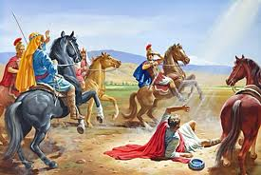

Slide 29
The Name of Jesus – not a charm – Acts 19:13-17

Slide 30
Acts 19:13-17 (NLT) ¹³ A group of Jews was traveling from town to town casting out evil spirits. They tried to use the name of the Lord Jesus in their incantation, saying, “I command you in the name of Jesus, whom Paul preaches, to come out!” ¹⁴ Seven sons of Sceva, a leading priest, were doing this. ¹⁵ But one time when they tried it, the evil spirit replied, “I know Jesus, and I know Paul, but who are you?” ¹⁶ Then the man with the evil spirit leaped on them, overpowered them, and attacked them with such violence that they fled from the house, naked and battered. ¹⁷ The story of what happened spread quickly all through Ephesus, to Jews and Greeks alike. A solemn fear descended on the city, and the name of the Lord Jesus was greatly honored.

Slide 31
Empowered by the Holy Spirit
Equipped with the name of Jesus – the authority with that name because of your relationship with him

