Slide 2
The Story Finding Your Story in God’s Story “The Resurrection”
Series 3 - God Saves His People

Slide 3
Review Chapter 26 “The Hour of Darkness”
Series 3 - God Saves His People

Slide 5
I. Jesus Conquers the Grave
Luke 24:1-12

Slide 6
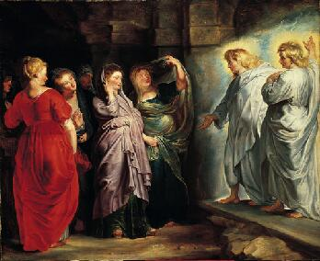
Why do you look for the living among the dead?
He is not here – he has risen from the dead
He told you he must be betrayed, crucified, and rise on the third day

Slide 7
They remembered he said this
They rushed to tell the disciples

Slide 8
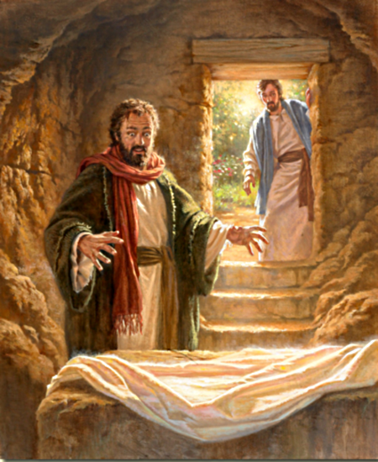

Slide 9
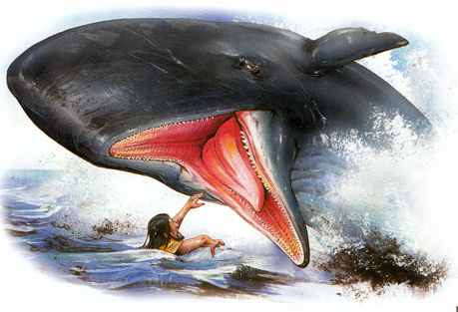
Like Jonah – three days and nights in the heart of the earth

Slide 10
Matthew 16:21 (NLT) ²¹ From then on Jesus began to tell his disciples plainly that it was necessary for him to go to Jerusalem, and that he would suffer many terrible things at the hands of the elders, the leading priests, and the teachers of religious law. He would be killed, but on the third day he would be raised from the dead.

Slide 11
Romans 1:4 (NLT) ⁴ and he was shown to be the Son of God when he was raised from the dead by the power of the Holy Spirit. He is Jesus Christ our Lord.

Slide 12
Revelation 1:17-18 (NLT) ¹⁷ When I saw him, I fell at his feet as if I were dead. But he laid his right hand on me and said, “Don’t be afraid! I am the First and the Last. ¹⁸ I am the living one. I died, but look—I am alive forever and ever! And I hold the keys of death and the grave [Greek – Hades].

Slide 13
II. Appearances
Mark 16:9-14

Slide 14
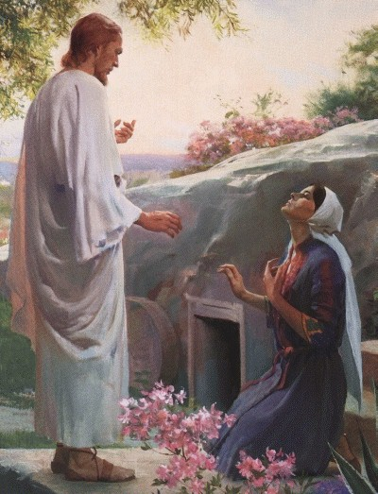
To Mary Magdalene – John 20:11-18

Slide 15
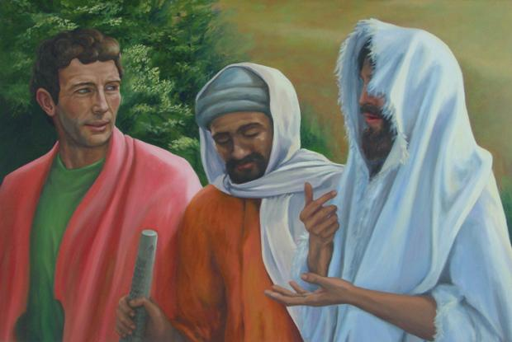
To two followers – Luke 24:13-34

Slide 16
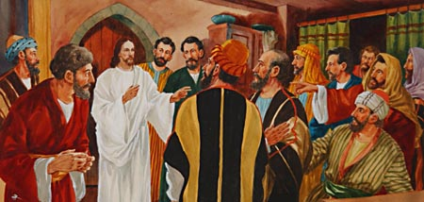
To eleven disciples – Luke 24:35-49

Slide 17
1 Corinthians 15:4-8
Seen by Peter and then by the Twelve.
Seen by more than 500 of his followers
Seen by James and later by all the apostles.
Seen by Paul

Slide 18
Acts 13:31 (NLT) ³¹ And over a period of many days he appeared to those who had gone with him from Galilee to Jerusalem. They are now his witnesses to the people of Israel.

Slide 19
Acts 4:33 (NLT) ³³ The apostles testified powerfully to the resurrection of the Lord Jesus, and God’s great blessing was upon them all.

Slide 20
III. Resurrection Relevancies

Slide 21
Hebrews 2:14-15 (NLT) ¹⁴ Because God’s children are human beings—made of flesh and blood—the Son also became flesh and blood. For only as a human being could he die, and only by dying could he break the power of the devil, who had the power of death. ¹⁵ Only in this way could he set free all who have lived their lives as slaves to the fear of dying.
The Resurrection – the hope of the believer

Slide 22
1 Corinthians 15
If no resurrection – your faith is useless and you are still guilty of your sin and more to be pitied than anyone in the world
Everyone who belongs to Christ will be given new life
The last enemy to be destroyed is death
If there is no resurrection – live it up!! Don’t be fooled.

Slide 23
Resurrection Bodies
Earthly bodies
Buried in brokenness
Buried in weakness
Cannot inherit the eternal
mortal
Resurrection bodies
Raised in glory
Raised in strength
Like Christ’s (heavenly man)
Immortal

Slide 24
Order of Resurrection
Jesus
Those who have died in Christ
Transformation of those living when Christ returns
Victory over sin and death through our Lord Jesus Christ

