Slide 2
The Story Finding Your Story in God’s Story “The Hour of Darkness”
Series 3 - God Saves His People

Slide 3
Review Chapter 25 “Jesus, the Son of God”
Series 3 - God Saves His People

Slide 5
I. Jesus Humbles Himself

Slide 6
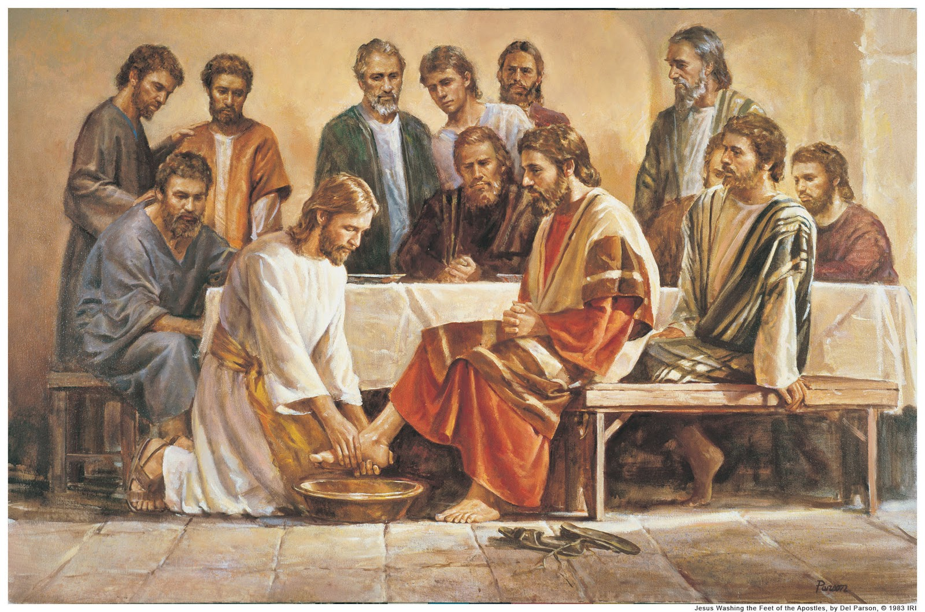
John 13 – Jesus washed his disciples feet

Slide 7
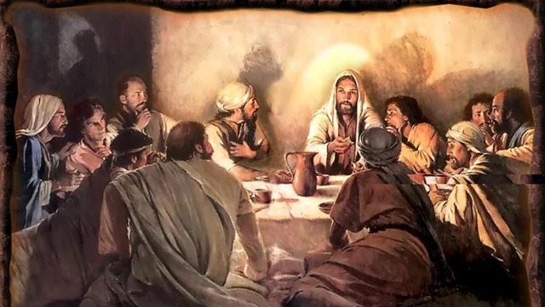

Slide 8
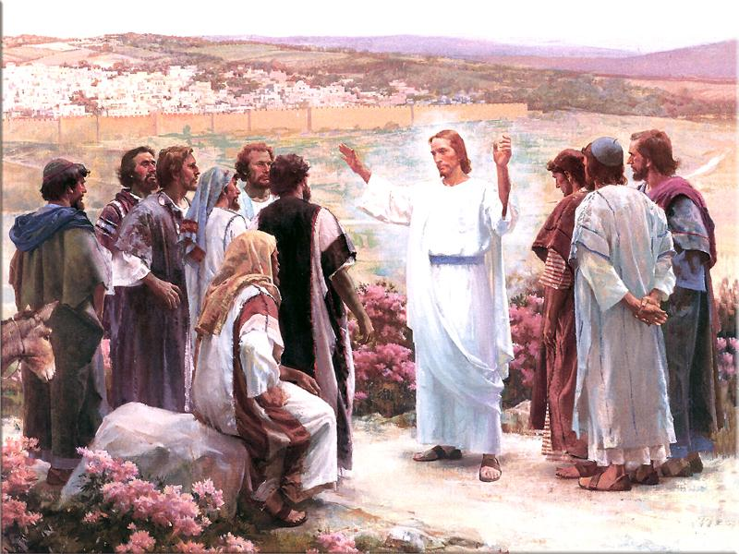
Focused on disciples peace and comfort – John 14

Slide 9
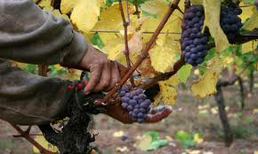
Reinforcing relationship and calling – John 15

Slide 10
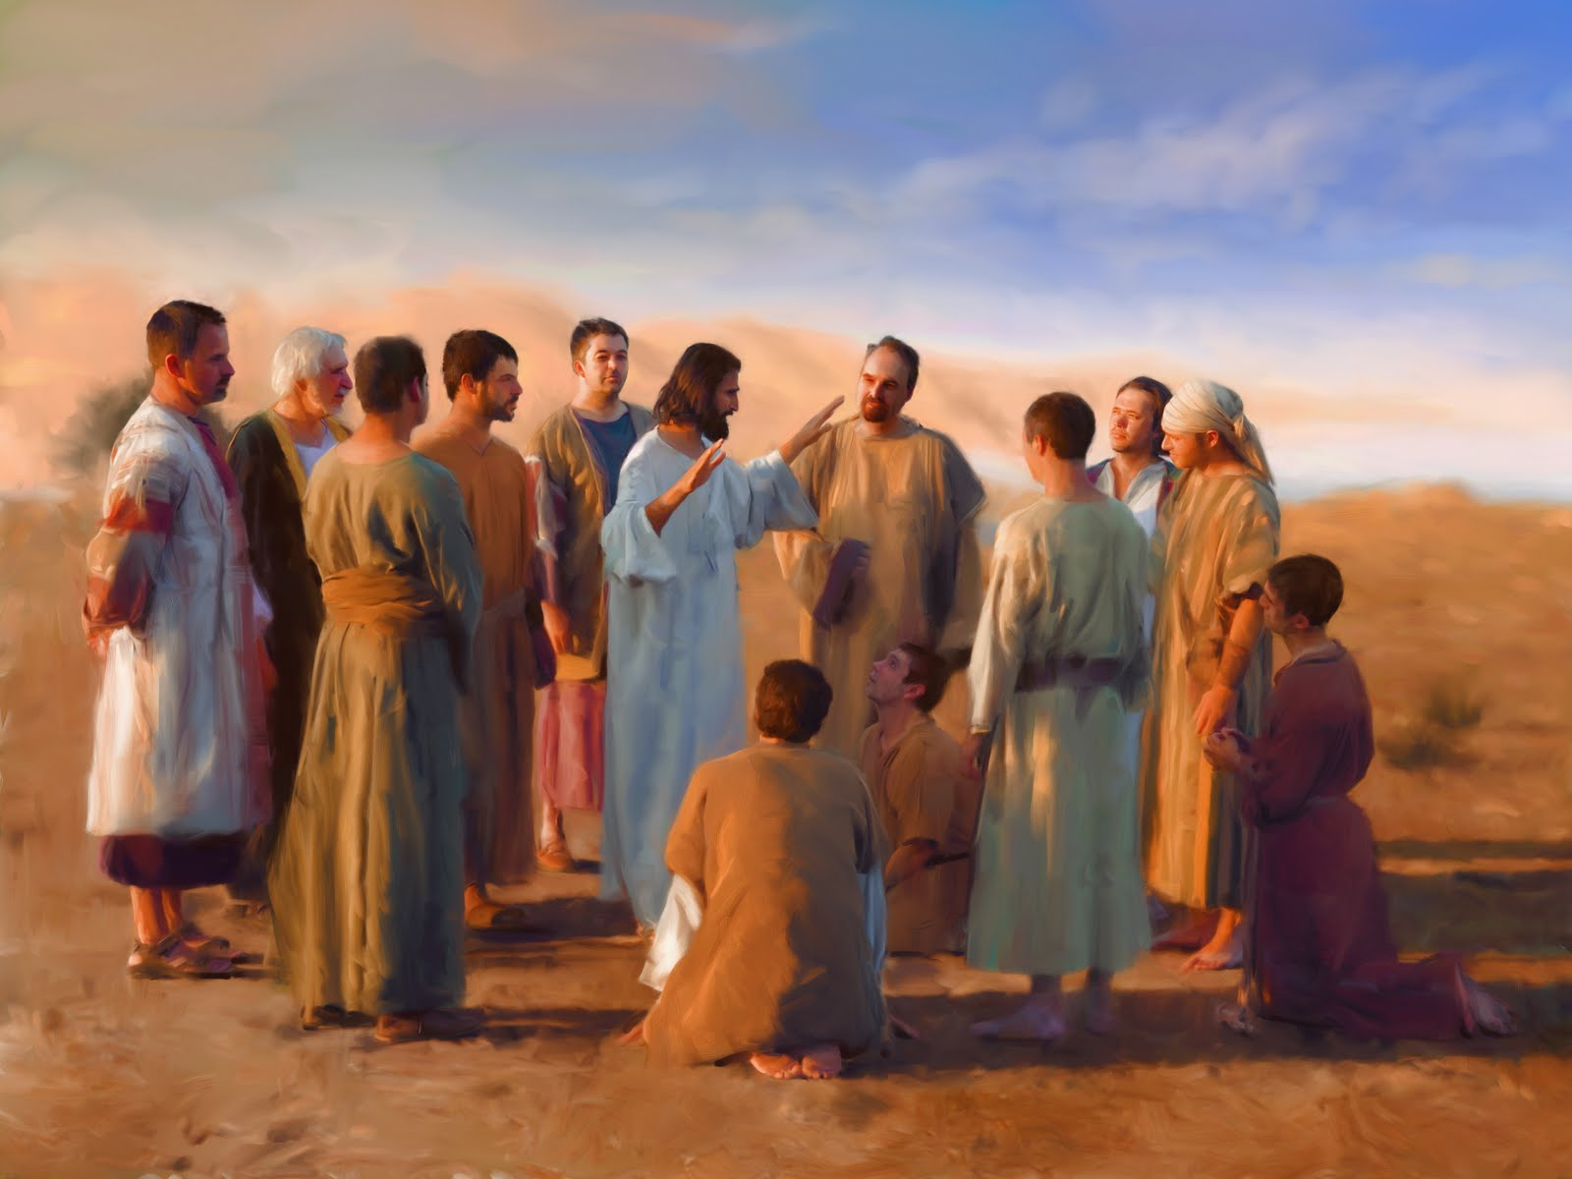

Slide 11
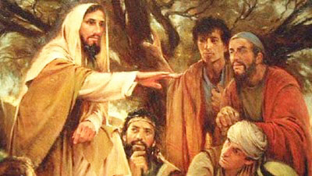
Warning about opposition and the advantage of the Holy Spirit’s ministry – John 16

Slide 12
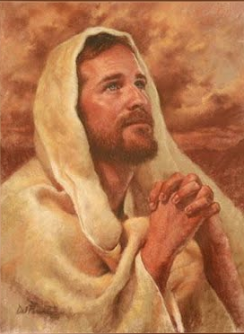
Jesus prays for them and us – John 17

Slide 13
II. Jesus Betrayed and Arrested

Slide 14
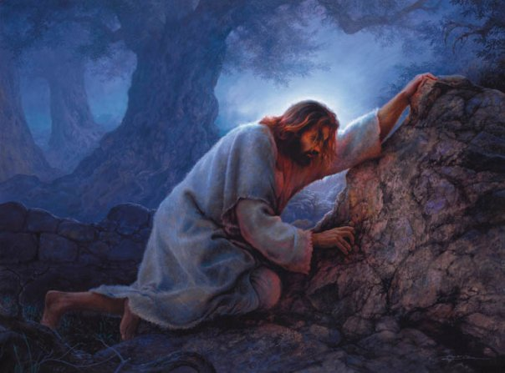
Jesus and Disciples at Gethsemane – Matthew 26

Slide 16
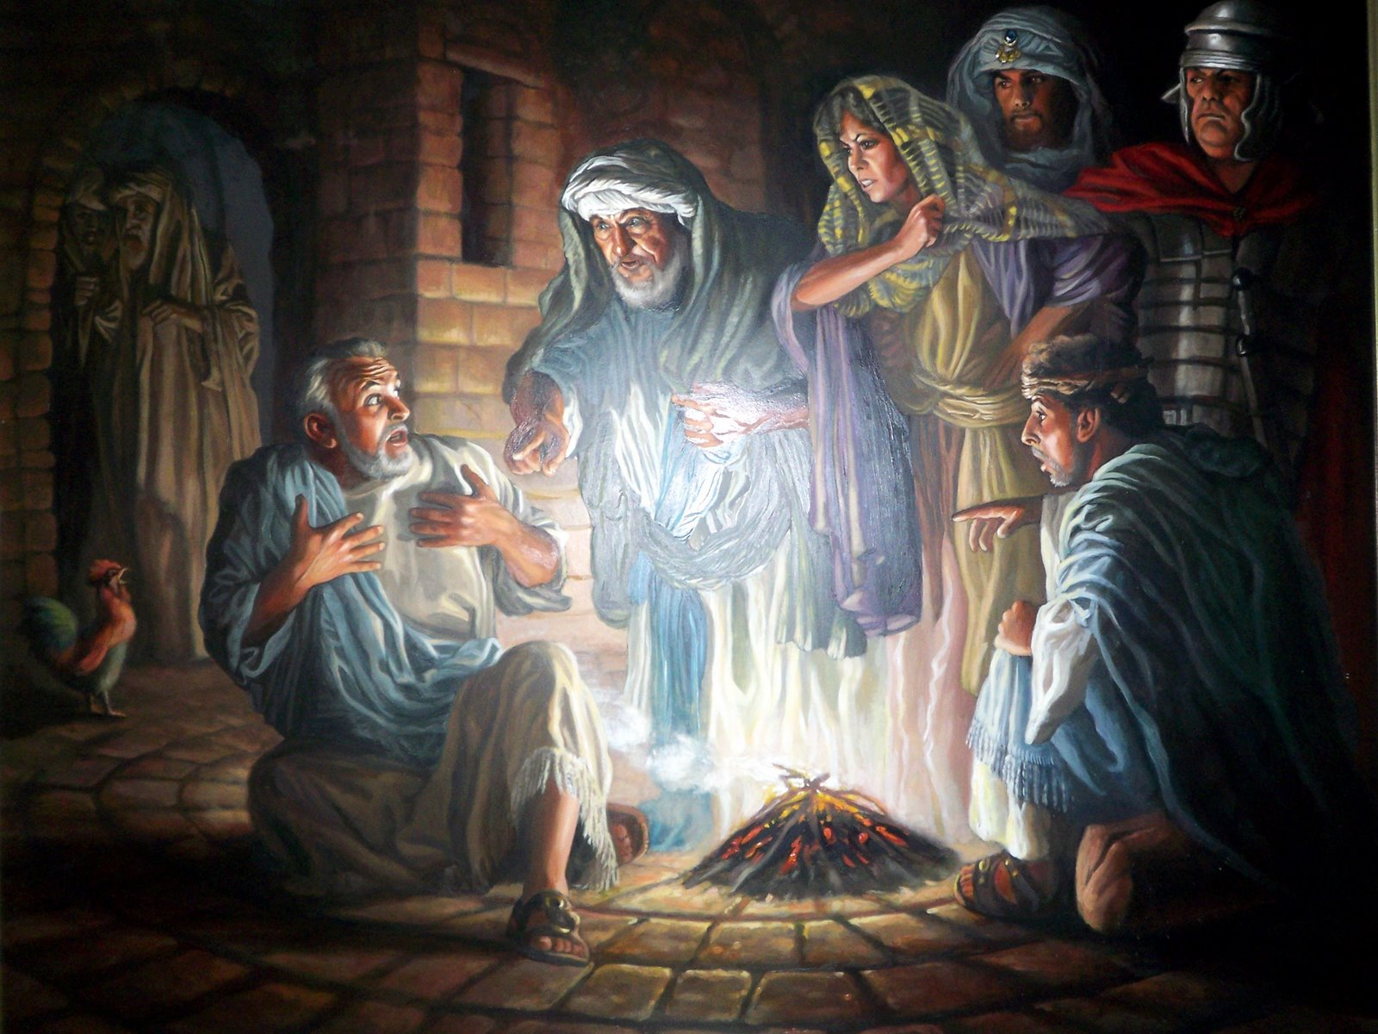

Slide 17
III. Jesus Crucified

Slide 18
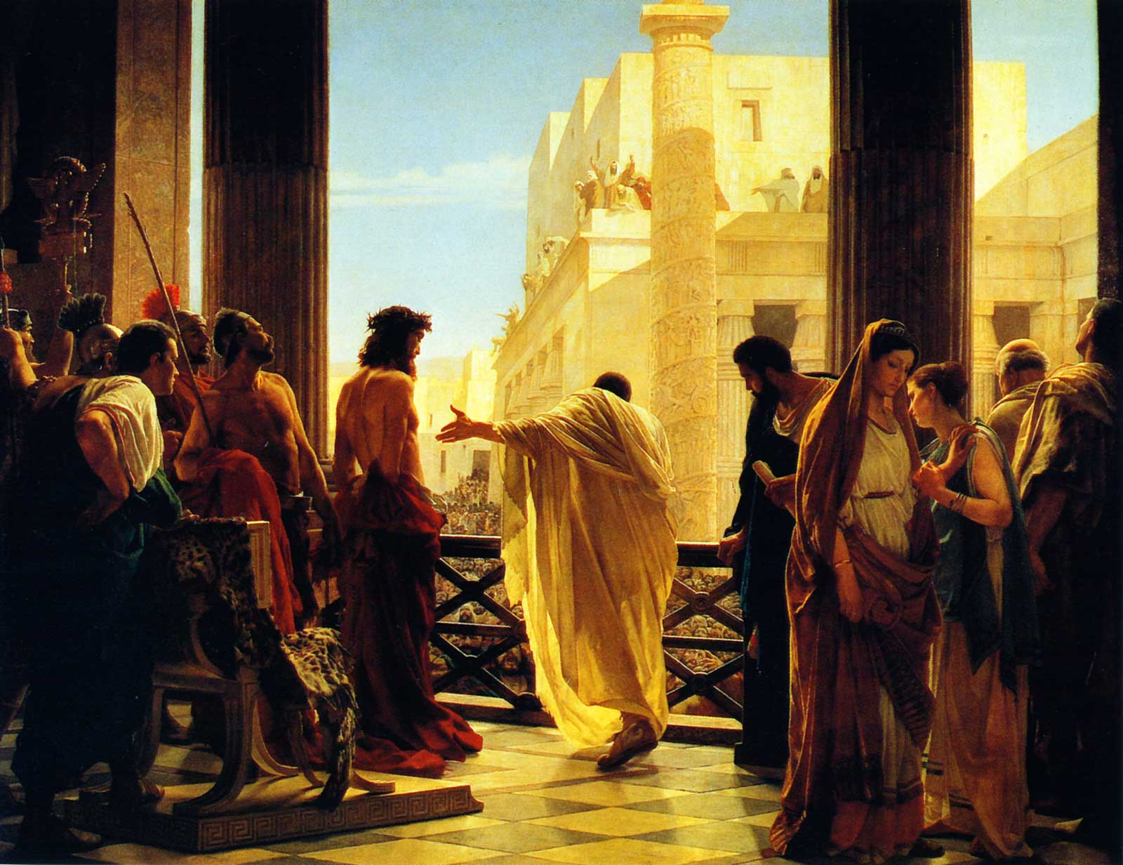
Jesus condemned, crucified, and buried - Matthew 27

Slide 19
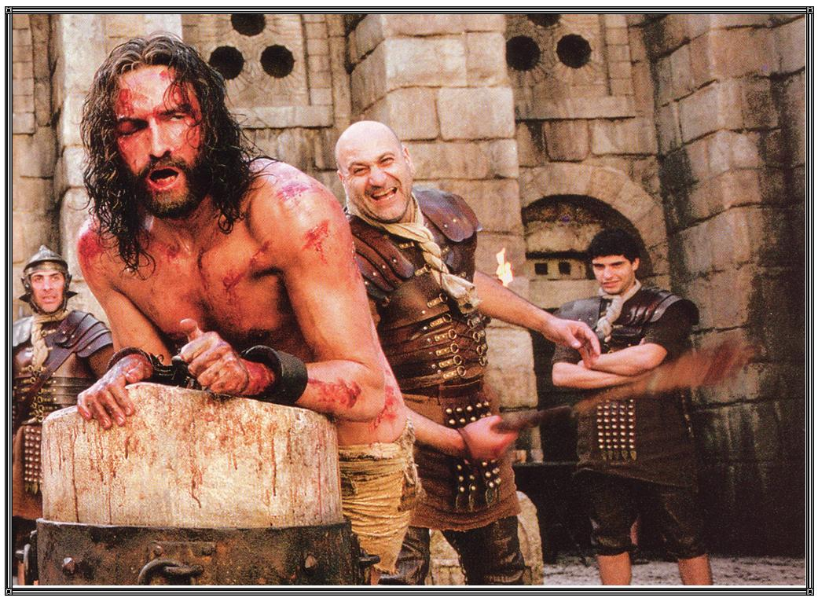

Slide 20
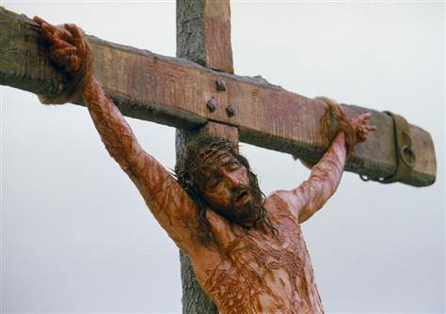

Slide 21
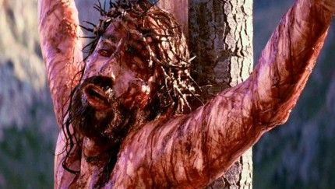
Isaiah 53 - But he was pierced for our rebellion, crushed for our sins. He was beaten so we could be whole. He was whipped so we could be healed.

Slide 22
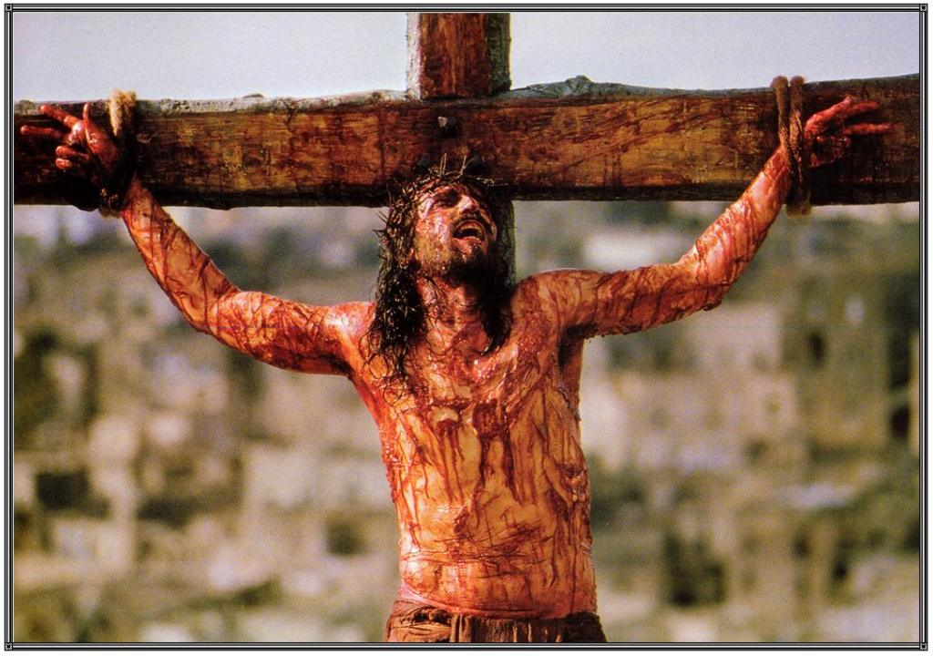
Psalm 22:1 My God, My God, why have your forsaken me?
Why have you abandoned me?
The Lord laid on him the sin of us all

Slide 23
2 Corinthians 5:21 (NASB) ²¹ He made Him who knew no sin to be sin on our behalf, so that we might become the righteousness of God in Him.

Slide 24
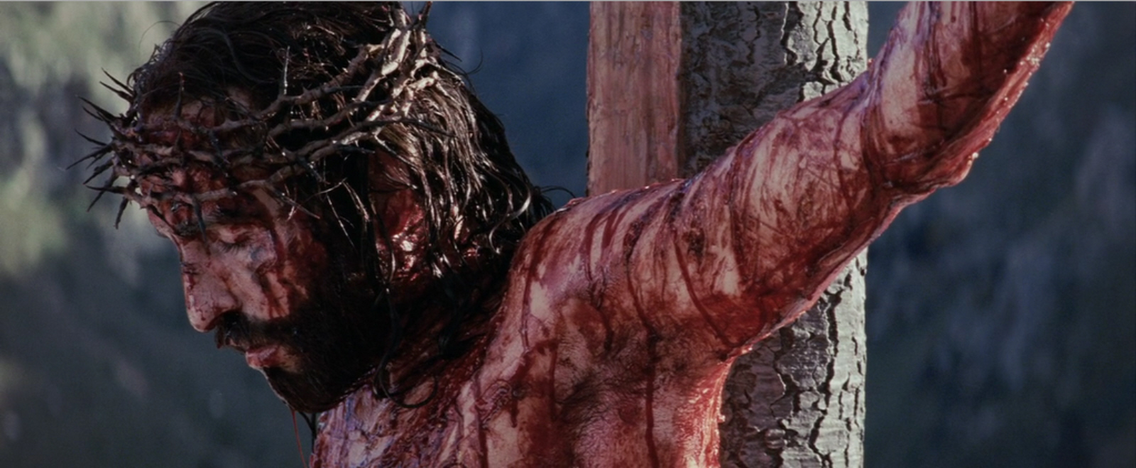
God uses all the elements of nature to show the significance of this event

Slide 25
Colossians 2:13-15 (NLT) ¹³ You were dead because of your sins and because your sinful nature was not yet cut away. Then God made you alive with Christ, for he forgave all our sins. ¹⁴ He canceled the record of the charges against us and took it away by nailing it to the cross. ¹⁵ In this way, he disarmed the spiritual rulers and authorities. He shamed them publicly by his victory over them on the cross.

Slide 26
Romans 5:8-11 (NLT) ⁸ But God showed his great love for us by sending Christ to die for us while we were still sinners. ⁹ And since we have been made right in God’s sight by the blood of Christ, he will certainly save us from God’s condemnation. ¹⁰ For since our friendship with God was restored by the death of his Son while we were still his enemies, we will certainly be saved through the life of his Son. ¹¹ So now we can rejoice in our wonderful new relationship with God because our Lord Jesus Christ has made us friends of God.

