Slide 1
The Story Finding Your Story in God’s Story “No Ordinary Man”
Series 3 - God Saves His People

Slide 2
Review Chapter 23 “Jesus’ Ministry Begins”
Series 3 - God Saves His People

Slide 4
I. Introducing God’s Kingdom
It was always God’s intent to be the king of his people
1 Samuel 8:5-7

Slide 5
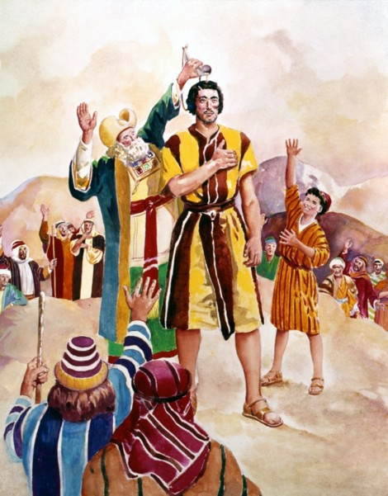
Give us a king to judge us like all the other nations have…
They don’t want me to be their king any longer.

Slide 6
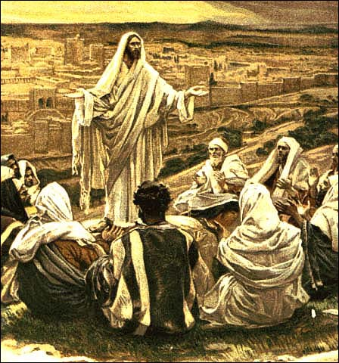
Pray this way…
Thy Kingdom come

Slide 7
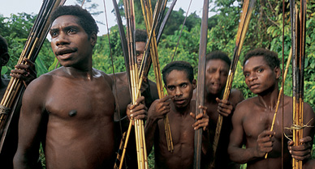

Slide 8
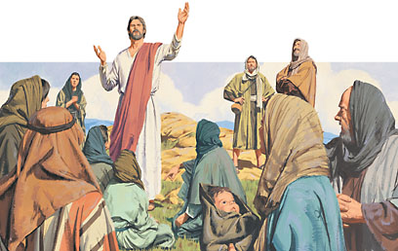
The Kingdom of God is like

Slide 9
Worry-free zone – Matthew 6:25-34
Don’t worry about everyday life
These things dominate the thought of unbelievers
Seek the kingdom of God above all else – he will give you everything you need

Slide 10
A great treasure Matthew 13:44-45
Like a treasure hidden in a field

Slide 11
Like a pearl of great value
Sell everything to buy it

Slide 12
A great power – Mark 4:26-29
The seed sprouts and grows
He does not understand how

Slide 13
II. Kingdom Authority
Over nature – Matthew 8:23-27

Slide 14
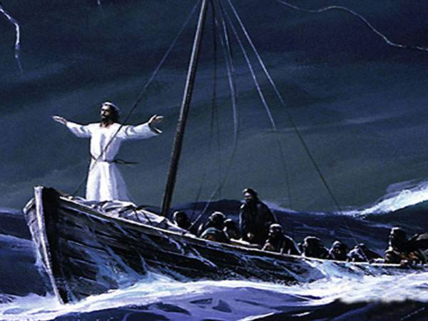
Jesus rebuked the wind and waves
Even the wind and waves obey him

Slide 15
Over the powers of darkness - Luke 8:26-37

Slide 16
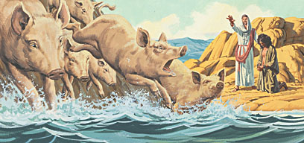
Man of Garasenes completely under the power of a legion of demons
People in the region beg him to leave for fear

Slide 17
Over sin and sickness – Mark 2:1-12

Slide 18
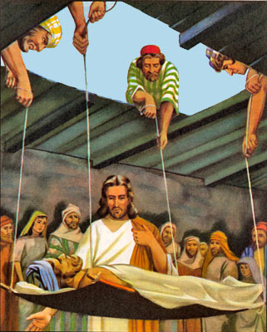
The son of man has the authority to forgive sin – pick up your mat and go home

Slide 19
Teaching as one with authority – not as the scribes – Matthew 7:28-29
The crowds were amazed at his teaching

Slide 20
Matthew 11:6 (NLT) ⁶ And tell him, ‘God blesses those who do not turn away because of me.’”
Don’t turn away because of Jesus
John 6:66 - Many turn away – asks disciples do you want to leave too?

Slide 21
III. Father King
Abba Father
Our Father in heaven
Matthew 7:9-11 (NLT) ⁹ “You parents—if your children ask for a loaf of bread, do you give them a stone instead? ¹⁰ Or if they ask for a fish, do you give them a snake? Of course not! ¹¹ So if you sinful people know how to give good gifts to your children, how much more will your heavenly Father give good gifts to those who ask him.

Slide 22
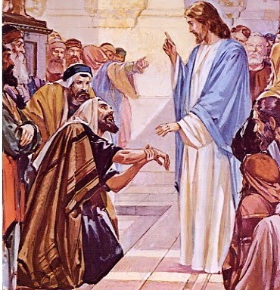
Lawful to do good on the Sabbath?
Matthew 12:9-14

Slide 23
People over process – relationship over religion

Slide 24
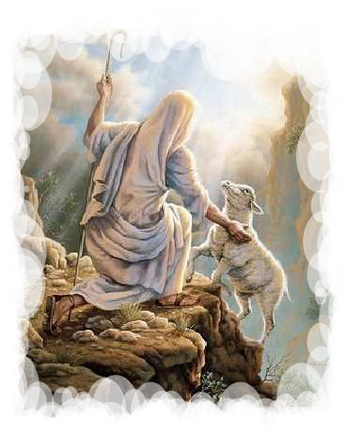
One lost sheep – Matthew 18:12-14

Slide 25
Application
Philippians 3:20 – we are citizens of the kingdom of heaven
2 Corinthians 5:19 – we are Christ’s ambassadors
Embrace the kingdom
Live the kingdom
Be the kingdom

