Slide 2
The Story Finding Your Story in God’s Story “A Kingdom Torn in Two”
Series 2 - God Pursues His People

Slide 3
Review Chapter 13 “The King Who Had it All”
Series 2 - God Pursues His People

Slide 5
I. Division Set in Motion

Slide 6
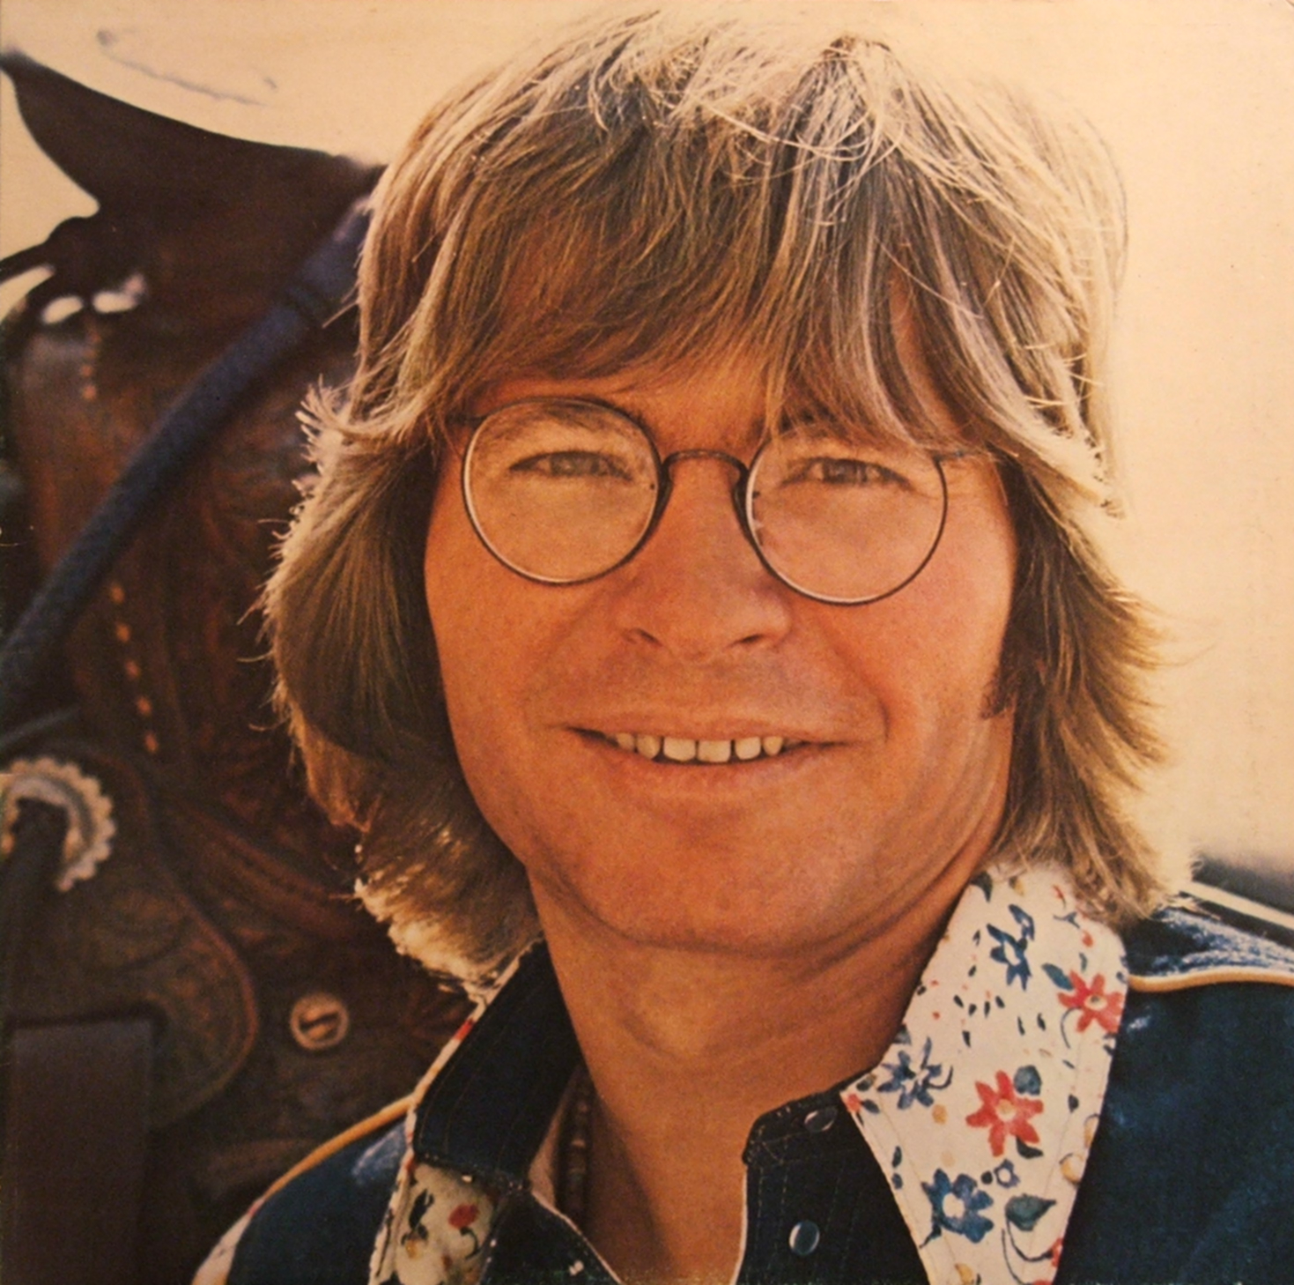

Slide 8
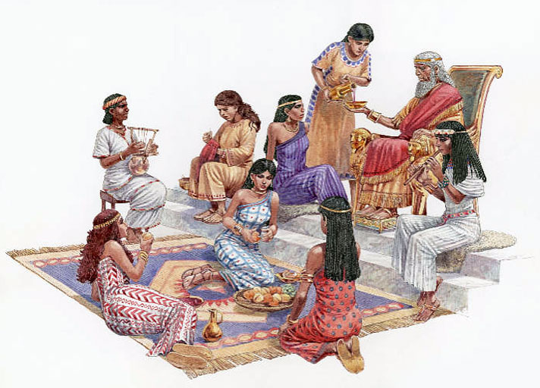
Solomon’s wives
They turned his heart to worship other gods

Slide 9
Jeroboam – 1 Kings 11
In charge of labor force for rebuilding terraces of Solomon
Prophet Ahijah – 1 Kings 11:29-33
About to tear the kingdom from Solomon
He has abandoned me
I will give you ten tribes (Israel)
Solomon tried to kill Jeroboam
Rehoboam
Son of Solomon – became the next king – 1 Kings 11:42-43
Ruled Judah (Judah and Benjamin)

Slide 10
Tax burden causes revolt against Rehoboam – 1 Kings 12:1-20

Slide 11
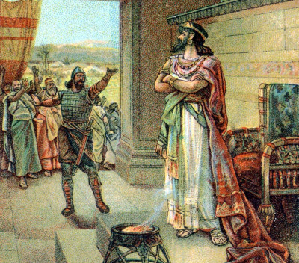
Lighten the tax burden and we will be your loyal subjects

Slide 12
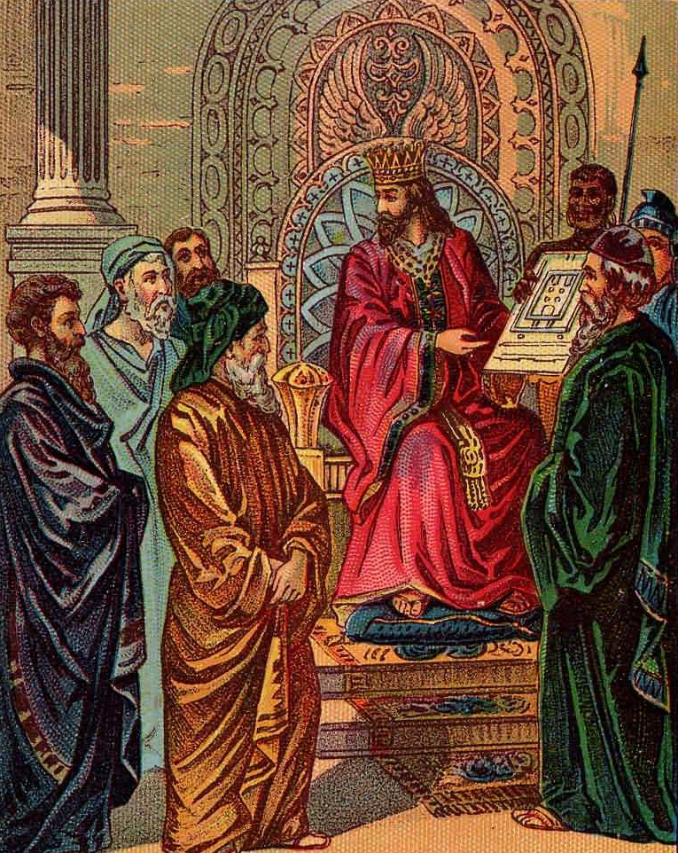
Counsel of the elders – be a servant to the people and they will be loyal

Slide 13
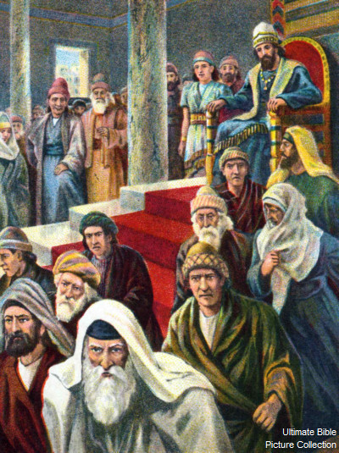

Slide 14
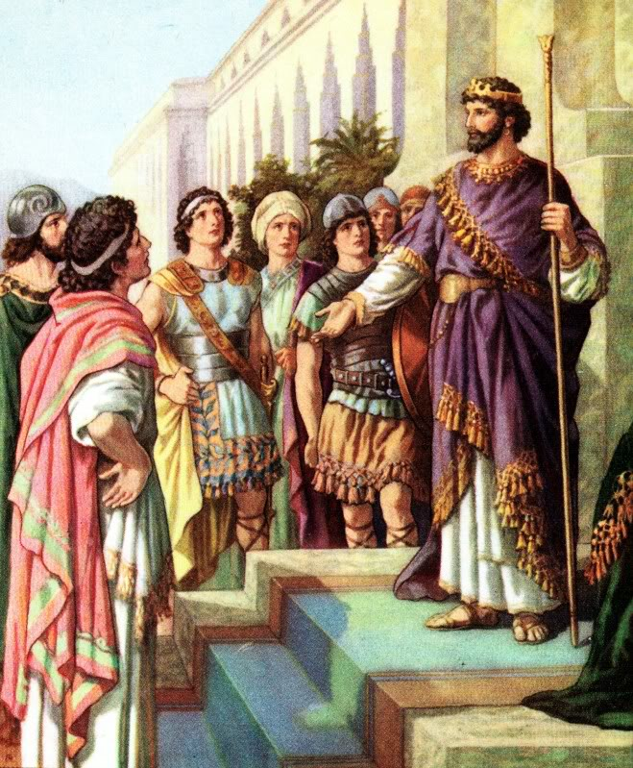
Counsel of the peers – make the burdens heavier

Slide 15
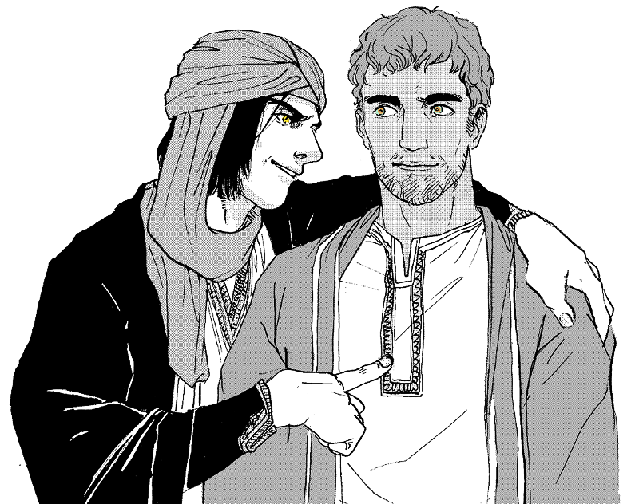
Counsel of the peers – make the burdens heavier

Slide 16
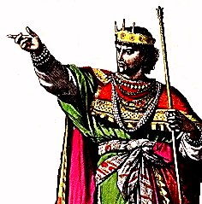
Rehoboam paid no attention to the people
Revolt by the design of God

Slide 17
II. Leadership of the Insecure
1 Kings 12:25-33
Jeroboam establishes idols and places of worship
If people go to the temple in Jerusalem – they will return their allegiance to Rehoboam

Slide 18
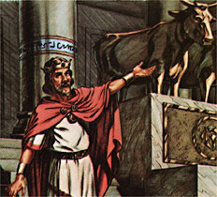
Two gold calves – the gods who brought you out of Egypt

Slide 19
Confronted by a man of God – 1 Kings 13

Slide 20
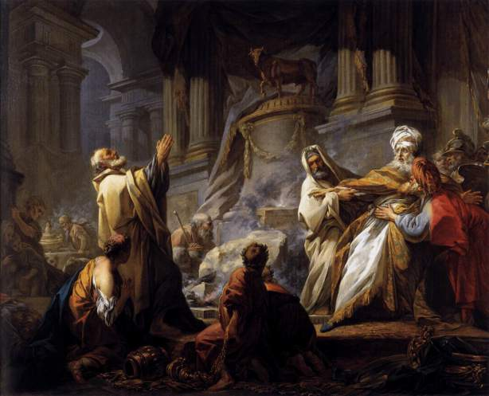
Speaks against the altar raised up by Jeroboam

Slide 21
Jeroboam continued in his evil ways

Slide 22
III. Divided Loyalties
Started with Solomon’s divided heart
No other gods – no idols
Divided heart
Divided kingdom – division ordered by God, but not in the plan of God
The influence of leadership
Home
Employment
church

Slide 23
Integrity – integrated
No division in life/lifestyle
No dilemma for confusion of followers

Slide 24
Bad leadership caused all of Israel to suffer – so does bad leadership in our homes, churches, political
During the divided kingdom there were 38 kings, and only five of them followed God.
Spatial disorientation – spiritual disorientation, where you don’t trust the instruments

Slide 25
Division or Unity?
John 17:20-23 (NLT) ²⁰ “I am praying not only for these disciples but also for all who will ever believe in me through their message. ²¹ I pray that they will all be one, just as you and I are one—as you are in me, Father, and I am in you. And may they be in us so that the world will believe you sent me. ²² “I have given them the glory you gave me, so they may be one as we are one. ²³ I am in them and you are in me. May they experience such perfect unity that the world will know that you sent me and that you love them as much as you love me.
Father – make them all one

