Slide 2
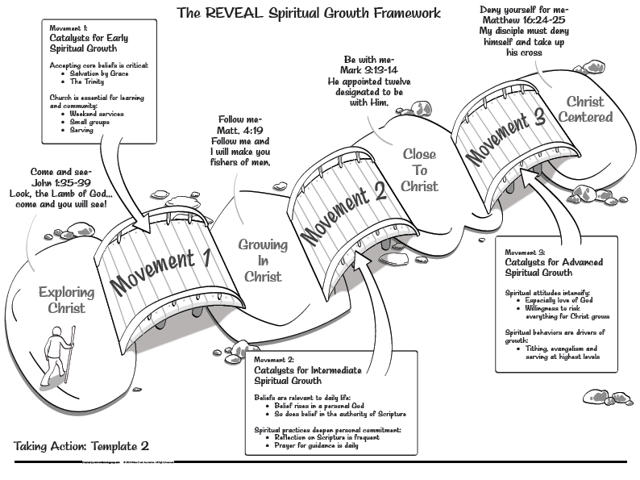

Slide 3
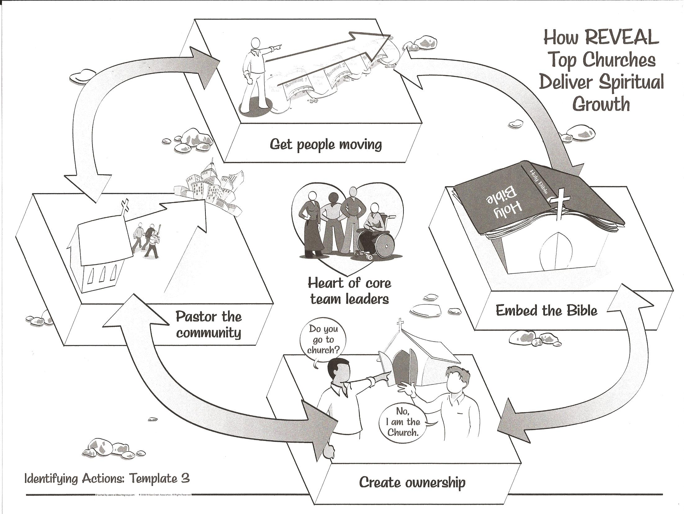

Slide 5
The Story Finding Your Story in God’s Story “The King Who Had it All”
Series 2 - God Pursues His People

Slide 6
Review Chapter 12 “The Trials of a King”
Series 2 - God Pursues His People

Slide 8
I. The Wisdom of Solomon
1 Kings 1, 2
David makes Solomon king
Solomon’s kingdom was firmly established
Solomon’s request for wisdom 1 Kings 3

Slide 9
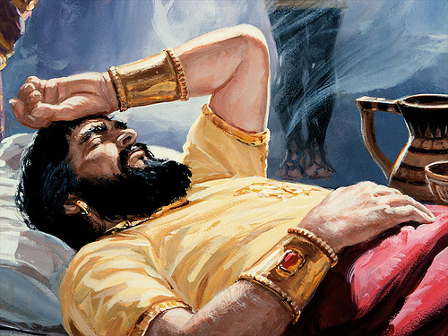

Slide 10
An understanding heart to govern God’s people well
Know the difference between right and wrong

Slide 11
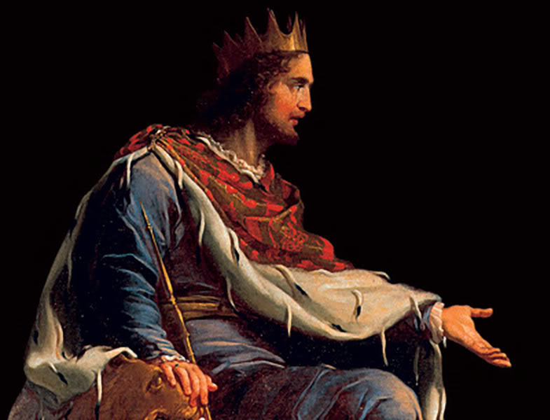
The Lord was pleased that Solomon asked for wisdom
Granted wise and understanding heart like none other
Granted riches and fame

Slide 12
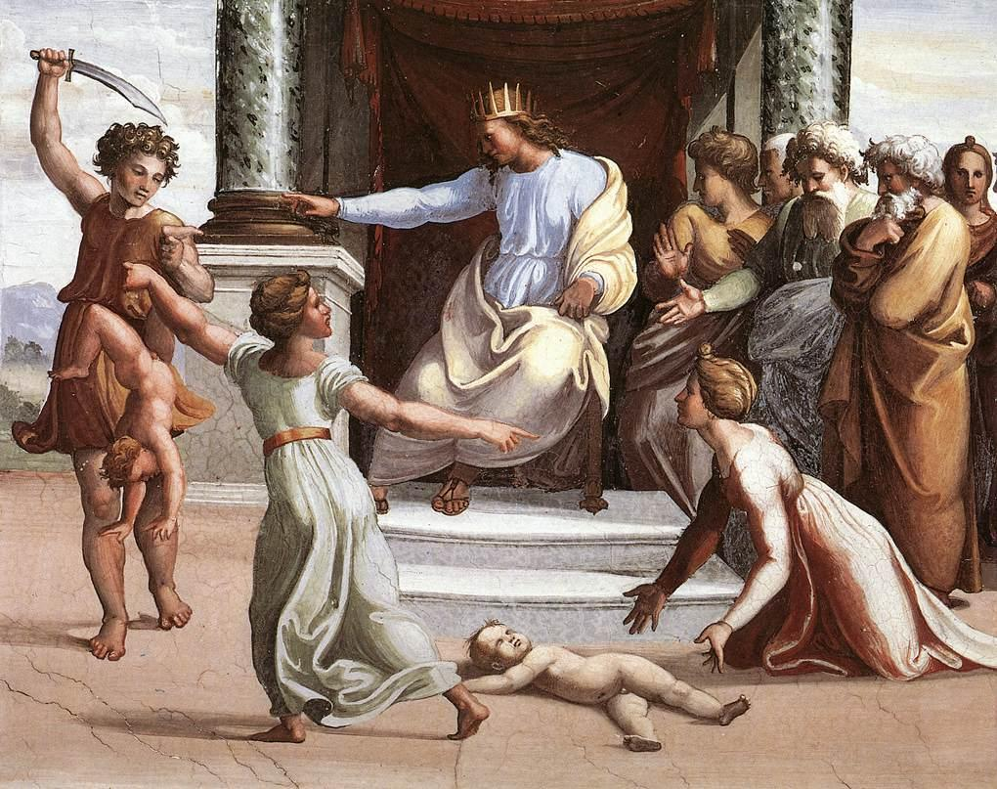
Solomon’s application of wisdom 3:16-28

Slide 13
The Proverbs
Proverbs 1:1-7

Slide 14
II. Solomon Builds the Temple
1 Kings 6-8

Slide 15
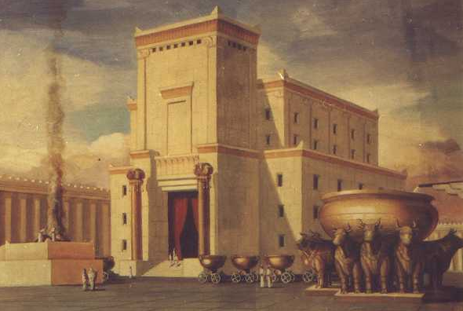
Patterned after the Tabernacle
Took seven years to complete

Slide 16
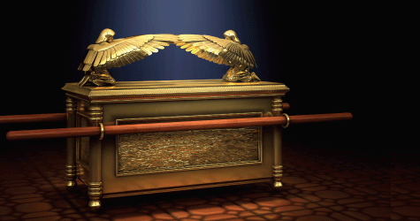
Brings the Ark of the Covenant into the inner sanctuary

Slide 17
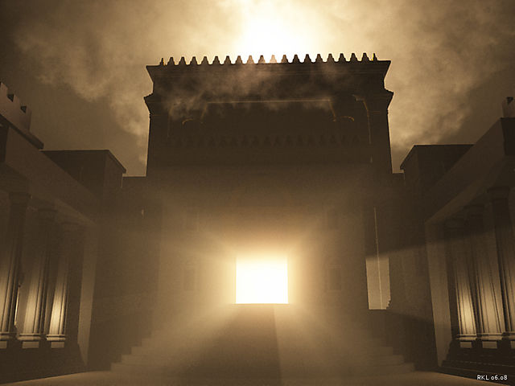
The glorious presence of God fills the temple

Slide 18
Solomon’s Fame and Fortune – 1 Kings 10

Slide 19
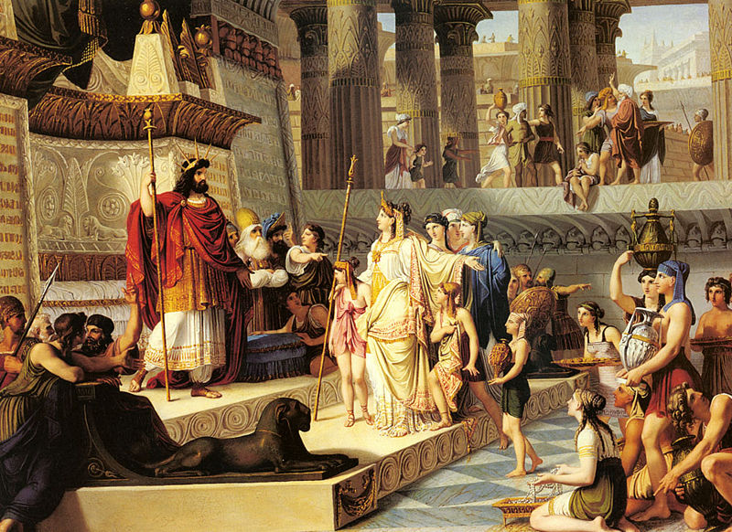
Queen of Sheba came to test him with hard questions

Slide 20
Your wisdom and prosperity are far beyond what I was told

Slide 21
God delights in you

Slide 22
The Lord has made you king so you can rule with justice

Slide 23
III. Solomon’s Heart Turns
1 Kings 11
God’s warning –
don’t marry foreign women
They will turn your hearts to their gods

Slide 24
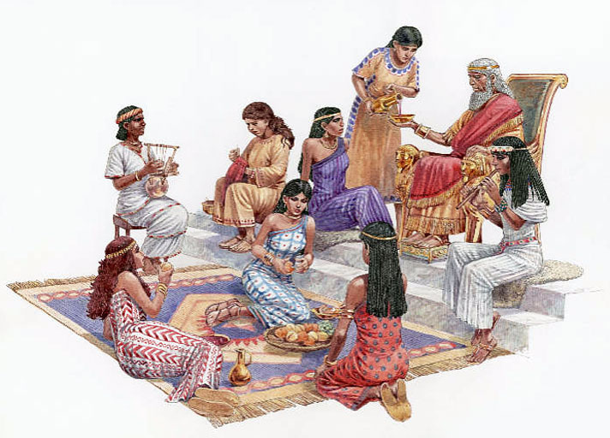
Solomon’s wives
They turned his heart to worship other gods

Slide 25
God’s pronouncement
Divided heart
Divided kingdom

Slide 26
Deconstruct the story of Solomon

Slide 27
Proverbs 5:15-20 (NLT) ¹⁵ Drink water from your own well— share your love only with your wife. ¹⁶ Why spill the water of your springs in the streets, having sex with just anyone? ¹⁷ You should reserve it for yourselves. Never share it with strangers. ¹⁸ Let your wife be a fountain of blessing for you. Rejoice in the wife of your youth. ¹⁹ She is a loving deer, a graceful doe. Let her breasts satisfy you always. May you always be captivated by her love. ²⁰ Why be captivated, my son, by an immoral woman, or fondle the breasts of a promiscuous woman?

Slide 28
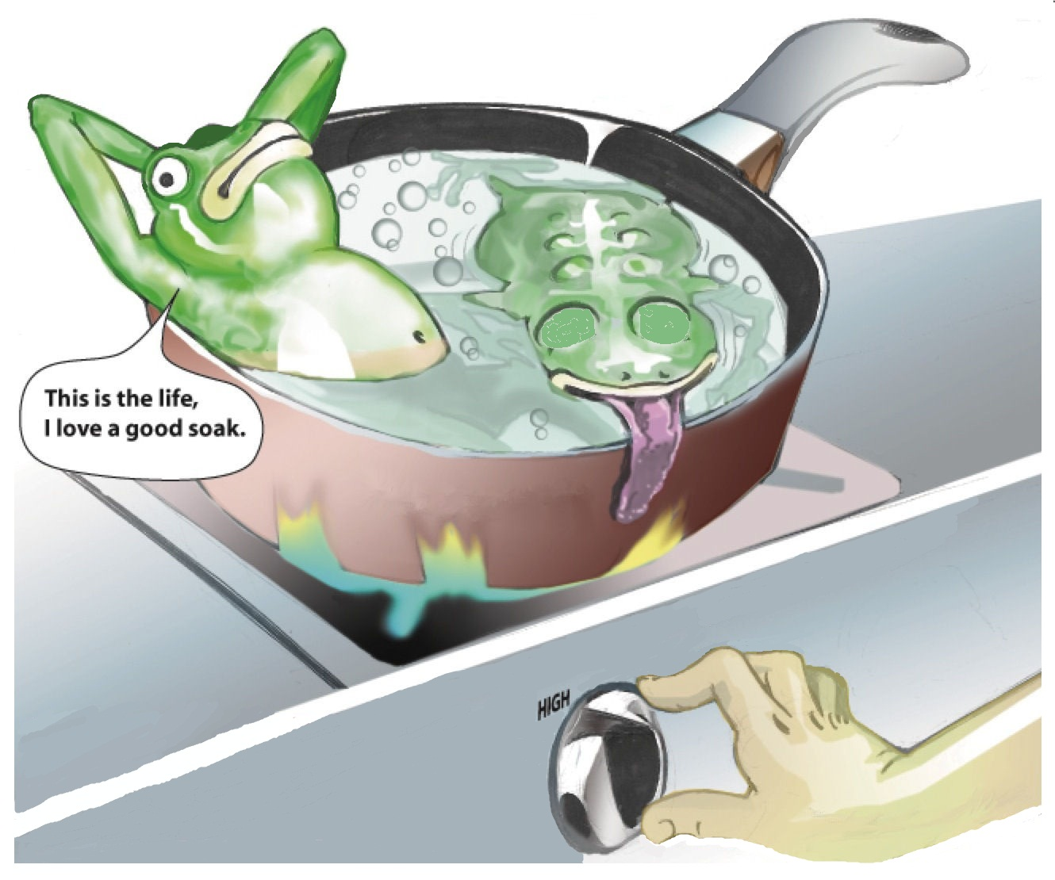

Slide 29
Slow Fade – Casting Crowns - It's a slow fade when you give yourself away It's a slow fade when black and white have turned to gray Thoughts invade, choices are made, a price will be paid When you give yourself away People never crumble in a day It's a slow fade, it's a slow fade

Slide 30
2 Corinthians 6:14-15 (NLT) ¹⁴ Don’t team up with those who are unbelievers. How can righteousness be a partner with wickedness? How can light live with darkness? ¹⁵ What harmony can there be between Christ and the devil? How can a believer be a partner with an unbeliever?

Slide 31
Three ways to stay out of the pot of lukewarm water:
Ask for wisdom James 1:5 (NLT) ⁵ If you need wisdom, ask our generous God, and he will give it to you. He will not rebuke you for asking.
Desire to finish strong and pray for it. 1 Corinthians 16:13 (NLT) ¹³ Be on guard. Stand firm in the faith. Be courageous. Be strong.
Invite accountability with those who will tell you when you have jumped into a pot of lukewarm water

