Slide 2
The Story Finding Your Story in God’s Story “The Trials of a King”
Series 2 - God Pursues His People

Slide 3
Review Chapter 11 “Shepherd to King”

Slide 5
I. King David’s Sin
2 Samuel 11

Slide 6
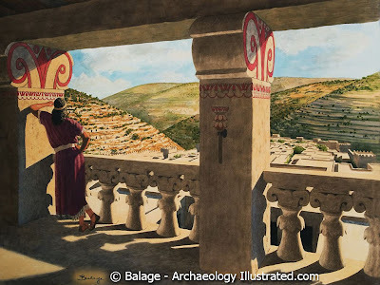
The wandering eyes of David

Slide 7
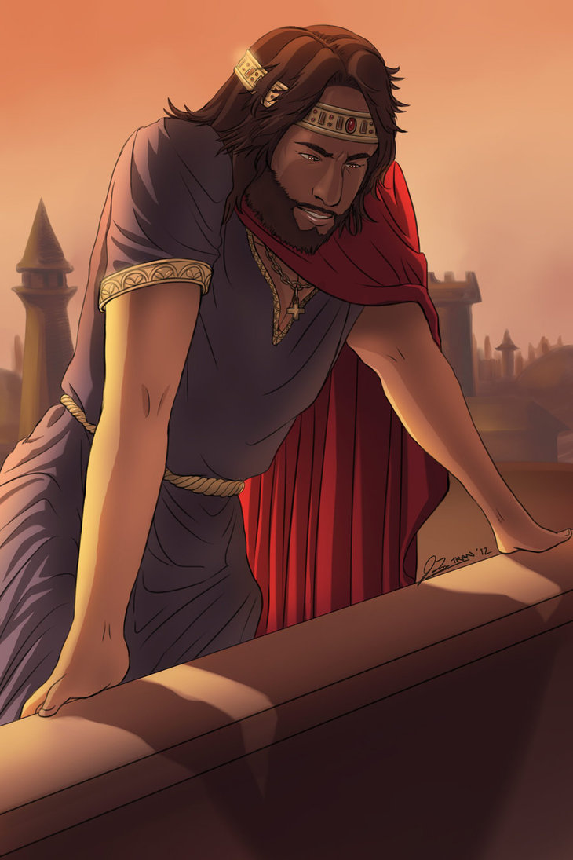

Slide 8
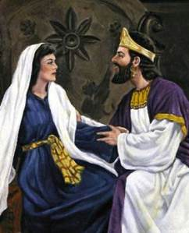
Sin and conception

Slide 9
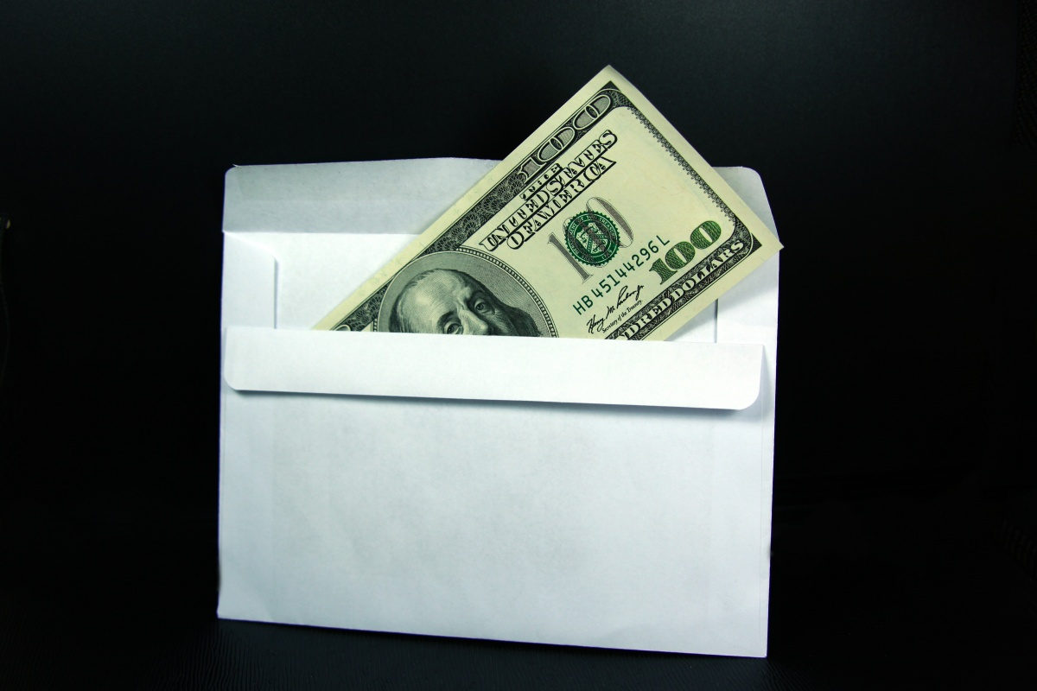
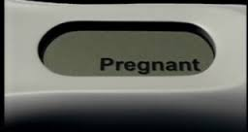
Sin and conception
To: King David
From: Bathsheba

Slide 10
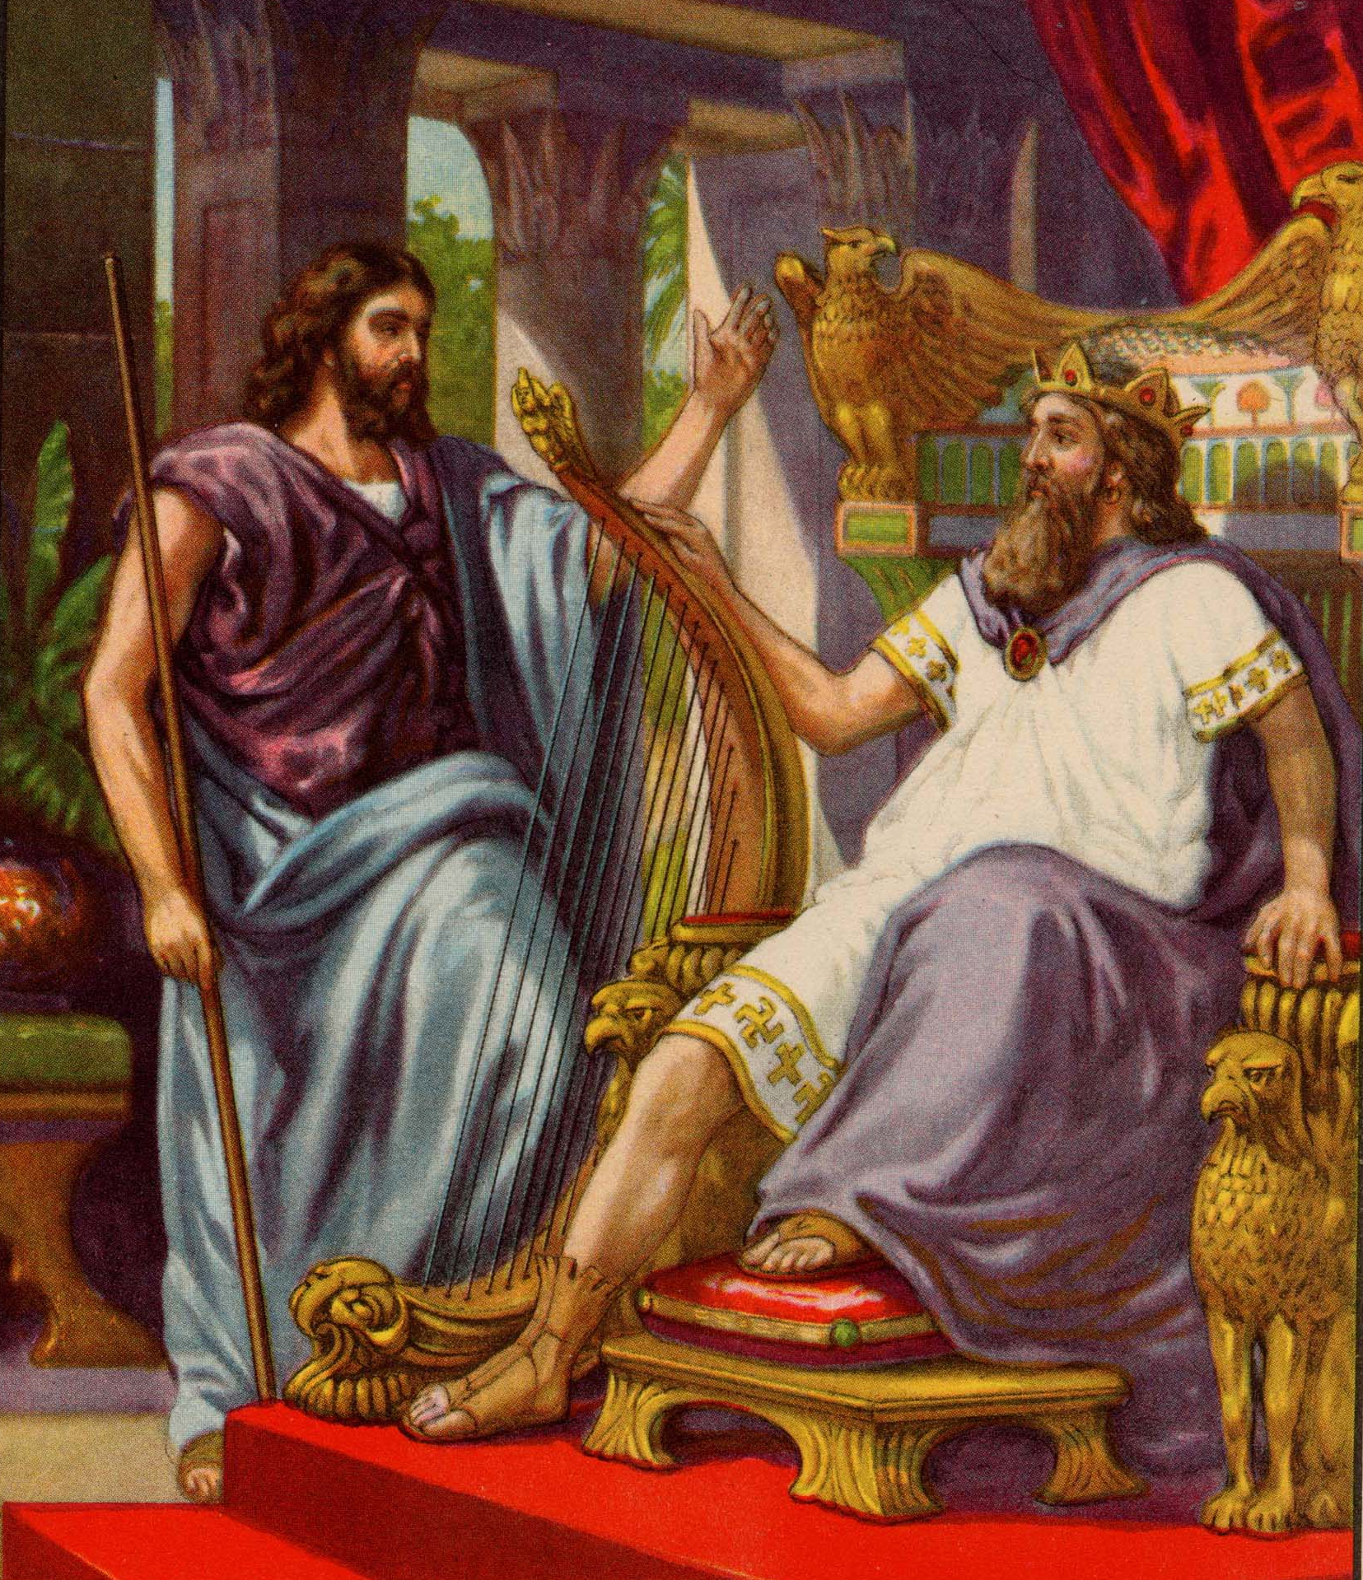
The cover up
The integrity of Uriah

Slide 11
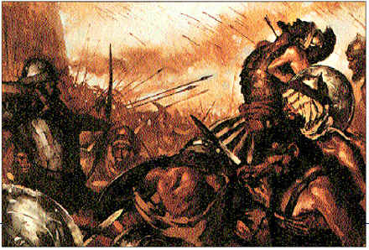
More sin and cover up

Slide 12
II. Confronted and Repentant
2 Samuel 12

Slide 13
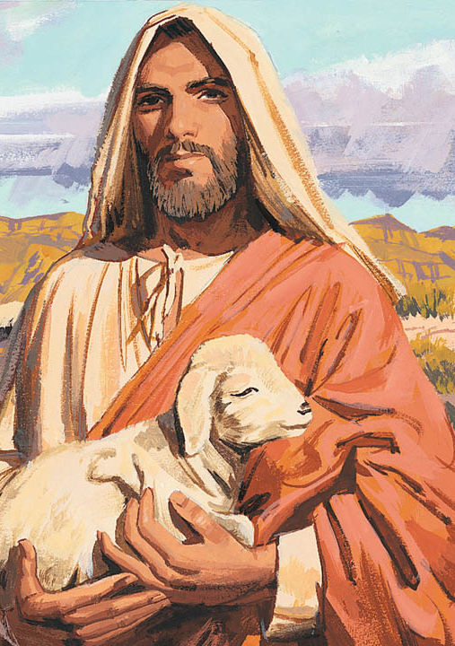
The Word Picture – that David will understand

Slide 14
The Judgment - according to David

Slide 15
The Verdict #1– according the Lord (through the prophet Nathan)
You are the man

Slide 16
Repentance
The difference between David and Saul
Saul – justify, rationalize
David – repent
Psalm 51

Slide 17
The Verdict #2
Forgiven
Consequences
Calamity from your family
Death of the son
Faced consequences with dignity

Slide 18
III. Dealing with Temptation
The descent to sin
See
Desire
Take

Slide 19
David

Slide 20
Eve – Genesis 3:6 ⁶ The woman was convinced. She saw that the tree was beautiful and its fruit looked delicious, and she wanted the wisdom it would give her. So she took some of the fruit and ate it. Then she gave some to her husband, who was with her, and he ate it, too.

Slide 21
James 1:14-15
See - implied
Desire - enticed
Take – lust conceived - sin
Consequences – death

Slide 23
1 John 1:8-9 (NLT) ⁸ If we claim we have no sin, we are only fooling ourselves and not living in the truth. ⁹ But if we confess our sins to him, he is faithful and just to forgive us our sins and to cleanse us from all wickedness.

Slide 24
Psalm 32:3-5 (NLT) ³ When I refused to confess my sin, my body wasted away, and I groaned all day long. ⁴ Day and night your hand of discipline was heavy on me. My strength evaporated like water in the summer heat. ⁵ Finally, I confessed all my sins to you and stopped trying to hide my guilt. I said to myself, “I will confess my rebellion to the LORD.” And you forgave me! All my guilt is gone.

Slide 25
If forgiveness is so complete and so unconditional – then what is the big deal about sin?
Consequences
Death

Slide 26
Set up a Guard
1 Corinthians 10:13 (NLT) ¹³ The temptations in your life are no different from what others experience. And God is faithful. He will not allow the temptation to be more than you can stand. When you are tempted, he will show you a way out so that you can endure.
Proverbs 4:23 (NLT) ²³ Guard your heart above all else, for it determines the course of your life.

Slide 27
Guard where you see and desire
Lesson learned from David – if you have to hide it or lie about it, don’t do it

Slide 28
Applications
Uriah – personal integrity
Nathan – courage to speak truth
David – confession rather than rationalize
David – accept forgiveness, deal with consequences with dignity

