Slide 2
Review Chapter 1

Slide 4
Noah and family rescued from the flood
Genesis 8:21 (NLT) …“I will never again curse the ground because of the human race, even though everything they think or imagine is bent toward evil from childhood. I will never again destroy all living things.

Slide 5
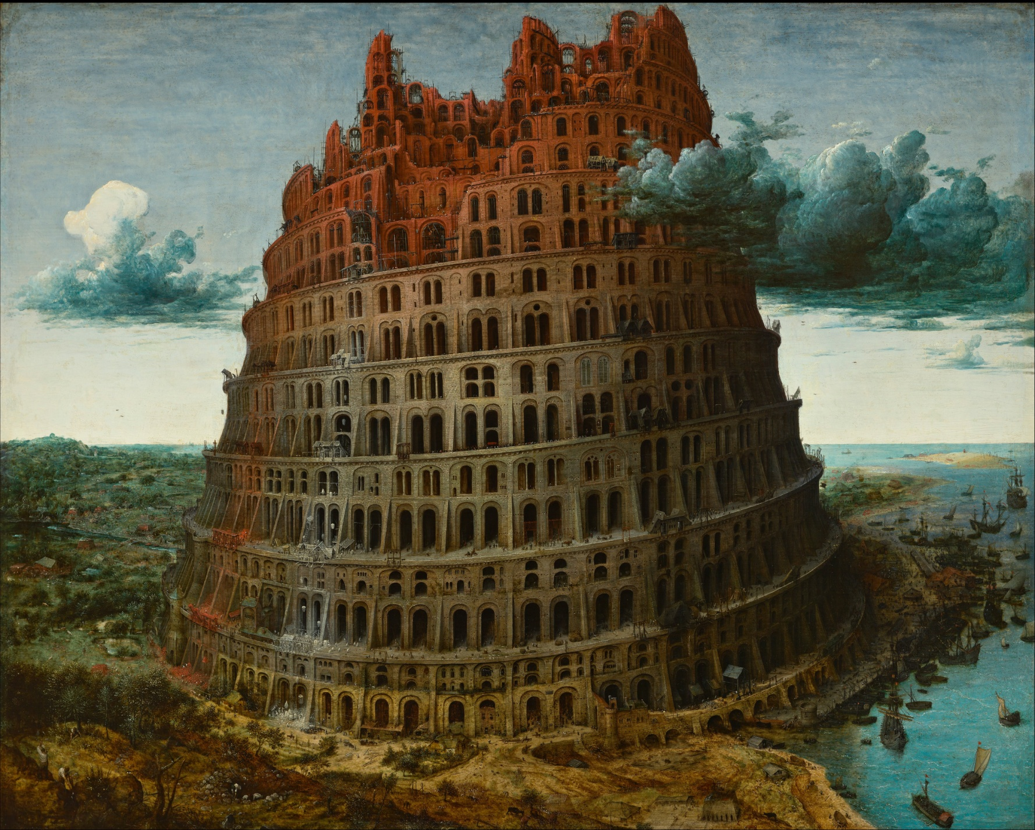

Slide 6
The Story Finding Your Story in God’s Story “God Builds a Nation”
Series 1 - God Forms His People

Slide 7
I. A Call and a Covenant
Genesis 12:1-3 - I will…
Make your descendants into a great nation
Give you a land in which to dwell
Bless all other nations through the nation of Israel
God’s call is personal

Slide 8
God works through broken people
Abraham lies twice about Sarah being his sister not wife
Abraham and Sarah “help” the promise of God with Sarah’s maid
Isaac marries Rebekah – raises a dysfunctional family
Rebekah creates a hoax to see her favorite son blessed
Jacob makes a fool of his brother for his birthright
Laban – deceives Jacob with the wrong daughter between the sheets

Slide 9
2 Corinthians 4:7 (NLT) ⁷ We now have this light shining in our hearts, but we ourselves are like fragile clay jars containing this great treasure. This makes it clear that our great power is from God, not from ourselves.

Slide 10
II. Promises Not by Performance but by Faith
Genesis 15:1-6
Abraham believed the Lord
Counted as righteous because of his faith

Slide 11
Hebrews 11:8-12 – by faith
Abraham obeyed and moved
Sarah conceived
A nation came from this one man
Hebrews 11:17-19 – by faith
Abraham offered up Isaac
Received Isaac back from the dead
Genesis 22
Where is the sheep?
God will provide

Slide 12
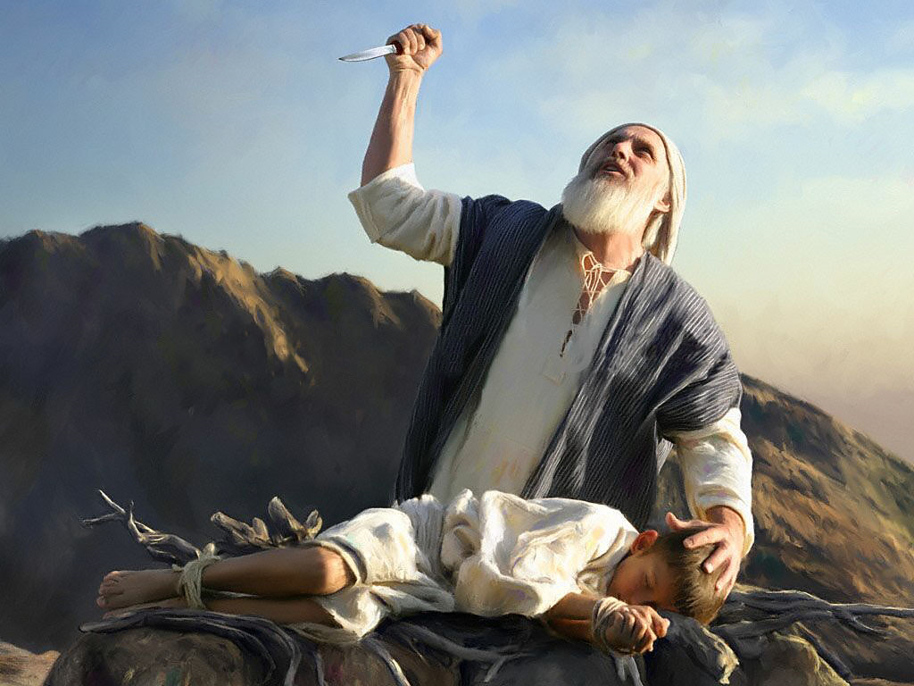
I know that you fear God

Slide 13
You have not withheld your only son from me

Slide 14
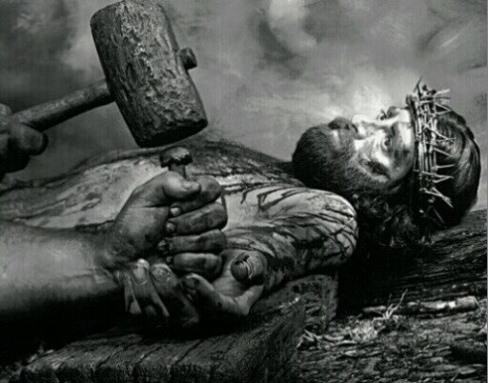

Slide 15
Genesis 22:2 “Take your son your only son whom you love and sacrifice him”
John 3:16 “For God so loved the world that he gave his one and only son.”

Slide 16
III. Isaac and Sons
Hebrews 11:20 (NLT) ²⁰ It was by faith that Isaac promised blessings for the future to his sons, Jacob and Esau.

Slide 17
Genesis 25-33

Slide 18
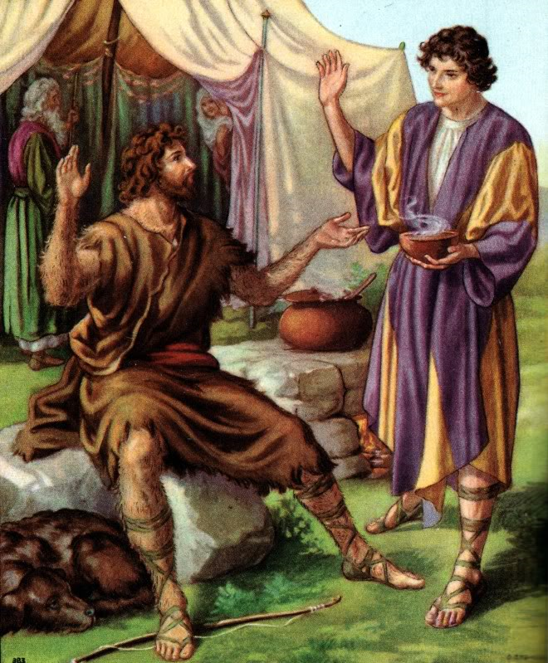
25:27-34 Esau trades his birthright for a bowl of stew

Slide 19
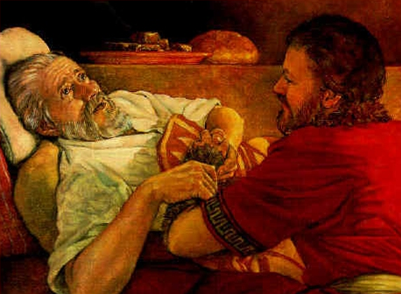
27:1-29 Jacob steals the blessing of the firstborn

Slide 20
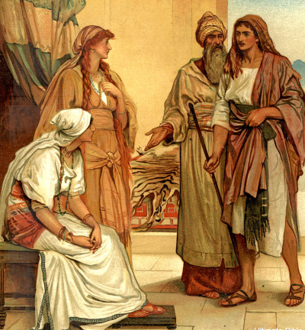

Slide 21
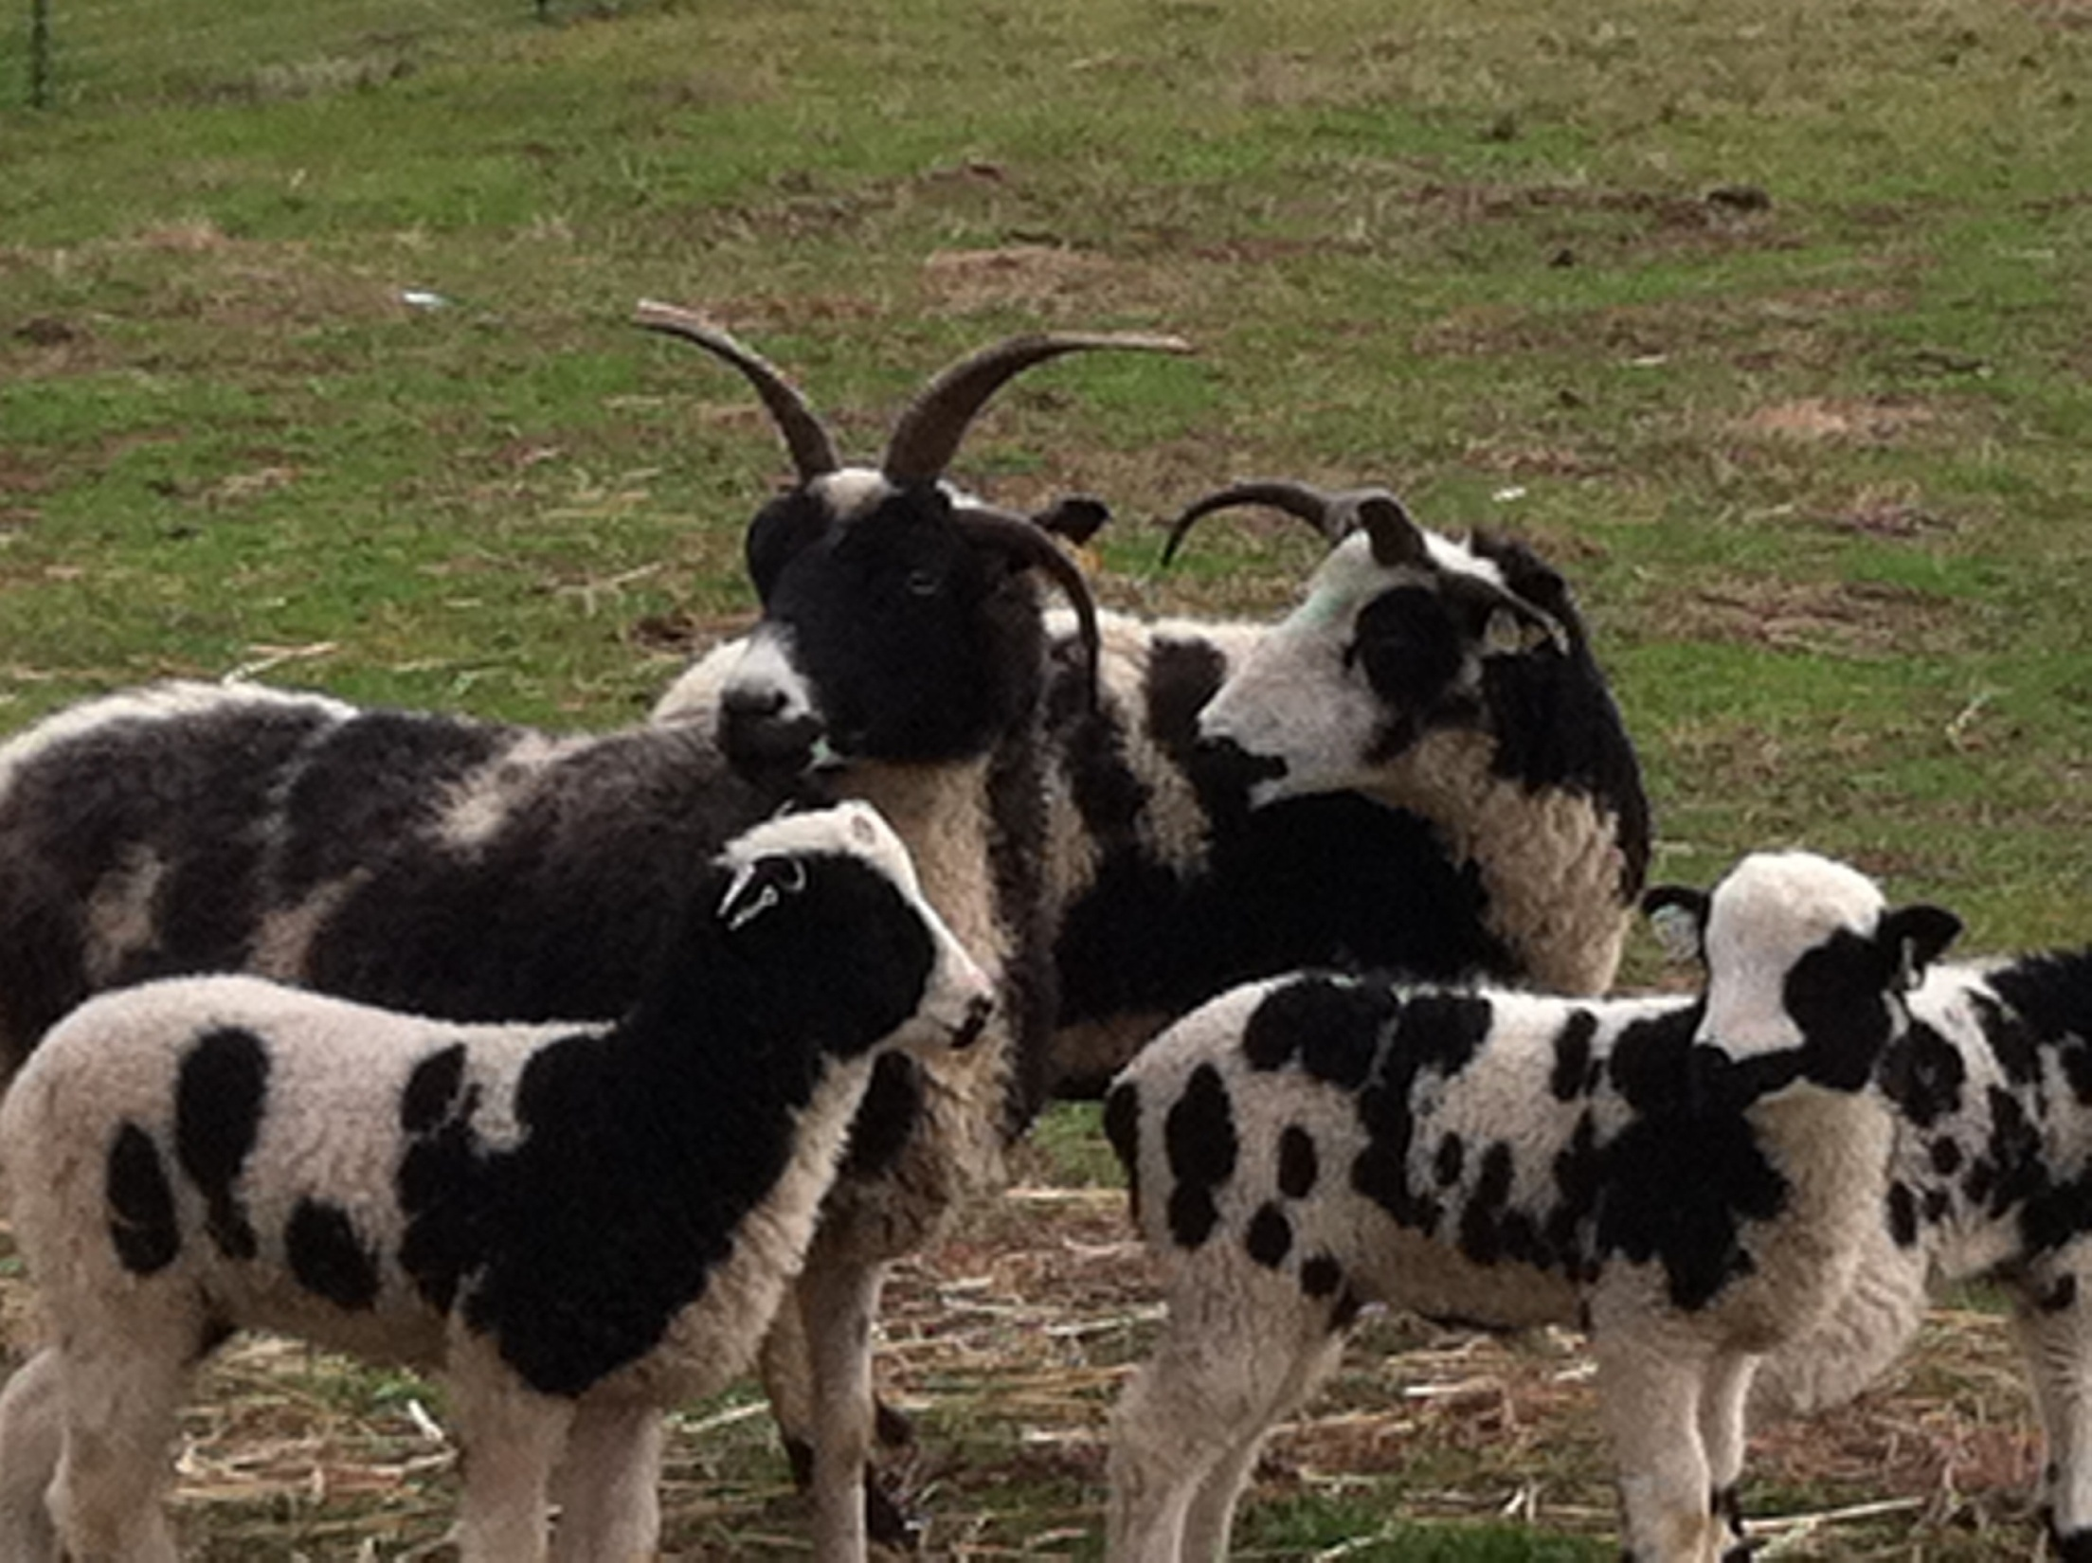

Slide 22
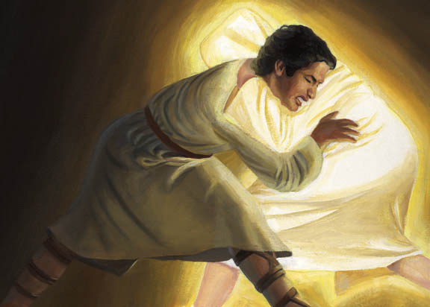

Slide 23
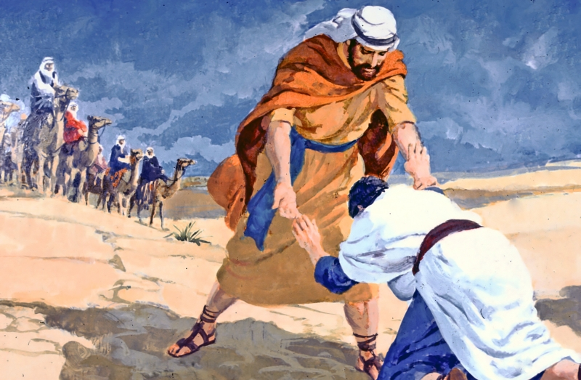

Slide 24
Application: God reveals a pattern. God chooses unlikely people who are not the smartest, the most beautiful and handsome with the best resumes. God chooses ordinary people like you and me.

