Slide 2
Examples of Grace
Biblical Tension of Grace and Works Series

Slide 3
Examples of Grace – Ephesians 2:1-7
Dead because of disobedience and sin
Subject to God’s wrath
But God – rich in mercy, loved so much
Gave us life – by grace you have been saved
Point to us as examples of the incredible wealth of his grace

Slide 4
I. Grace That Saves You
CHARIS khar'-ece - good will, loving-kindness, favor - of the merciful kindness by which God, exerting his holy influence upon souls, turns them to Christ, keeps, strengthens, increases them in Christian faith, knowledge, affection, and kindles them to the exercise of the Christian virtues
Grace, not works

Slide 5
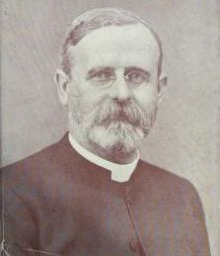
“Grace means more, far more than we can put into words, because it means nothing less than the infinite character of God Himself. It includes mercy for the undeserving and unmerciful, help for the helpless and hopeless, redemption for the renegade and repulsive, love for the unloving and unlovely, kindness for the unkind and unthankful. And all of this in full measure and overflowing abundance, because of nothing in the object, and because of everything in the Giver, God Himself”
William Henry Griffith Thomas (1861–1924)

Slide 7
Romans 4:1-12, 16
Work = wages earned
Free gift – not wages earned from work
People made right with God not because of their work, but their faith in God who gives the free gift of forgiveness (GRACE)

Slide 8
Established in who I am and who God has made me to be – Romans 5:6-11
Jesus came for the utterly helpless
Made us right in God’s sight
Rejoice in our wonderful new relationship
Jesus has made us friends of God

Slide 9
II. Grace That Empowers You
Charisma - char'-is-mah a (divine) gratuity specifically a spiritual endowment, miraculous faculty:—(free) gift.
Grace for works

Slide 10
Ephesians 4:7 (NASB) But to each one of us grace (CHARIS) was given according to the measure of Christ’s gift.
1 Peter 4:10-11 (NASB) ¹⁰As each one has received a special gift (CHARISMA), employ it in serving one another as good stewards of the manifold grace (CHARIS) of God.

Slide 11
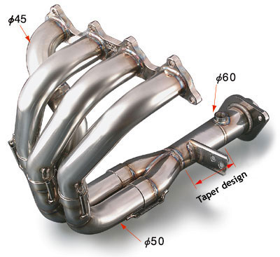

Slide 13
Manifold – various in character, diverse
1 Corinthians 12:4 Now there are varieties of gifts (CHARISMA), but the same Spirit.
Employ - Unemployment of gifts
Speak as though God were speaking through you
Help with all the strength and energy God gives you
Established in my response-ability
Bring glory to God through Jesus

Slide 14
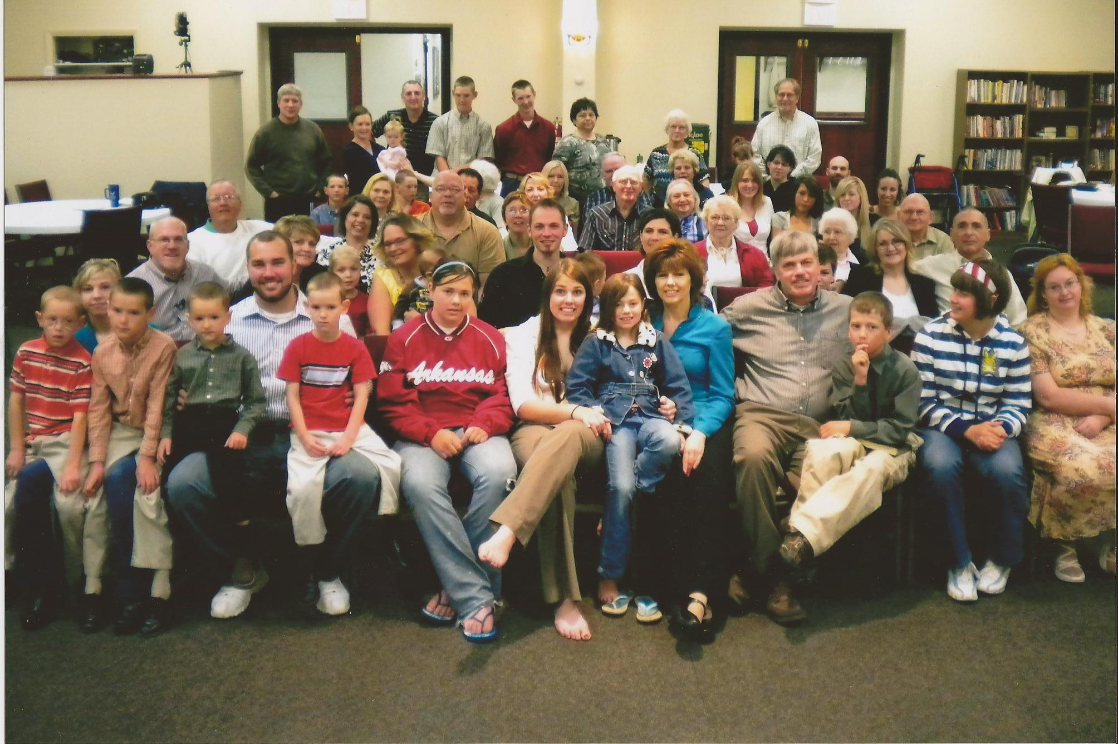
Ephesians 2:7 So God can point to us in all future ages as examples of the incredible wealth of his grace and kindness toward us, as shown in all he has done for us who are united with Christ Jesus.

