Slide 2
$100 | $100 | $100 | $100 | $100
$100 | $100 | $100 | $100 | $100
$100 | $100 | $100 | $100 | $100
$100 | $100 | $100 | $100 | $100
$50
$50
$25
$25
$25
$25

Slide 3
$100 | $100 | $100 | $100 | $100
$100 | $100 | $100 | $100 | $100
$100 | $100 | $100 | $100 | $100
$100 | $100 | $100 | $100 | $100
$50
$50
$25
$25
$25
$25

Slide 5
The Full Gospel-Part 2
Biblical Tension of Grace and Works Series

Slide 6
I. Saved by Grace Through a Narrow Door
We are made right with God by placing our faith in Jesus
Matthew 7:13-14 – the gate and the path
Gate – narrow
Path – difficult

Slide 7
II. The Gate
Gate – salvation by grace through faith in Jesus
The Battle – tolerance, inclusion, imperialistic exclusivism
Acts 4:12 There is salvation in no one else! God has given no other name under heaven by which we must be saved.

Slide 8
III. The Difficult Path
Path – obedience to the fulfilled law (the Word)
Matthew 7:15-27
You can identify people by their actions
Not everyone who cries “Lord, Lord” but only those who do the will of my Father
Wise man hears and obeys and endures the storms

Slide 9
Ephesians 2:8-10
Saved by grace through faith (Gate)
Not a reward for good things we have done
Created anew in Christ to do the good things planned for us (Path)
Psalms 139:16 You saw me before I was born. Every day of my life was recorded in your book. Every moment was laid out before a single day had passed.

Slide 10
Difficult Path Due to Temptation and Peer Pressure
Galatians 5:13-24
Desires of sinful nature oppose the desires of the Holy Spirit
Let the Holy Spirit guide your lives
The results are very clear

Slide 11
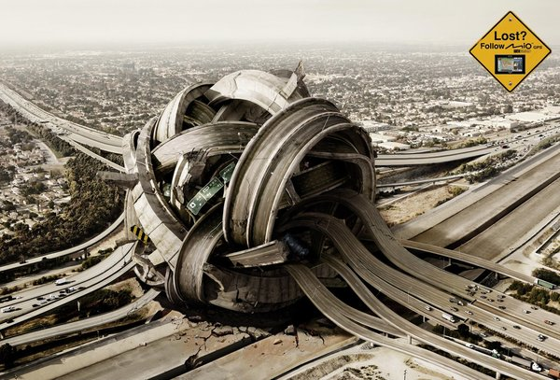
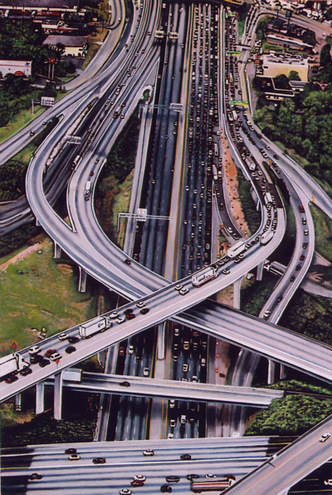
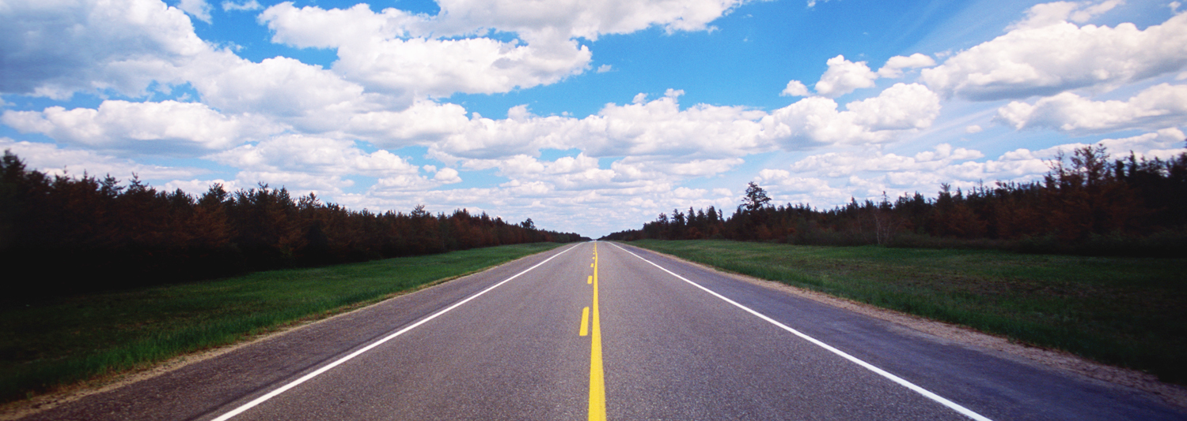

Slide 12
1 Peter 4:1-11
Not chasing your own desires – anxious to do the will of God
Former friends slander you – but they will face God
Use your gifts to serve
Bring glory to God

Slide 13
Philippians 2:12-15
Work hard to show the results of your salvation
Shining like bright lights in corrupt world (Matthew 5:16)

Slide 14
1 Corinthians 3:12-15
Judgment day will reveal the value of each one’s works
Reward
Suffer loss
Saved (barely)

Slide 15
Conclusion – the Full Gospel
Not just about saved by grace through faith to go to heaven, but saved to do the works, to love and obey, to stand against the storms, to be a light to the corrupt world, to receive an eternal reward

Slide 17
IV.

