Slide 2
Jesus Humbled Himself

Slide 3
I. The Birth of Jesus in Context

Slide 4
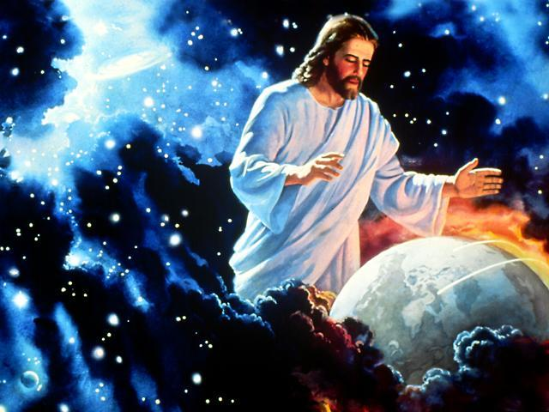
Jesus, the Word, was God
Colossians 1:15 (NLT) ¹⁵ Christ is the visible image of the invisible God. He existed before anything was created and is supreme over all creation,

Slide 5
Creation of the physical universe
Genesis 1:1-2 (NLT) ¹ In the beginning God created the heavens and the earth. ² The earth was formless and empty, and darkness covered the deep waters. And the Spirit of God was hovering over the surface of the waters.

Slide 6
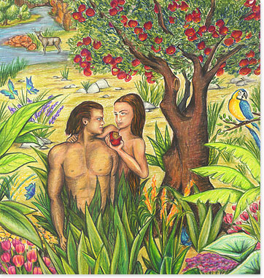
Adam and Eve Rebel
Romans 5:12 (NLT) ¹² When Adam sinned, sin entered the world. Adam’s sin brought death, so death spread to everyone, for everyone sinned.

Slide 7
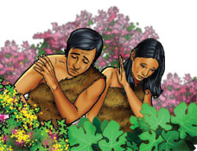
Genesis 3:21 (NLT) ²¹ And the LORD God made clothing from animal skins for Adam and his wife.
People’s Sin Atoned for by the blood of an innocent substitute

Slide 8
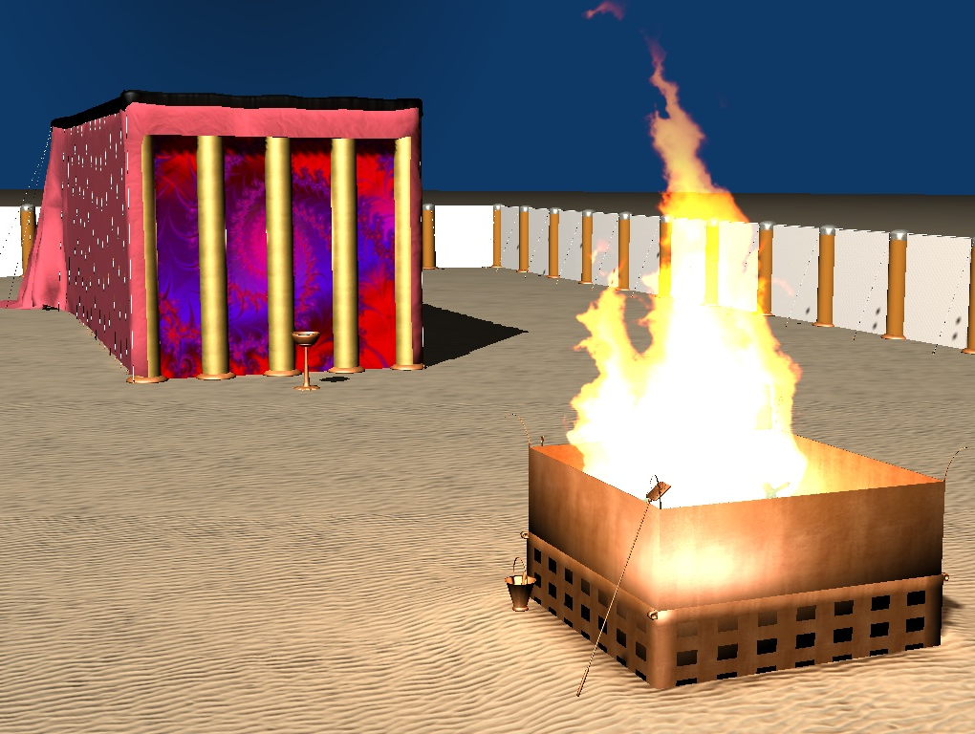
Leviticus 17:11 (NLT) ¹¹ for the life of the body is in its blood. I have given you the blood on the altar to purify you, making you right with the LORD. It is the blood, given in exchange for a life, that makes purification possible.
People’s Sin Atoned for by the blood of an innocent substitute

Slide 9
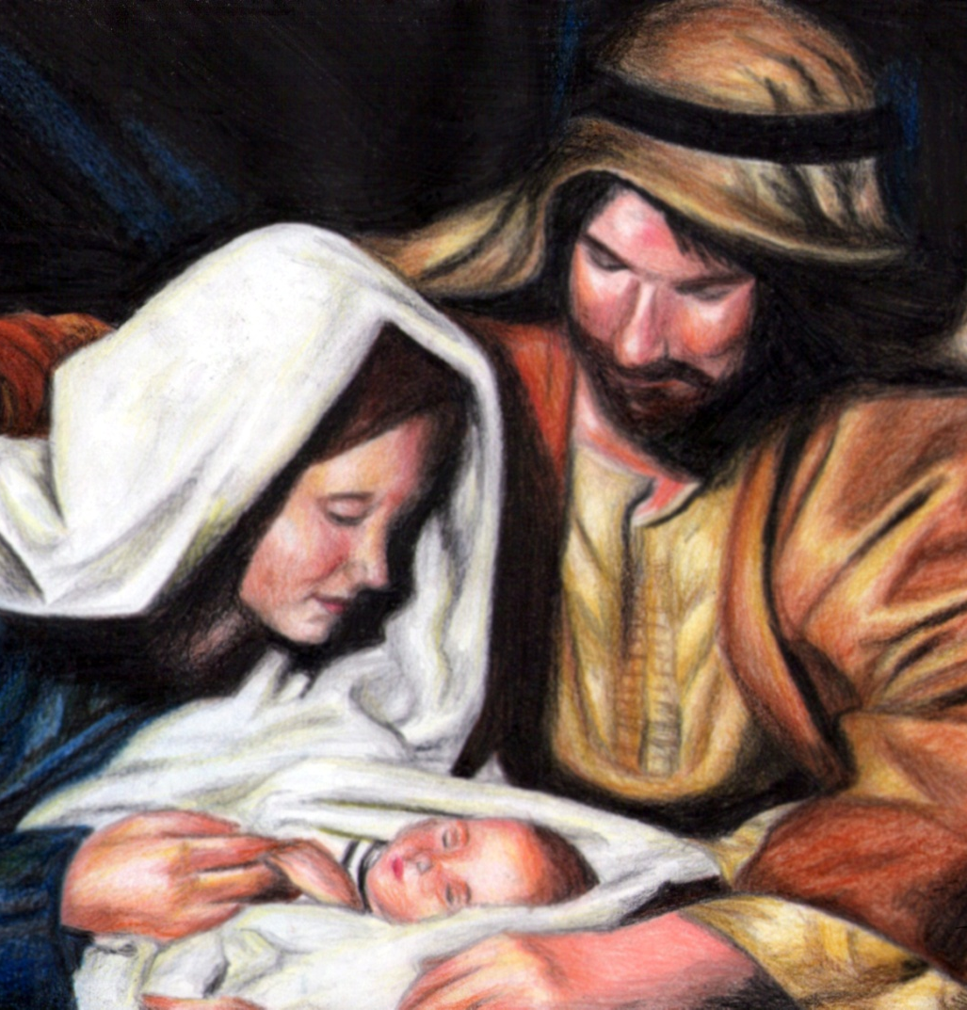
Jesus is Born
Galatians 4:4 (NLT) ⁴ But when the right time came, God sent his Son, born of a woman, subject to the law.

Slide 10
II. God Became Man
Hebrews 10:1-9
Sacrifices were unable to provide perfect cleansing
Not possible for the blood of animals to take away sins – just a preview of what was to come
God’s will – for us to be made holy by the sacrifice of the body of Jesus
Jesus said “I have come to do your will”

Slide 11
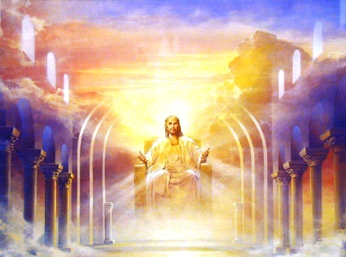
Philippians 2:6-8
Jesus was God
Equality with God not something to cling to

Slide 12
Gave up divine privileges
Glory – John 17:4-5 (NLT) ⁴ I brought glory to you here on earth by completing the work you gave me to do. ⁵ Now, Father, bring me into the glory we shared before the world began.
Humble position of a slave
Born as a human

Slide 13
The one difference – born without the nature of sin
Born of a virgin
Conceived of the Holy Spirit
God in flesh

Slide 14
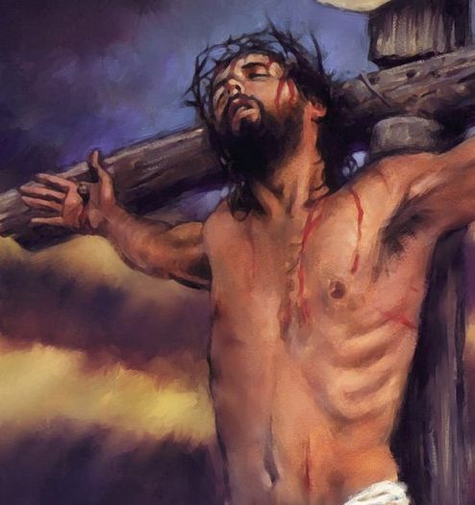
Humbled himself to a criminal’s death

Slide 15
John 10:17-18 (NLT) ¹⁷ “The Father loves me because I sacrifice my life so I may take it back again. ¹⁸ No one can take my life from me. I sacrifice it voluntarily. For I have the authority to lay it down when I want to and also to take it up again. For this is what my Father has commanded.”

Slide 16
Jesus dies on the Cross
Romans 5:18-19 (NLT) ¹⁸ Yes, Adam’s one sin brings condemnation for everyone, but Christ’s one act of righteousness brings a right relationship with God and new life for everyone. ¹⁹ Because one person disobeyed God, many became sinners. But because one other person obeyed God, many will be made righteous.

Slide 17
Jesus dies on the Cross
Hebrews 2:14 (NLT) ¹⁴ Because God’s children are human beings—made of flesh and blood—the Son also became flesh and blood. For only as a human being could he die, and only by dying could he break the power of the devil, who had the power of death.

Slide 18
Jesus dies on the Cross
2 Corinthians 5:21 (NLT) ²¹ For God made Christ, who never sinned, to be the offering for our sin, so that we could be made right with God through Christ.

Slide 19
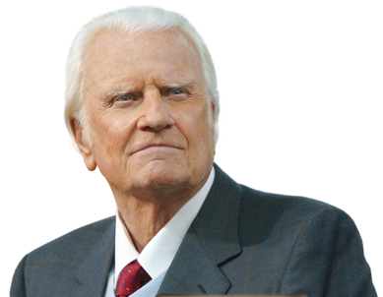
“The very purpose of Christ's coming into the world was that He might offer up His life as a sacrifice for the sins of men. He came to die. This is the heart of Christmas.” --Rev. Billy Graham

Slide 20
John 3:16 (NASB) ¹⁶ "For God so loved the world, that He gave His only begotten Son, that whoever believes in Him shall not perish, but have eternal life.

