Slide 2
The Church - The Family

Slide 3
I. Relative Terms
Jesus introduces God as “Father”
Matthew 5:16 (NLT) ¹⁶ In the same way, let your good deeds shine out for all to see, so that everyone will praise your heavenly Father.
Matthew 5:48 (NLT) ⁴⁸ But you are to be perfect, even as your Father in heaven is perfect.

Slide 4
Matthew 6:1 (NLT) ¹ “Watch out! Don’t do your good deeds publicly, to be admired by others, for you will lose the reward from your Father in heaven.
Matthew 6:4 (NLT) ⁴ Give your gifts in private, and your Father, who sees everything, will reward you.
Matthew 6:6 (NLT) ⁶ But when you pray, go away by yourself, shut the door behind you, and pray to your Father in private. Then your Father, who sees everything, will reward you.

Slide 5
Matthew 6:9 (NLT) ⁹ Pray like this: Our Father in heaven, may your name be kept holy.
Matthew 6:26 (NLT) ²⁶ Look at the birds. They don’t plant or harvest or store food in barns, for your heavenly Father feeds them. And aren’t you far more valuable to him than they are?
Matthew 6:32 (NLT) ³² These things dominate the thoughts of unbelievers, but your heavenly Father already knows all your needs.

Slide 6
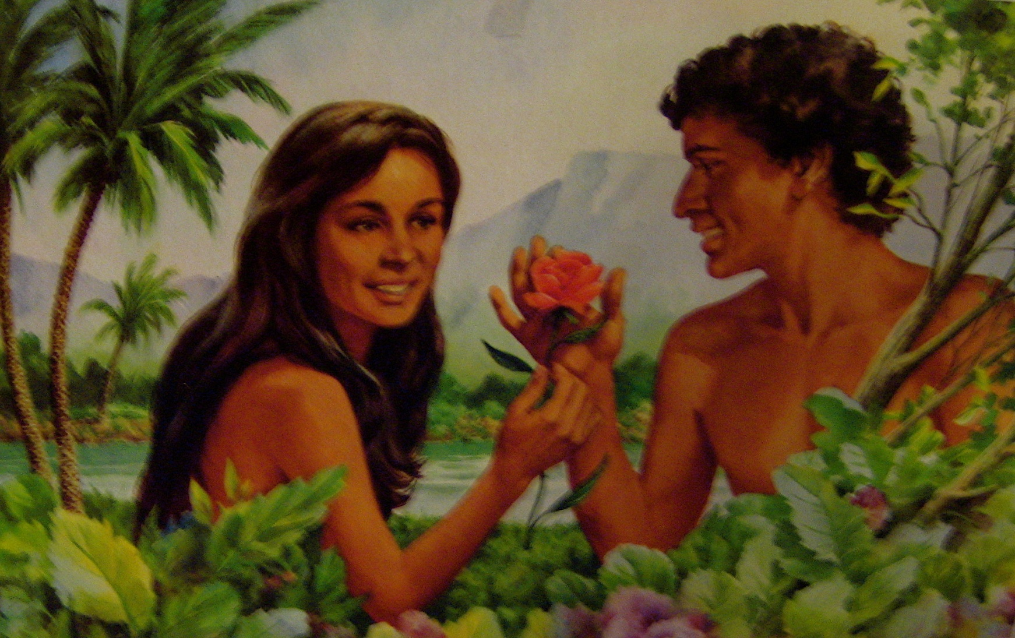
Mother God?
Genesis 1:27 (NLT) ²⁷ So God created human beings in his own image. In the image of God he created them; male and female he created them.

Slide 7
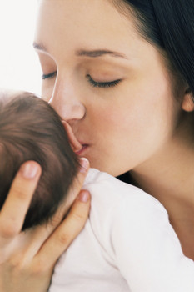
Isaiah 49:15 (NLT) ¹⁵ “Never! Can a mother forget her nursing child? Can she feel no love for the child she has borne? But even if that were possible, I would not forget you

Slide 8
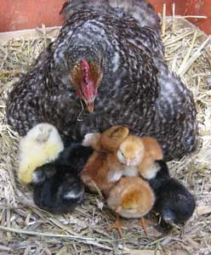
Matthew 23:37 (NLT) ³⁷ “O Jerusalem, Jerusalem, the city that kills the prophets and stones God’s messengers! How often I have wanted to gather your children together as a hen protects her chicks beneath her wings, but you wouldn’t let me. !

Slide 9
Jesus – Brother
Hebrews 2:11 (NLT) ¹¹ So now Jesus and the ones he makes holy have the same Father. That is why Jesus is not ashamed to call them his brothers and sisters.

Slide 10
Brothers and Sisters in Christ
Colossians 1:2 (NLT) ² We are writing to God’s holy people in the city of Colosse, who are faithful brothers and sisters in Christ. May God our Father give you grace and peace.
1 Thessalonians 3:2 (NLT) ² and we sent Timothy to visit you. He is our brother and God’s co-worker in proclaiming the Good News of Christ. We sent him to strengthen you, to encourage you in your faith,

Slide 11
Spiritual Fathers
1 Corinthians 4:15 (NLT) ¹⁵ For even if you had ten thousand others to teach you about Christ, you have only one spiritual father. For I became your father in Christ Jesus when I preached the Good News to you.

Slide 12
II. Family Dynamics

Slide 13
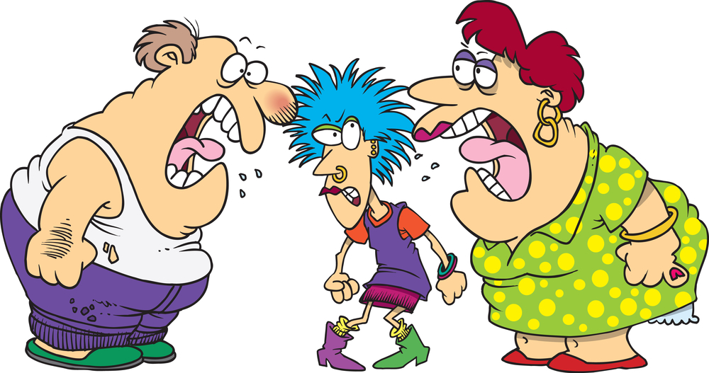
Functional vs. Dysfunctional

Slide 14
Nurture vs. Nature
Discipline
Culture – family background
Gifting
Personality

Slide 15
Learning to Deal
Abrasive
Confrontative
Passive
Offensive

Slide 16
III. What’s Good for the Family
Galatians 6:10 (NLT) ¹⁰ Therefore, whenever we have the opportunity, we should do good to everyone—especially to those in the family of faith.
1 Timothy 5:8 (NLT) ⁸ But those who won’t care for their relatives, especially those in their own household, have denied the true faith. Such people are worse than unbelievers.

Slide 17
Romans 12:6-16
Different gifts for doing things well
Don’t just pretend to love others, really love them
Delight in honoring each other
Be ready to help God’s people in need
Always be eager to practice hospitality
Be happy with the happy – weep with those who weep
Live in harmony with each other
Don’t think you know it all!

Slide 18
1 Corinthians 4-8 This love of which I speak is slow to lose patience, it looks for a way of being constructive. It is not possessive: it is neither anxious to impress nor does it cherish inflated ideas of its own importance. Love has good manners and does not pursue selfish advantage. It is not touchy. It does not compile statistics of evil of gloat over the wickedness of other people. On the contrary, it is glad with all good men when Truth prevails. Love knows no limits to its endurance, no end to its trust, no fading of its hope; it can out last anything. It is, in fact the one thing that still stands when all else has fallen.

