Slide 2
Seasons Considerations

Slide 3
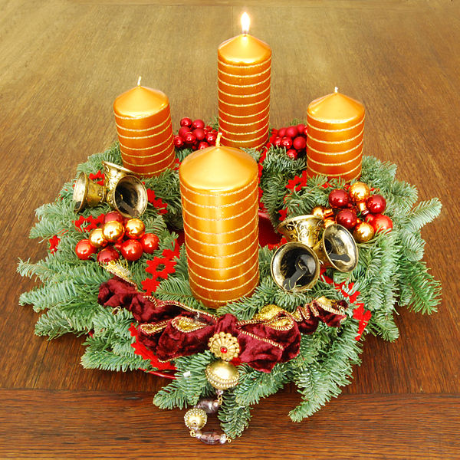
I. The Advent
Advent – defined
A coming into place, arrival
The coming of Christ into the world
The period beginning four Sundays before Christmas, observed in commemoration of the coming of Christ into the world.

Slide 4
Living in the Age of Advent
Consider this…Living within the Advent-age (Advantage)
Part fulfilled – part promised
Luke 24:44-48
Jesus in the law, prophets and psalms
Messiah would suffer, die, and be raised
This message will be proclaimed world-wide
You are witnesses of these things

Slide 5
Living in the period of eyewitnesses of Jesus having come, died, resurrected
Acts 1:21-22 (NLT) ²¹ “So now we must choose a replacement for Judas from among the men who were with us the entire time we were traveling with the Lord Jesus— ²² from the time he was baptized by John until the day he was taken from us. Whoever is chosen will join us as a witness of Jesus’ resurrection.”

Slide 6
Advent-age
Witnesses of Jesus’ ministry on earth
Witnesses of Jesus’ exact representation of the Father – (Hebrews 1:3); John 1:18 (NLT) ¹⁸ No one has ever seen God. But the one and only Son is himself God and is near to the Father’s heart. He has revealed God to us.
Witnesses of the promise of 2nd Advent Acts 1:11 (NLT) ¹¹ “Men of Galilee,” they said, “why are you standing here staring into heaven? Jesus has been taken from you into heaven, but someday he will return from heaven in the same way you saw him go!”

Slide 7
Advantage of His Ascension - John 16:7 (NASB) ⁷ "But I tell you the truth, it is to your advantage that I go away; for if I do not go away, the Helper will not come to you; but if I go, I will send Him to you.

Slide 8
II. Happy Holidays
Holiday – defined
a day fixed by law or custom on which ordinary business is suspended in commemoration of some event or in honor of some person.
Consider this…Old English hāligdæg, literally: holy day
“Happy Holy Day”

Slide 10
III. Merry Xmas
Consider this…The X is the Greek letter chi, the initial in the word Χριστός ( Christos ) “Christ”

Slide 11
ΙΧΘΥΣ (Ichthys) is an acronym for
Ίησοῦς - Jesus
Χριστός - Christ
Θεοῦ - God’s
Υἱός - Son
Σωτήρ - Savior

Slide 12
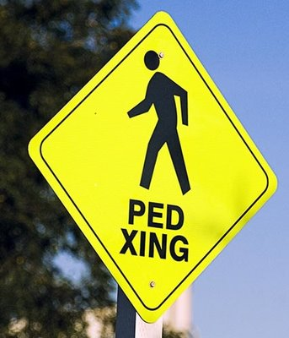
Consider this…

Slide 13
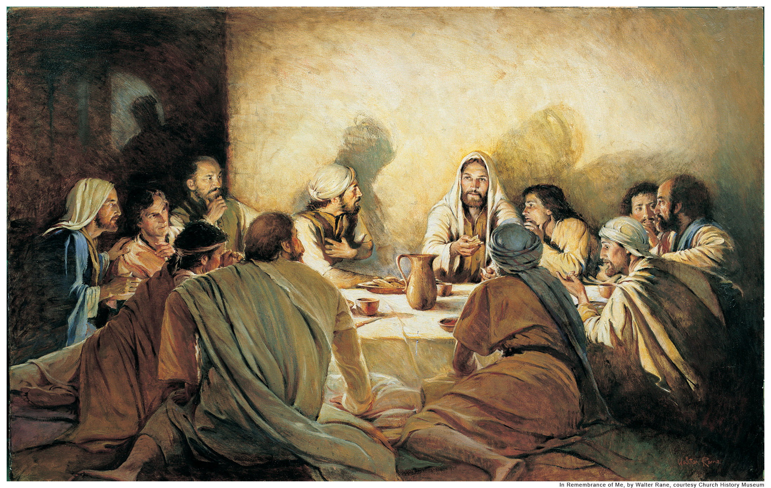
Merry Cross-mas
Mas – Mass – Eucharist or Lord’s Supper

Slide 14
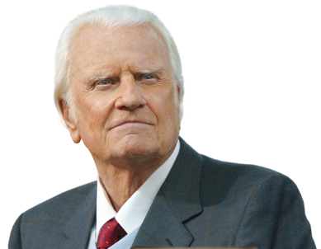
“The very purpose of Christ's coming into the world was that He might offer up His life as a sacrifice for the sins of men. He came to die. This is the heart of Christmas.” --Rev. Billy Graham

Slide 15
John 1:1 (NLT) ¹ In the beginning the Word already existed. The Word was with God, and the Word was God.
John 1:14 (NLT) ¹⁴ So the Word became human and made his home among us. He was full of unfailing love and faithfulness. And we have seen his glory, the glory of the Father’s one and only Son.
2 Corinthians 5:19 (NLT) ¹⁹ For God was in Christ, reconciling the world to himself, no longer counting people’s sins against them. And he gave us this wonderful message of reconciliation.

