Slide 2
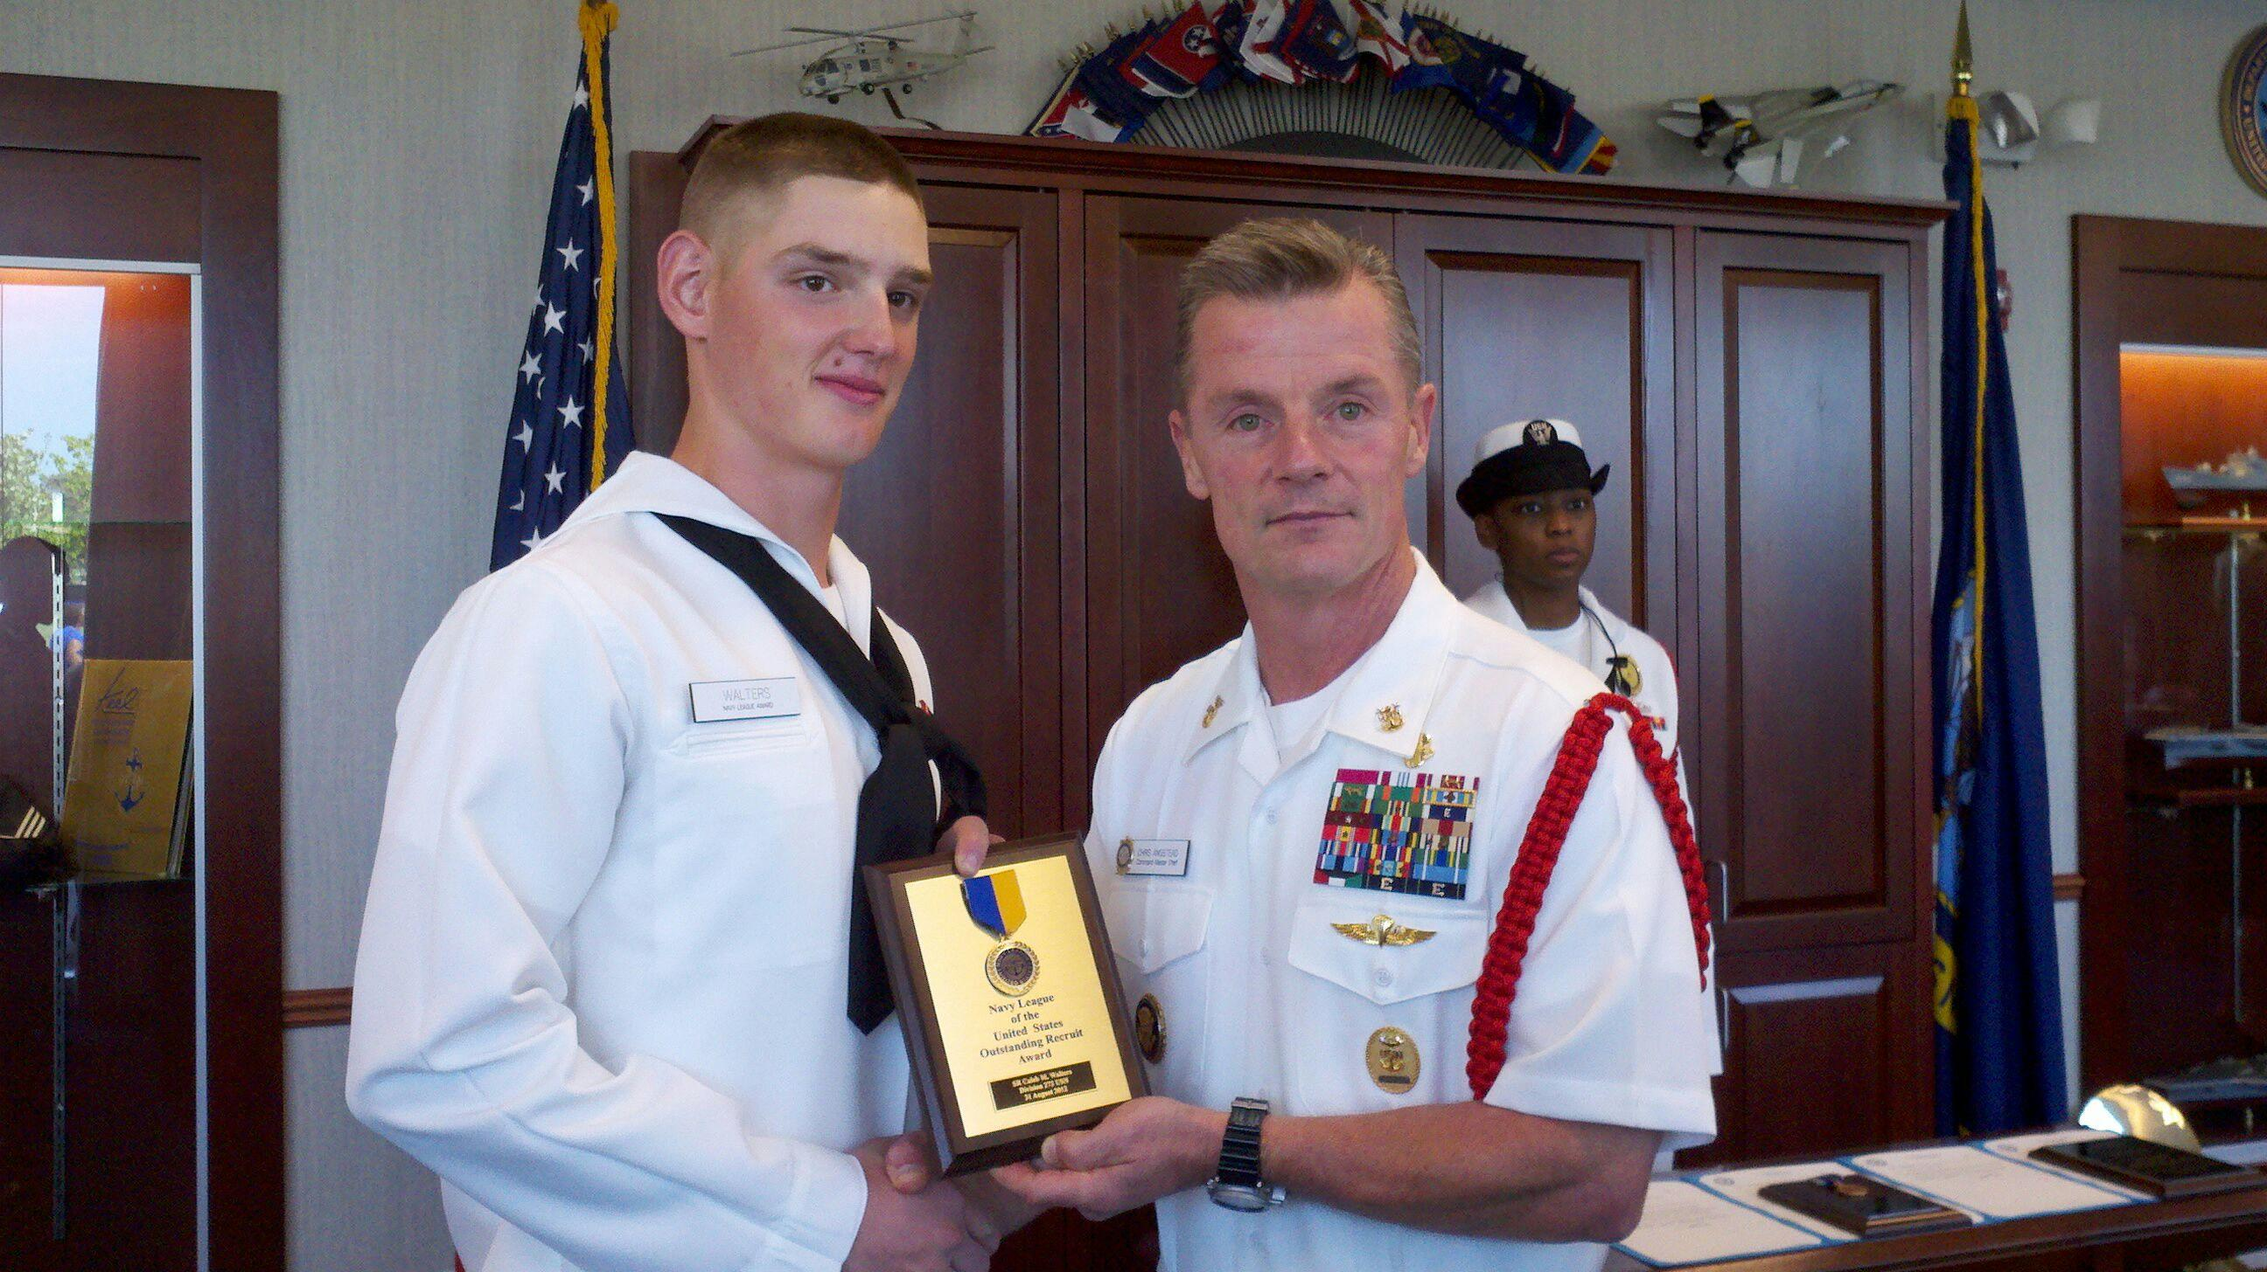

Slide 4
Stand on the Bible For the Binding is Strong

Slide 5
I. Equipped
2 Timothy 3:14-17
Remain faithful to the things taught
You’ve been taught the scriptures
Scriptures teach what is true and corrects us when we’re wrong
Prepared and equipped for every good work
For every season and position in life

Slide 6
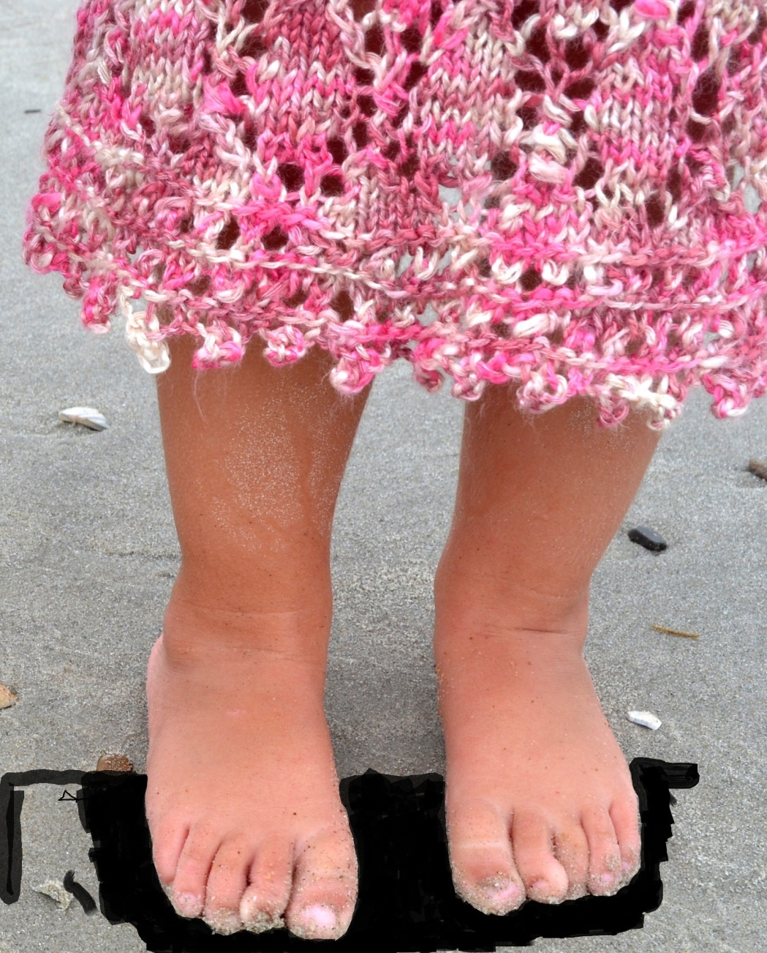
Holy Bible

Slide 7
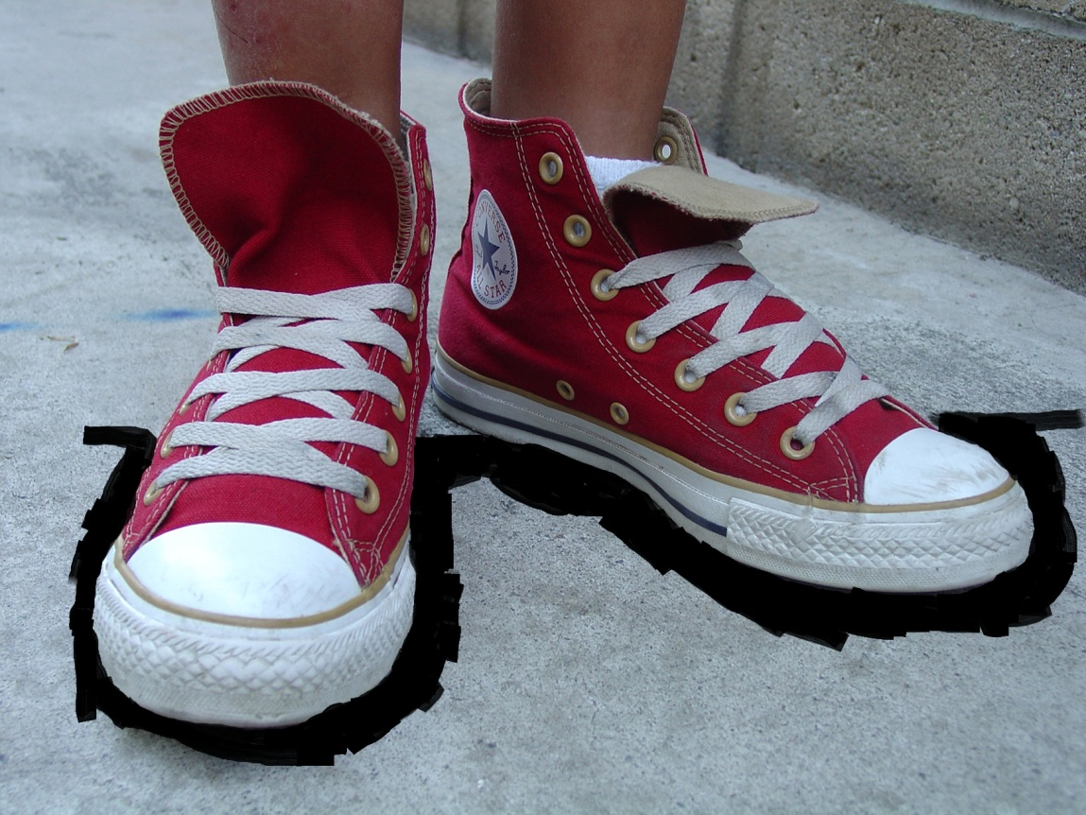
Holy Bible

Slide 8
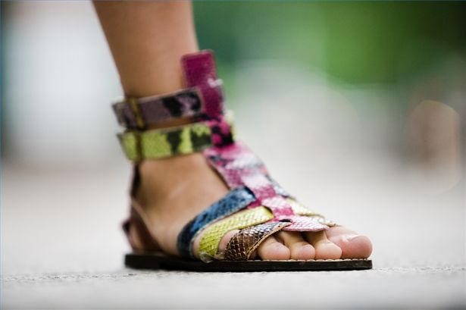
Holy Bible

Slide 9
Holy Bible
Holy Bible

Slide 10
V. Parents
Holy Bible
Holy Bible

Slide 11
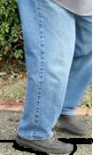
Holy Bible

Slide 12
II. Children
Holy Bible

Slide 13
II. Children
Mark 10:13-16
Jesus loves so much
Angry with those who considered them a bother
Commended the attitude of child like and took the opportunity to bless them

Slide 14
Colossians 3:20 (NLT) ²⁰ Children, always obey your parents, for this pleases the Lord.
Ephesians 6:1-3 (NLT) ¹ Children, obey your parents because you belong to the Lord, for this is the right thing to do. ² “Honor your father and mother.” This is the first commandment with a promise: ³ If you honor your father and mother, “things will go well for you, and you will have a long life on the earth.”

Slide 15
III. Teens and 20’s
Holy Bible

Slide 16
III. Teens and 20’s
Holy Bible

Slide 17
III. Teens and 20’s
Time when becoming independent
Psalm 119:9-11
How can you stay pure? – by obeying God’s Word
Hide God’s Word in your heart – not sin against Him
Proverbs 4:23 (NLT) ²³ Guard your heart above all else, for it determines the course of your life.

Slide 18
IV. Marrieds
Holy Bible
Holy Bible

Slide 19
Ephesians 5:21-28
Submit to one another
Wives submit to husbands
Husbands love your wives as Christ loved the church
1 Corinthians 7:3 (NLT) ³ The husband should fulfill his wife’s sexual needs, and the wife should fulfill her husband’s needs.

Slide 20
1 Peter 3:3-5, 7 (NLT) ³ Don’t be concerned about the outward beauty of fancy hairstyles, expensive jewelry, or beautiful clothes. ⁴ You should clothe yourselves instead with the beauty that comes from within, the unfading beauty of a gentle and quiet spirit, which is so precious to God. ⁵ This is how the holy women of old made themselves beautiful. They trusted God and accepted the authority of their husbands… ⁷ In the same way, you husbands must give honor to your wives. Treat your wife with understanding as you live together. She may be weaker than you are, but she is your equal partner in God’s gift of new life. Treat her as you should so your prayers will not be hindered.

Slide 21
V. Parents
Holy Bible
Holy Bible

Slide 22
V. Parents
Make disciples – followers of Jesus
Disciple – discipline
Proverbs 22:15 (NLT) ¹⁵ A youngster’s heart is filled with foolishness, but physical discipline will drive it far away.
Proverbs 13:24 (NLT) ²⁴ Those who spare the rod of discipline hate their children. Those who love their children care enough to discipline them.

Slide 23
Deuteronomy 6:5-7 (NLT) ⁵ And you must love the LORD your God with all your heart, all your soul, and all your strength. ⁶ And you must commit yourselves wholeheartedly to these commands that I am giving you today. ⁷ Repeat them again and again to your children. Talk about them when you are at home and when you are on the road, when you are going to bed and when you are getting up.
Proverbs 22:6 (NLT) ⁶ Direct your children onto the right path, and when they are older, they will not leave it.

Slide 24
Standing spiritual guard
1 Peter 5:8-9 (NLT) ⁸ Stay alert! Watch out for your great enemy, the devil. He prowls around like a roaring lion, looking for someone to devour. ⁹ Stand firm against him, and be strong in your faith…
Shield of faith – extinguish all the flaming missiles of the evil one (Ephesians 6:16)
Faith comes by hearing…the Word of God (Romans 10:17)

Slide 25
VI. Elders - Seasoned Citizens
Holy Bible

Slide 26
VI. Elders - Seasoned Citizens
Your job is not done
Titus 2:2-5
Elder men – live wisely, worthy of respect
Elder women – train younger women
Elders in the gates of the city
Renewed spirits and expectant future

Slide 27
2 Corinthians 4:16 (NLT) ¹⁶ That is why we never give up. Though our bodies are dying, our spirits are being renewed every day.
2 Corinthians 5:1-2 (NLT) ¹ For we know that when this earthly tent we live in is taken down (that is, when we die and leave this earthly body), we will have a house in heaven, an eternal body made for us by God himself and not by human hands. ² We grow weary in our present bodies, and we long to put on our heavenly bodies like new clothing.
2 Corinthians 5:9 (NLT) ⁹ So whether we are here in this body or away from this body, our goal is to please him.

Slide 28
Many other stations in life

Slide 29
In this world you will have trouble so when the world begins to quake…
SOTBFTBIS
you’re standing on a kingdom that cannot be shaken

Slide 30
When a relationship starts to fall apart…
SOTBFTBIS
it’s got the glue of love that is the perfect bond of unity

Slide 31
When you’ve stepped into the quicksand of life that is pulling you down…
SOTBFTBIS
hearing and doing the Word is a solid rock foundation

Slide 32
When the storms of life are tossing you to and fro…
SOTBFTBIS
it has the hope that becomes the anchor to the soul

Slide 33
When you are tempted to sin…
SOTBFTBIS
by it a young person will keep their way pure and secure

Slide 34
When the worries of life come to choke out the word…
SOTBFTBIS
it offers the peace that passes all understanding

