Slide 2
Living in Freedom

Slide 3
I. Just Tell Me the Rules!
Galatians 3:1-12
Foolish – trying to become perfect by human effort
Trying to be right with God by following rules
It is through faith that a righteous person has life
The way of faith is very different from the way of law
Good start, but people try to talk you into making it about keeping rules

Slide 4
Questions: George Barna research
Does a legalist know they are a legalist?
no, they see themselves as the ultimate defender of the faith
The Christian life is well summed up in trying to do what God commands? – yes or no?
82% agreed – 57% strongly agreed

Slide 5
Christian maturity is understanding the principles of the Bible and trying my best to live them? Yes or no?
No – Christian maturity is character and trying my best to do it should be heresy
Rigid rule and strict standards are an important part of the life and teaching of my church? Yes or no?
66% agreed – 39% strongly agreed

Slide 6
Extremes:
Legalism – church like a wienie roast – turn or burn
70’s Jesus movement – God is love – have a joint
There is still a standard – to walk in righteousness, but can’t do it by following law

Slide 7
Trouble communicating?
James – show me your faith by your works
A personal relationship is going to result in this…

Slide 8
II. What is Freedom?
The reason God gave rules (Galatians 3:19-25)
To show people their sins (nature to sin)
Romans 7:5 (NASB) ⁵ For while we were in the flesh, the sinful passions, which were aroused by the Law, were at work in the members of our body to bear fruit for death.

Slide 9
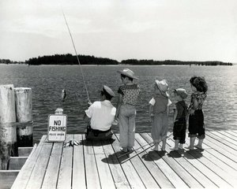

Slide 11
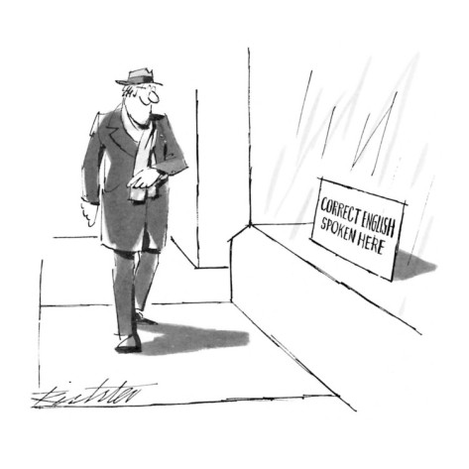
Do not look in this hole

Slide 12
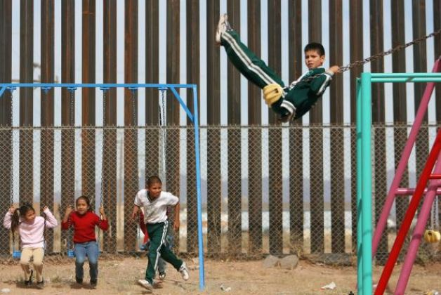
To protect us

Slide 13
To bring us to faith in Christ

Slide 14
We receive freedom only by believing in Jesus
Freedom in knowing it is not up to me to be able to be right with God
Freedom in believing the Lord has my best interest in heart

Slide 15
What freedom is not – Galatians 5:13
Sinful desires – leads to bondage and death

Slide 16
III. Relationship Results in Freedom
Galatians 5:16-22
Constant conflict – between sinful nature and Spirit of God
Results are obvious
Let the Holy Spirit guide your lives
The Spirit gives desires opposite of the sinful nature

Slide 17
Harvest what you plant – Galatians 6:7-9
Live to satisfy sinful nature – harvest decay and death
Live to please the Spirit – harvest everlasting life
Don’t get tired of doing good – we will reap the harvest of blessing

