Slide 2
Dream and Steam Team
Direction for Praise Fellowship Church

Slide 3
I. My Challenge
Linda Gassler’s Word – God is doing a great work here and you’ve got a great church. It’s sound, it’s stable, it’s strong, You’ve got quality here. Don’t take it for granted. Know that everything that God gives you, you need to protect and guard what God has given you here. It’s a precious gift, not something to be taken lightly. God is doing a great work here in Dodge Center. You don’t believe that, though, do you. I shouldn’t say, you don’t believe it, but you don’t have the impact of it to the extent that the Spirit of God wants you to know. He wants you to be excited about this place. Be excited about it and guard it and keep it as precious. Don’t take what you’ve got for granted and know that what you’ve got is really good.

Slide 4
Brock – Community is strong here (cultishly friendly?)
Larissa – church (s)hopped in TX. It’s rare to find a church where the young people are given charge of the service
Sue – after ATF – rare to find pastors/churches that are seeing the value and are supportive of youth ministry
Melanie with Chad Greene – describing their search for church. Mel - We’ve spoiled a bunch of you young people and it is hard to find something similar to what you grew up with. Chad – Yes, exactly.

Slide 5
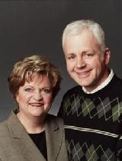
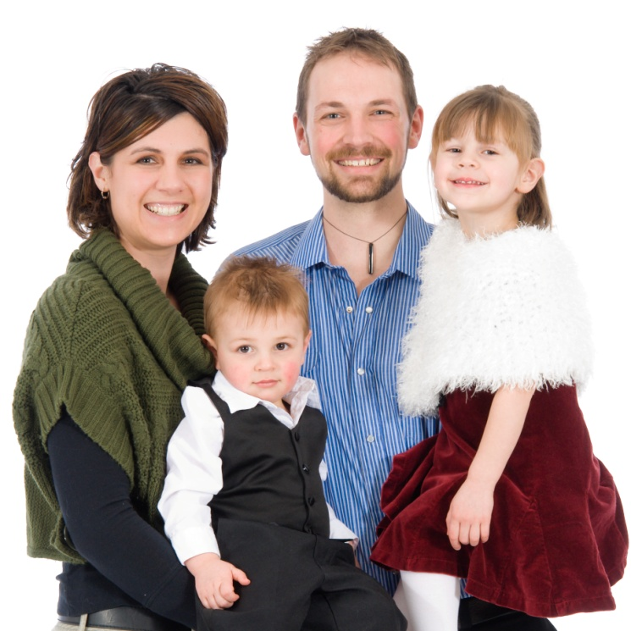
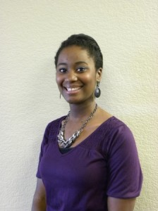
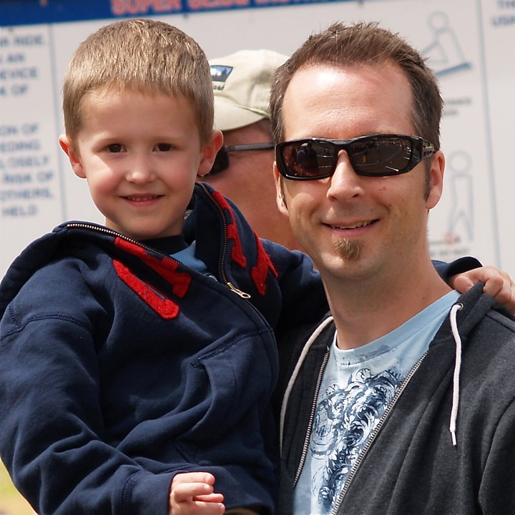
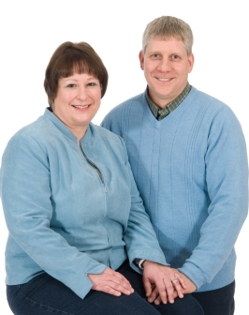

Slide 6
What is challenging me – a good thing that doesn’t grow?
Statistics of attendance over the years
2009 average: 62
2010 average: 65
2011 average: 62

Slide 7
II. Why concerned about Numbers?
The thing about numbers
Does outward appearance reveal true success?
Success is not always what you see

Slide 8
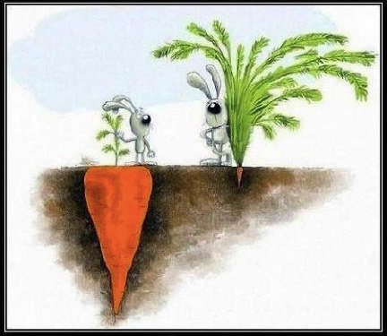

Slide 9
Numbers does not equal success
What constitutes growth?
Expanding the kingdom of God
Outreach events
Missions – not only supporting, but direct involvement
Sending growth
People move
Young people relocate

Slide 10
So what’s the thing about growing in numbers here?
Word of the Lord - July 1996 – Tent Revival Meetings on the Hwy 56 property - the Lord said that He wanted a church building built on that piece of property. - Size – 300 expandable to 500.

Slide 11
Biblical Tensions That Keep Us In Tune
CHURCH GROWTH
Biblical Truth
-Talents
-Gideon
BALANCE
Error
-Numbers equals success
Error
-Justifica-tion
-Why
bother?
Biblical Truth
-Faithful with
the few, entrusted with much

Slide 12
Not just about numbers – many things will draw a crowd
Mark 16:15 And then he told them, “Go into all the world and preach the Good News to everyone.”
Matthew 28:20 “Teach these new disciples to obey all the commands I have given you. And be sure of this: I am with you always, even to the end of the age.”

Slide 13
Our part and God’s part- Acts 2:42 - 47 (NLT) All the believers devoted themselves …And each day the Lord added to their fellowship those who were being saved.

Slide 14
III. Dream and Steam Team
Purpose: Utilization of the ministry leader team for the development of an OBJECTIVE PERSPECTIVE for effectively reaching, ministering to, and maturing 300 people
Evaluation of each area of ministry: and its applications for achieving the vision of 300
PERSPECTIVE – DREAM
APPLICATION – STEAM
TEAM – balanced perspective

Slide 15
From Unique Design - Balance of “lenses” of perspectives
Dreamer – calm, reflective
Catalyzer – persuasive, bold
Energizer – spontaneous, funloving
Persister – dedicated, conscientious
Harmonizer – compassionate, warm
Achiever – logical, organized

Slide 16
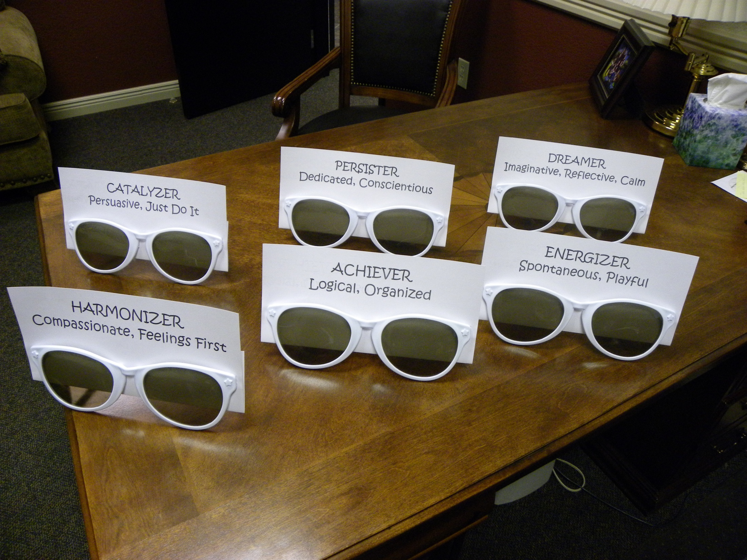

Slide 18
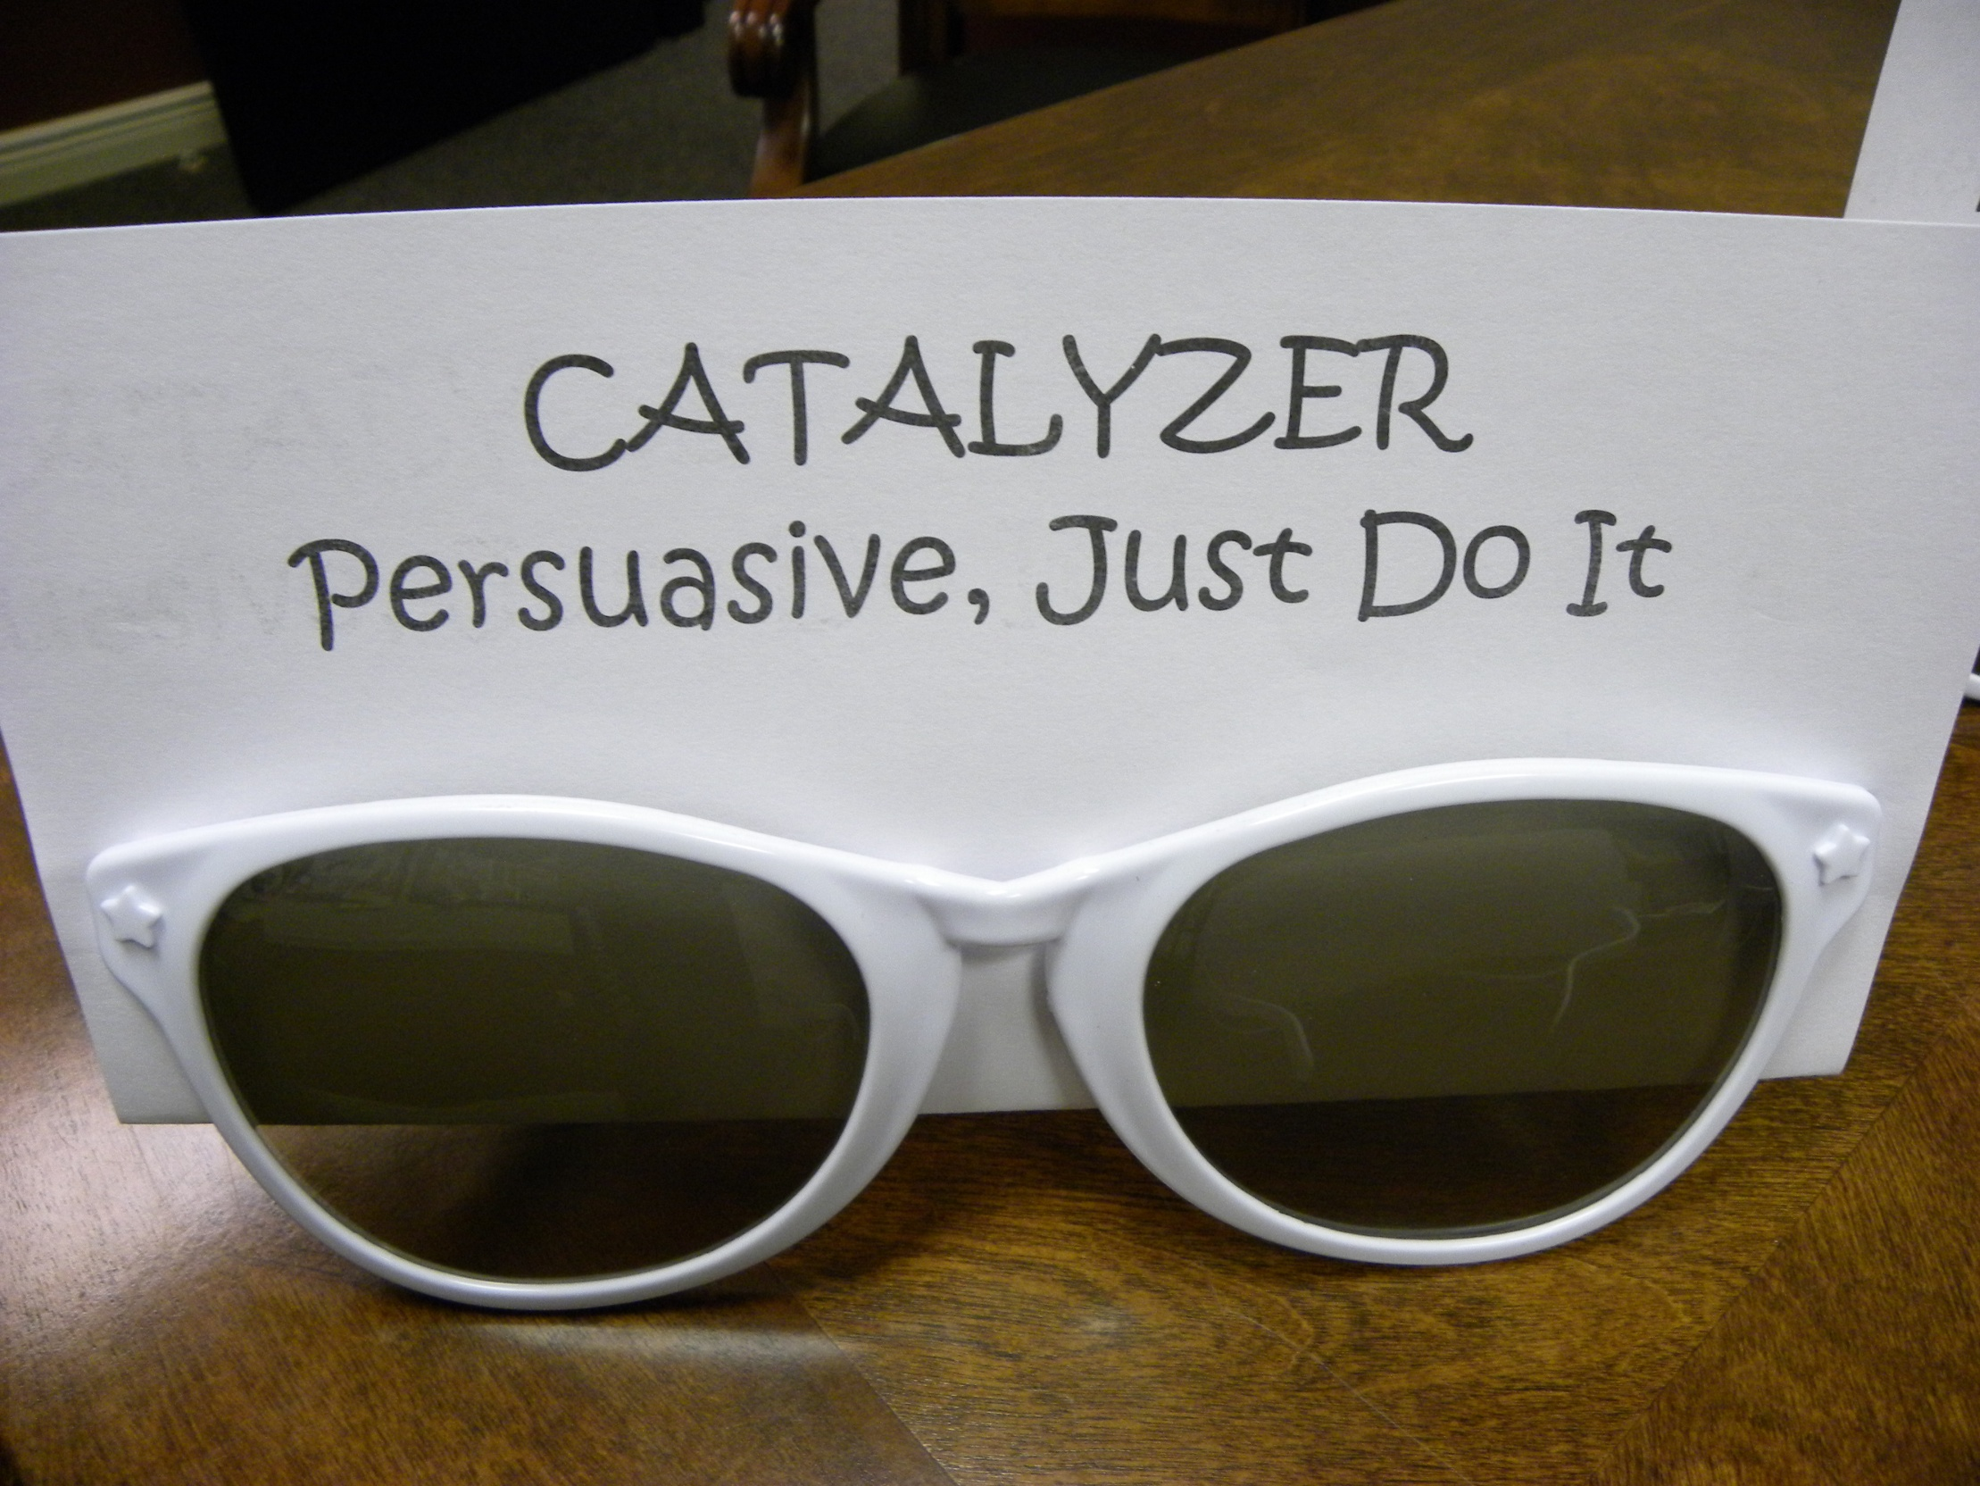

Slide 19
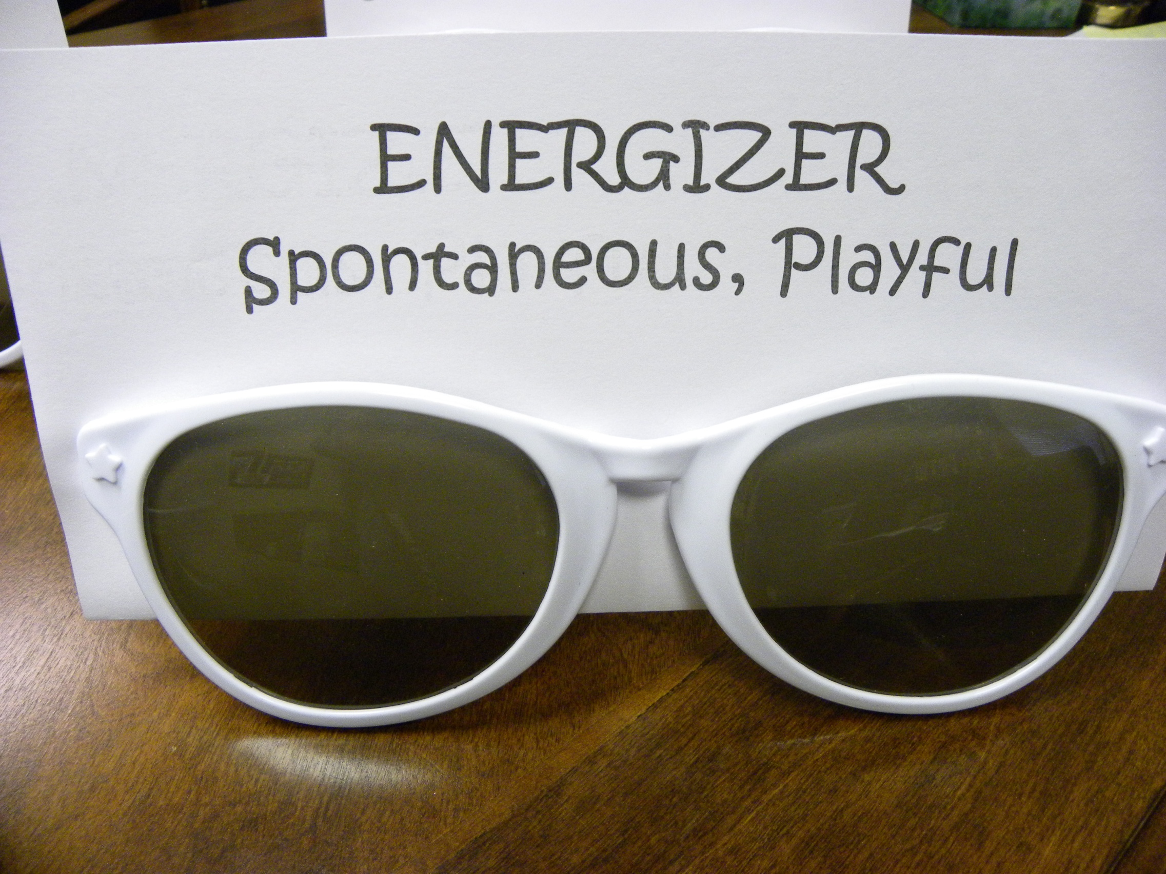

Slide 21
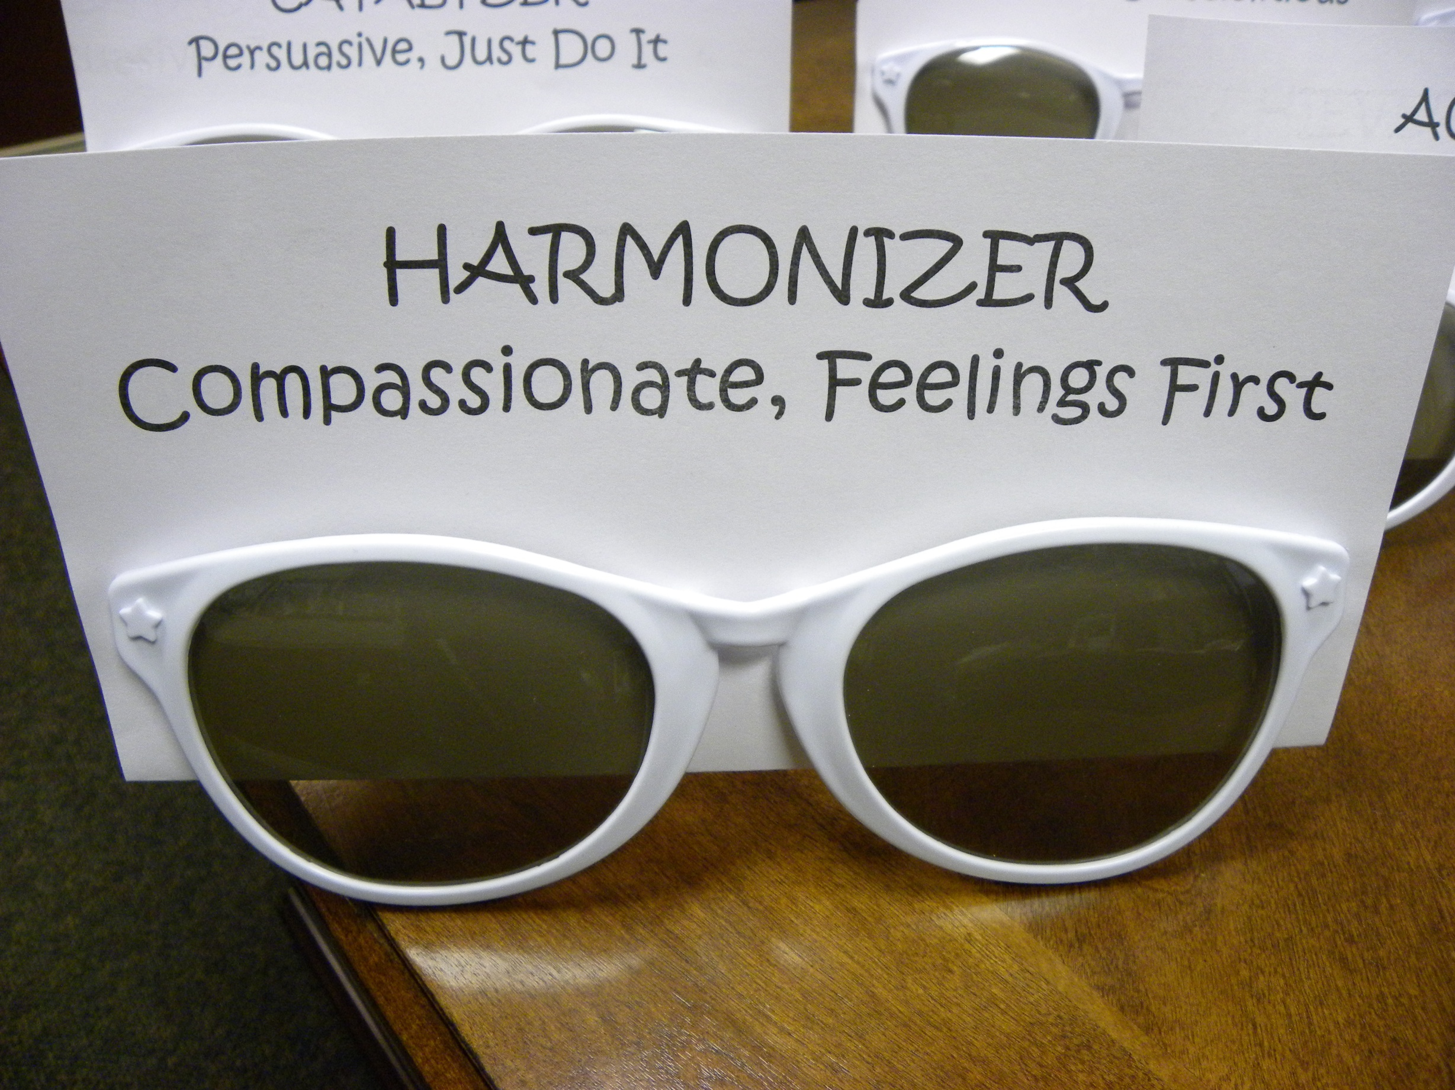

Slide 23
From Various “Thinking Hats”
White – information, objective facts and figures
Red – feelings and emotion
Black – caution, looking for danger
Yellow – sunny and positive
Green – creativity, new ideas
Blue – control, the organization of the thinking process

Slide 24
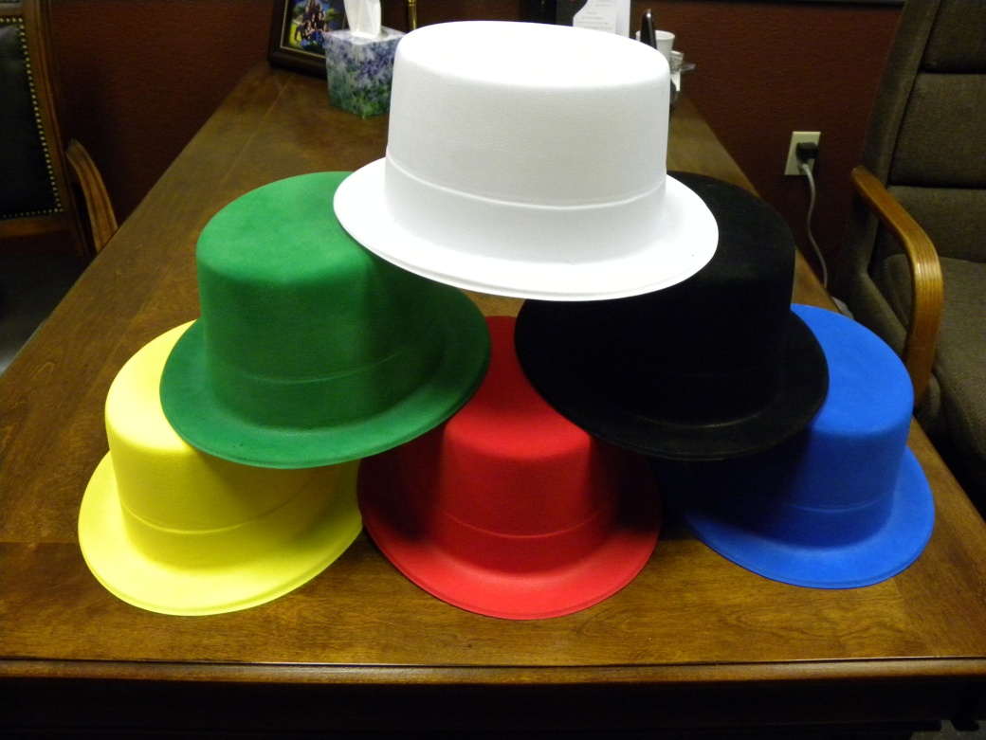

Slide 25
Each ministry leaders present their area of ministry
What it looks like at 300
What steps to take to get there
What resources are needed
What will need to change for me personally
Not just a dutiful obligation, but joy filled delight – let’s make this a fun adventure, not a grueling exercise that puts people in guilt mode

Slide 26
IV. Mature

Slide 27
Exploring Christ
Close to Christ
Christ Centered
Growing in Christ
Movement 1
Movement 2
Movement 3

Slide 28
Statements used – asked to describe how strongly you agree with these
Salvation by Grace: I believe nothing I do or have done can earn my salvation
The Trinity: I believe the God of the Bible is the one true God – Father, Son and Holy Spirit
Personal God: I believe God is actively involved in my life
Christ is First: I desire Jesus to be first in my life
Authority of the Bible: I believe the Bible has decisive authority over what I say and do
Identity in Christ: I exist to know, love, and serve God

Slide 29
Statements used – asked to describe how strongly you agree with these
Stewardship: I believe a Christian should live a sacrificial life that is not driven by pursuit of material things
Giving My Life Away: I am willing to risk everything that is important in my life for Jesus Christ
Giving Away My Faith: I pray for non-Christians to accept Jesus Christ as their Lord and Savior
Giving Away My Time: I give away my time to serve and help others in my community
Giving Away My Money: My first priority in spending is to support God’s work

Slide 30
Colossians 1:25-28
A servant to the church
Teaching with the wisdom God has given me
to present them to God, perfect (mature) in their relationship to Christ.
Depending on Christ’s mighty power that works within me.

Slide 31
2 Corinthians 5:14 - 15 (NLT) ¹⁴Either way, Christ’s love controls us. Since we believe that Christ died for all, we also believe that we have all died to our old life. ¹⁵He died for everyone so that those who receive his new life will no longer live for themselves. Instead, they will live for Christ, who died and was raised for them.

