Slide 2
Reconciled!

Slide 3
Separated
Reconciled
Access
Immortal
Victory

Slide 4
I. God in Christ - Reconciling
Colossians 1:19-23
God living in Christ, reconciling everything to himself – restoring relationship
By means of Christ’s blood on the cross
Separated from God by our sin

Slide 5
Romans 5:8-11
God so loved…God showed his love – sent Christ to die while yet sinners
Made right with God by the blood of Christ
New relationship – Jesus has made us friends of God

Slide 6
II. Reconciled Results
Hebrews 10:19-22
Bold access into heaven’s most holy place
Through the veil – (NASB - that is, His flesh)

Slide 7
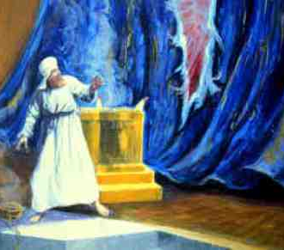
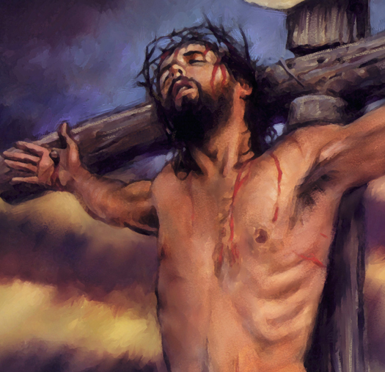
Matthew 27:50 - 51 ⁵⁰Then Jesus shouted out again, and he released his spirit. ⁵¹At that moment the curtain in the sanctuary of the Temple was torn in two, from top to bottom. The earth shook, rocks split apart,

Slide 8
1 Corinthians 15:20-23, 42-44, 50-57

Slide 9
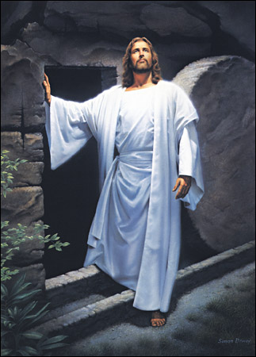
Jesus – the first of a great harvest
His resurrection from the dead guarantees ours

Slide 10
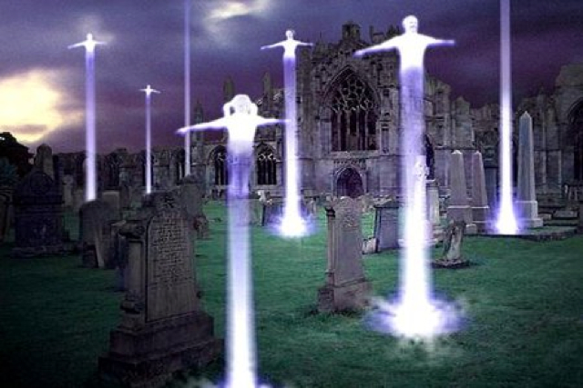
Order – Jesus, those who have died in Him, we who remain – BLINK!

Slide 11
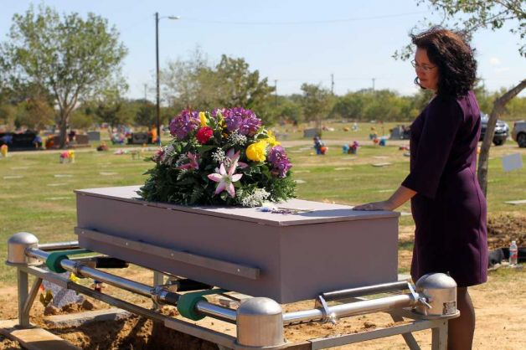
Buried – broken, weak, natural

Slide 12
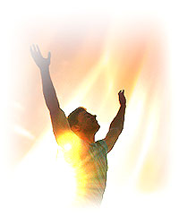
Raised – glorious, strength, spiritual, immortal

Slide 13
Buried – broken, weak, natural

Slide 14
Raised – glorious, strength, spiritual, immortal

Slide 15
Buried – broken, weak, natural

Slide 16
Raised – glorious, strength, spiritual, immortal

Slide 17
Death swallowed in victory
Victory over sin and death through Jesus

Slide 18
2 Corinthians 5:19-21

