Slide 2
The Bible Tells Me, So

Slide 3
The bible tells me so – emphatic affirmative, most certain
So – as in “it is so”
The bible tells me, so… - elicited response, hence, subsequently
So – as in “so therefore…”

Slide 4
How about the homonyms?
The bible tells me sow
How about raze hell?
I need the bible in my daily life

Slide 5
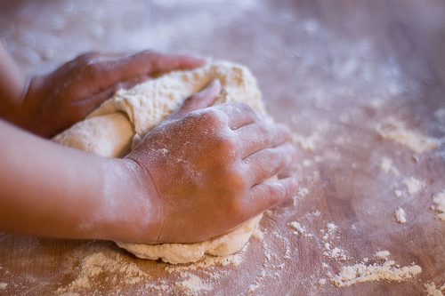
I knead the bible in my daily life

Slide 6
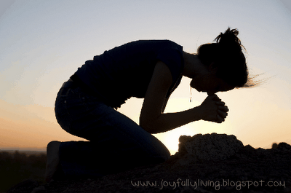
I kneed the bible in my daily life

Slide 7
I. Elicited Response
Common Phrase – God said it, I believe it, that settles it
Amended Phrase – God said it, that settles it
However – belief elicits response
I believe it, so… I am going to act on my belief
FAITH WITHOUT DEEDS IS DEAD

Slide 8
James 2:14-26
Faith and actions work together
Actions complete faith
Brother or sister in need
Shown to be right with God (proven) by what we do

Slide 9
Establish the So’s – as in “it is so”
Establish the So’s – as in “therefore…”

Slide 10
Jesus loves me this I know, for the Bible tells me, so…
2 Corinthians 5:14-15
Christ’s love controls us
He died for us and gave us new life
So… no longer live for selves, but for him

Slide 11
Romans 12:1 And so, dear brothers and sisters, I plead with you to give your bodies to God because of all he has done for you. Let them be a living and holy sacrifice—the kind he will find acceptable. This is truly the way to worship him.

Slide 13
II. Equipped

Slide 19
III. Head of the Body

Slide 21
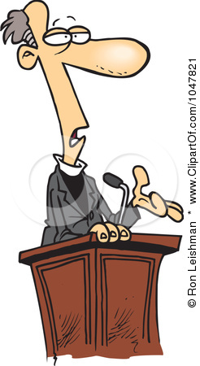
The Pastor’s Stump Feature Just for fun and discovery– asking questions that arise as you read the gospels

Slide 23
IV.

