Slide 2
God’s Rescue The Faithful Love of the Lord

Slide 3
I. Acts of God’s Kindness
Psalms 106-107
Like our ancestors we have sinned
Even so…

Slide 4
They Forgot
They intervened
The Lord Rescued them
Let them rejoice
Tell others

Slide 5
II. Your Response
We have sinned like our ancestors
James 4:1-10
Friendship with the world makes you enemies of God
Humbles yourselves, purify your hearts

Slide 6
Intervene
Jude 1:20 - 23 ²⁰But you, dear friends, must build each other up in your most holy faith, pray in the power of the Holy Spirit, ²¹and await the mercy of our Lord Jesus Christ, who will bring you eternal life. In this way, you will keep yourselves safe in God’s love. ²²And you must show mercy to those whose faith is wavering. ²³Rescue others by snatching them from the flames of judgment. Show mercy to still others, but do so with great caution, hating the sins that contaminate their lives.

Slide 7
Ezekiel 22:30 - 31 ³⁰“I looked for someone who might rebuild the wall of righteousness that guards the land. I searched for someone to stand in the gap in the wall so I wouldn’t have to destroy the land, but I found no one. ³¹So now I will pour out my fury on them, consuming them with the fire of my anger. I will heap on their heads the full penalty for all their sins. I, the Sovereign LORD, have spoken!”

Slide 8
Tell others – a witness
107:2 – has the Lord redeemed you? Then speak out!
107:42-43
Wicked are struck silent
See in our history the faithful love of the Lord

Slide 10
They forgot
106:7 – rebelled at the Red Sea
106:13 – rebelled against Moses’ leadership
106:21 – worshiped a grass-eating bull
106:24 – they refused to enter the promised land
106:28 – they worshiped Baal
106:32 – they angered the Lord and Moses
107:4 – some wandered
107:11 – some rebelled
107:17 – some were fools
107:23 – some went off to sea

Slide 11
They intervened
106:23 - Moses
106:30 – Phinehas – Aaron’s grandson
Numbers 25

Slide 12
The Lord rescued them
106:4
106:8
106:10
106:43
106:47
107:2
107:6
107:13
107:19
107:28
107:41

Slide 13
Let them rejoice - his faithful love endures forever
106:5
106:12
106:47-48
107:8
107:15
107:21,22
107:31,32

Slide 14
Tell others –
107:2
107:43

Slide 15
III. Head of the Body

Slide 16
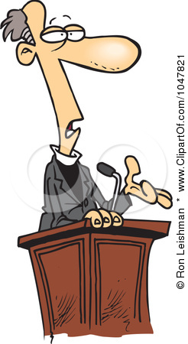
The Pastor’s Stump Feature Just for fun and discovery– asking questions that arise as you read the gospels

Slide 18
IV.

