Slide 2
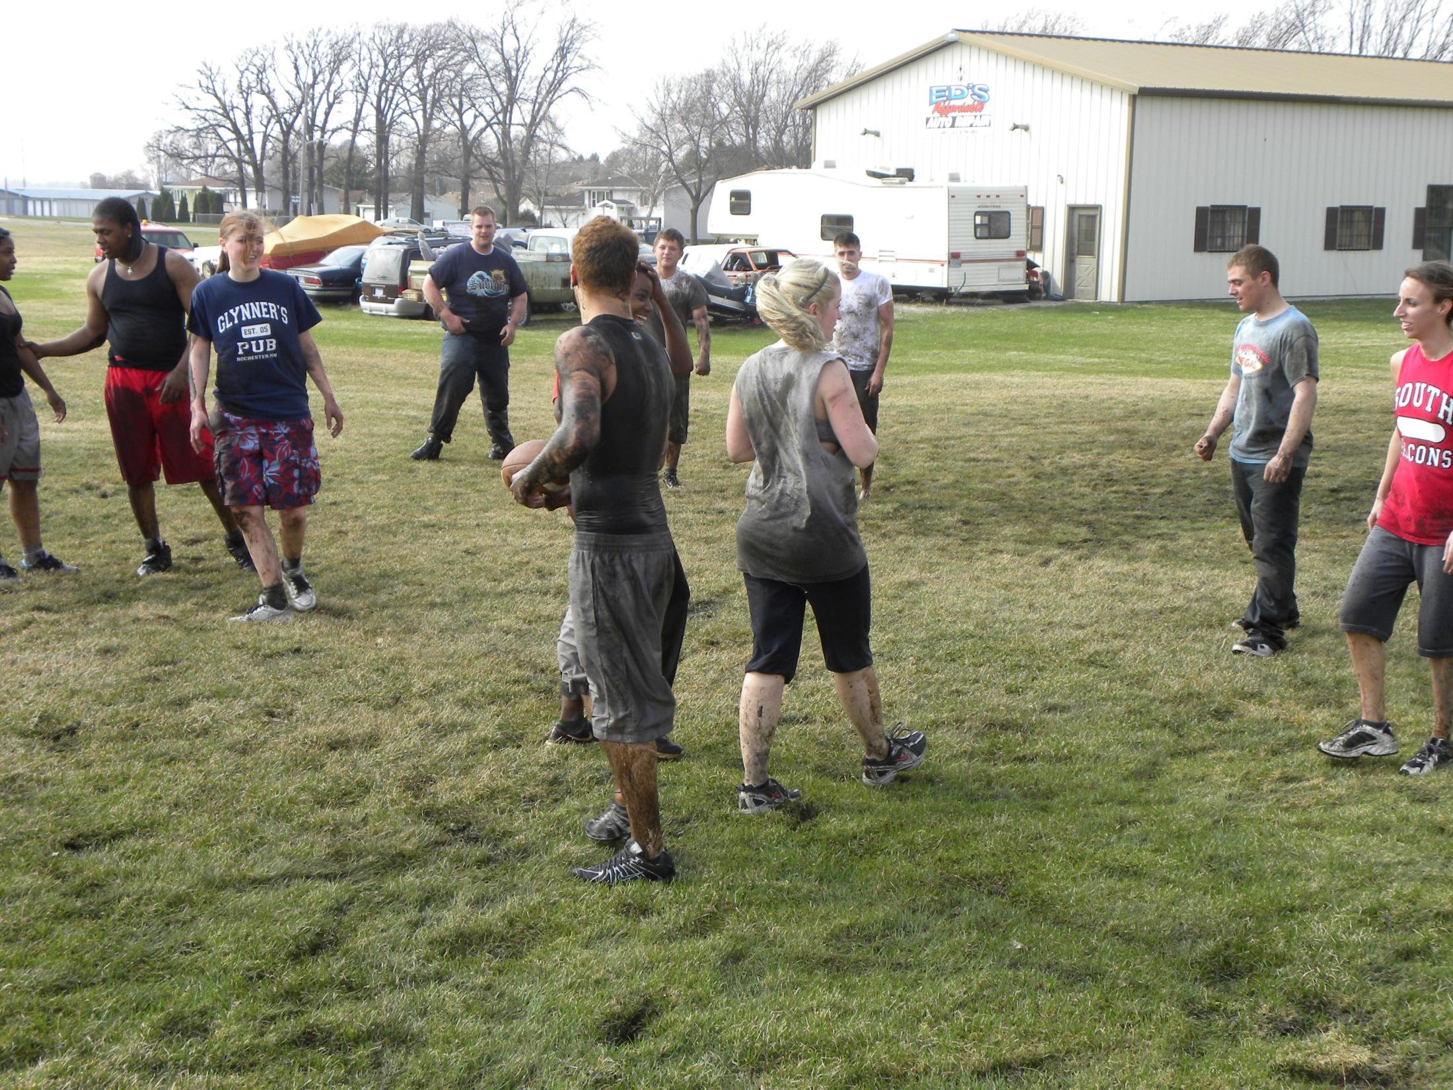

Slide 3
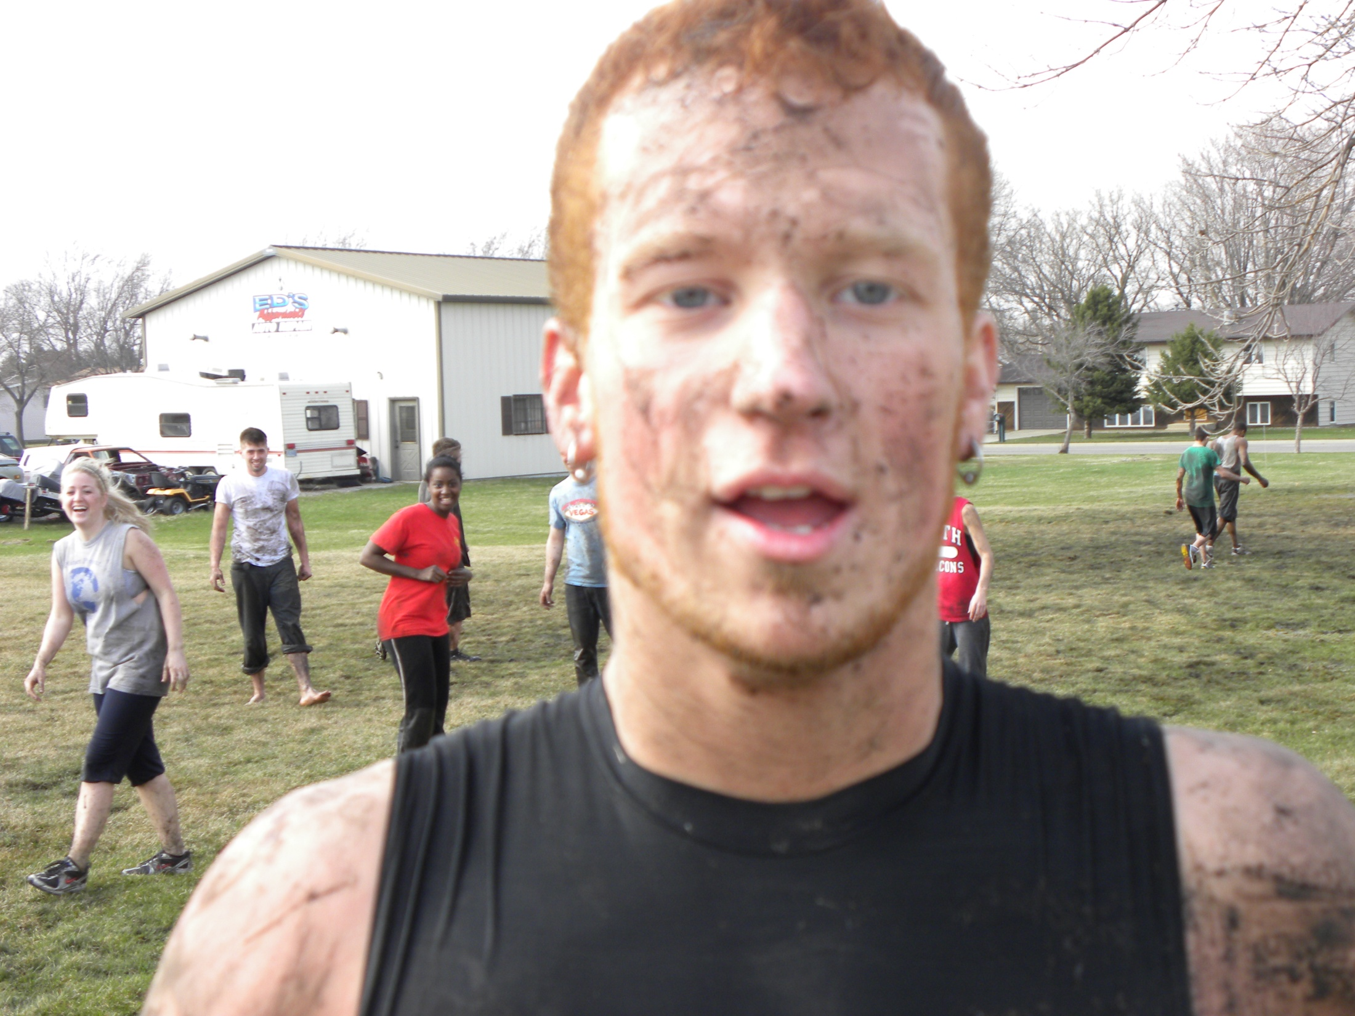

Slide 4
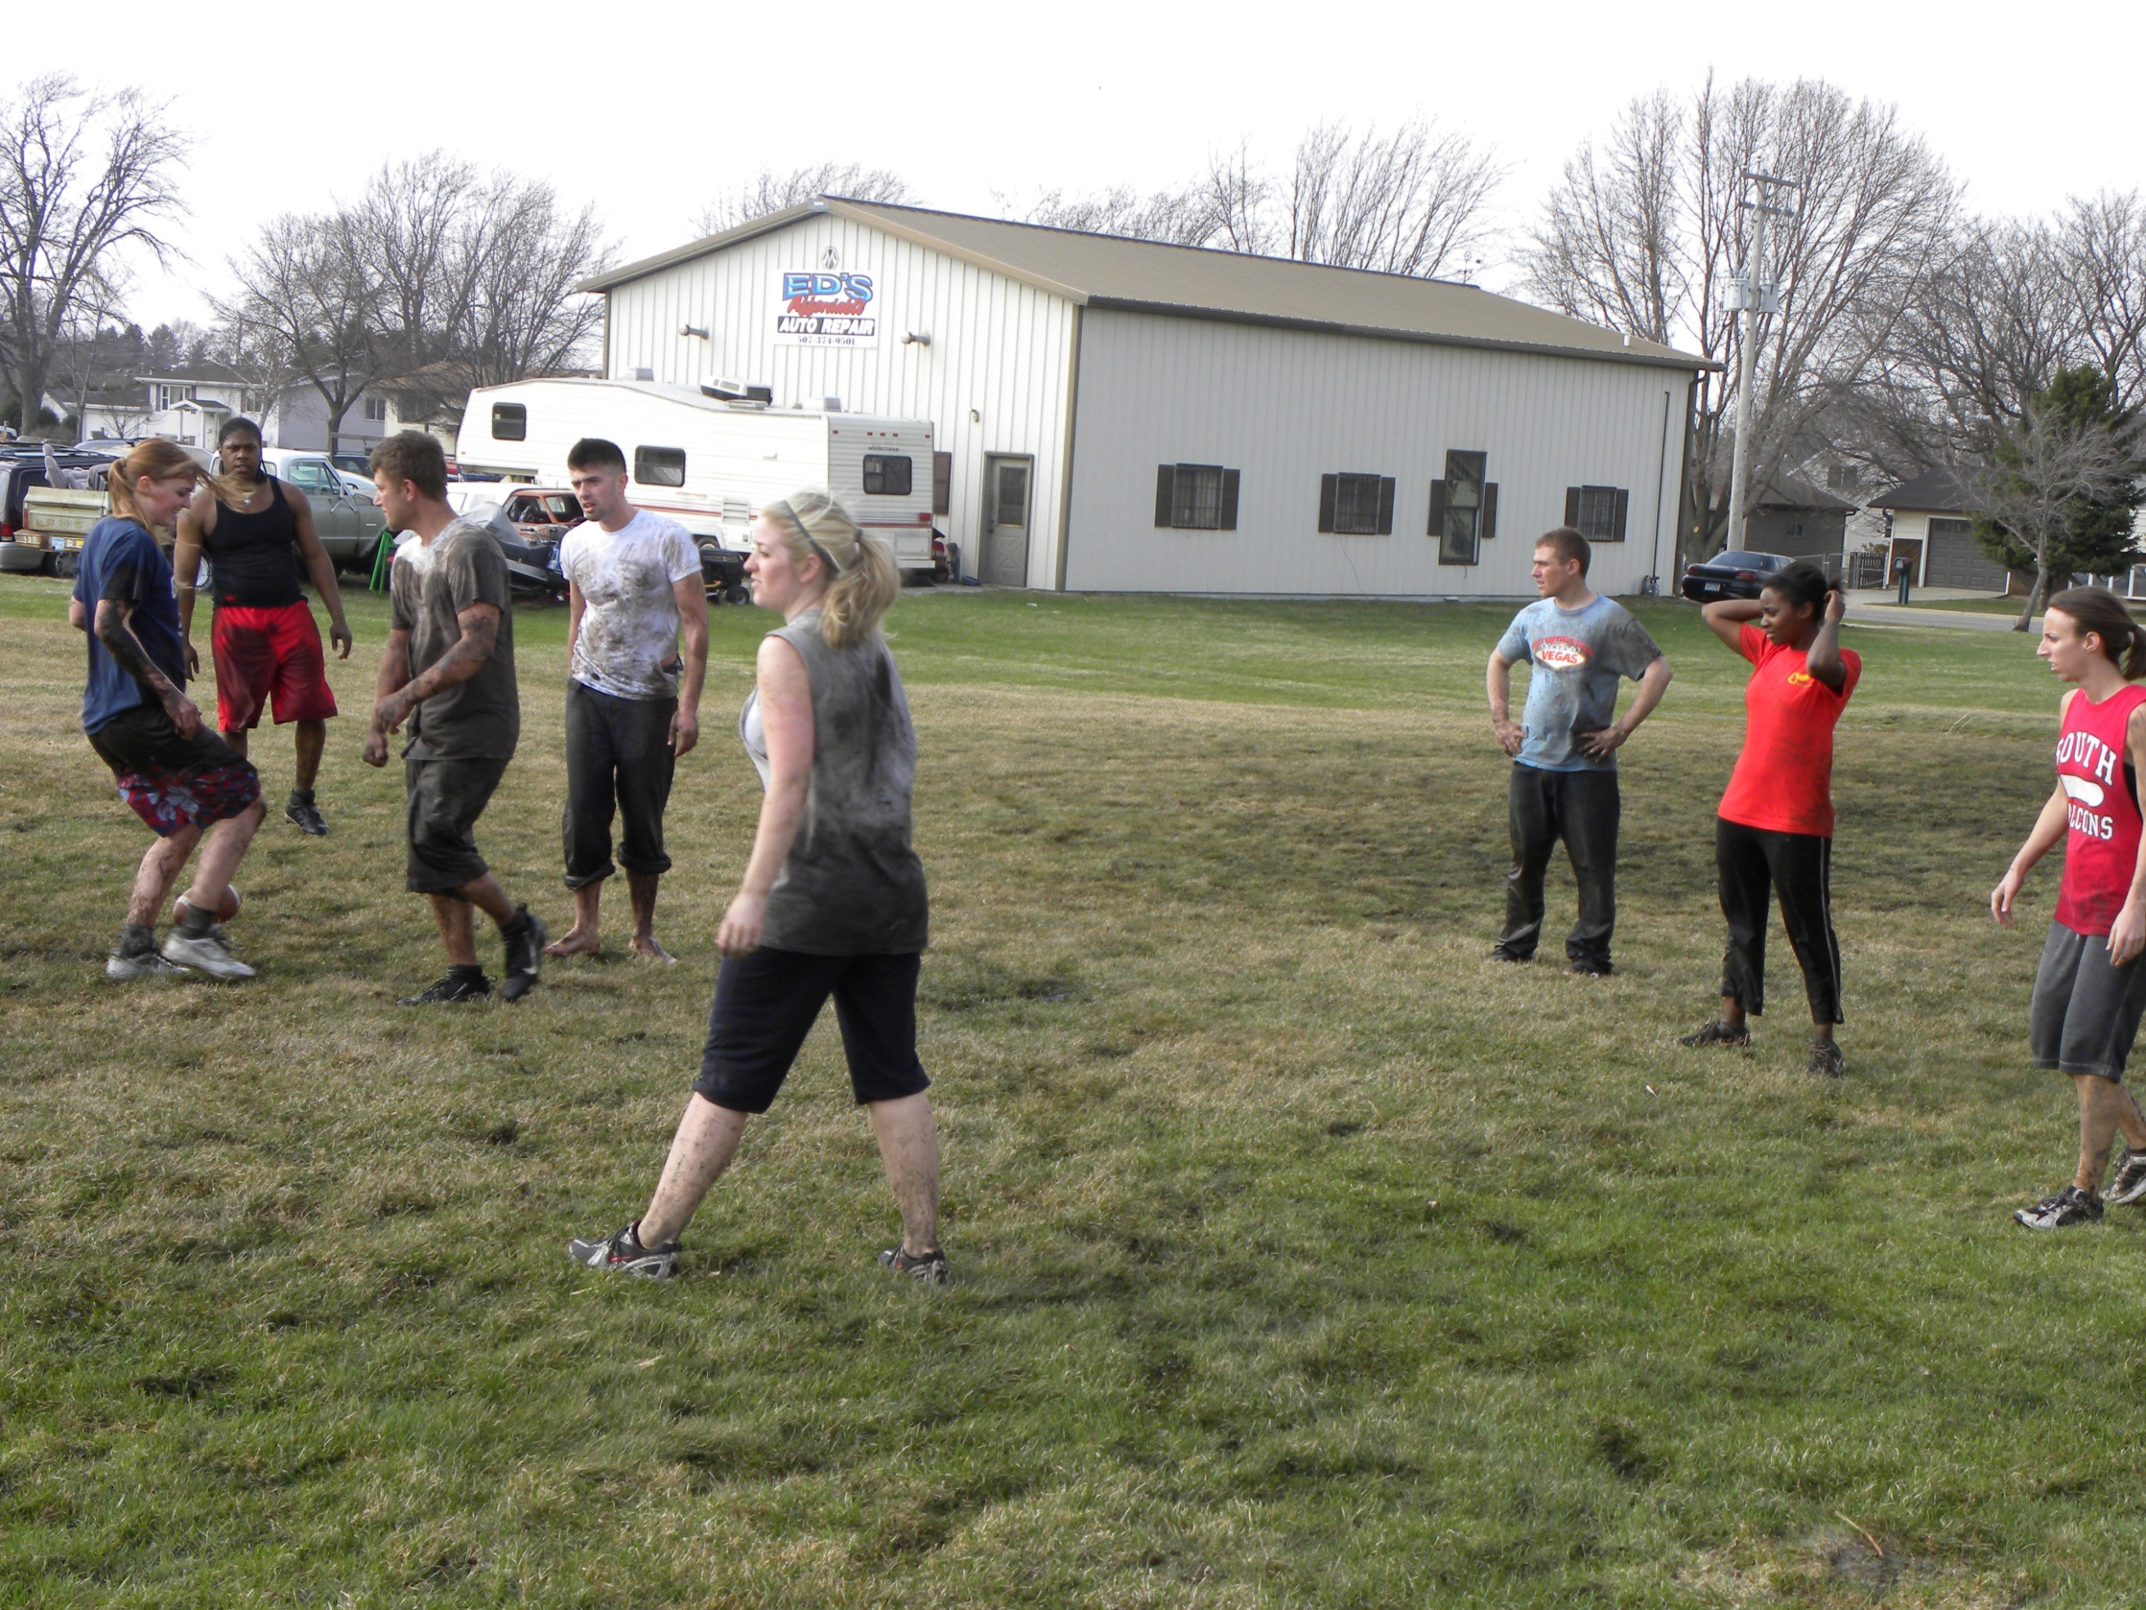

Slide 5
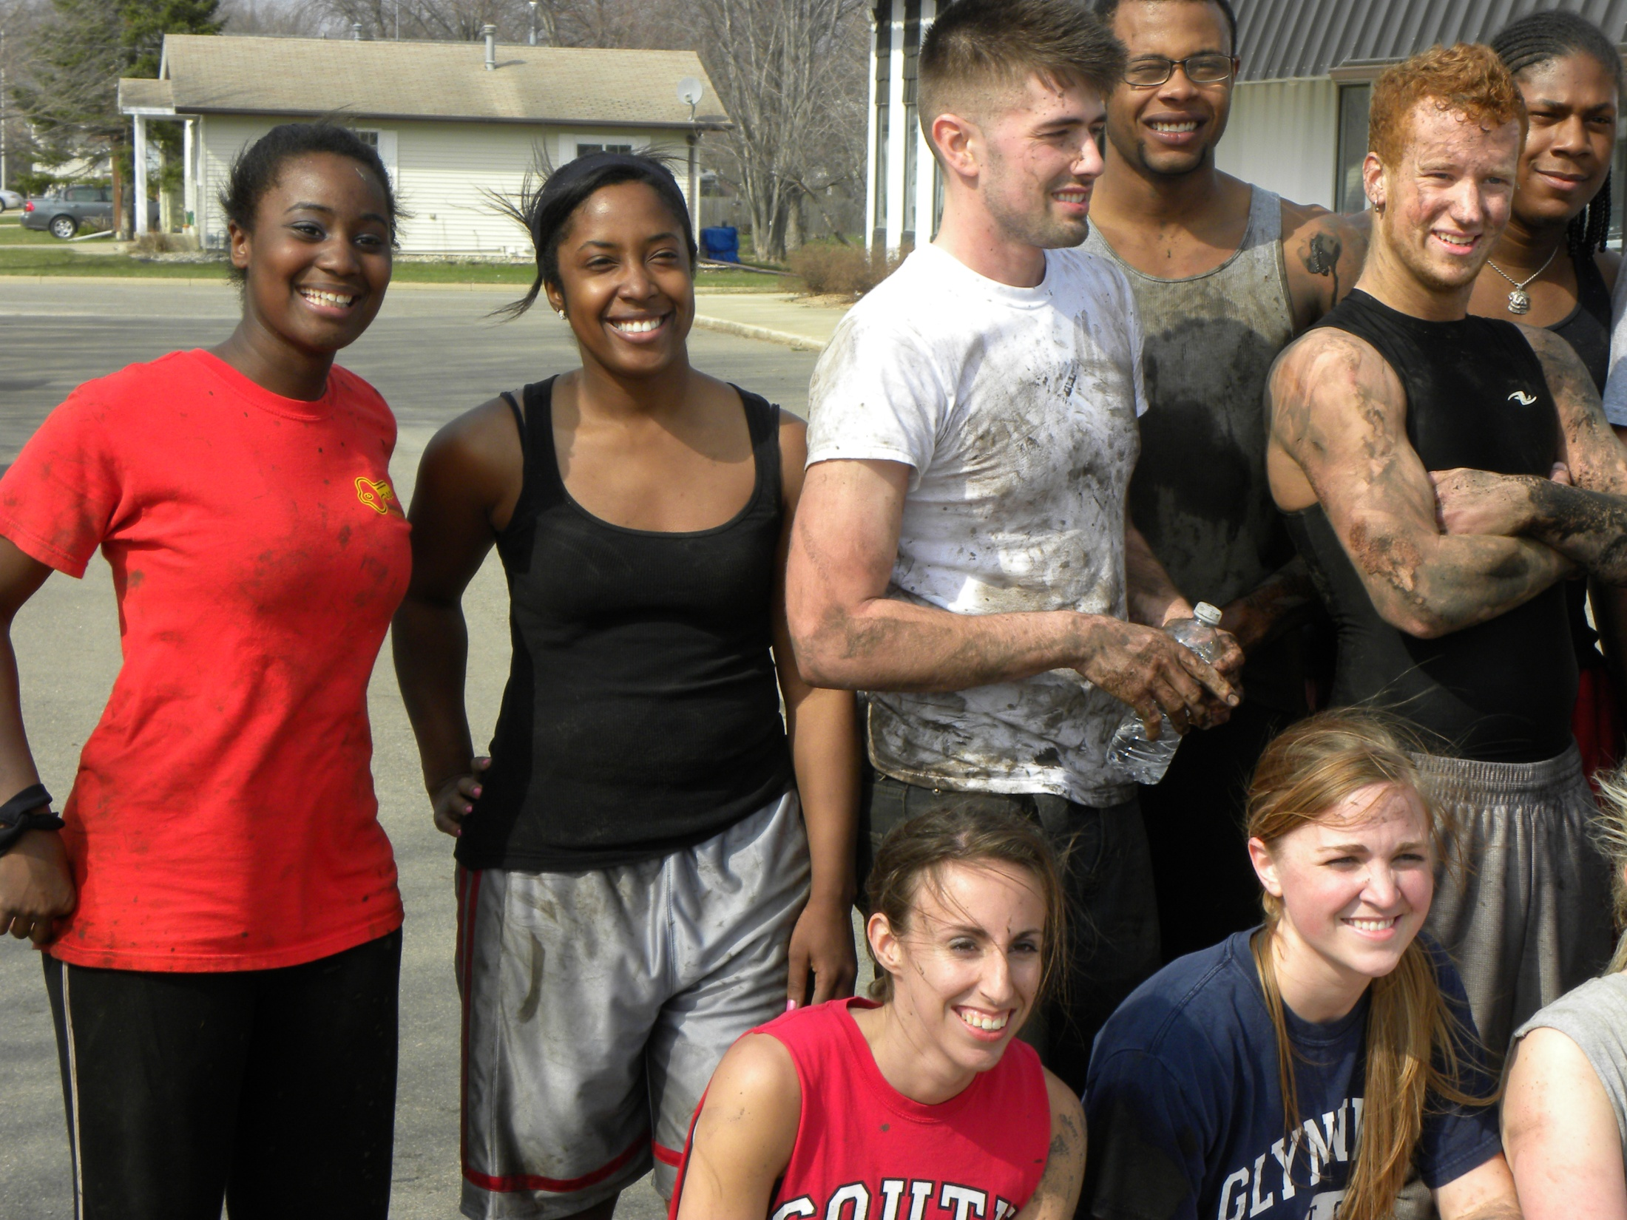

Slide 6
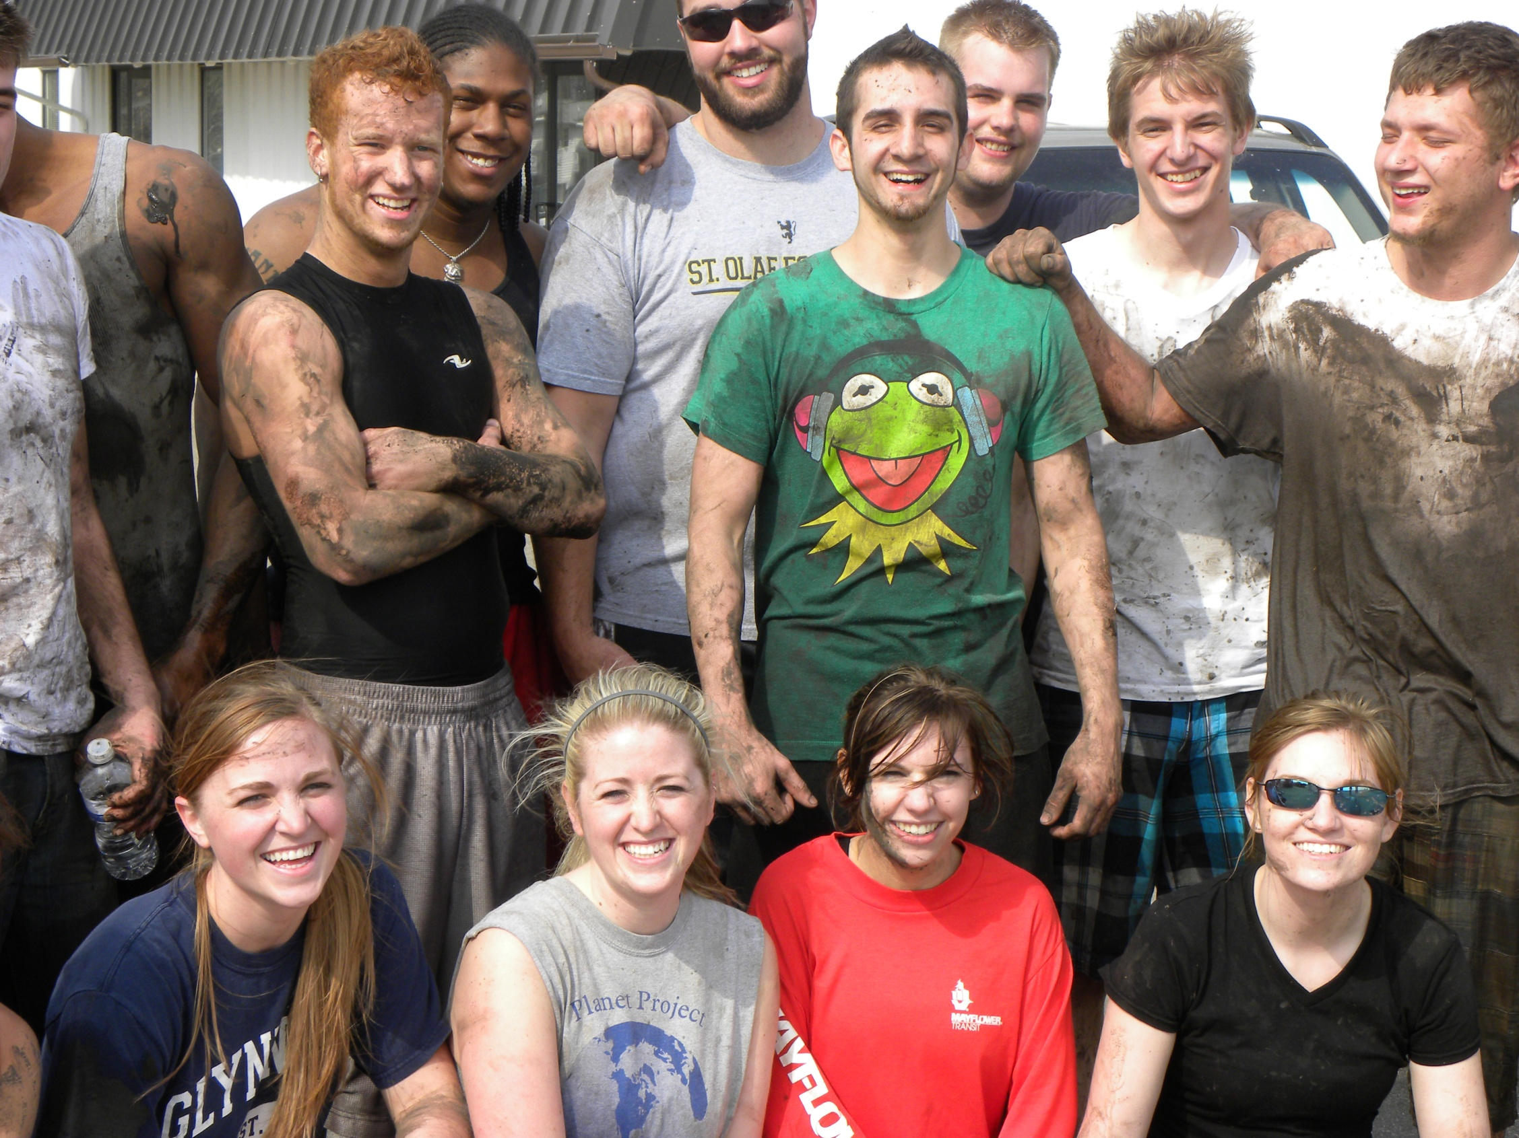

Slide 7
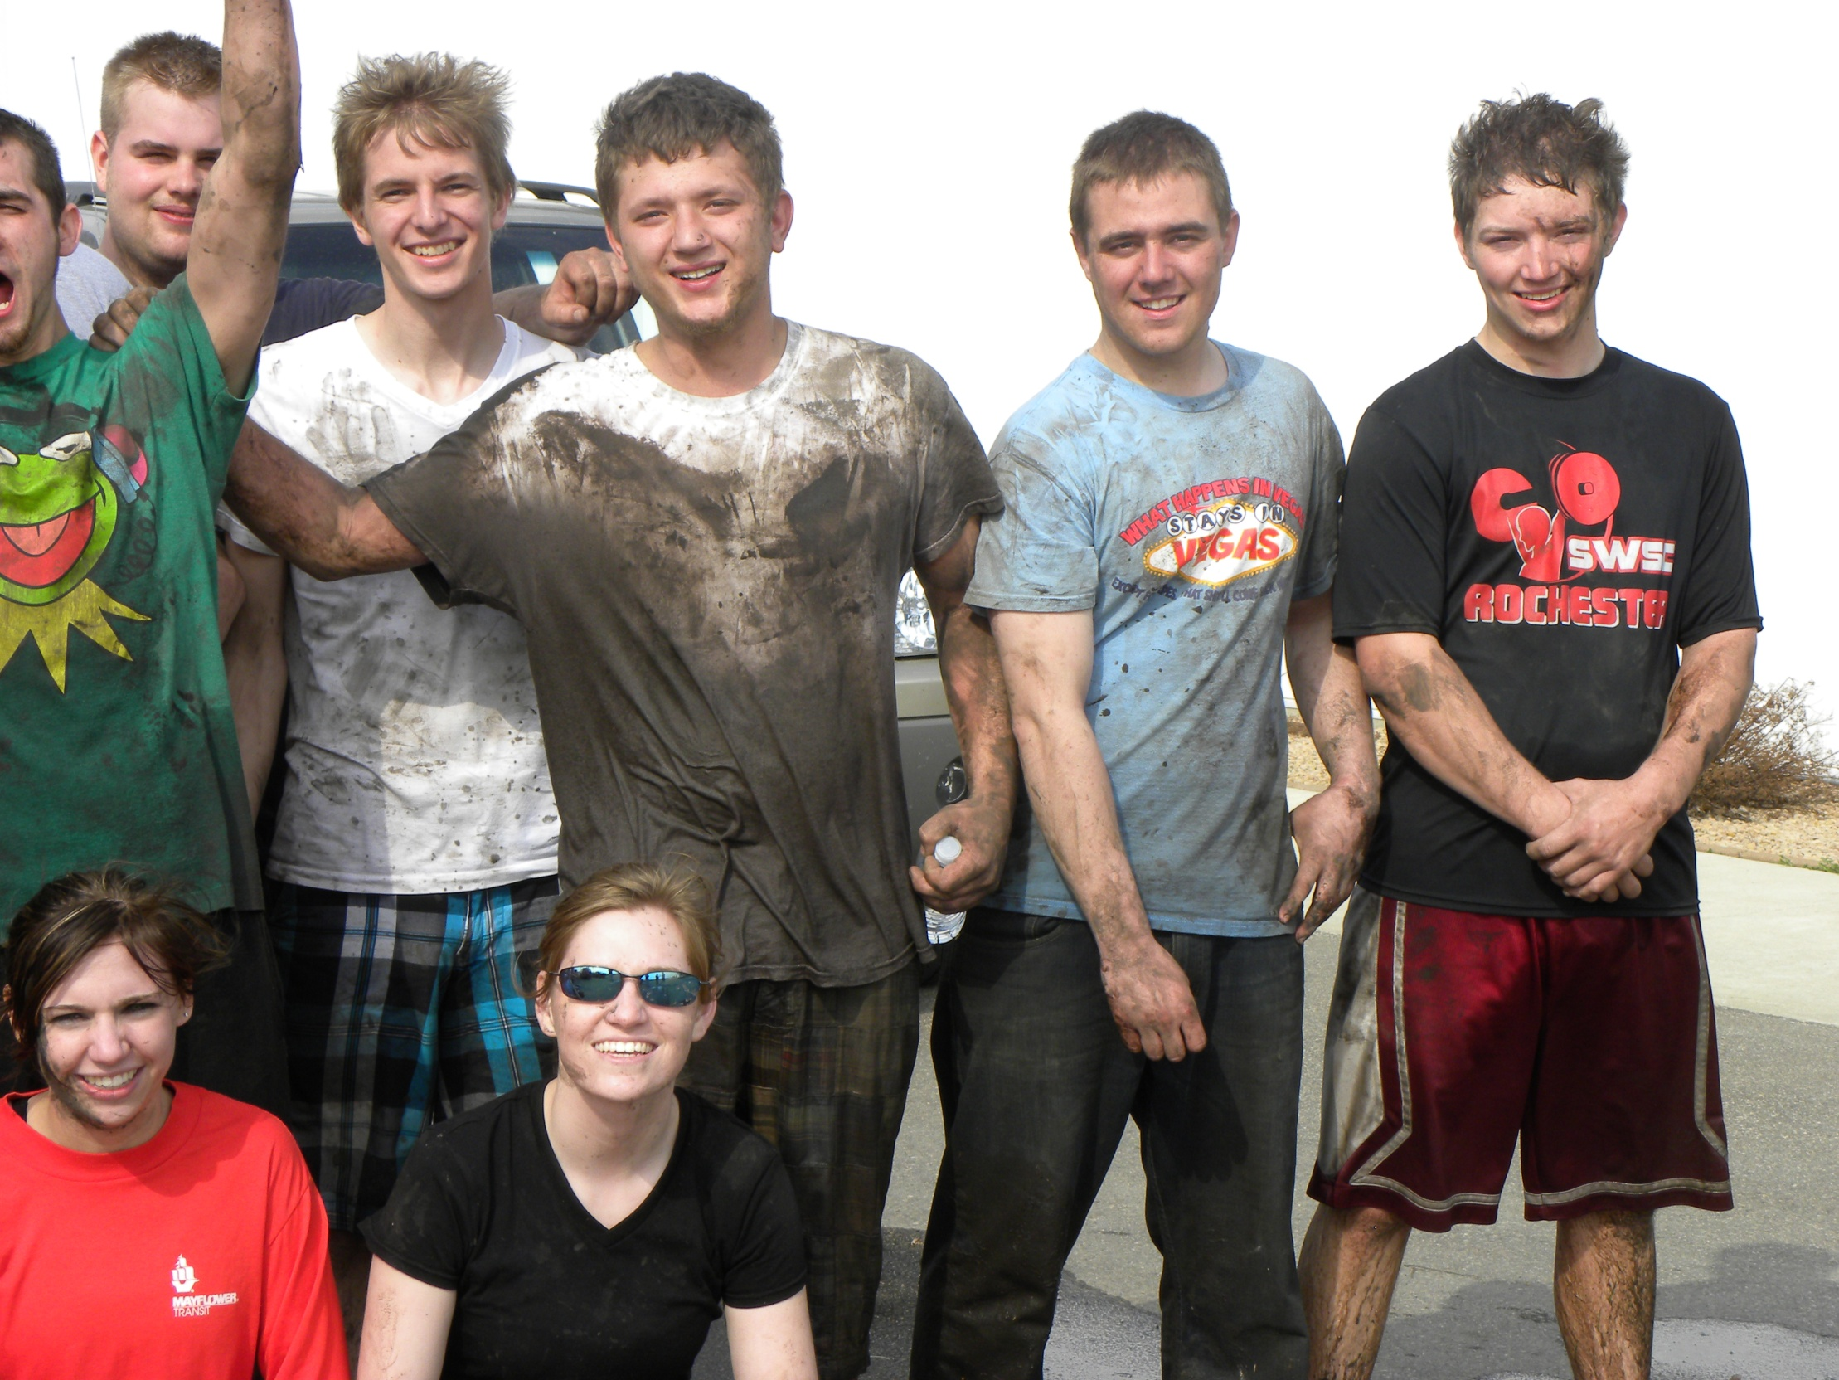

Slide 9
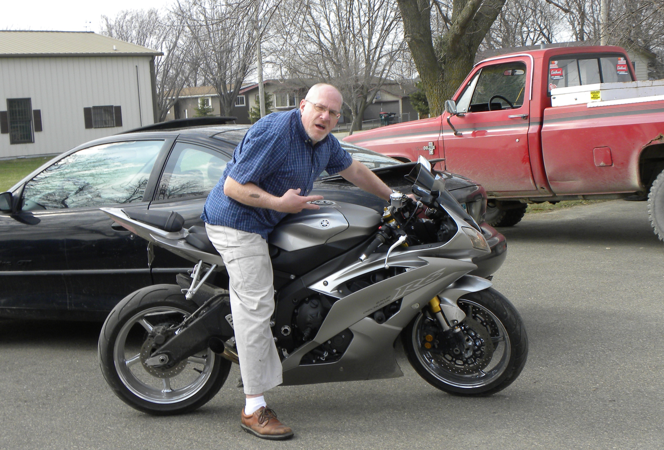

Slide 11
Resurrection Revelation

Slide 12
I. Unveiled Presence

Slide 13
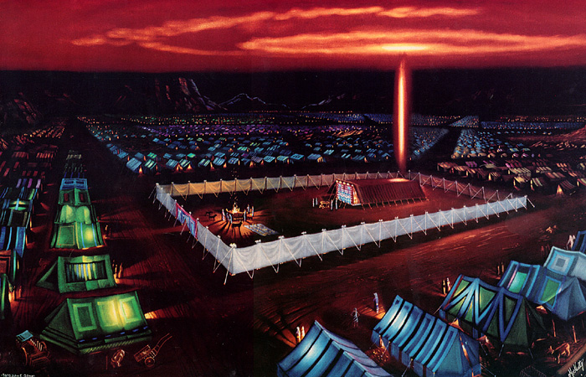

Slide 14
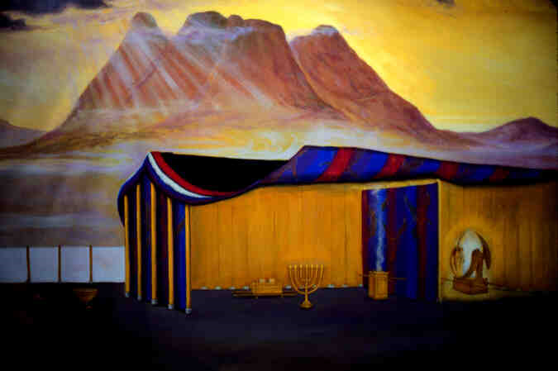
Exodus 26:31-35 – Tabernacle Veil

Slide 15
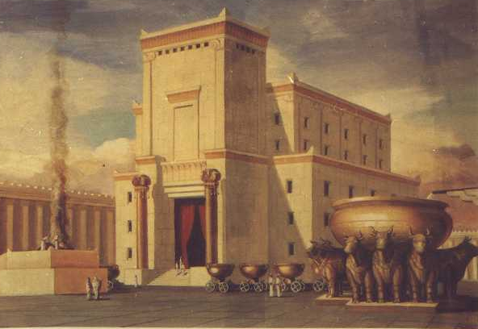

Slide 16
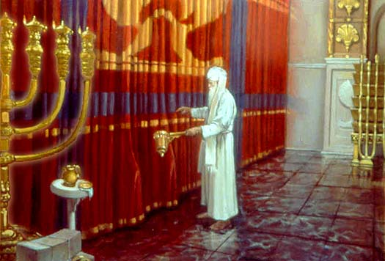
2 Chronicles 3:14 – Temple Veil

Slide 17
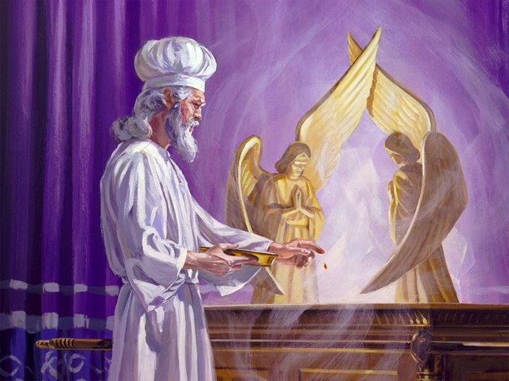
Hebrews 9:6-8 – High Priest’s offering for forgiveness

Slide 18
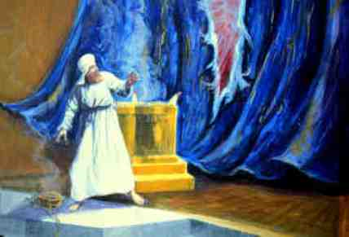
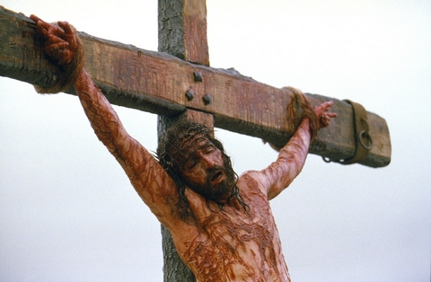
Matthew 27:50-52

Slide 19
Hebrews 9:11-12
Jesus entered heaven’s Most Holy Place
With his own blood
Securing our redemption
Hebrews 10:19-20
We can boldly enter heaven’s Most Holy Place

Slide 20
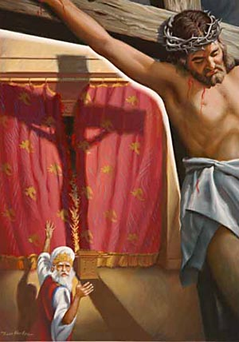
Jesus opened the way through the curtain (NASB - through the veil, that is, His flesh)
Go right into the presence of God

Slide 21
II. Unveiled Resurrection Revelation
Romans 1:1-4
Good news about God’s son
Shown to be God’s son when he raised from the dead
He is Jesus Christ our lord

Slide 22
1 Corinthians 15
Vs. 1-4 reminder of Good News
Vs. 12-19 – absurdities
Vs. 20-26 – new life in Christ
Vs. 35-38, 42-44 – how resurrection works

Slide 23
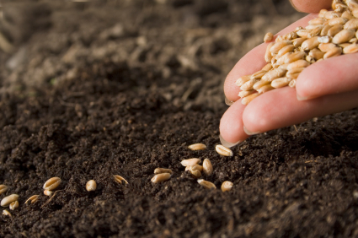

Slide 24
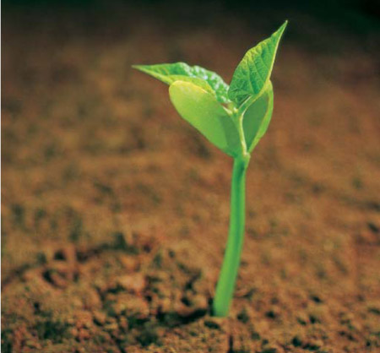

Slide 25
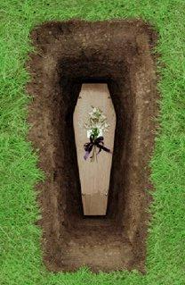

Slide 26
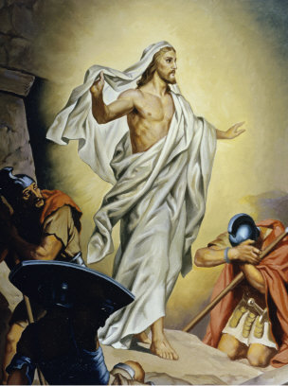
1 John 3:2 Dear friends, we are already God’s children, but he has not yet shown us what we will be like when Christ appears. But we do know that we will be like him, for we will see him as he really is.

Slide 27
Vs. 50-57 – victory over sin and death

Slide 28
III. Unveiled Future
1 Thessalonians 4:13-18
1 Peter 1:3-7

Slide 31
IV.

