Slide 2
Authority

Slide 3
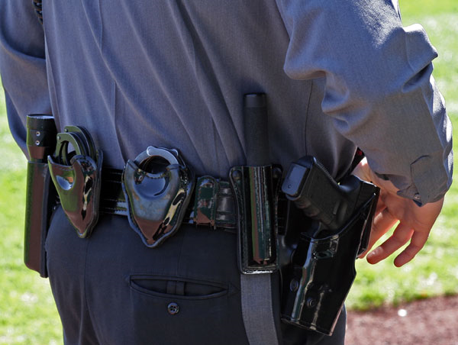
Power

Slide 4
Expanding Boundaries

Slide 5
I. Boundaries
There are both spiritual and physical boundaries
Spiritual – level of God’s reign that we submit to
Physical – geographic area we are given to serve

Slide 6
2 Corinthians 10:13-15
The boundaries of the work God has given us
Our area of authority
We hope your faith will grow so the boundaries of our work among you will be extended

Slide 7
2 Timothy 2:2 You have heard me teach things that have been confirmed by many reliable witnesses. Now teach these truths to other trustworthy people who will be able to pass them on to others.

Slide 8
Expanding Spiritual boundaries
Boundaries = capacities
Increasing faith/trust
God’s rule expanding

Slide 9
Expanding physical boundaries
Ministry in Dodge Center and surrounding area
Boundaries expanding
Advancing the Kingdom of God – the physical and spiritual boundaries/capacities increasing

Slide 10
Expectation of expansion Hebrews 5:11-14
Much more to explain
Spiritually dull and don’t seem to listen
You ought to be teaching others
You need someone to teach you basics
Like babies, not mature

Slide 11
Video Illustration – “Preacher Beeper”

Slide 12
Better things – Hebrews 6:9-12
We don’t believe this applies to you
Meant for better things that come with salvation
Show your love for God by caring for other believers
Then you will not become spiritually dull
Inherit God’s promises because of faith and endurance

Slide 13
Acknowledging other’s boundaries
Don’t trespass
Acknowledge authority and God’s grace
Don’t make judgments - NEI

Slide 14
II. Guarding Against Lost Ground
Colossians 1:13 For he has rescued us from the kingdom (NASB – domain) of darkness and transferred us into the Kingdom of his dear Son,

Slide 15
Ephesians 4:20-27
Throw off the sinful nature
Put on your new nature
Don’t let anger control you

Slide 16
Controlled by anger gives a foothold to the devil

Slide 17
John 10:10 The thief comes to steal, kill, and destroy…
1 Peter 5:8-9
The devil is looking for someone to destroy
Stand firm against him and be strong in your faith

Slide 18
III. Response
Self Examination
For spiritual dullness
For footholds/strongholds of the devil
How are my boundaries expanding?
Personal growth
Teaching/mentoring others
Caring for other believers
Reaching out to non-believers
Opportunities abound at PFC

Slide 20
IV.

