Slide 2
Your Field of Assignment

Slide 3
I. God Has a Plan
Isaiah 25:1 O LORD, I will honor and praise your name, for you are my God. You do such wonderful things! You planned them long ago, and now you have accomplished them.
Psalms 33:11 But the LORD’s plans stand firm forever; his intentions can never be shaken.
Psalms 139:16 You saw me before I was born. Every day of my life was recorded in your book. Every moment was laid out before a single day had passed.

Slide 4
Our plans lining up with God’s
Proverbs 16:9 We can make our plans, but the LORD determines our steps.
Proverbs 16:3 Commit your actions to the LORD, and your plans will succeed.

Slide 5
II. God’s Assignments
2 Corinthians 10:13-17
2 Corinthians 10:13 (NIV) – “We, however, will not boast beyond proper limits, but will confine our boasting to the field God has assigned to us, a field that reaches even to you.”
2 Corinthians 10:13 (NASB) ¹³But we will not boast beyond our measure, but within the measure of the sphere which God apportioned to us as a measure, to reach even as far as you.

Slide 6
The work God has given us
Field of assignment
Sphere apportioned to us
Boundaries
Area of authority

Slide 7
Areas of Jurisdiction
Jurisdiction defined – (Webster’s) – the power, right, or authority to interpret and apply the law; the authority of a sovereign power to govern or legislate; the limits or territory within which authority may be exercised
Application of Areas of Jurisdiction – the God-given grace, enabling a person to function within a limited level of God-given authority in the area of their gifting and anointing. It is the ability to receive, interpret, and discern God-given wisdom, revelation and insight in line with the gift of grace given

Slide 8
Authority and Power – the difference
Authority – delegated
Power – ability to exercise authority

Slide 9
Authority

Slide 10
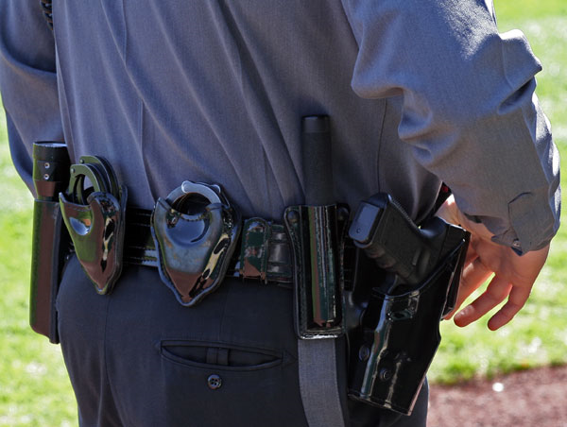
Power

Slide 11
Matthew 28:18 - 19 ¹⁸Jesus came and told his disciples, “I have been given all authority in heaven and on earth. ¹⁹Therefore, go and make disciples of all the nations…

Slide 12
Luke 24:49 ⁴⁹“And now I will send the Holy Spirit, just as my Father promised. But stay here in the city until the Holy Spirit comes and fills you with power from heaven.”

Slide 13
Examples of field of assignment
Ephesians 3:7-8
By God’s grace
Telling the Gentiles the good news
Colossians 1:25
Responsibility of serving his church
Proclaiming his entire message
1 Corinthians 3:10
Because of God’s grace
I have laid the foundation

Slide 14
Our own field of assignment/areas of jurisdiction
1 Peter 4:10
Each has received a special gift
From his variety of spiritual gifts
Use them to serve one another
NASB – as good stewards of the manifold grace of God

Slide 15
Characteristics of Assignment/Jurisdiction
Authority – delegated responsibility from God
Power – the enabling gifts of God’s grace
Desire, ambition
Energy
Confidence and competence

Slide 16
Desire, Ambition
Psalms 37:4 Delight yourself in the LORD; And He will give you the desires of your heart.
Romans 15:20 My ambition has always been to preach the Good News where the name of Christ has never been heard, rather than where a church has already been started by someone else.

Slide 17
Energy
1 Corinthians 15:10 But whatever I am now, it is all because God poured out his special favor on me—and not without results. For I have worked harder than any of the other apostles; yet it was not I but God who was working through me by his grace.
Colossians 1:29 That’s why I work and struggle so hard, depending on Christ’s mighty power that works within me.
1 Peter 4:11 …Do you have the gift of helping others? Do it with all the strength and energy that God supplies…

Slide 18
Confidence and Competence
2 Corinthians 3:4 - 6 ⁴Such confidence we have through Christ toward God. ⁵Not that we are adequate in ourselves to consider anything as coming from ourselves, but our adequacy is from God, ⁶who also made us adequate as servants of a new covenant, not of the letter but of the Spirit; for the letter kills, but the Spirit gives life.

Slide 19
III. Our Response

Slide 20
We will give an account
2 Corinthians 5:10 For we must all appear before the judgment seat of Christ, so that each one may be recompensed for his deeds in the body, according to what he has done, whether good or bad.
Matthew 25 – parable of the talents
Well done good and faithful slave
Wicked lazy slave

Slide 21
Walking in God’s plan for your life
Reaching your potential as a member of his body – what is your gift of grace and are you employing it?

Slide 23
IV.

