Slide 1
Reaching (Y)our Potential – Review/Conclusion
Colossians 1:28-29 (NASB) ²⁸ We proclaim Him, admonishing every man and teaching every man with all wisdom, so that we may present every man complete in Christ.
Philippians 1:6 (AMP) ⁶ And I am convinced and sure of this very thing, that He Who began a good work in you will continue until the day of Jesus Christ [right up to the time of His return], developing [that good work] and perfecting and bringing it to full completion in you.

Slide 2
Guarding Against Vulnerabilities
  Like a city without walls
Spiritual Vitality
  Personal spiritual practices
  Faith in action
  Church’s role
Dealing With the Enemy
  Roaring Lion, disguised angel of light
  spiritual/psychological warfare

Slide 3
The Process of Completion
  God effectually at work in you
  Energizing you
  Giving you the power
  Giving you the desire
  YIELD! and COOPERATE!
Conceit or Contrite
  Conceit – complacent – captivity
  Contrite – commitment – compassion

Slide 4


Slide 5
God Speaks
Reaching (Y)our Potential

Slide 6
I. God Speaks
2 Peter 1:19-21
  Prophets moved by the Holy Spirit spoke from God
  No prophecy in scripture is the result of human initiative
  Pay attention to what they wrote

Slide 7
Hebrews 1:1-4
  God spoke through prophets
  God speaks through his Son
  Through the Son he created the Universe
  He sustains everything by the mighty power of his command (NASB – by the word of his power)
2 Peter 3:15-16
  Paul wrote with the wisdom God gave him
  Paul’s writings equated with other scripture
  Ignorant and unstable twist the scriptures – resulting in destruction

Slide 8
Holy Spirit given to teach truth
  John 16:13 (NLT) ¹³ When the Spirit of truth comes, he will guide you into all truth. He will not speak on his own but will tell you what he has heard. He will tell you about the future.
  1 John 2:27 (NLT) ²⁷ But you have received the Holy Spirit, and he lives within you, so you don’t need anyone to teach you what is true. For the Spirit teaches you everything you need to know, and what he teaches is true—it is not a lie. So just as he has taught you, remain in fellowship with Christ.

Slide 9
II. Embedding the Word

Slide 10
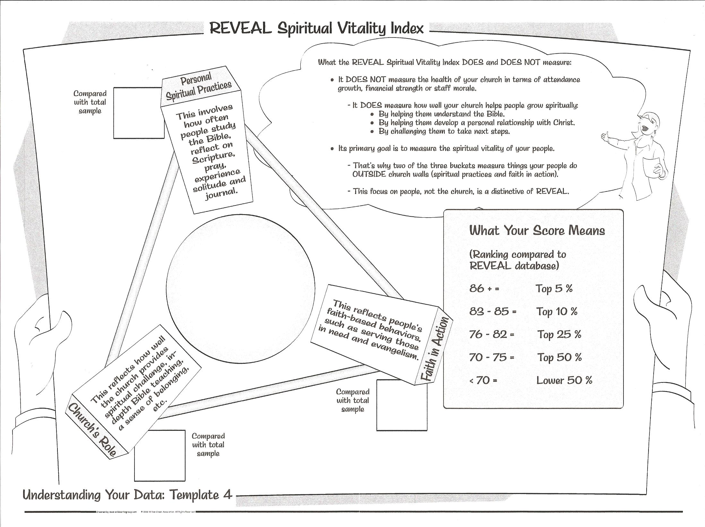
74

Slide 11
Personal Spiritual Practices

Slide 12
Church’s Role

Slide 13
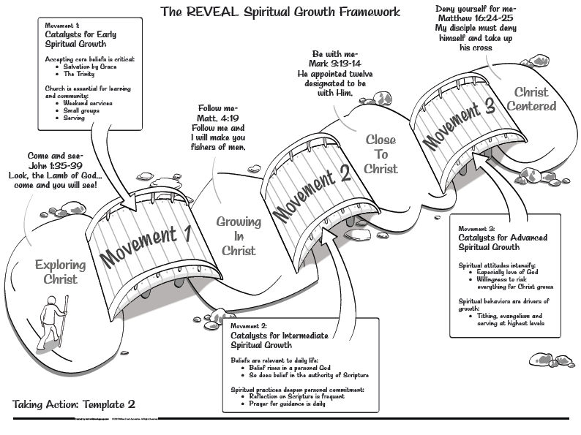

Slide 15
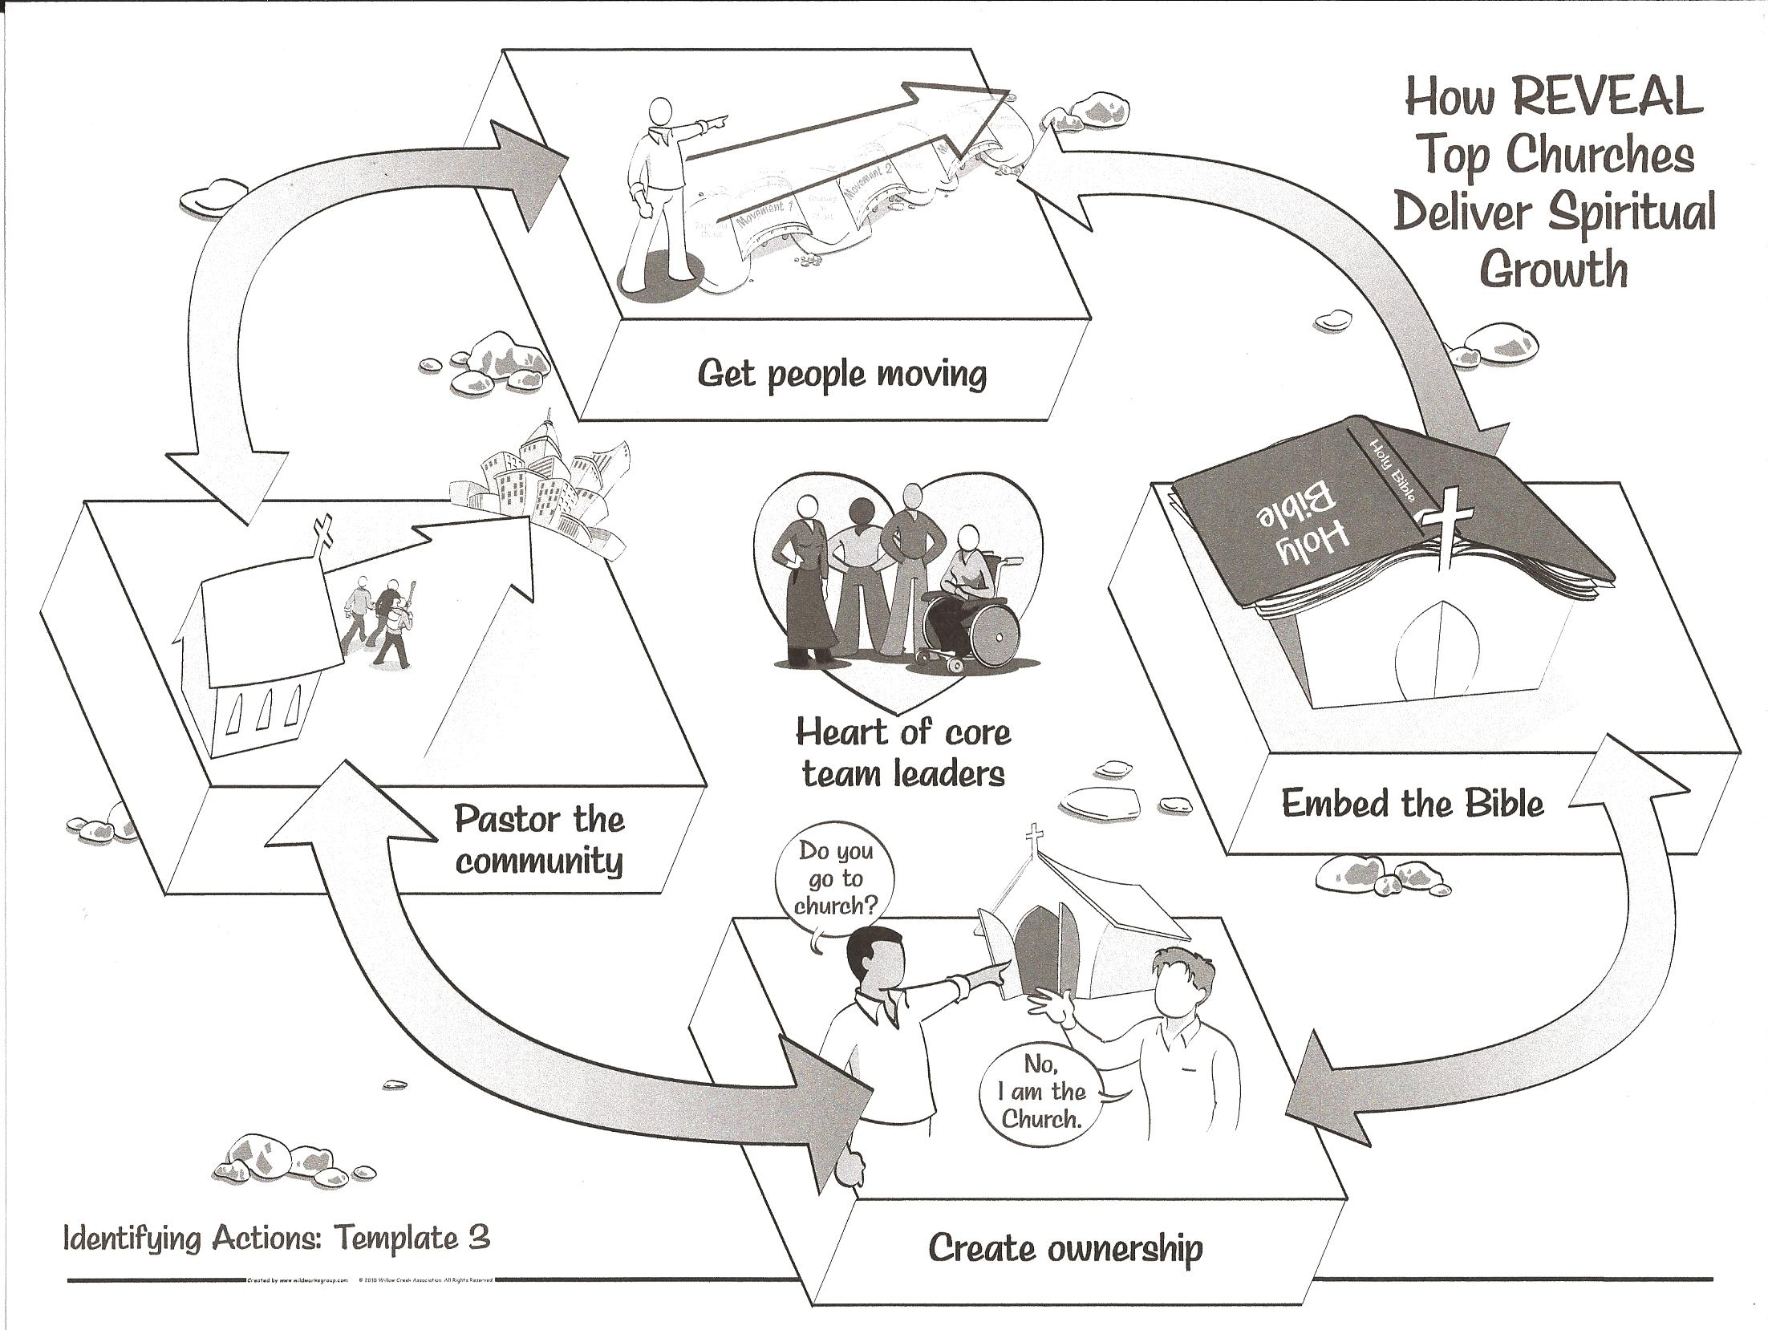

Slide 18


  DST – unpack the kit

Slide 20


Slide 21


Slide 22


Slide 23


Slide 24



Slide 26
How we will distribute
  Family and Single packs for people that are regularly participating at PFC
  Let you know what the retail value would be
  Let you know what our cost is
  Determine to receive it as a gift as a regular participant at PFC
  Help defray the costs with a contribution

Slide 27
Family _______________________________________
Item | retail cost per unit | PFC cost per unit | Quantity | Total
The Story - Adult Edition | $ 20.00 | $ 5.00 | 2 | $ 10.00
The Story - Teen Edition | $ 15.00 | $ 7.50 | 2 | $ 15.00
The Story - For Kids | $ 10.00 | $ 5.00 | 1 | $ 5.00
The Story - For Children | $ 20.00 | $10.00 | 1 | $ 10.00
The Story - For Little Ones | $ 18.00 | $ 9.00 | 0 | $ -
 |  |  | Total Package | $ 40.00

Slide 28
Extras available for purchase at PFC 50% cost
  Non participating family members
  Christmas Gifts
  New people coming in for the adventure

Slide 29
III. The Living Word
Hebrews 4:12
  The Word of God is alive and powerful
  Sharper than a two-edged sword
  Exposes innermost thoughts and desires
2 Timothy 3:16-17
  Scripture is inspired by God
  Teaches us what is true
  Corrects us when we are wrong
  Equips us to do every good work

