Slide 2
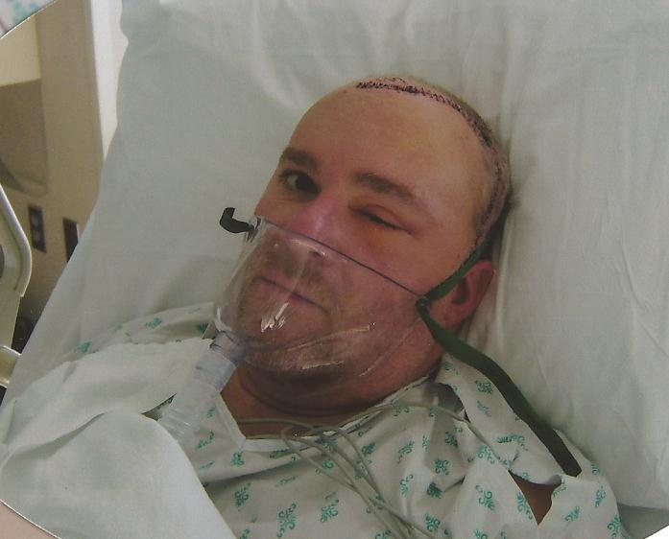

Slide 3
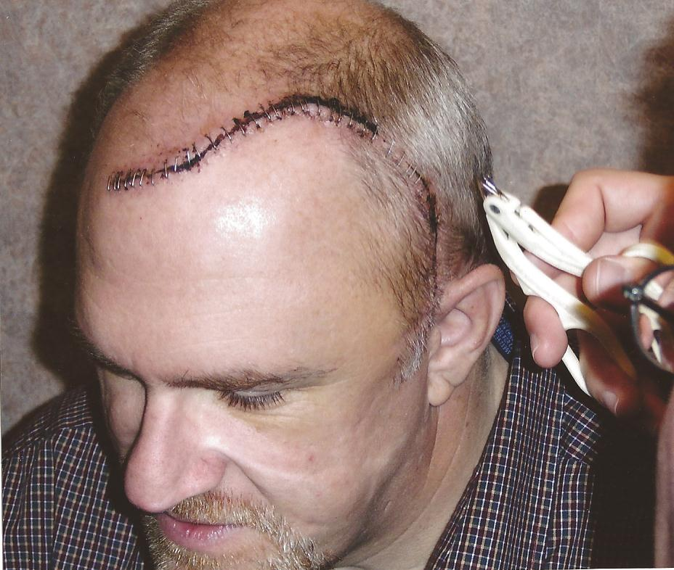

Slide 5
Conceited or Contrite
Reaching (Y)our Potential

Slide 6
Conceit
Complacent
Captivity

Slide 7
Contrition
Commitment
Compassion

Slide 8
Israel’s History reviewed – Nehemiah 8-10

Slide 9
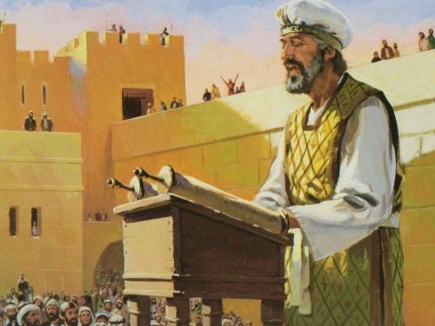

Slide 10
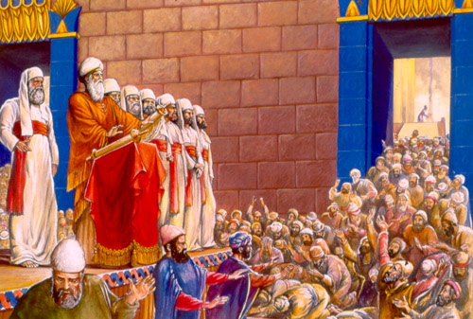

Slide 11
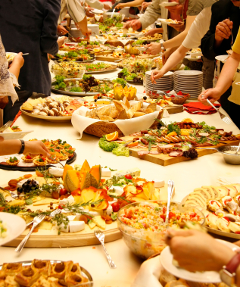

Slide 12
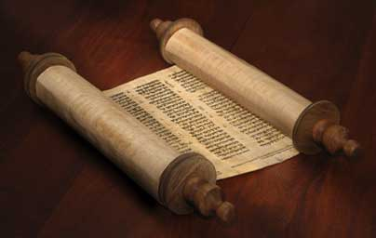

Slide 13
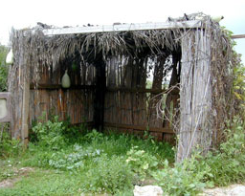

Slide 15
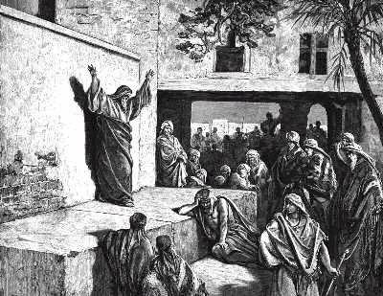

Slide 17
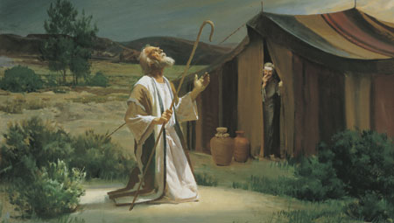

Slide 18
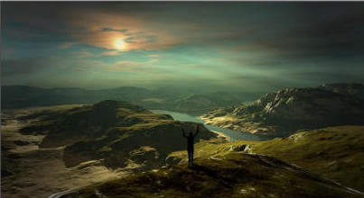

Slide 19
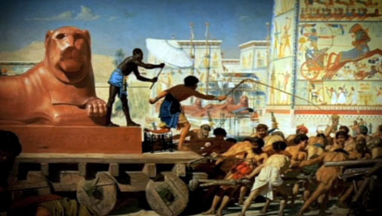

Slide 20
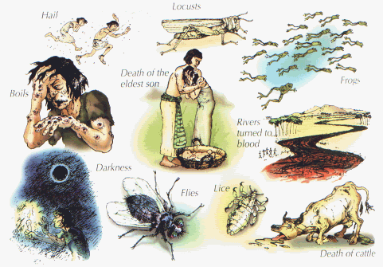

Slide 21
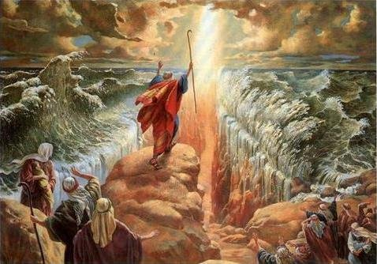

Slide 22
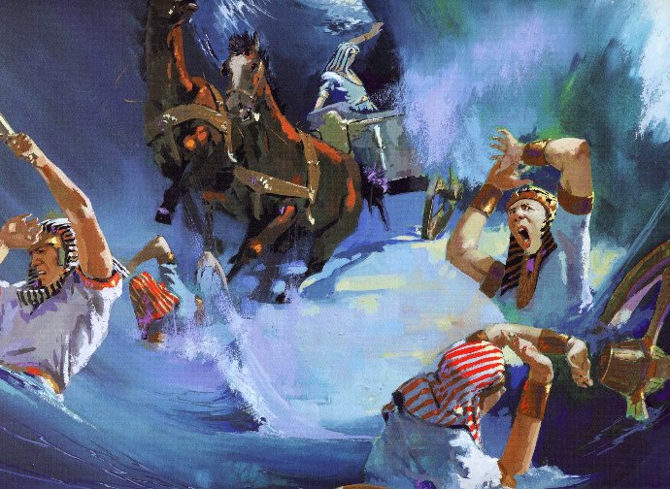

Slide 23
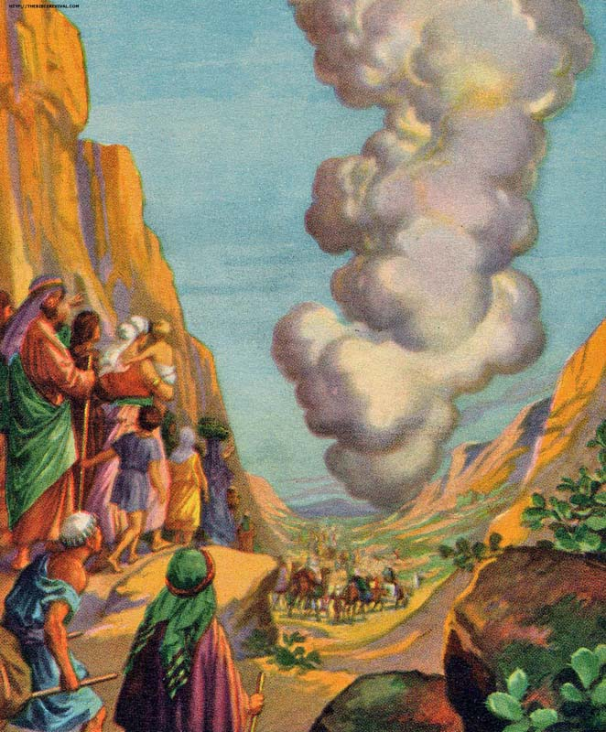
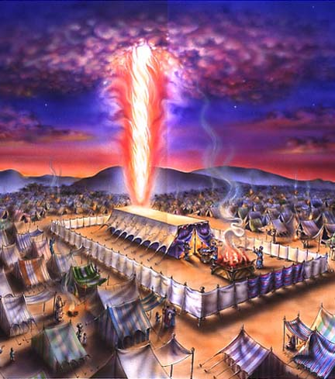

Slide 24
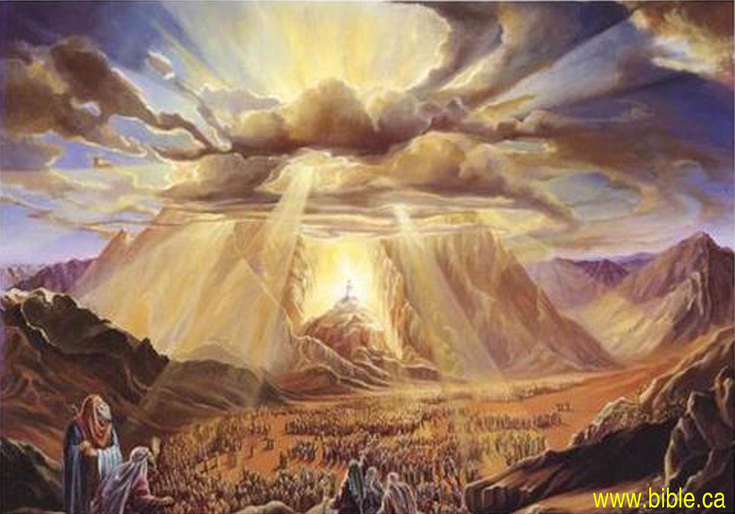

Slide 25
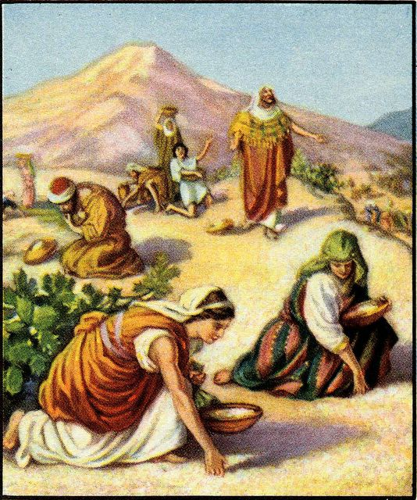
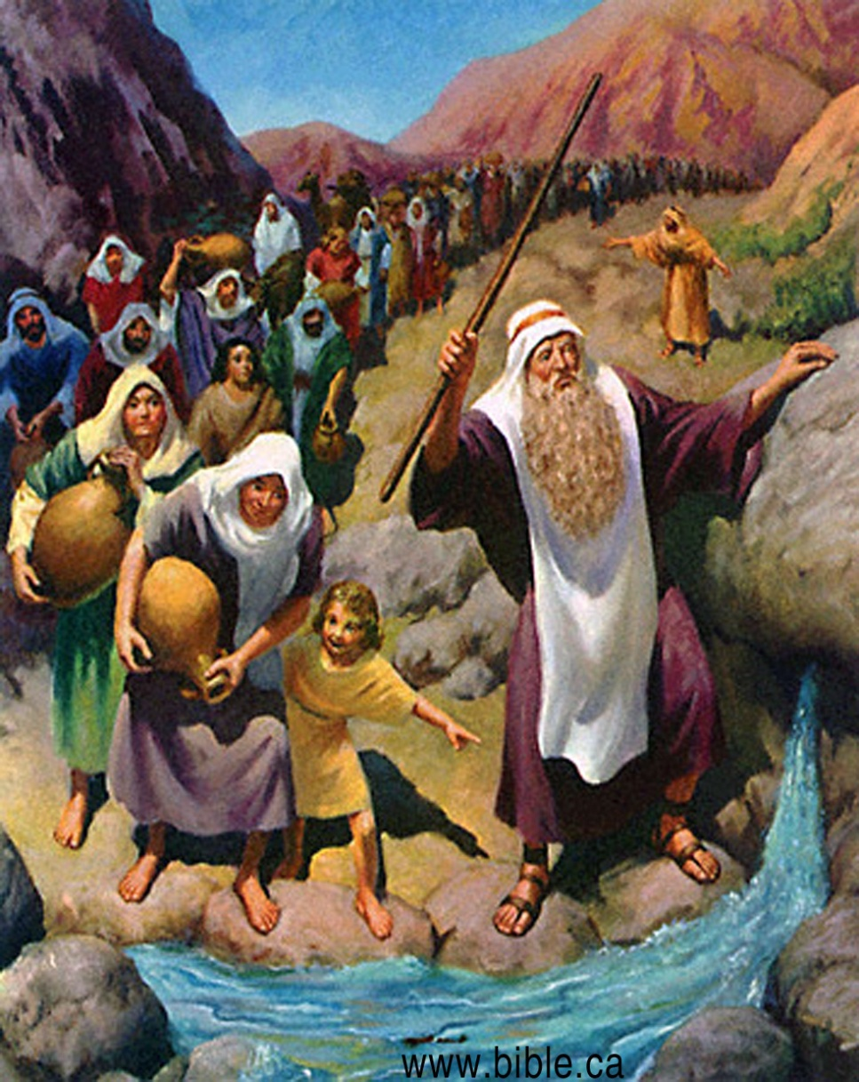

Slide 26
Conceit
Complacent
Captivity

Slide 27
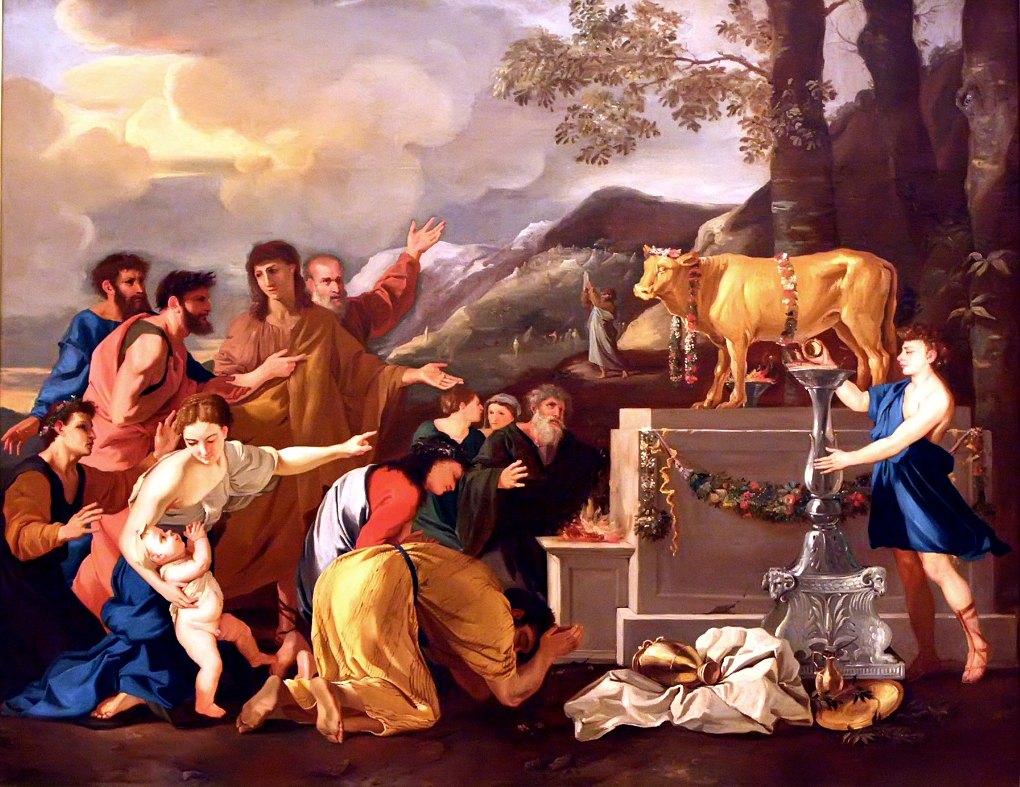

Slide 29
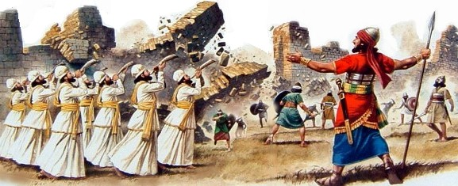

Slide 30
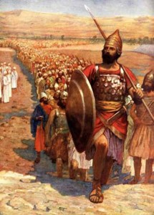

Slide 31
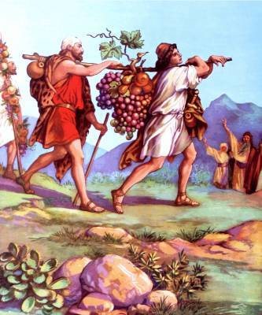

Slide 32
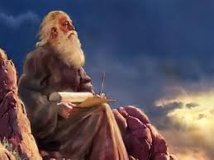

Slide 33
Conceit
Complacent
Captivity

Slide 34
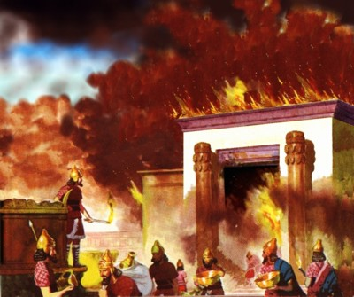

Slide 35
Contrition
Commitment
Compassion

Slide 36
Conceit
Complacent
Captivity

Slide 37
Contrition
Commitment
Compassion

Slide 38
Conceit
Complacent
Captivity

Slide 40
Contrition
Commitment
Compassion

Slide 41
Conceit
Complacent
Captivity

Slide 42
Contrition
Commitment
Compassion

Slide 43
Romans 11:20-22 (NASB) ²⁰ Quite right, they were broken off for their unbelief, but you stand by your faith. Do not be conceited, but fear; ²¹ for if God did not spare the natural branches, He will not spare you, either. ²² Behold then the kindness and severity of God; to those who fell, severity, but to you, God's kindness, if you continue in His kindness; otherwise you also will be cut off.

Slide 44
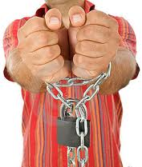
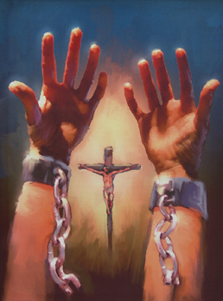

Slide 45
Isaiah 57:15 (NLT) ¹⁵ The high and lofty one who lives in eternity, the Holy One, says this: “I live in the high and holy place with those whose spirits are contrite and humble. I restore the crushed spirit of the humble and revive the courage of those with repentant hearts.

Slide 46
Isaiah 66:2 (NLT) ² My hands have made both heaven and earth; they and everything in them are mine. I, the LORD, have spoken! “I will bless those who have humble and contrite hearts, who tremble at my word.

Slide 47
For the Conceit of the Complacent the answer is Contrition and Commitment

Slide 50
II.

Slide 52
III.

