Slide 1
Reaching (Y)our Potential
Philippians 1:6 (AMP) ⁶ And I am convinced and sure of this very thing, that He Who began a good work in you will continue until the day of Jesus Christ [right up to the time of His return], developing [that good work] and perfecting and bringing it to full completion in you.
Colossians 1:28-29 (NASB) ²⁸ We proclaim Him, admonishing every man and teaching every man with all wisdom, so that we may present every man complete in Christ. ²⁹ For this purpose also I labor, striving according to His power, which mightily works within me.

Slide 2
The Process of Completion
Reaching (Y)our Potential

Slide 3
I. Catalytic Practices
Nehemiah 6:15-16
This work had been done
With the help of God
Nehemiah 2:17-18 – the motivating force
End the disgrace
The favor of God

Slide 4
The help of God - Philippians 2:12-13 (AMP) ¹² Therefore, my dear ones, as you have always obeyed [my suggestions], so now, not only [with the enthusiasm you would show] in my presence but much more because I am absent, work out (cultivate, carry out to the goal, and fully complete) your own salvation with reverence and awe and trembling (self-distrust, with serious caution, tenderness of conscience, watchfulness against temptation, timidly shrinking from whatever might offend God and discredit the name of Christ). ¹³ [Not in your own strength] for it is God Who is all the while effectually at work in you [energizing and creating in you the power and desire], both to will and to work for His good pleasure and satisfaction and delight.

Slide 5
God effectually at work in you
Energizing you
Giving you the power
Giving you the desire
To become fully complete

Slide 6
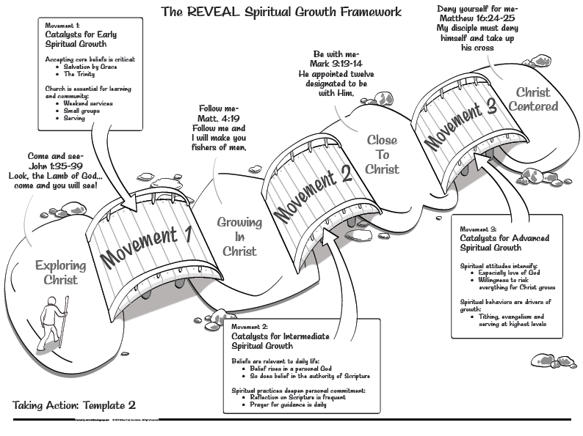

Slide 7
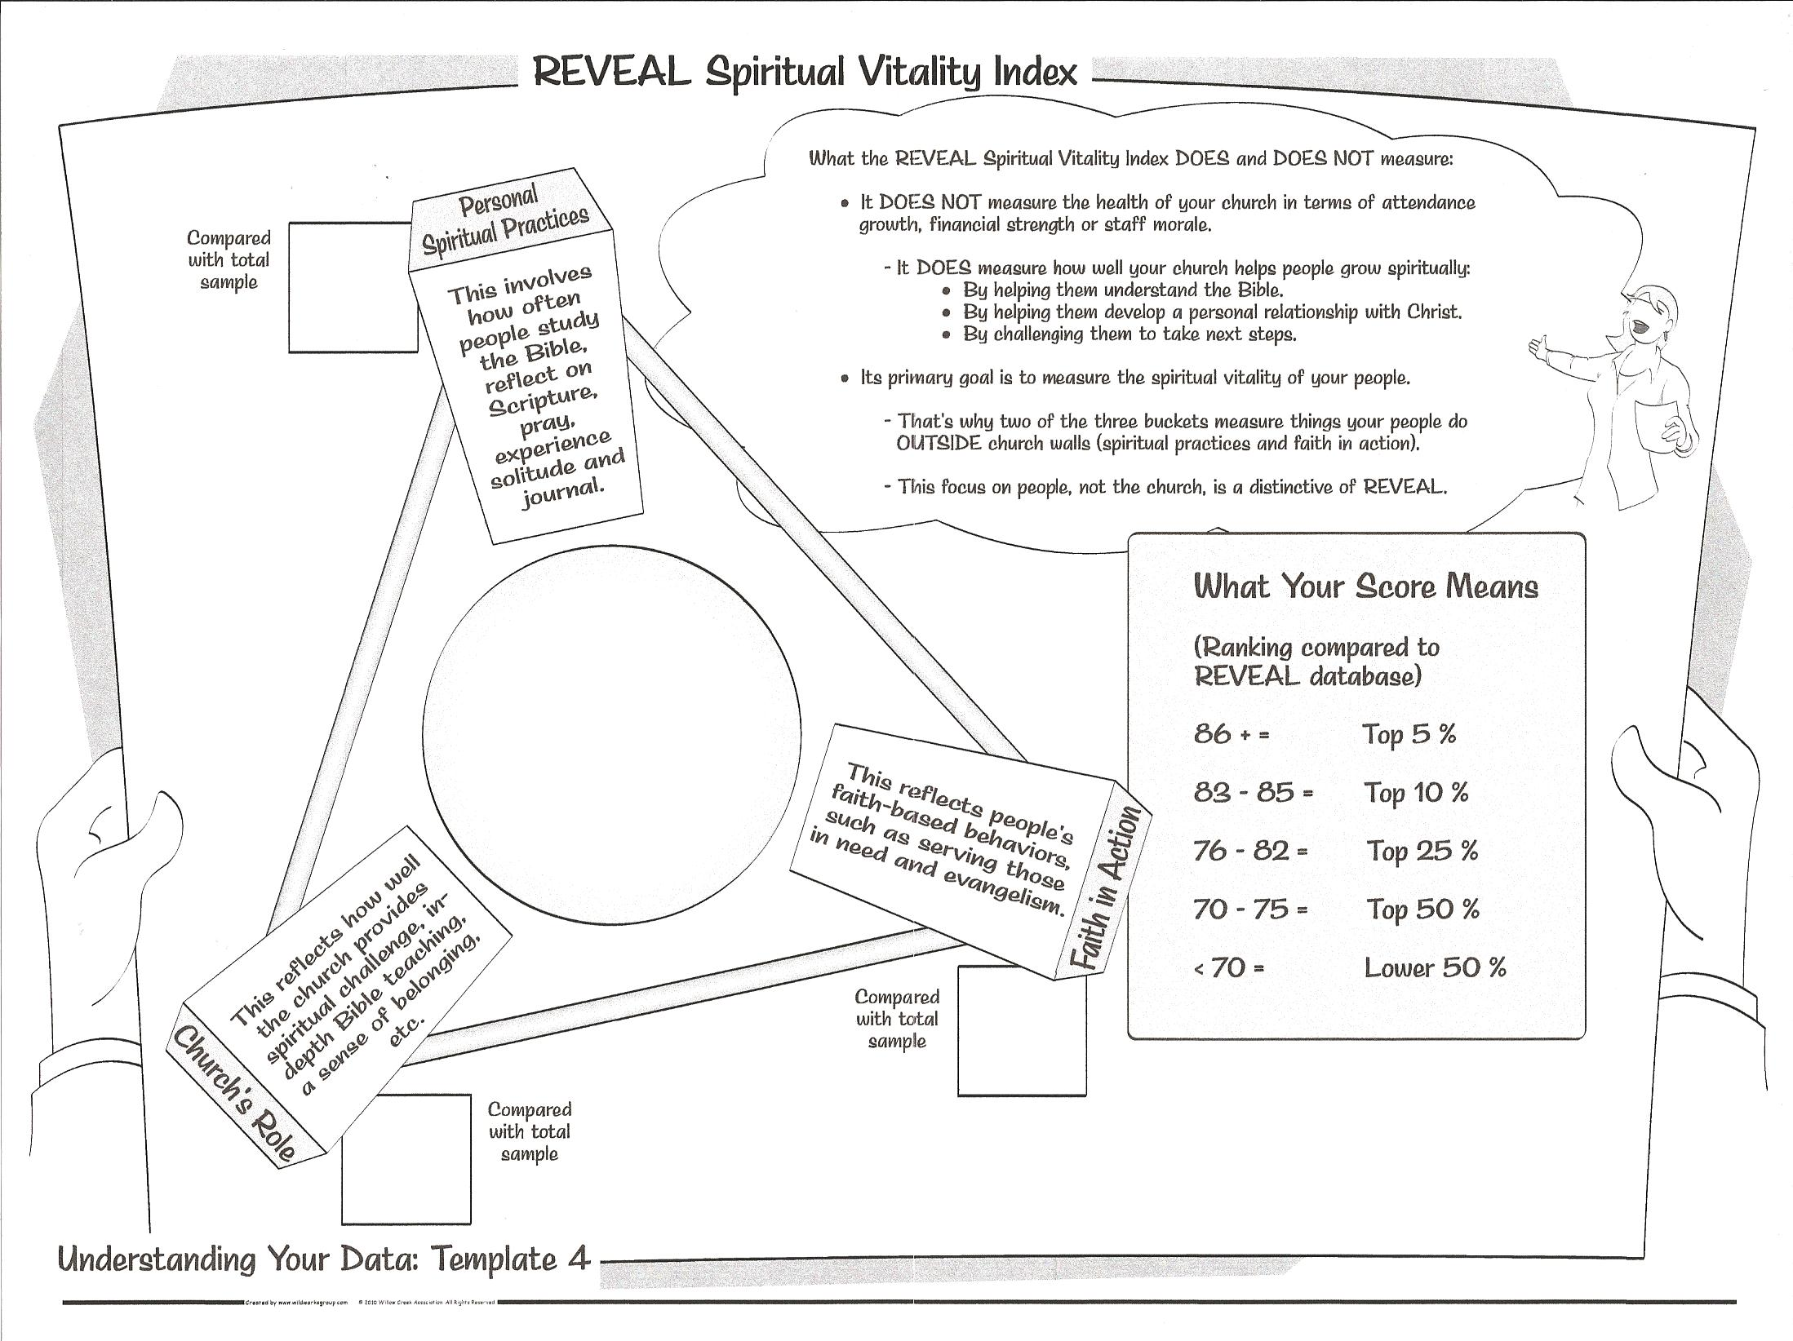
74

Slide 8
_
Personal Spiritual Practices

Slide 9
Church’s Role
_

Slide 10
Faith in Action
_

Slide 11
How REVEAL Top Churches Deliver Spiritual Growth – top 5%

Slide 12
74

Slide 14
II. Intentional Spiritual Growth

Slide 15
How would you describe your current pace of spiritual growth?
I am in a season of rapid spiritual growth
9%

Slide 16
How would you describe your current pace of spiritual growth?
I am growing at a moderate but not rapid rate
28%

Slide 17
How would you describe your current pace of spiritual growth?
I am growing at a slow but steady rate
28%

Slide 18
How would you describe your current pace of spiritual growth?
I am content with staying right where I am at
7%

Slide 19
How would you describe your current pace of spiritual growth?
I have stalled spiritually
28%

Slide 20
Have you ever had a time in your life that you have stalled spiritually
Yes
91%

Slide 21
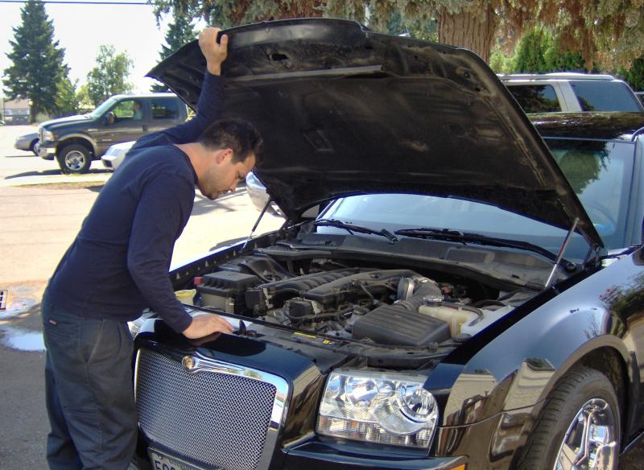

Slide 23
The reality gap – the difference between the IDEAL and the REAL and learning to DEAL
Ideal
Deal
Real

Slide 24
Which of the following reasons caused you to stall spiritually?
Lack of discipline in spiritual practices (e.g. not incorporating prayer and/or bible into life)
Letting other activities take precedence (e.g. too much TV, Internet)
Which factors were responsible for helping you move on from being stalled spiritually?
Connected with God in a powerful way through prayer, solitude, and/or scripture
Shared my struggles with a spiritual friend or mentor

Slide 25
Like Nehemiah – People doing the work with the help of God
God effectually at work in you
Energizing you
Giving you the power
Giving you the desire
YIELD! and COOPERATE!

Slide 26
The disgrace
Hebrews 5:12 (NLT) ¹² You have been believers so long now that you ought to be teaching others. Instead, you need someone to teach you again the basic things about God’s word. You are like babies who need milk and cannot eat solid food.

Slide 27
1 Corinthians 3:1-3 (NLT) ¹ Dear brothers and sisters, when I was with you I couldn’t talk to you as I would to spiritual people. I had to talk as though you belonged to this world or as though you were infants in the Christian life. ² I had to feed you with milk, not with solid food, because you weren’t ready for anything stronger. And you still aren’t ready, ³ for you are still controlled by your sinful nature. You are jealous of one another and quarrel with each other. Doesn’t that prove you are controlled by your sinful nature? Aren’t you living like people of the world?

Slide 28
As leadership – 1 Timothy 4:14-15
Don’t neglect the spiritual gift
Throw yourself into your tasks
Stay true to what is right

Slide 29
As members of the church – Romans 12:9-11
Keep your enthusiasm
12:11 (NLT) Never be lazy, but work hard and serve the Lord enthusiastically.
12:11 (NASB) not lagging behind in diligence, fervent in spirit, serving the Lord;
12:11 (NIV) Never be lacking in zeal, but keep your spiritual fervor, serving the Lord.

Slide 30
YIELD and COOPERATE
Engaged in the Word
Engaged in serving the Lord
Keeping your enthusiasm – your spiritual fervor

Slide 32
III.

