Slide 2
Dealing with the Enemy
Reaching (Y)our Potential

Slide 3
I. Opposing Your Purpose
Nehemiah’s Opposition
2:10 Sanballat and Tobiah displeased
Psychological Warfare
2:19-20 – they scoffed with contempt
4:1-2 Sanballat mocking
4:3 Tobiah’s condescension
4:7-8 Furious, plans to fight, confusion
4:11 Terrorist threats – kill them, end their work

Slide 4
Nehemiah’s Response
4:4-6 prayer and enthusiastic work
4:9 prayer and set up a guard

Slide 5
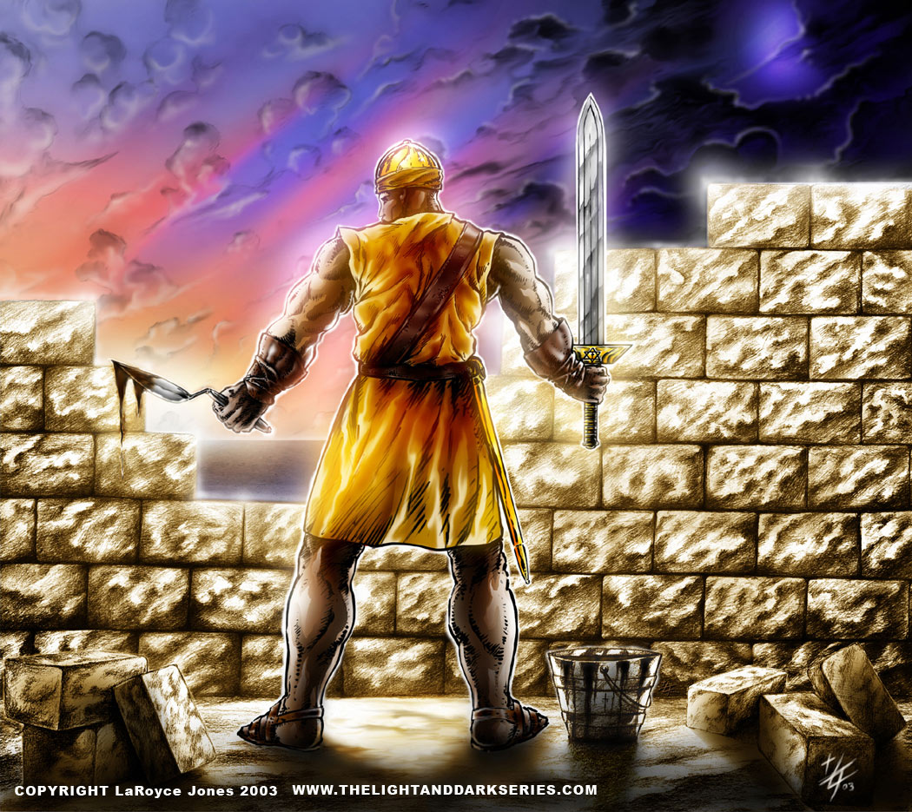
4:13 equip the people with arms

Slide 6
4:14 establish courage in the Lord
4:15 enemies plans frustrated

Slide 7
(Y)our Enemy Opposes (Y)our Purpose
Attaining Spiritual Maturity
Conformed to the image of Jesus
Transformed by renewing your mind
Competent ministers of the new covenant
Walking in a manner worthy of the calling with which you have been called
Ambassadors of Christ – God making his appeal through us

Slide 8
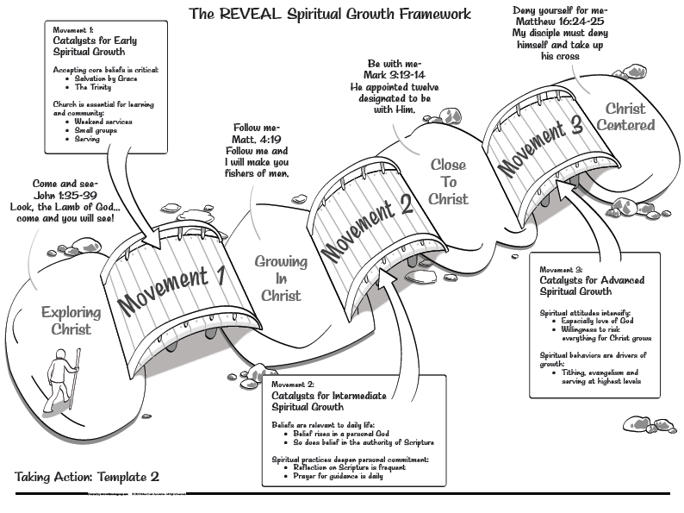
Good soil producing much fruit reaching your potential

Slide 9
II. How the Enemy Opposes You
Psychological/Spiritual Warfare

Slide 10
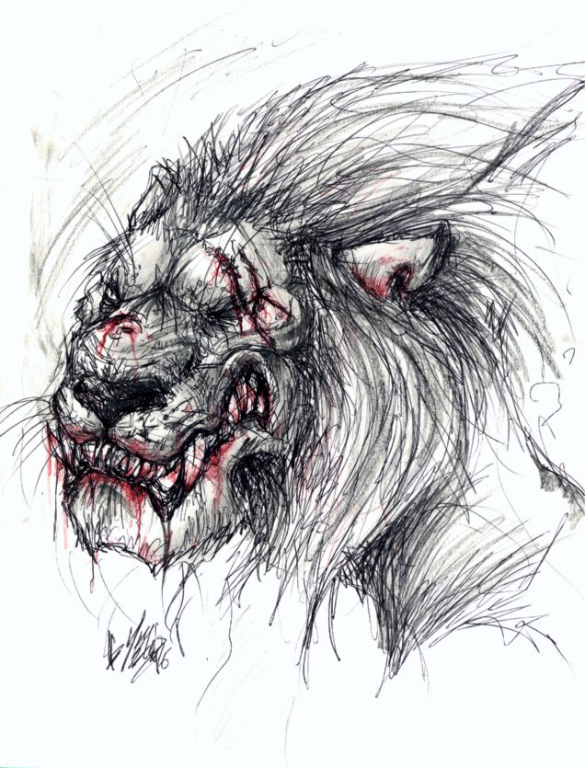
Roaring Lion - 1 Peter 5:8 (NLT) Stay alert! Watch out for your great enemy, the devil. He prowls around like a roaring lion, looking for someone to devour.

Slide 11
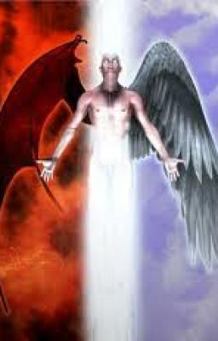
Disguised Angel of Light – 2 Corinthians 11:14 (NLT) ¹⁴ But I am not surprised! Even Satan disguises himself as an angel of light.

Slide 12
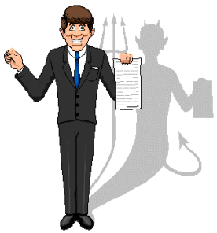
Schemes - 2 Corinthians 2:11 (NLT) ¹¹ so that Satan will not outsmart us. For we are familiar with his evil schemes.

Slide 13
Pursuing (Y)our Purpose
Consistent Spiritual Disciplines
True friendship
Meaningful conversations with unbelievers
Enemy’s warfare – Psychological/Spiritual
Mocking - What a waste of time … more important things for you to do
Condescension - You aren’t going to make any difference
Threats - You get more serious … I’m going to make trouble for you
Schemes - Your witness is cancelled out by your history

Slide 14
III. Standing Firm
2 Corinthians 10:4-5 (NASB) ⁴ for the weapons of our warfare are not of the flesh, but divinely powerful for the destruction of fortresses. ⁵ We are destroying speculations and every lofty thing raised up against the knowledge of God, and we are taking every thought captive to the obedience of Christ,

Slide 15
Roaring Lion - 1 Peter 5:8 (NLT) Stay alert! Watch out for your great enemy, the devil. He prowls around like a roaring lion, looking for someone to devour. ⁹ But resist him, firm in your faith,…
Stay alert
Resist him firm in your faith

Slide 16
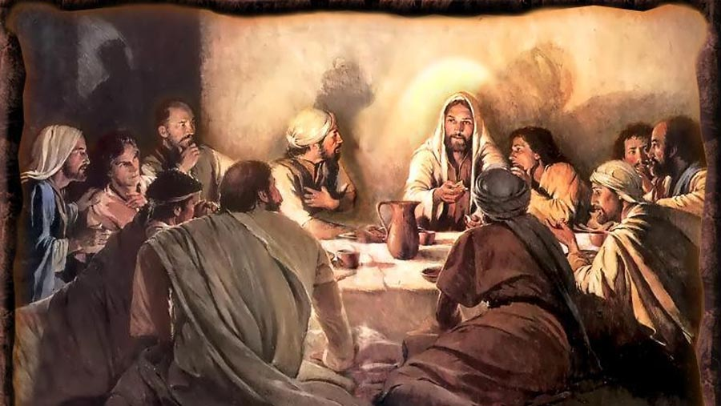
Matthew 26:41 (NLT) ⁴¹ Keep watch and pray, so that you will not give in to temptation. For the spirit is willing, but the body is weak!”

Slide 18
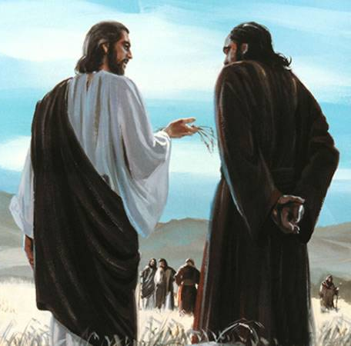
Luke 22:31-32 (NLT) ³¹ “Simon, Simon, Satan has asked to sift each of you like wheat. ³² But I have pleaded in prayer for you, Simon, that your faith should not fail. So when you have repented and turned to me again, strengthen your brothers.”

Slide 19
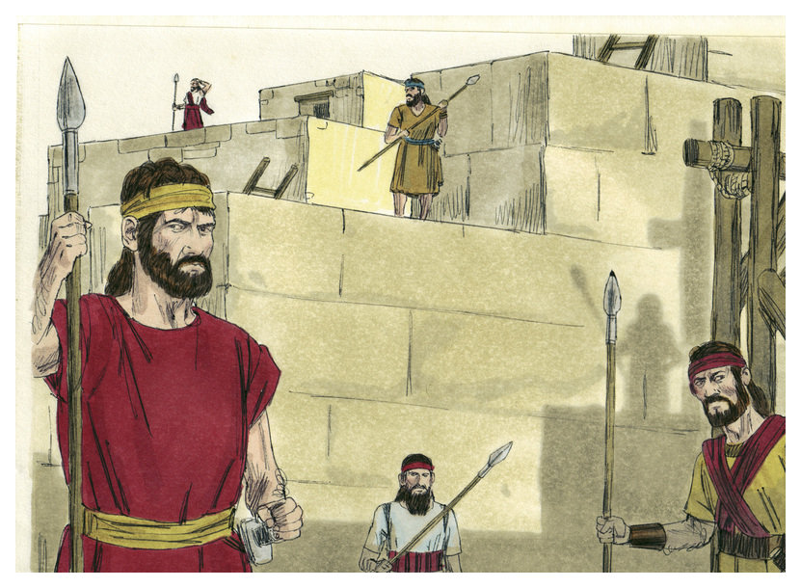
When you hear the blast of the trumpet, rush to wherever it is sounding – Nehemiah 4:20

Slide 20
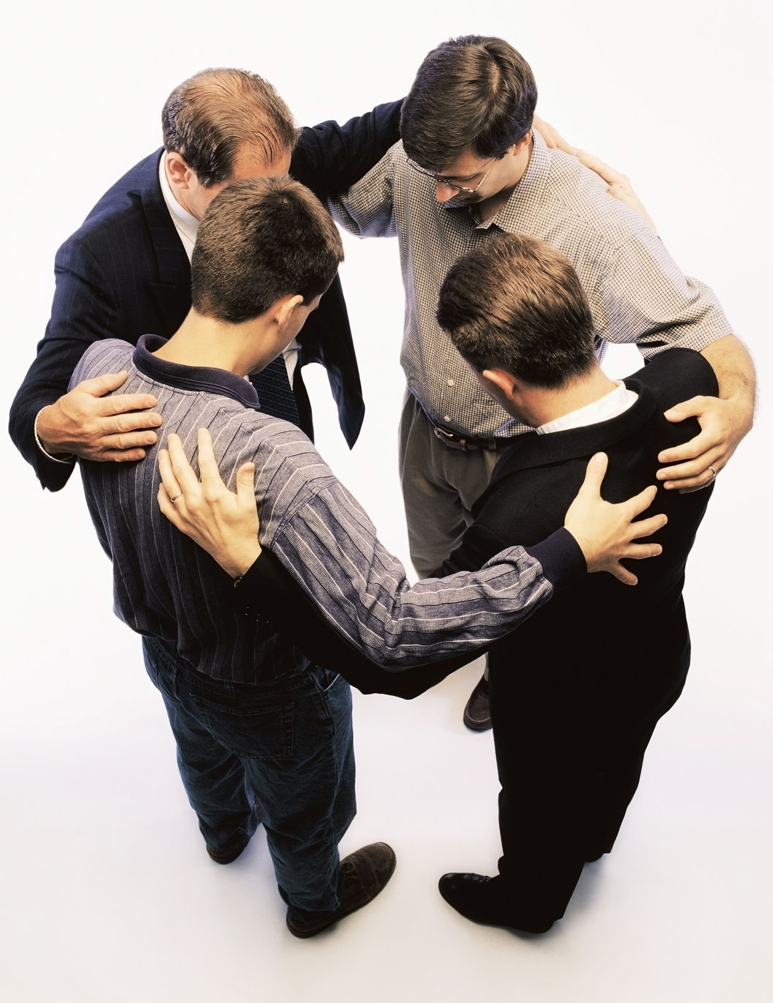
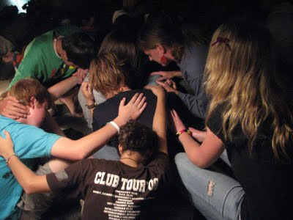
Pray for others that their faith not fail when being sifted by the enemy
Strengthen brothers and sisters

Slide 21
Turning it around on the enemy Nehemiah 6:15-16
The wall was finished
Enemies and surrounding nations frightened and humiliated
Realized the work was done with the help of God
James 4:7 (NLT) ⁷ So humble yourselves before God. Resist the devil, and he will flee from you.

Slide 23
Nehemiah exhibited many characteristics necessary for effective leadership. Donald K. Campbell lists 21 such factors (Nehemiah: Man in Charge, p. 23):
1. He established a reasonable and attainable goal.
2. He had a sense of mission.
3. He was willing to get involved.
4. He rearranged his priorities in order to accomplish his goal.
5. He patiently waited for God’s timing.
6. He showed respect to his superior.
7. He prayed at crucial times.
8. He made his request with tact and graciousness.
9. He was well prepared and thought of his needs in advance.
10. He went through proper channels.
11. He took time (three days) to rest, pray, and plan.
12. He investigated the situation firsthand.
13. He informed others only after he knew the size of the problem.
14. He identified himself as one with the people.
15. He set before them a reasonable and attainable goal.
16. He assured them God was in the project.
17. He displayed self-confidence in facing obstacles.
18. He displayed God’s confidence in facing obstacles.
19. He did not argue with opponents.
20. He was not discouraged by opposition.
21. He courageously used the authority of his position.

