Slide 2
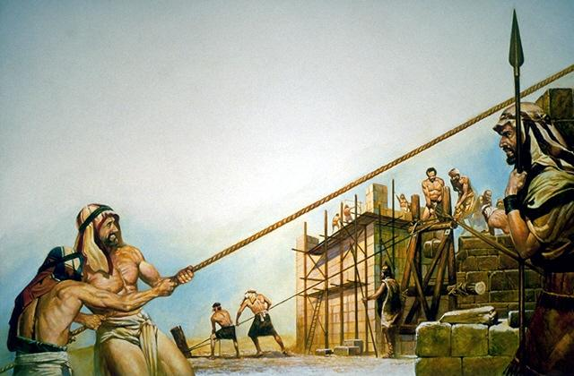
Building up the walls and gates around the city – Nehemiah 2:11-18

Slide 3
Spiritual Vitality
Reaching (Y)our Potential

Slide 4
I. Vitality
Defined - Vitality
Exuberant physical strength or mental vigor
Capacity for survival or for the continuation of a meaningful or purposeful existence
Power to live or grow
Vital force or principle

Slide 5
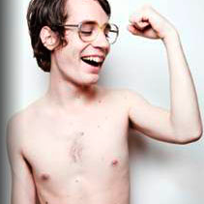

Slide 6
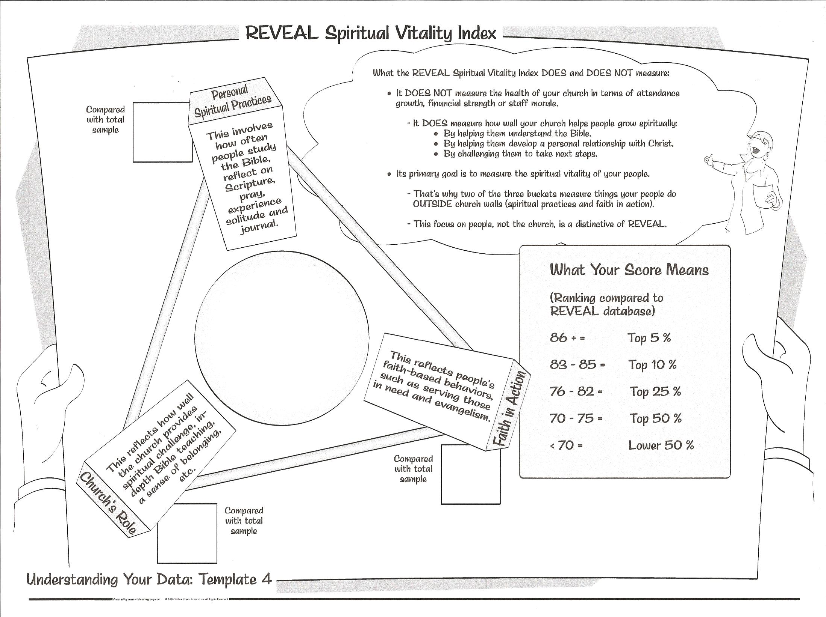

Slide 7
74

Slide 8
_
Personal Spiritual Practices: Observations
Your congregation’s personal spiritual practices are close to the average of the total sample. Key factors include how many read the Bible, pray and experience solitude on a daily basis. How many tithe, donating 10% or more to the church. Personal engagement with the Bible is a critical spiritual growth catalyst for all people regardless of spiritual maturity

Slide 9
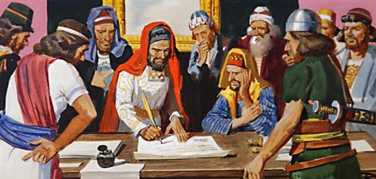
Nehemiah’s Dream and Steam Team

Slide 10
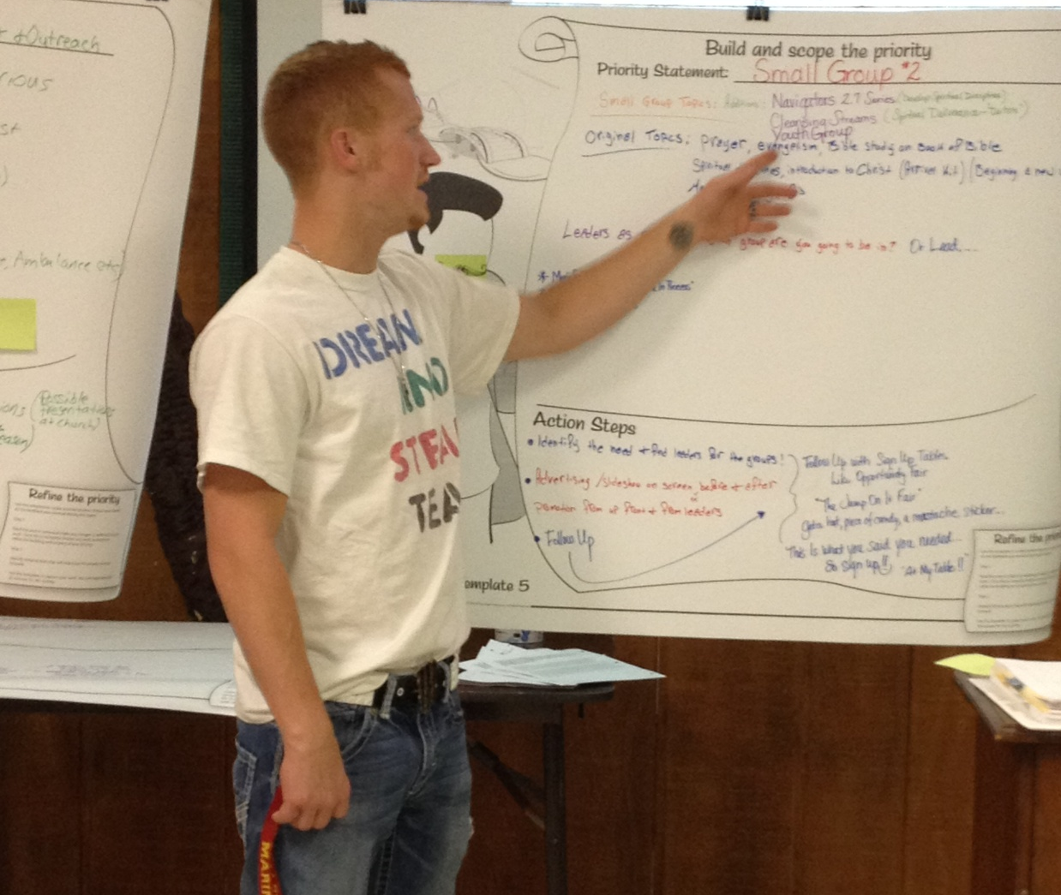
Key takeaway of Dream and Steam Team review of Data Pack - Not Consistent in Spiritual Disciplines –

Slide 11
Church’s Role: Observations
_
Your congregation reports a level of satisfaction with the role your church plays in their spiritual growth that is close to average of the total sample. Key factors include their views on how well the church challenges them to grow, provides in-depth Bible teaching, helps them develop a relationship with Christ and helps them feel like they belong

Slide 12
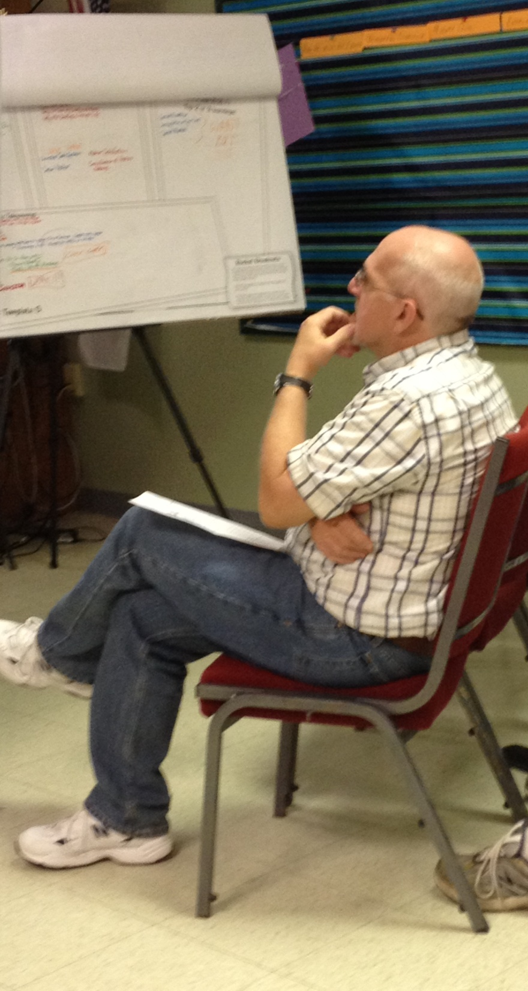
Friendly – on the surface
Low on spiritual friendship connections with explorers
Low on investing time where it counts – mentoring, discipleship
Low on personal ministry

Slide 13
Faith in Action: Observations
_
Your congregation reports an average level of participation in faith based activities compared to the total sample. Key factors include the frequency of their serving activities in the church and also for those in need, as well as evangelistic activities. Another key measure is their agreement with the statement “I am willing to risk everything that’s important in my life to Jesus Christ”

Slide 14
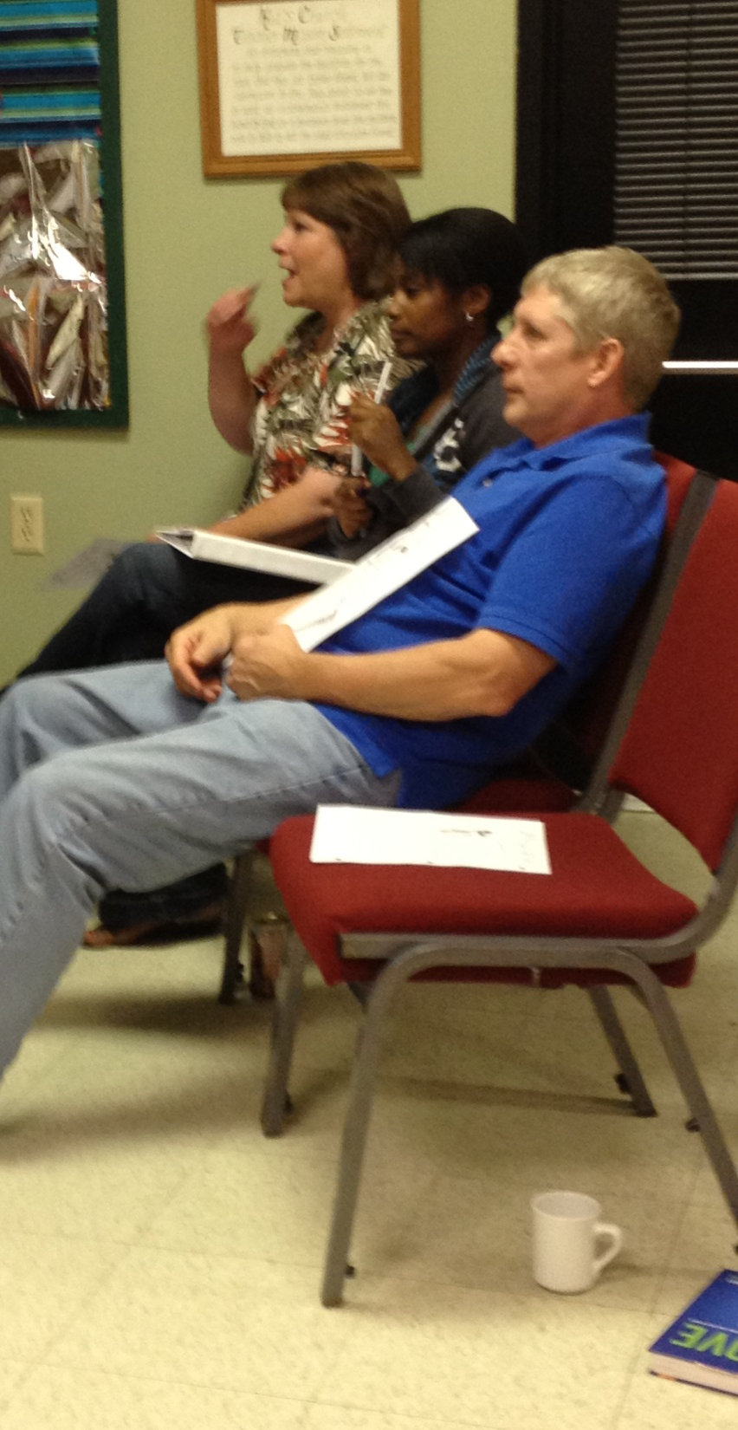
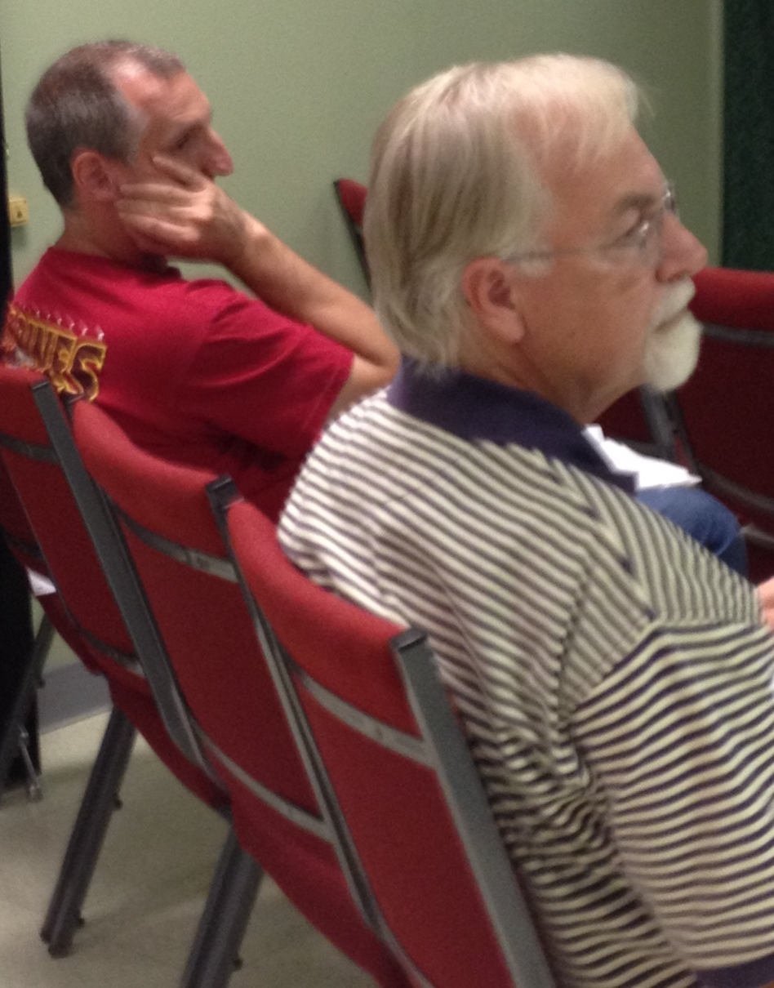
Low on Evangelism

Slide 15
II. Relationship
It’s not about DOING it’s about BEING
Who you are in Christ
Sons and daughters of God – John 1:12
Made right with God – 2 Corinthians 5:21
2 Corinthians 5:19 For God was in Christ, reconciling the world to himself, no longer counting people’s sins against them…

Slide 16
Romans 5:6-11
God showed his love by sending Christ to die for us
Made right with God by the blood of Christ
Rejoice in our wonderful new relationship - friendship with God

Slide 17
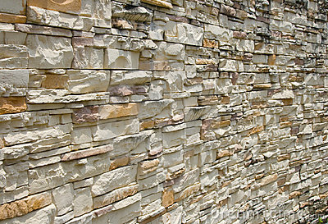
Salvation wall - Isaiah 26:1 (NLT) ¹ In that day, everyone in the land of Judah will sing this song: Our city is strong! We are surrounded by the walls of God’s salvation.
SALVATION

Slide 18
Relationship elicits Response – 2 Corinthians 5:15 He died for everyone so that those who receive his new life will no longer live for themselves. Instead, they will live for Christ, who died and was raised for them.

Slide 19
III. The Starting Gate

Slide 20
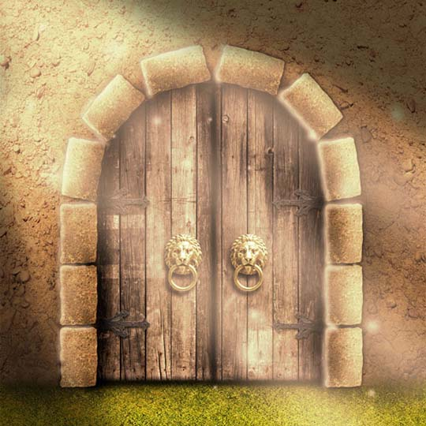
Relationship

Slide 21
The gate for us to begin the work of making it complete – Relationship with the Lord
Time reading, reflecting meditating in his word
Time of fellowship, conversation, prayer
Journaling – connecting your book with God’s book of you (Psalm 139)

Slide 22
WORD

Slide 23
The inspired word of God 2 Timothy 3:16-17
Teaches us what is true
Makes us realize what is wrong in our lives
God uses it to prepare and equip us to do every good work

Slide 24
CLING

Slide 25
Following God
Psalm 63:8 (KJV) ⁸ My soul followeth hard after thee: thy right hand upholdeth me.
Psalm 63:8 (NLT) ⁸ I cling to you; your strong right hand holds me securely.

Slide 26
FELLOWSHIP

Slide 27
Fellowship with God - 1 John 1:3-7
Our fellowship is with the Father and Son
Cannot have fellowship with God while living in spiritual darkness

Slide 30
