Slide 2
Reaching (Y)our Potential
Guarding Against Vulnerabilities

Slide 3
Potential – Colossians 1:25-29
Responsibility of serving his church
Proclaiming his entire message
Teaching with all the wisdom God has given
Present them to Christ – mature
Work hard – depending on Christ’s mighty power

Slide 4
I. Facts
Your spiritual growth is of central importance to our church. Whether you’re just starting to explore the Christian faith, or you’re a long-time Christ-follower, we want to do everything we can to help you on your spiritual journey. We’re asking for your feedback on our church and your spiritual journey through a Spiritual Life Survey

Slide 5
Praise Fellowship Church’s
Spiritual Growth Framework
Christ-Centered
Close to Christ
Growing in Christ
“My relationship with Jesus is the most important relationship in my life It guides everything I do.”
Exploring Christ
“I feel really close to Christ and depend on him daily for guidance.”
“I believe in Jesus and am working on what it means to get to know him.”
“I believe in God, but I am not sure about Christ. My faith is not a significant part of my life.”
13
5
23
2

Slide 7
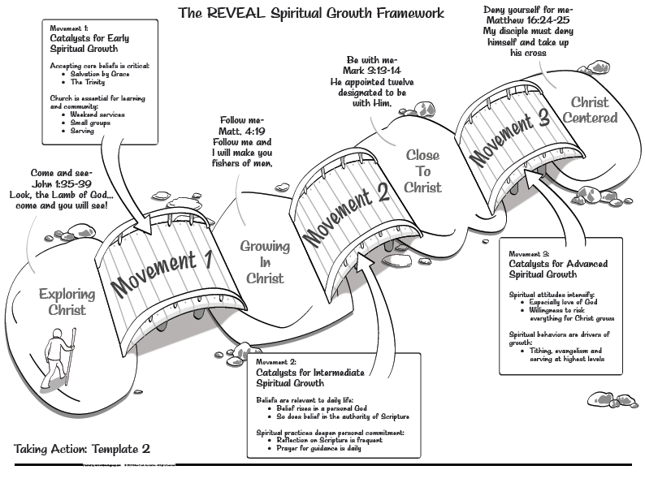

Slide 8
II. Vulnerabilities
1 Thessalonians 3:10 (NLT) ¹⁰ Night and day we pray earnestly for you, asking God to let us see you again to fill the gaps in your faith.
Nehemiah – rebuilding the Wall
Proverbs 25:28 (NLT) ²⁸ A person without self-control is like a city with broken-down walls.

Slide 9
Notes on Jerusalem’s circumstances
Beginnings and Judgment
Patriarchs – Abraham, Isaac and Jacob
Theocracy – God’s rule by Law and Prophets
Monarchy – Kings – David and Solomon
Divided Kingdom and deterioration

Slide 10
Exile – 70 years
Israel taken captive by Assyrians
Judah conquered by Babylonians
Fall of Babylon to Medo-Persians
King Cyrus allows a remnant to return
Restoration
Rebuilding the temple
Rebuilding the wall

Slide 11
Hearing the News - Nehemiah 1:1-10
Things are not going well
Walls torn down
Gates have been destroyed
Prayer of repentance

Slide 12
Gathering the Facts – Nehemiah 2:11-18
The trouble we are in
City in ruins
Gates destroyed
disgrace
Let’s rebuild the wall
Yes, let’s rebuild – they began the good work

Slide 13
III. Gaps
Mark 4:13-20 – the parable of the soils

Slide 14
Vulnerabilities
Unsaved
footpath soil, Satan steals the Word

Slide 15
Vulnerabilities
Unrenewed Mind
Can be lukewarm
Thorny soil - worries, desires, deceit

Slide 16
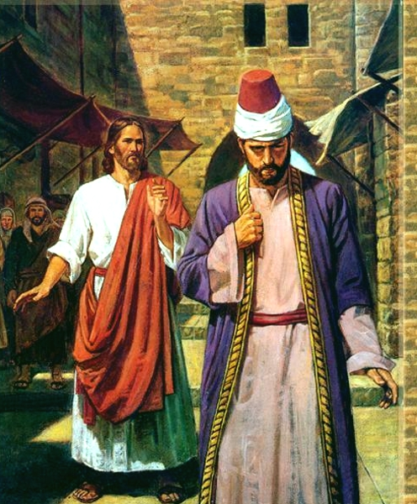
Rich Man
Mark 10:20-22
…he went away grieving, for he was one who owned much property.

Slide 17
Vulnerabilities
Not sold out
No deep roots, fall away when trouble comes

Slide 18
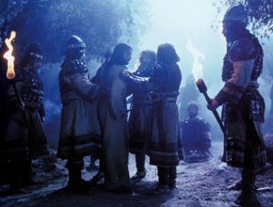
Disciples in Gethsemane Mark 14:50 …And they all left Him and fled

Slide 19
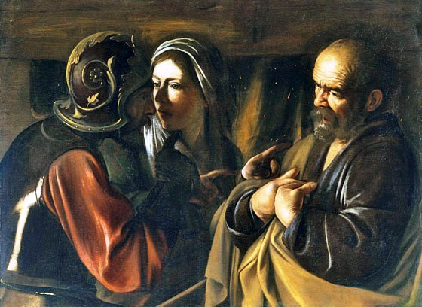
Peter - Mark 14:71 But he began to curse and swear, "I do not know this man you are talking about!"

Slide 20
Vulnerabilities
Weary in well doing?
Fear of man?
Good soil, producing much fruit – reaching potential

Slide 22
Putting ourselves in the best position to reach our potential and guarding ourselves from the vulnerabilities that come with lack of maturity

