Slide 2
Recording the Vision

Slide 3
Habakkuk 2:2 - 3 (NASB) ²Then the LORD answered me and said, “Record the vision And inscribe it on tablets, That the one who reads it may run. ³“For the vision is yet for the appointed time; It hastens toward the goal and it will not fail. Though it tarries, wait for it; For it will certainly come, it will not delay.

Slide 4
I. What is our Purpose?
The Mission and Purpose of Praise Fellowship Church is to love God and people too and to make followers of Jesus
The Great Commandment – Matthew 22:36-39
The Great Commission – Matthew 28:19-20

Slide 5
Loving God
Through worship and praise
Through practice of the scriptures
Loving people too
Through sharing the gospel
Through small-group meetings
Making followers of Jesus
By discipling others
By training and equipping

Slide 6
II. Increasing Effectiveness
Growing into an ever-increasing effectiveness in our mission and purpose
As followers of Jesus becoming complete in Christ
As individuals – growing in Christ and functioning in the body
As a church - becoming fully functional and fully funded doing the work of the ministry

Slide 7
Accomplishing our mission and purpose
Emphasis of living by the Word
Effective small groups
Not one size fits all
Ladies
Men’s fraternity
20 Something’s
Parenting
One-on-one – mentoring

Slide 8
Effective Outreaches
Individual - in your sphere of influence
Corporate - Outreach that we can only accomplish as a body working together

Slide 9
Area of jurisdiction – territory to lay claim to - The boundaries of I-90, Hwy 63, Hwy 60, I-35

Slide 11
Beyond this we support missions and ministries that are reaching other parts of the world

Slide 12
Effective Assimilation
Invitation
Come join the family
Introduction
Meet Father
Meet the rest of the family
Interaction
Small group activities
Household chores
Fulfilling your part
Invite the neighbors
Community outreach

Slide 13
III. Facilitating Needs
Church – about the people
Facilitating needs – individual and corporate
Spiritual
Relational
Emotional
Physical

Slide 14
Building Facilities are not a measure of success
Our experience of God’s grace with facilities
Building on Main Street – now Club IOU
5 acres donated – became prime real estate
This facility
The Lord’s word about building on the land

Slide 16
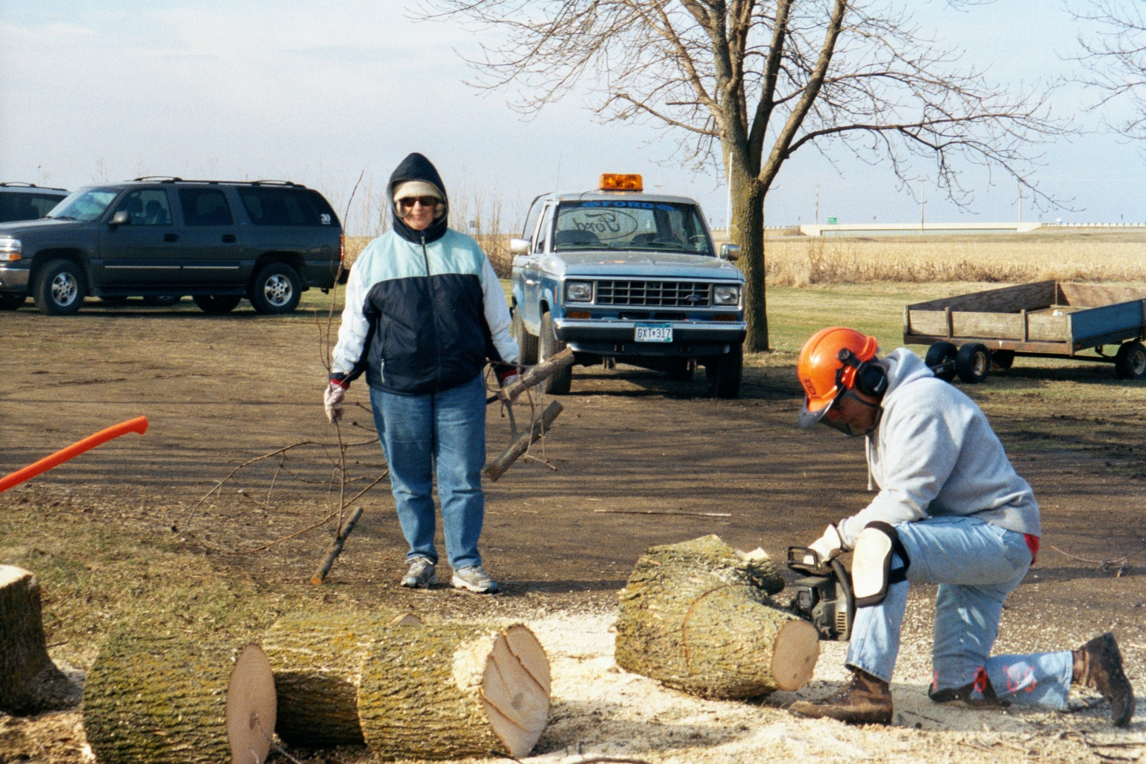
Building Addition Site Work

Slide 17
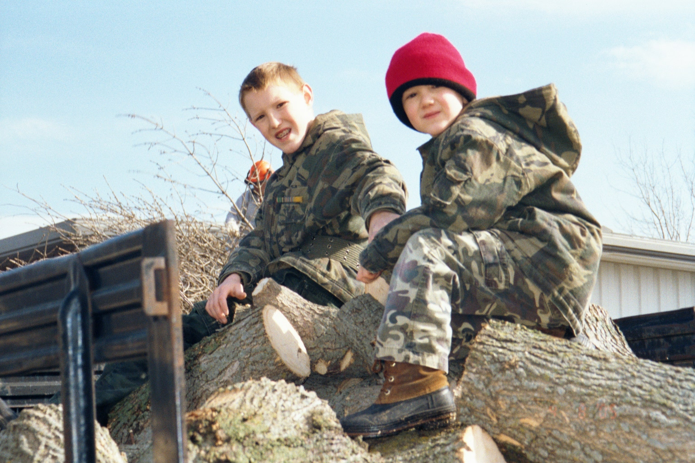
Building Addition Site Work

Slide 18
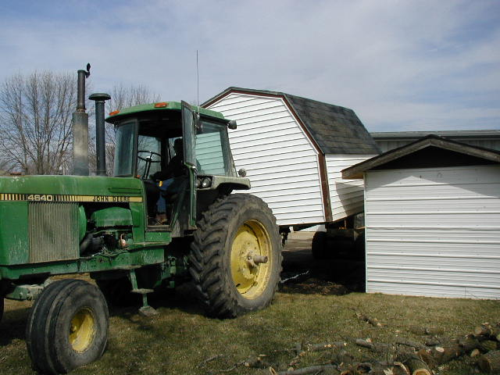
Building Addition Site Work

Slide 19
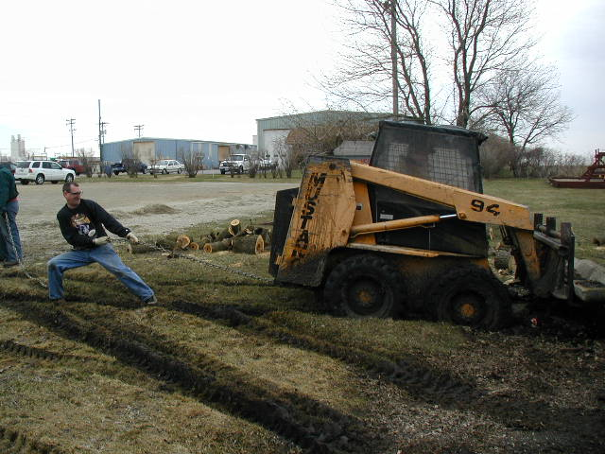
Building Addition Site Work

Slide 20
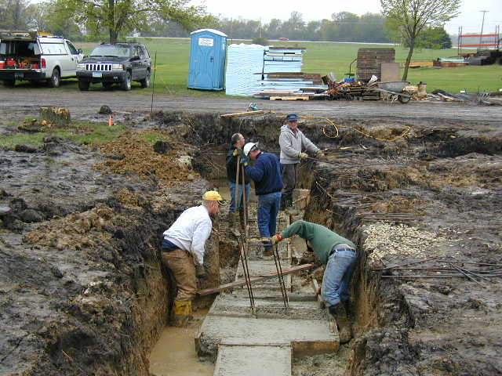
Foundations

Slide 21
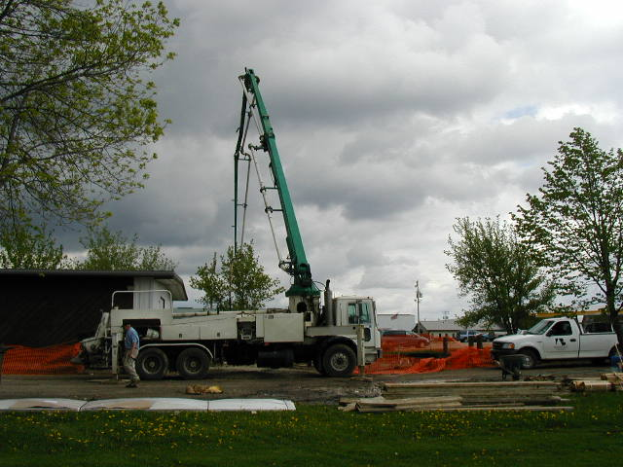
Foundations

Slide 22
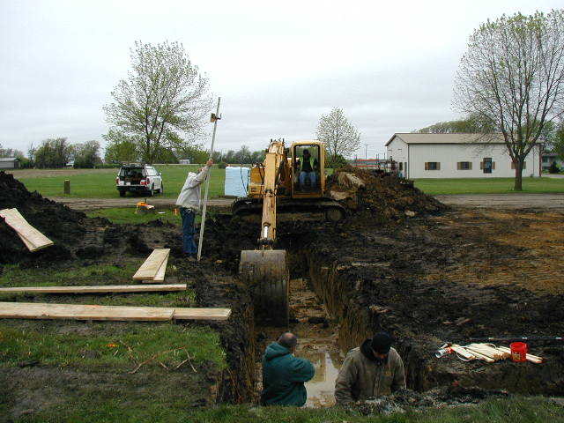
Foundations

Slide 23
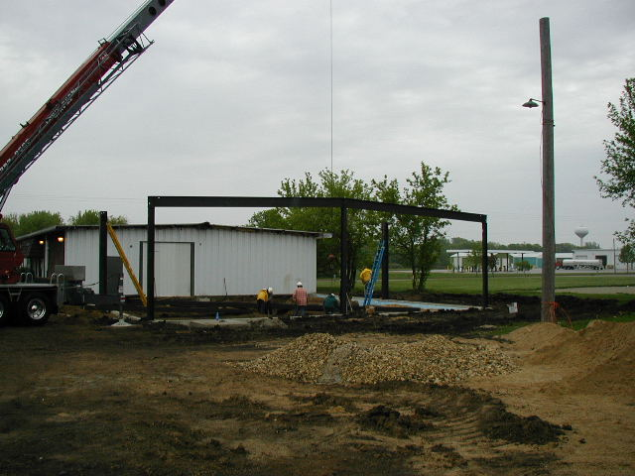
Framing

Slide 24
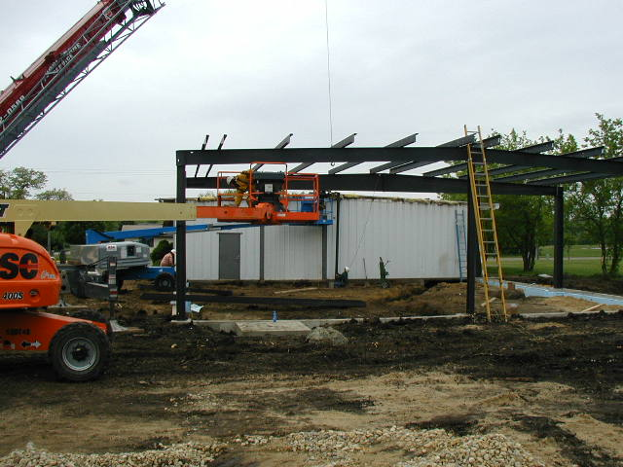
Framing

Slide 25
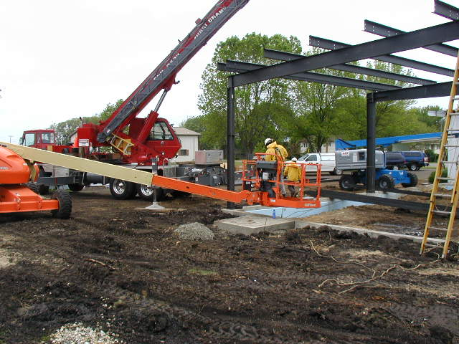
Framing

Slide 26
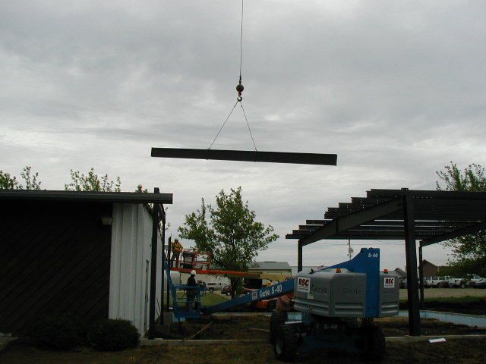
Framing

Slide 27
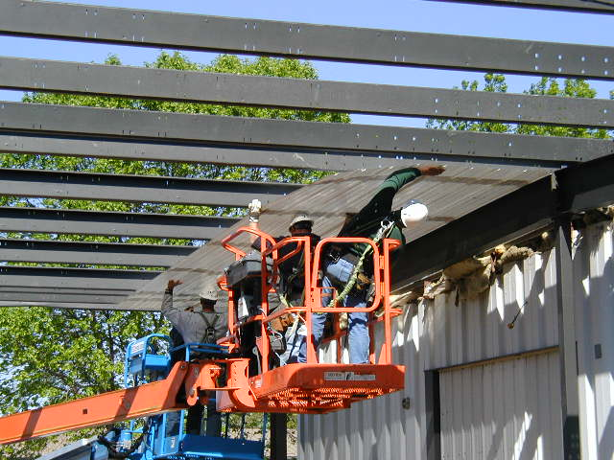
Ceiling

Slide 28
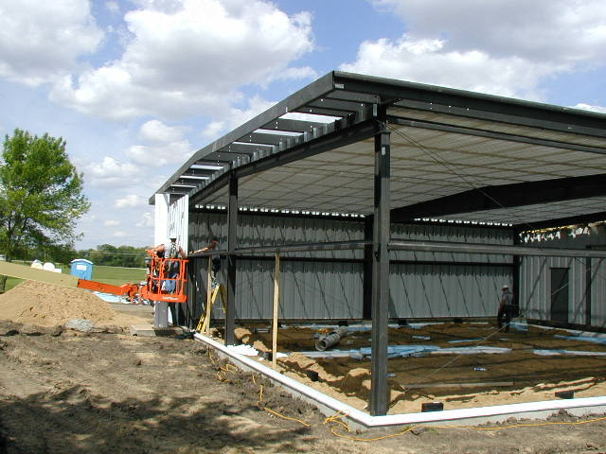
Siding

Slide 29
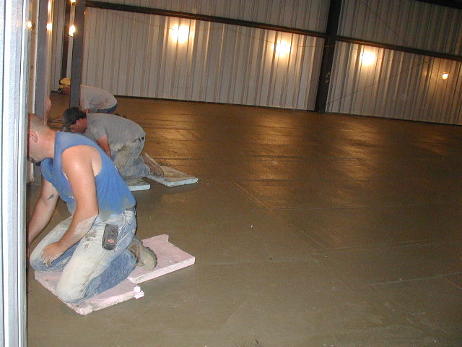
Interior Work

Slide 30
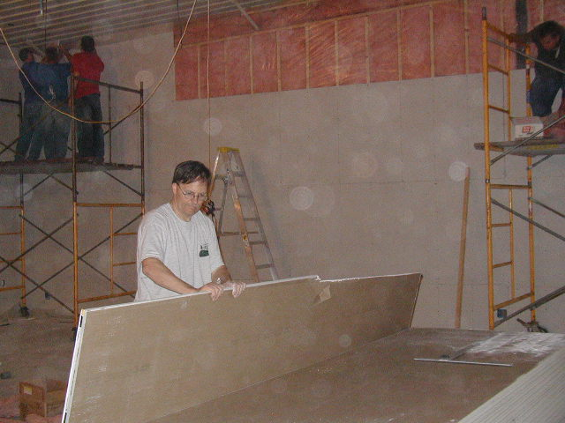
Interior Work

Slide 31
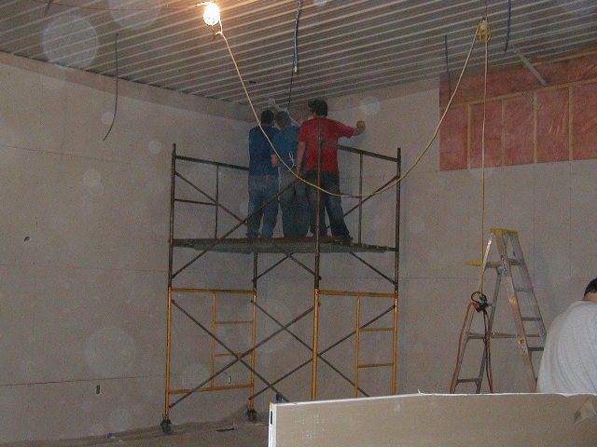
Interior Work

Slide 32
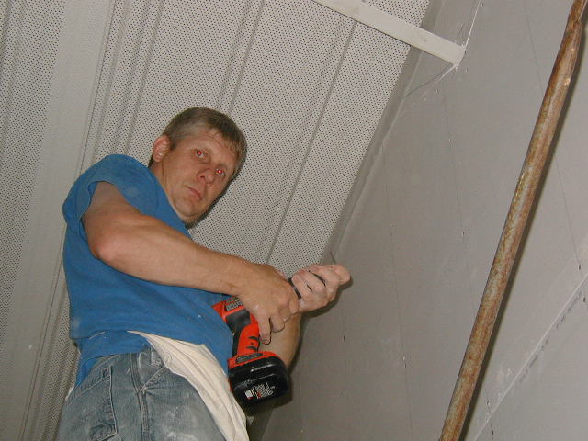
Interior Work

Slide 33
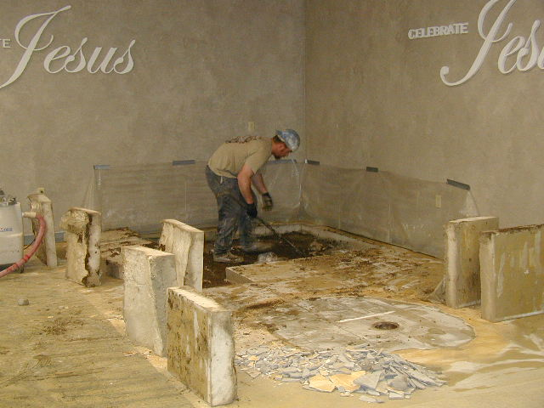
Interior Work

Slide 34
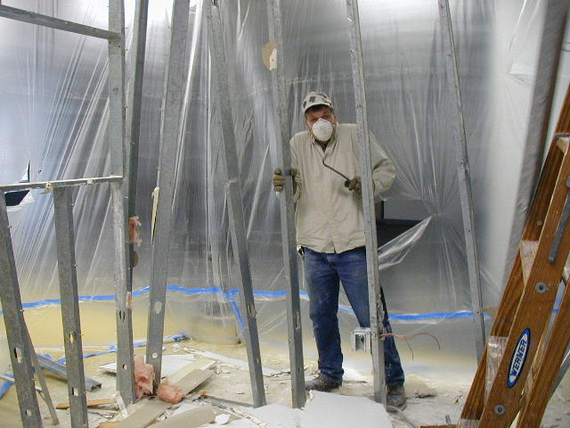
Interior Work

Slide 35
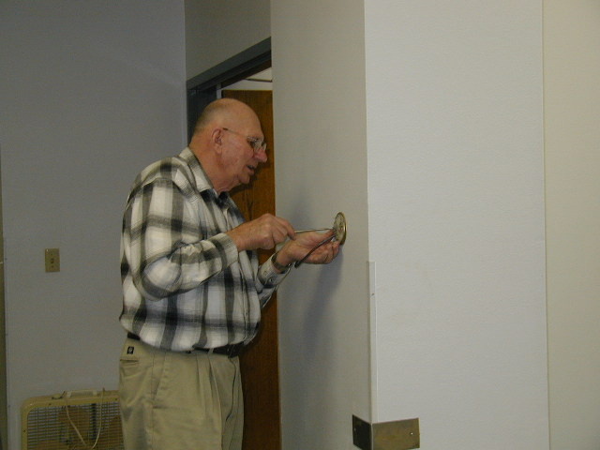
Interior Work

Slide 36
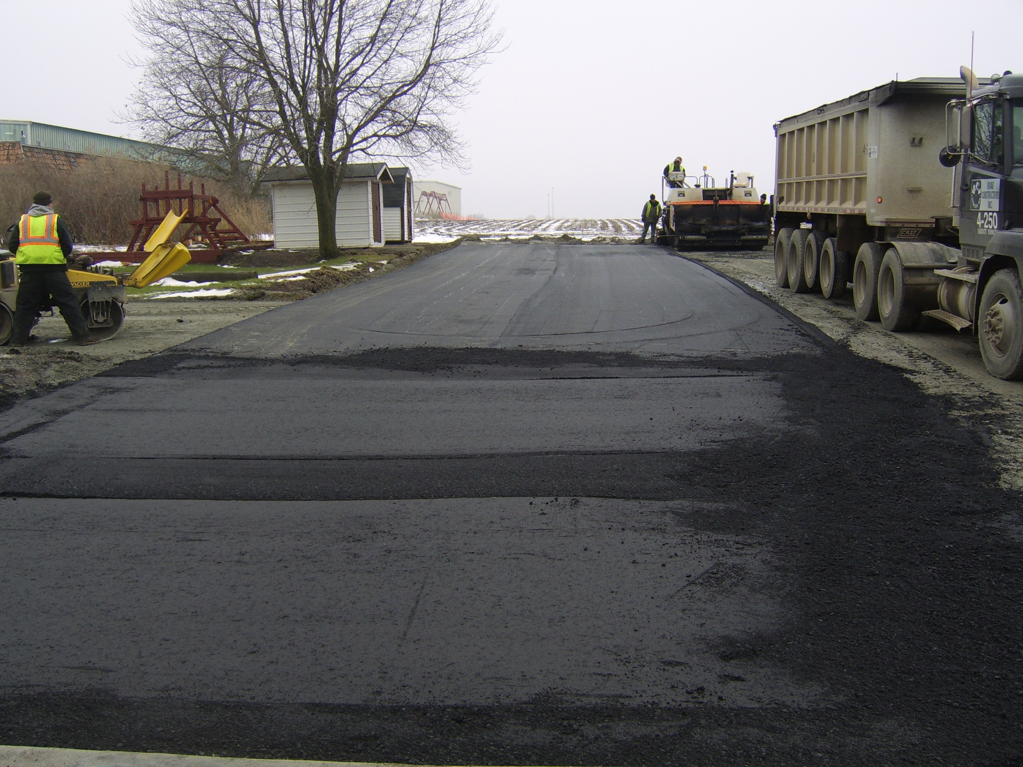
Parking Lot Paving

Slide 37
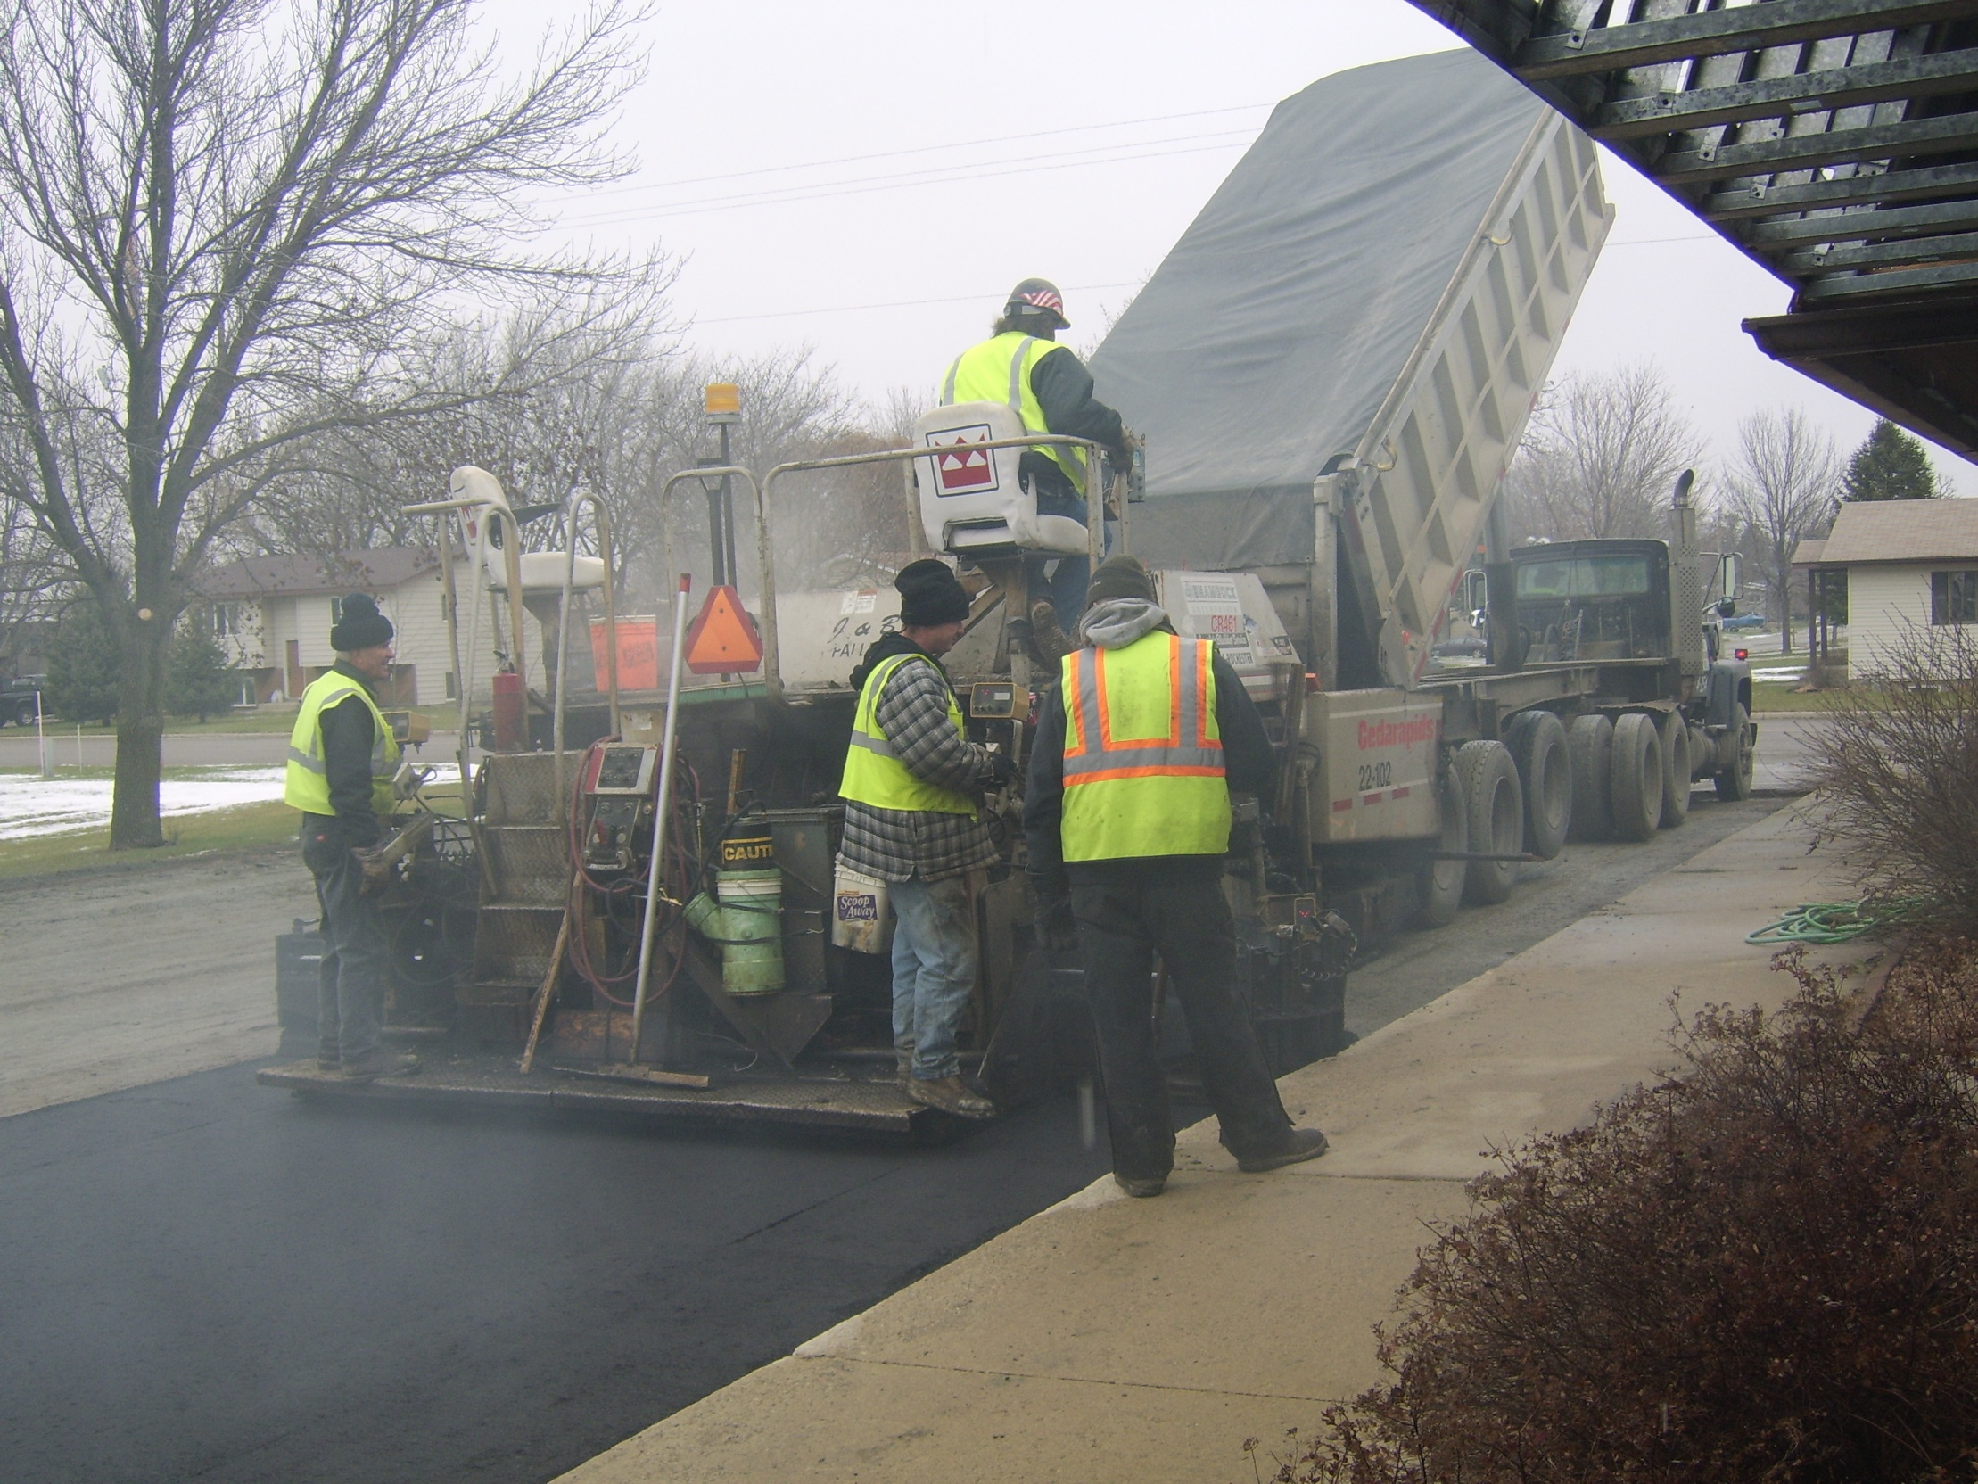
Parking Lot Paving

Slide 38
$100 | $100 | $100 | $100 | $100
$100 | $100 | $100 | $100 | $100
$100 | $100 | $100 | $100 | $100
$100 | $100 | $100 | $100 | $100
$50
$50
$25
$25
$25
$25

Slide 39
Numbers?
Numbers mean people
“We count people because people count”
Numbers are not success
Word of the Lord with new building 300 expandable to 500

Slide 41
Our part and God’s Part
Increasing effectiveness of outreach - ours
Increasing effectiveness of assimilation - ours
Loving God and people too and making followers of Jesus – ours
Fully functional and fully funded
God’s with what he has entrusted us
Ours in obedience
People being drawn to the Lord
God’s work in their heart
People’s free will
Giving us the increase – God’s

Slide 42
Record the vision and make it plain
The vision is yet for the appointed time; It hastens toward the goal and it will not fail. Though it tarries, wait for it; For it will certainly come, it will not delay.
Obedience to the completing work of the Lord in our lives

Slide 43
Prayer and laying claim to this area of our jurisdiction
Prayer and financial support beyond our area
Thy will be done, Thy kingdom come
In my life
In this church
In this territory
On earth

Slide 45
IV.

