Slide 1
Hebrews 12:1-2
A huge crowd of witnesses to the life of faith
All these pioneers who blazed the way, all these veterans cheering us on
Keeping our eyes on Jesus the champion who initiates and perfects our faith

Slide 2
Too Good for This World
Perfecting Our Faith

Slide 3
Hebrews 11:32-40

Slide 4
I. Great Victories of Faith
Vs. 32-35

Slide 5
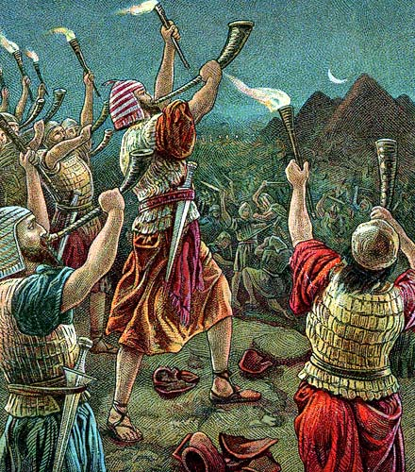
Gideon – Judges 6-8

Slide 6
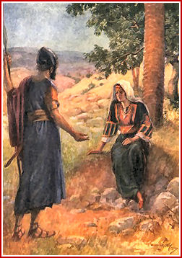
Barak - Judges 4

Slide 7
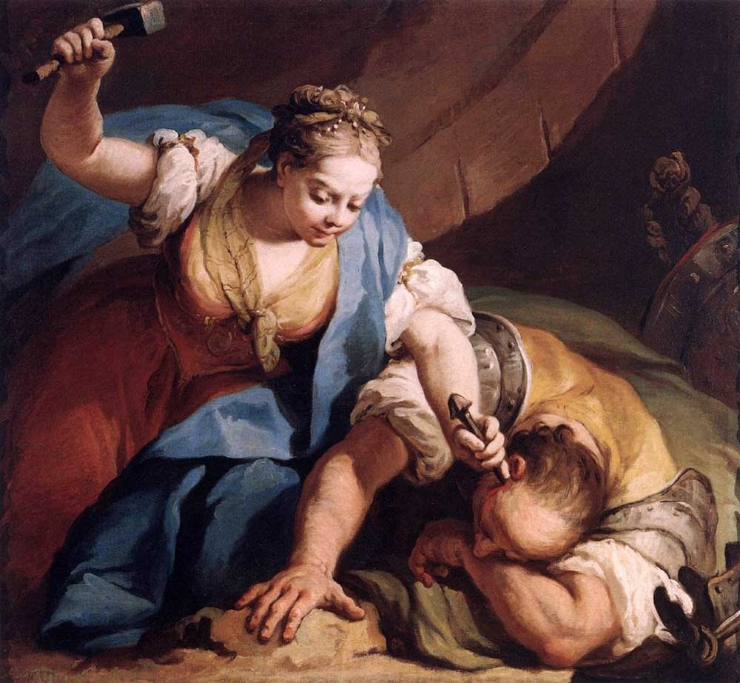

Slide 8
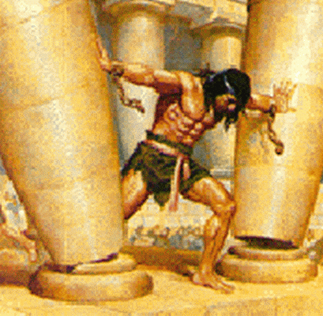
Samson – Judges 13-16

Slide 9
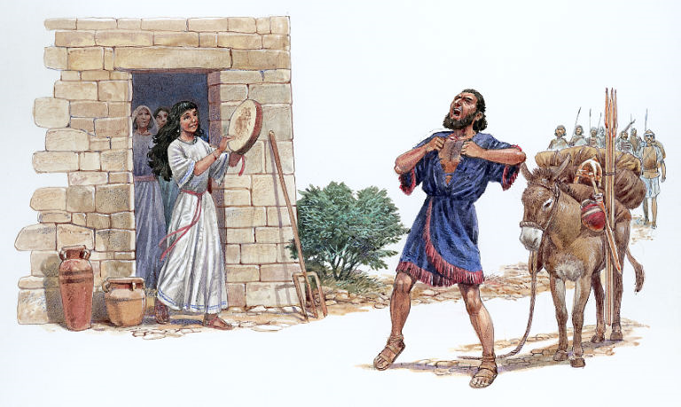
Jephthah – Judges 11

Slide 10
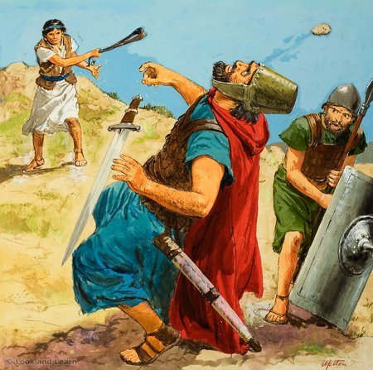
David

Slide 11
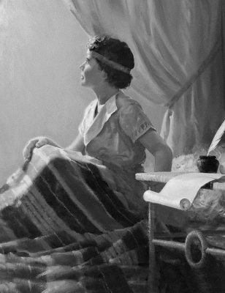
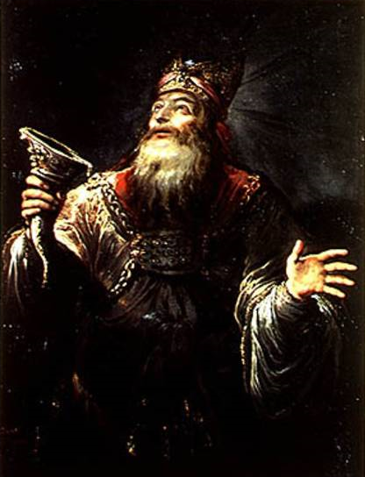
Samuel

Slide 12
Prophets

Slide 13
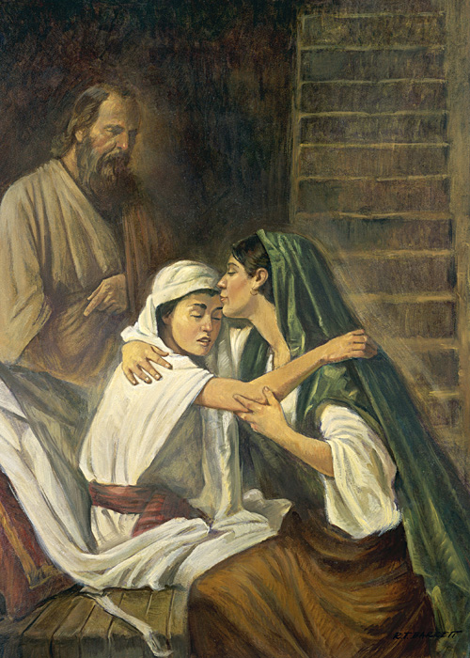
Women - received their dead raised to life
Widow of Zarephath - 1 Kings 17

Slide 14
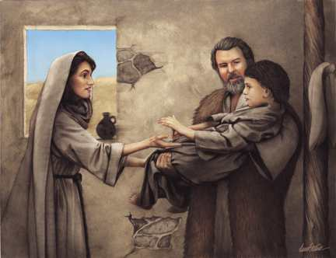
The Shunamite - 2 Kings 4

Slide 15
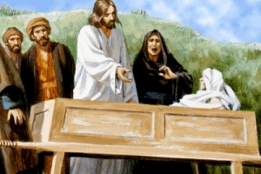
The widow of Nain - Luke 7

Slide 16
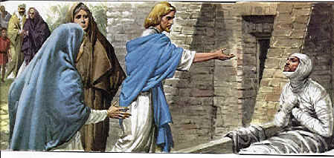
Mary and Martha – John 11

Slide 17
Their faith accomplishments – vs. 33-34

Slide 18
II. Great Martyrs of Faith
Refusing to turn from God
Hope in a better life after the resurrection
Things that they suffered – vs. 36-37

Slide 19
Too good for this world
TMSB - the world didn’t deserve them

Slide 20
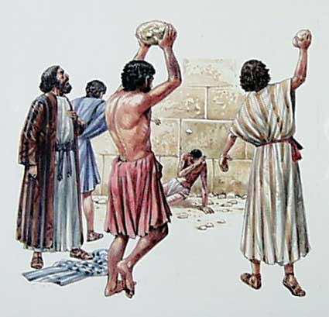
Stephen – Acts 7

Slide 21
Acts 8:1-4
Great persecution against the church
All were scattered
They preached the good news everywhere

Slide 22
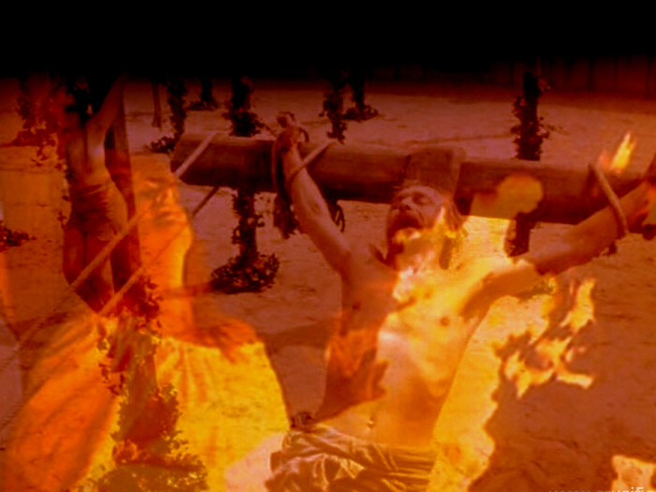

Slide 23
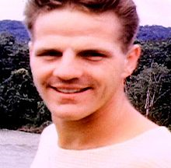
Jim Elliot - with the purpose of evangelizing Ecuador's Waodani Indians.
"He is no fool who gives what he cannot keep to gain that which he cannot lose.“

Slide 24
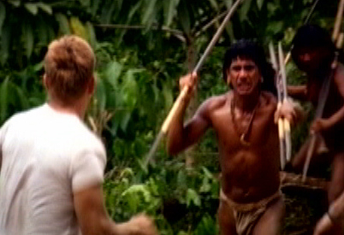

Slide 25
Luke 9:23-27
If anyone wants to follow me – take up your cross daily
Hang on to your own life – lose it
Give up your life for my sake – save it

Slide 26
III. Receiving all that God Promised
A good reputation because of their faith
V2. through their faith the people of old earned a good reputation
People who pleased God
None received all that God promised
They would not reach perfection without us

Slide 27
They had a title to the promises - of the gospel-state
Something better for us

Slide 30
IV.

