Slide 2
Perfecting Our Faith
Faith Required
My people shall live by faith
Without faith it is impossible to please God
Faith initiated
Faith challenged
Faith developed
or Faith abandoned
Examples of people and their successful response to the faith challenge
Examples and encouragement for our own faith challenges

Slide 3
The Water, Walls, and Welcome of Faith
Perfecting Our Faith

Slide 4
Hebrews 11:29-31
By faith Israel went through the Red Sea
By faith Israel marched around Jericho and the walls came crashing down
By Faith Rahab was not destroyed, giving friendly welcome to the spies

Slide 5
I. Positioned for Faith
By faith the people of Israel went through the Red Sea

Slide 6
Exodus 14:15-31
Divide the water – walk through the middle of the sea on dry ground – walls of water on each side

Slide 7
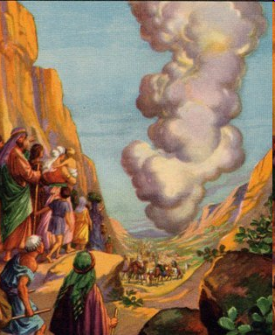
Protected by the pillar of cloud/fire

Slide 8
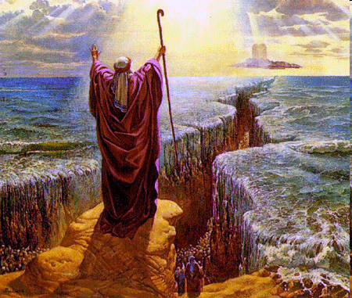
The Red Sea
The Lord opened a path and Israelites went through on dry ground

Slide 9
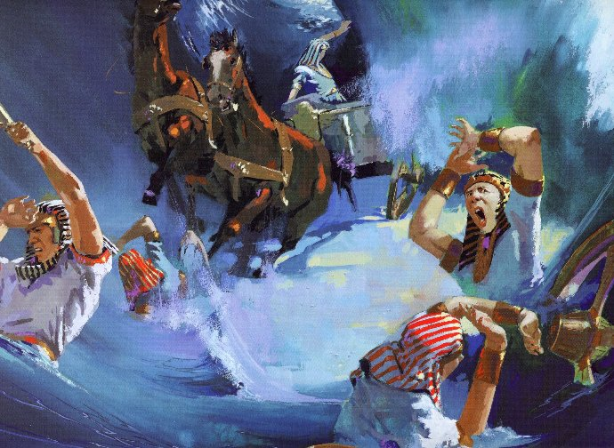

Slide 10
When they saw the mighty power of the Lord they put their faith in him

Slide 11
Psalms 136:10 - 15 ¹⁰Give thanks to him who killed the firstborn of Egypt. His faithful love endures forever. ¹¹He brought Israel out of Egypt. His faithful love endures forever. ¹²He acted with a strong hand and powerful arm. His faithful love endures forever. ¹³Give thanks to him who parted the Red Sea. His faithful love endures forever. ¹⁴He led Israel safely through, His faithful love endures forever. ¹⁵but he hurled Pharaoh and his army into the Red Sea. His faithful love endures forever.

Slide 12
II. Staying in Faith

Slide 13
Hebrews 11:29 It was by faith that the people of Israel went right through the Red Sea as though they were on dry ground. But when the Egyptians tried to follow, they were all drowned.
Hebrews 11:30 It was by faith that the people of Israel marched around Jericho for seven days, and the walls came crashing down.
What was rejected by one generation was possessed by the next
Both groups together in the wilderness for 40 years
One for judgment (Num. 14)
One for preparation (Deut. 8)

Slide 14
Hebrews 3:16-19
Because of unbelief they were not able to enter
Deceived by sin and hardened against God
V. 13-14 – stay faithful – share in all that belongs to Christ

Slide 15
III. Rahab’s Welcome

Slide 16
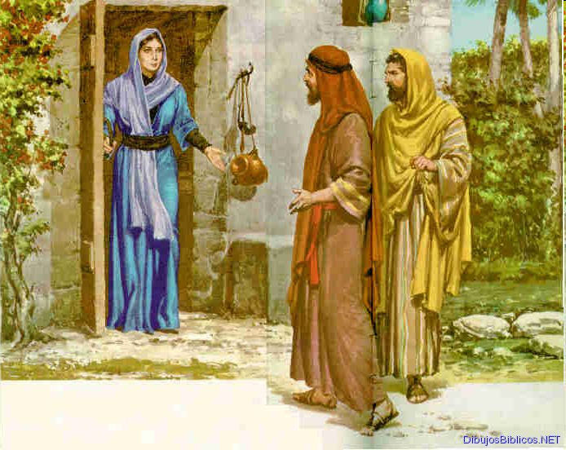
By Faith Rahab was not destroyed, giving friendly welcome to the spies – Joshua 2:1-14

Slide 17
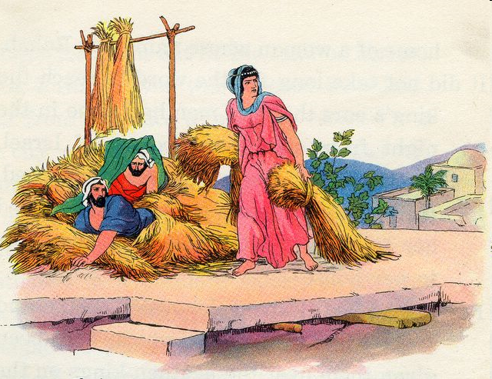
We are afraid of you – we have heard how the Lord made a dry path for you
The Lord your God is the supreme God of the heavens and earth

Slide 18
Rahab’s faith based on observation of the Lord’s work among his people
Matthew 5:16 “Let your light shine before men in such a way that they may see your good works, and glorify your Father who is in heaven.”
The spies’ report
The Lord has given us the whole land
The people are terrified of us

Slide 19
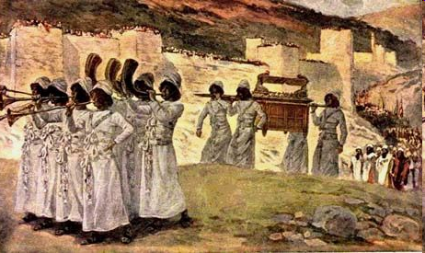
IV. Jericho’s Walls
By faith Israel marched around Jericho and the walls came crashing down - Joshua 6

Slide 20
Priests walk ahead of the Ark with rams horns
Fighting men and priests walk around Jericho once each day for six days

Slide 21
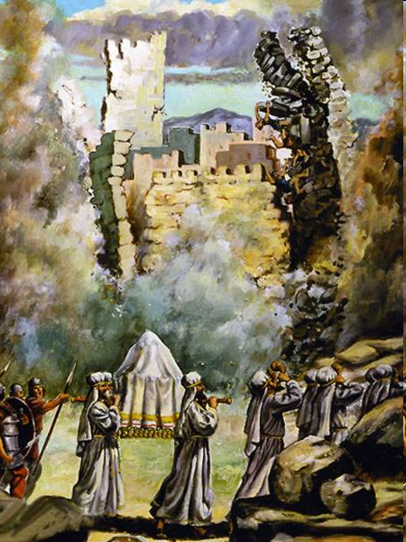
Seventh day march around seven times and blast the rams horns
All the people shouted
The walls of Jericho collapsed

Slide 22
All the people destroyed with the exception of Rahab and family
The Lord was with Joshua and his reputation spread throughout the land

Slide 23
Overwhelming Victory – Romans 8:31-39
If God is for us who can be against us?
God has given us his son – won’t he give us everything else?
God himself has given us right standing with him
Can anything separate us from his love?
Psalm 136 – His faithful love endures forever
Overwhelming victory is our through Christ who loved us

Slide 24
Hebrews 3:14 For if we are faithful to the end, trusting God just as firmly as when we first believed, we will share in all that belongs to Christ.

