Slide 2
Moses’ Faith Choices
Perfecting Our Faith

Slide 3
Hebrews 11:24-28 – By Faith
Moses chose his Hebrew heritage of oppression rather than the sin and treasures of Egypt
Looking ahead to his great reward
Left the land of Egypt – Exodus, eyes on the Lord not on the king of Egypt
Commanded the people to keep the Passover to deliver their firstborn

Slide 4
I. Moses, the Deliverer
Exodus 2 - 4

Slide 5
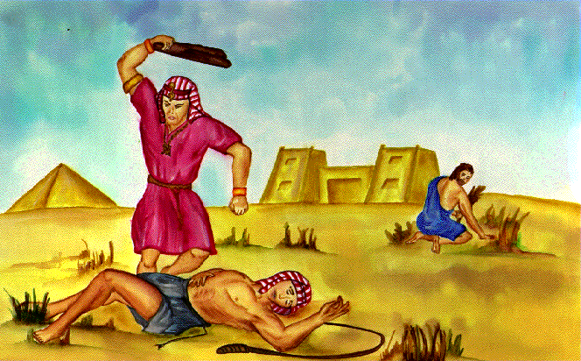
Moses killed an Egyptian who was beating his fellow Hebrew
Acts 7:25 “And he supposed that his brethren understood that God was granting them deliverance through him, but they did not understand.”

Slide 6
Pharaoh tried to kill Moses
Moses fled to Midian

Slide 7
God hears the cry of his people
He remembers his covenant
He knew it was time to act

Slide 8
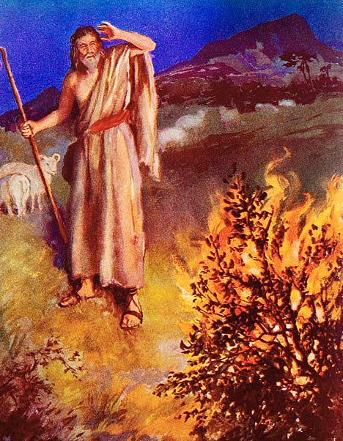
He calls Moses to lead the people out of Egypt
Moses protested – who am I?
Moses pleaded – send someone else

Slide 9
Acts 7:22 “Moses was educated in all the learning of the Egyptians, and he was a man of power in words and deeds.”

Slide 10
Chose his Hebrew heritage looking forward to his great reward

Slide 11
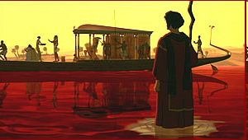
Plague of Blood

Slide 12
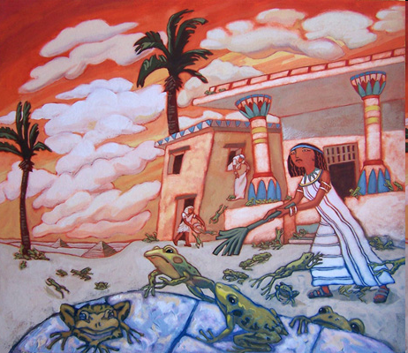
Plague of Frogs

Slide 13
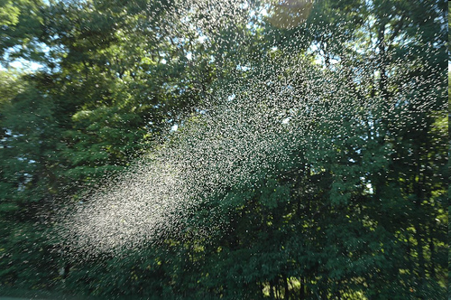
Plague of Gnats

Slide 14
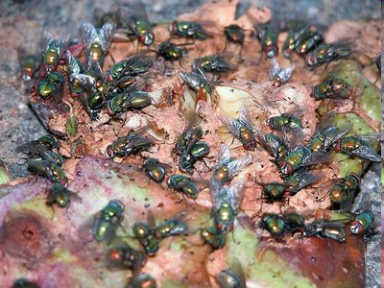
Plague of Flies

Slide 15
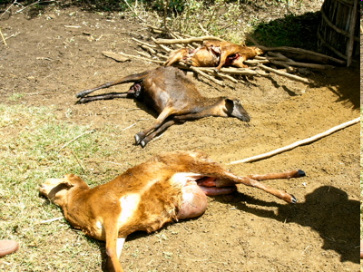
Plague against Livestock

Slide 16
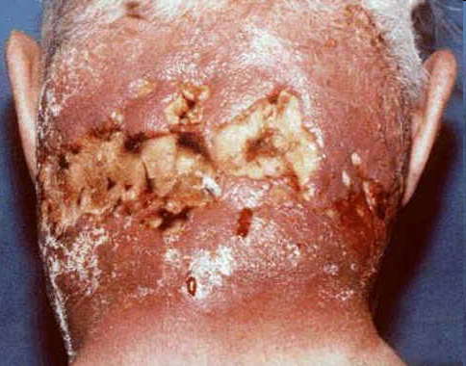
Plague of Festering Boils
Viewer
Warning!

Slide 17
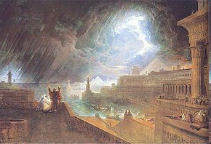
Plague of Hail

Slide 18
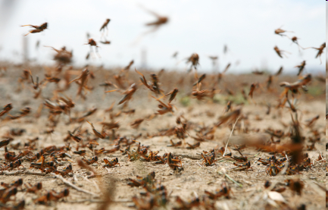
Plague of Locusts

Slide 19
Plague of Darkness

Slide 20
Plague of Death of Firstborn

Slide 21
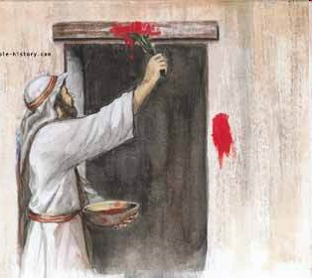
II. Keeping the Passover
By Faith Moses commanded the people to keep the Passover to deliver their firstborn
Exodus 11, 12

Slide 22
III. The Exodus – Exodus 12

Slide 23
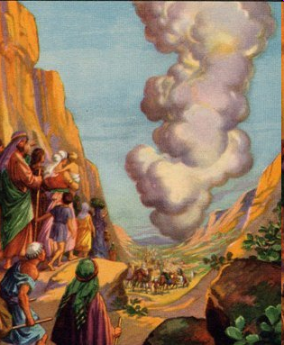
By faith Moses left the land of Egypt – eyes on the Lord not on the king of Egypt

Slide 24
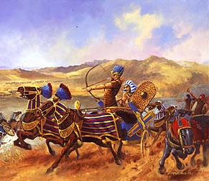
Pharaoh’s heart hardened again 14:1-14

Slide 25
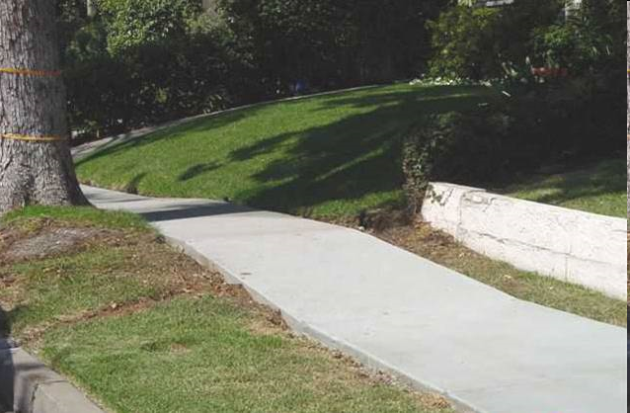

Slide 27
Hebrews 3:1 – 6
Looking forward to his great reward
Leading Israelites to the Promised land
Reward of being faithful
Example of truths to be revealed later

Slide 28
IV. Our Example of Moses in Faith
Choose God’s way rather than the easy way of least resistance
Treasures of the world
Pleasures of sin
Don’t let the shortcomings prevent you from being used of God

Slide 29
Hold fast to the word of God beyond the overwhelming circumstances
Keep your eye on the Lord rather than the opposition
Go for the eternal rewards of faithfulness
Accomplish your great exploits in the Lord

