Slide 2
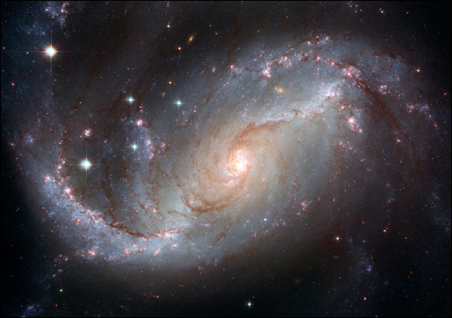

Slide 3
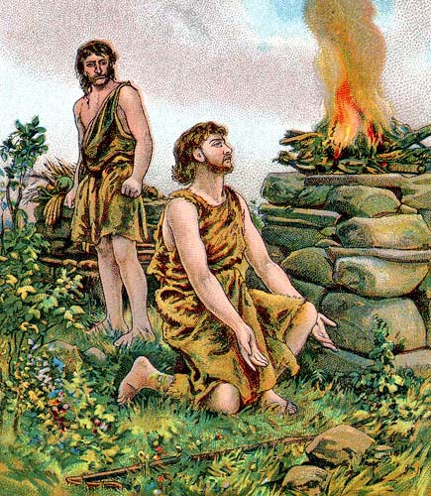

Slide 4
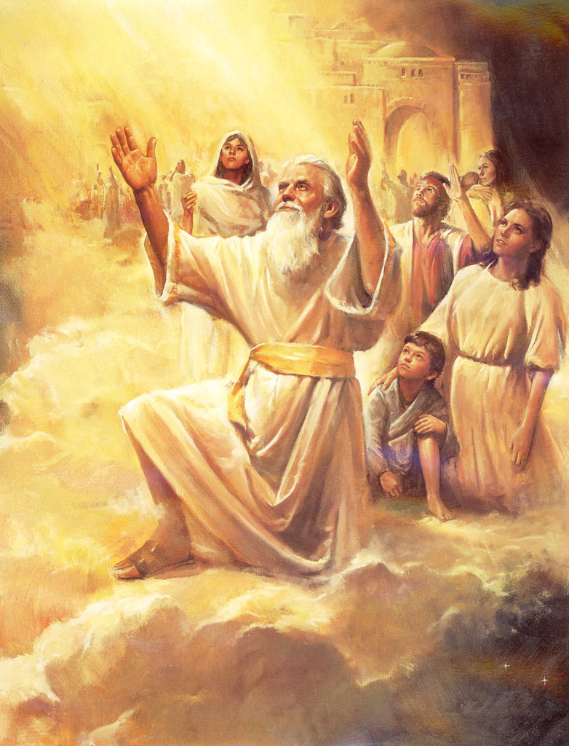

Slide 5
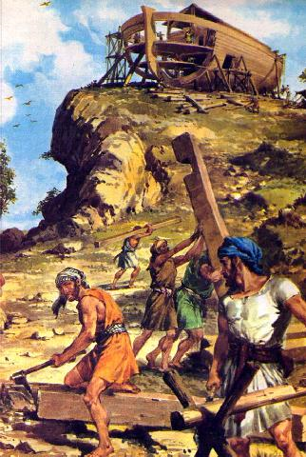

Slide 6
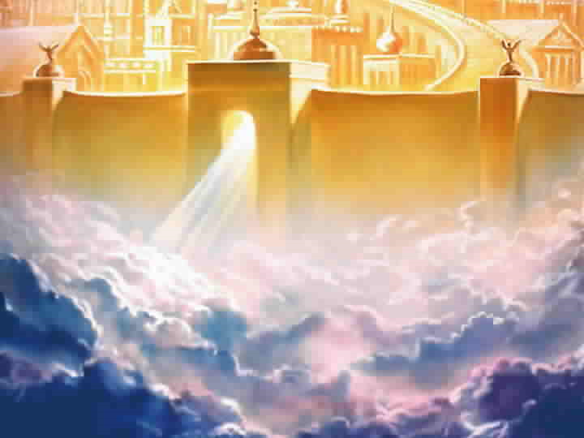

Slide 7
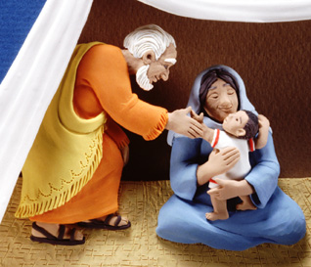

Slide 8
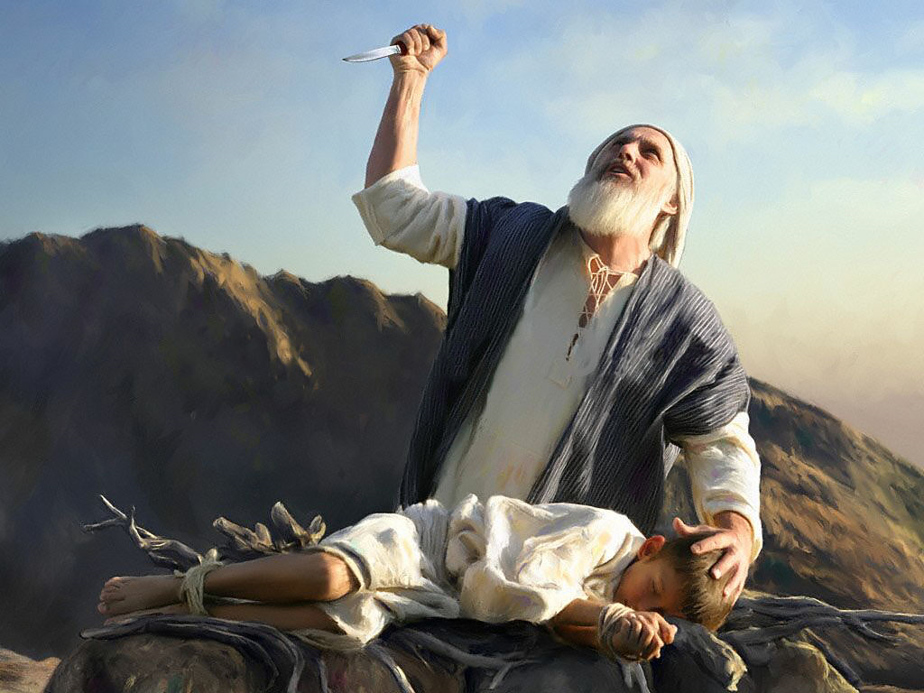

Slide 9
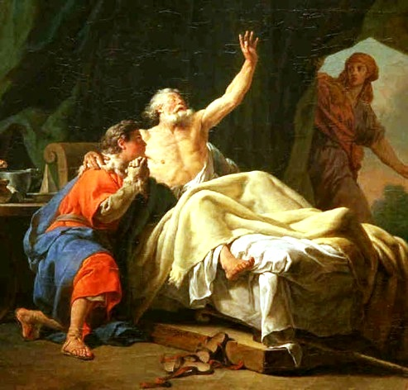

Slide 10
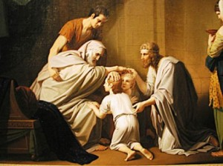

Slide 11
Hebrews 12:1 (TMSB) Do you see what this means—all these pioneers who blazed the way, all these veterans cheering us on? It means we’d better get on with it. Strip down, start running—and never quit! No extra spiritual fat, no parasitic sins.
Hebrews 12:2 (NLT) We do this by keeping our eyes on Jesus, the champion who initiates and perfects our faith. Because of the joy awaiting him, he endured the cross, disregarding its shame. Now he is seated in the place of honor beside God’s throne.

Slide 12
Faith Beyond This Life
Perfecting Our Faith

Slide 13
Hebrews 11:22-23
By faith Joseph
Confident the people would leave Egypt
Commanded them to take his bones with them
By faith Moses’ parents
Hid him when he was born
Knew God had given them an unusual child
Not afraid to disobey the king’s command

Slide 14
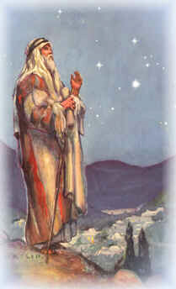
I. The Land of Promise
Genesis 12:7 – I will give this land to your descendants

Slide 15
Genesis 15:13-16
Your descendants will be foreigners in a strange land
Oppressed slaves for 400 years
Return here to this land when Amorites warrant destruction

Slide 16
Genesis 50:5 – Jacob’s body to be buried in Canaan
Genesis 50:22-26
God will lead you out of this land back to the promised land
Take my bones with you
Exodus 13:17-19 – When Pharaoh let the people go Moses took Joseph’s bones with him

Slide 17
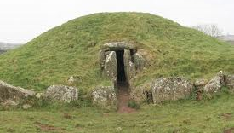
Joshua 24:32 The bones of Joseph, which the Israelites had brought along with them when they left Egypt, were buried at Shechem, in the parcel of ground Jacob had bought from the sons of Hamor for 100 pieces of silver. This land was located in the territory allotted to the descendants of Joseph.

Slide 18
Philippians 3:17-21
Many think only about their life here on this earth
But we are citizens of heaven where Jesus lives
The believers promised land
He will take our mortal bodies and change them into bodies like his own
FAITH BEYOND THIS LIFE

Slide 19
II. Defying Oppression

Slide 20
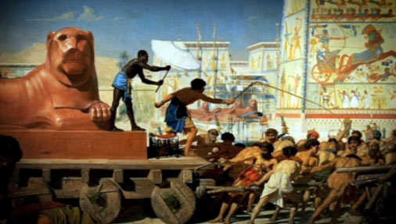
Exodus 1 – Israelites oppressed in Egypt
Joseph and brothers die
Descendants multiply and become powerful
Oppressive slavery by the Egyptians

Slide 21
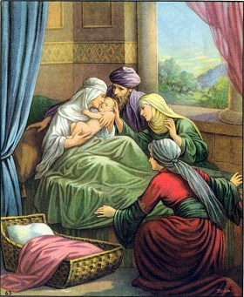
King orders death to newborn boys
Midwives fear God – refuse to obey the king

Slide 22
Exodus 2 – the birth of Moses
By faith Moses’ parents hid him when he was born
Amram and Jochebed (Exodus 6:20)

Slide 23
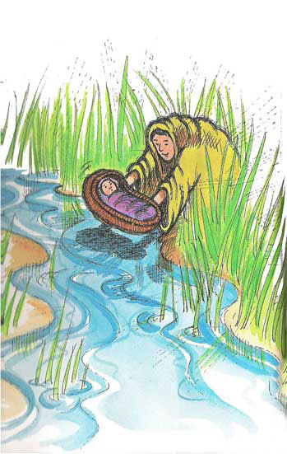
Entrusting him to God
Placing him in the river
Watched by Miriam

Slide 24
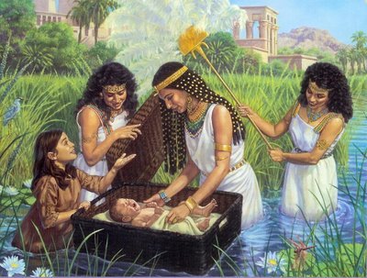
Adopted by the princess – Pharaoh’s daughter
Named Moses – Drawn forth

Slide 25
http://www.youtube.com/watch?v=RXNaZIGdk2Q

Slide 26
III. The Tension of Submission or Defiance

Slide 27
Submission
Civil authorities – Romans 13:1-6
IRS – Romans 13:6-7; Matthew 22:17-21
Husbands and wives – Ephesians 5:21-25
Parents – Ephesians 6:1
Spiritual leaders – Hebrews 13:17
Earthly masters – Colossians 3:22

Slide 28
Defiance
Hebrew midwives – Exodus 1
Moses’ parents – Exodus 2
Three Hebrew boys – Daniel 3
Daniel – Daniel 6
Disciples – Acts 4:13-22

Slide 29
The litmus test of submission or defiance – the fear of God - If what is right with God goes against the requirements of those in authority – choose God

Slide 30
Understand there may be consequences
Hebrews 11:35-38
FAITH BEYOND THIS LIFE

Slide 32
IV.

