Slide 2
Perfecting Our Faith
Faith Required
My people shall live by faith
Without faith it is impossible to please God
Faith initiated
Faith challenged
Faith developed
or Faith abandoned
Examples of people and their successful response to the faith challenge
Examples and encouragement for our own faith challenges

Slide 3
Blessing By Faith
Perfecting Our Faith

Slide 4
Hebrews 11:20-21
By faith Isaac promised blessings to his sons
By faith Jacob blessed Joseph’s sons

Slide 5
I. The Blessing of Jacob and Esau
Battle of the bulge – Genesis 25:19-26
Esau and Jacob struggle in the womb
Word of the Lord – two rival nations
The older son will serve the younger

Slide 6
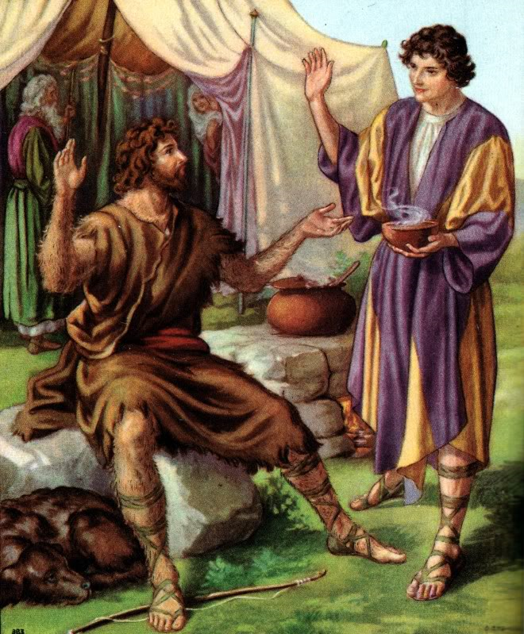
Birthright stew – Genesis 25:27-34
Jacob – culinary artist – cooking stew
Esau – hunter – I’m hungry give me some of that stew
Swear that your birthright is mine
Esau swore an oath showing contempt for his birthright

Slide 7
Blessing Jacob and Esau – Genesis 27

Slide 8
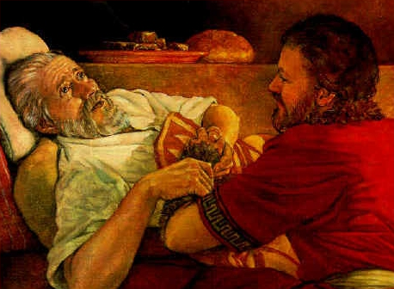
Jacob receives the blessing of the firstborn

Slide 9
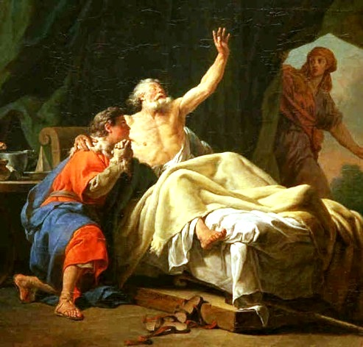
Esau is twice tricked?
Jacob master – Esau servant
Esau hated Jacob

Slide 10
God had determined the matter at birth
Hebrews 12:16 - 17 ¹⁶Make sure that no one is immoral or godless like Esau, who traded his birthright as the firstborn son for a single meal. ¹⁷You know that afterward, when he wanted his father’s blessing, he was rejected. It was too late for repentance, even though he begged with bitter tears.

Slide 11
Romans 9:10-16
Before they were born Rebekah received a message from God that the older would serve the younger
God loved Jacob but rejected Esau (quote from Malachi 1:2-3)

Slide 12
II. Blessing Joseph’s Sons

Slide 13
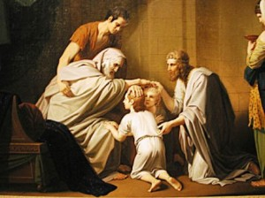
By faith Jacob blessed each of Joseph sons
Genesis 48

Slide 14
Joseph’s sons adopted as Jacob’s own
God has let me see not only your face, but your children too

Slide 15
The criss-cross blessing vs. the firstborn
Jacob put Ephraim ahead of Manasseh
Speaks to the sovereignty of God

Slide 16
Galatians 3:13 - 14 ¹³But Christ has rescued us from the curse pronounced by the law. When he was hung on the cross, he took upon himself the curse for our wrongdoing. For it is written in the Scriptures, “Cursed is everyone who is hung on a tree.” ¹⁴Through Christ Jesus, God has blessed the Gentiles with the same blessing he promised to Abraham, so that we who are believers might receive the promised Holy Spirit through faith.

Slide 17
2 Corinthians 5:21 For God made Christ, who never sinned, to be the offering for our sin, so that we could be made right with God through Christ.

Slide 18
III. Blessing our Children by Faith
By the example of Jesus – Mark 10:14 - 16 ¹⁴When Jesus saw what was happening, he was angry with his disciples. He said to them, “Let the children come to me. Don’t stop them! For the Kingdom of God belongs to those who are like these children. ¹⁵I tell you the truth, anyone who doesn’t receive the Kingdom of God like a child will never enter it.” ¹⁶Then he took the children in his arms and placed his hands on their heads and blessed them.

Slide 19
Proverbs 18:21 The tongue can bring death or life; those who love to talk will reap the consequences.

Slide 20
Proverbs 15 – the value of the words that you speak
Proverbs 15:1,2,4,7,23 ¹A gentle answer deflects anger, but harsh words make tempers flare. ²The tongue of the wise makes knowledge appealing, but the mouth of a fool belches out foolishness. ⁴Gentle words are a tree of life; a deceitful tongue crushes the spirit. ⁷The lips of the wise give good advice; the heart of a fool has none to give. ²³Everyone enjoys a fitting reply; it is wonderful to say the right thing at the right time!

Slide 21
Abraham chosen because he would teach these things to his children
Genesis 18:19 I have singled him out so that he will direct his sons and their families to keep the way of the LORD by doing what is right and just. Then I will do for Abraham all that I have promised.”

Slide 22
The blessing of their spiritual inheritance – by faith
The call of God on their life
Their bent (Proverbs 22:6)
Their place in the kingdom of God
Delivered from the dominion of darkness
Transferred to the kingdom of God’s dear son
Seated at the right hand of God in Christ
Walking in the steps ordered of the Lord
Their life reflecting God’s recorded book of their life

Slide 23
The children blessings of Psalm 127 and 128
Arrows in the hands of a warrior
Vigorous young olive trees as they sit around your table
By faith speak the blessings of their inheritance to your children and see the power of your faith-filled words bring life to them

Slide 25
IV.

