Slide 2
Perfecting Our Faith
Faith Required
My people shall live by faith
Without faith it is impossible to please God
Faith initiated
Faith challenged
Faith developed
or Faith abandoned
Examples of people and their successful response to the faith challenge
Examples and encouragement for our own faith challenges

Slide 3
Abraham’s Sacrifice
Perfecting Our Faith

Slide 4
Hebrews 11:17-19
By faith Abraham offered Isaac as a sacrifice
God tested him
Abraham reasoned God would bring him back to life
Abraham received Isaac back from the dead

Slide 5
I. Abraham’s Test - Genesis 22:1-19
Offer your son, whom you love, as a sacrifice

Slide 6
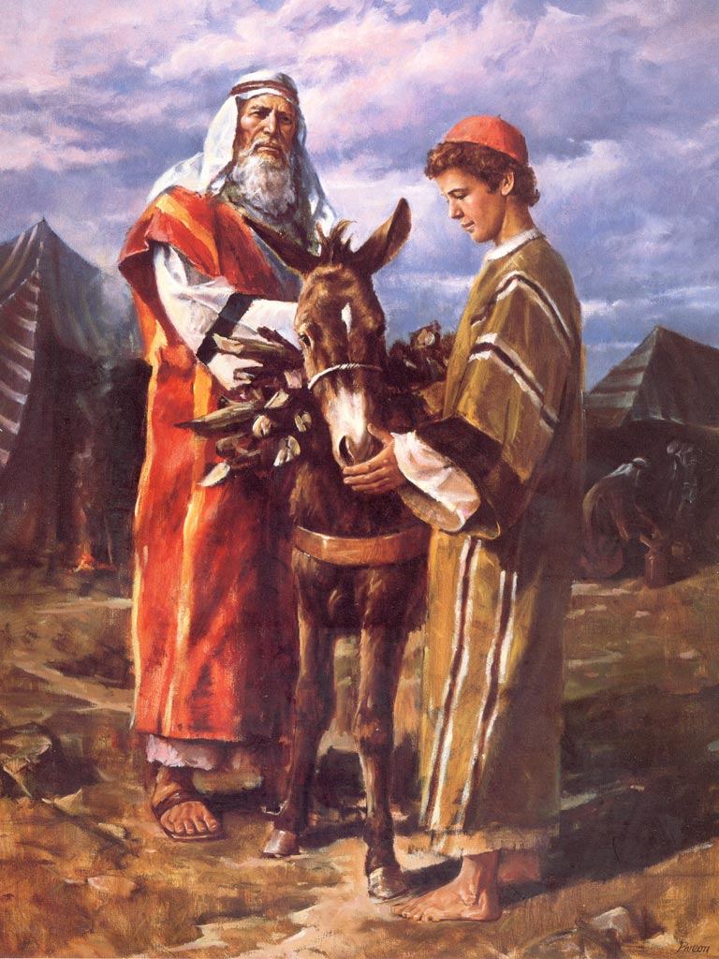
Three day journey to Mt. Moriah
The boy and I will go and worship and we will come back

Slide 7
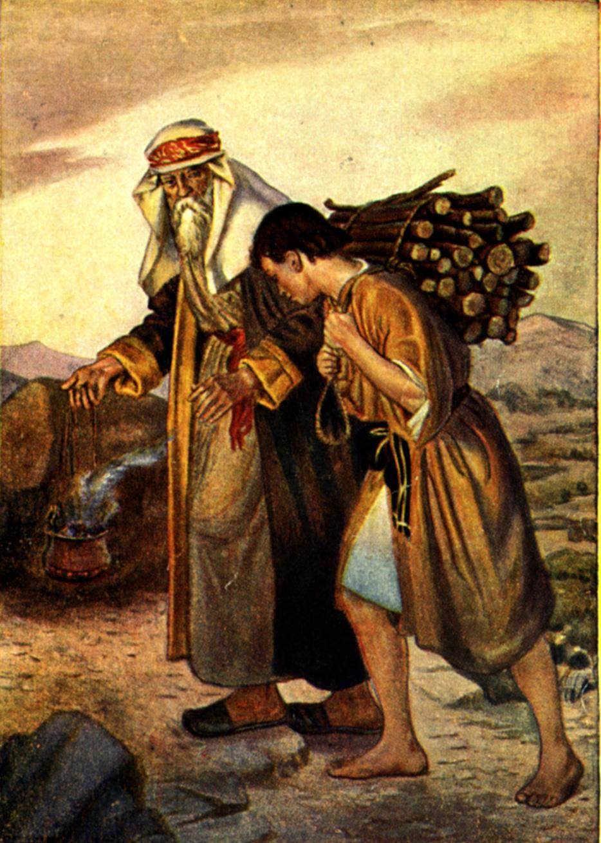
Isaac carries the wood

Slide 8
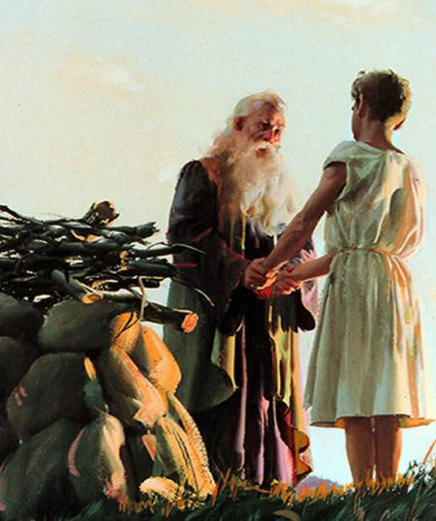
Isaac’s response
Isaac yields

Slide 9
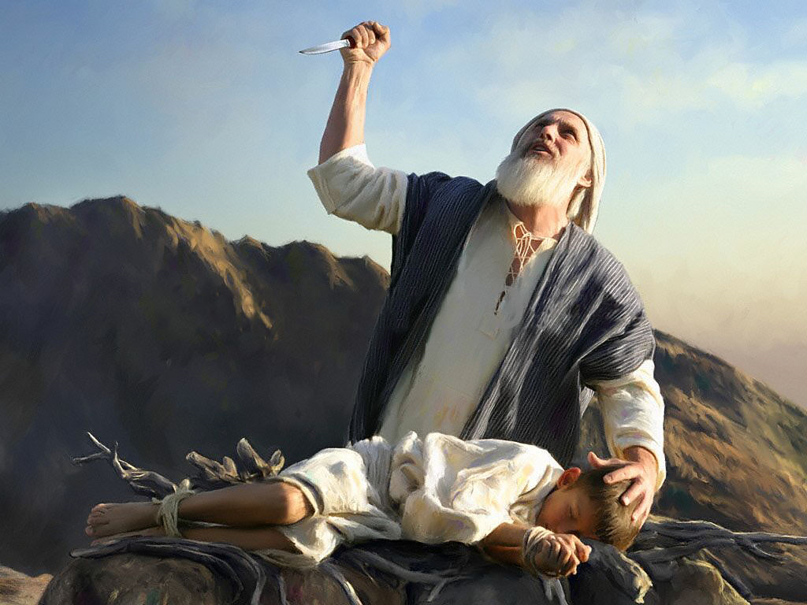
The knife is raised

Slide 10
The knife is stayed

Slide 11
Now I know you truly fear God
God does not require human sacrifice, but a substitution is provided
Jehovah Jireh – God provider

Slide 12
The Blessing
Conditional on continued obedience

Slide 13
II. Our Tests
James 1:12-15
God blesses those who endure testing and temptation
Do not say God is tempting me
Tempt (Greek peirazo)��pi-rad'-zo to test (objectively), that is endeavor, scrutinize, entice, discipline:- assay, examine, go about, prove, tempt (-er), try.

Slide 14
Discerning the challenge
The devil attempting to steal, kill, destroy, prowling about seeking whom he may devour - or
God developing and strengthening you in his completion project – with the intent of blessing you as a result of your obedience
Be careful what you rebuke

Slide 15
God testing your faithfulness that he might entrust you with more
I Corinthians 10:13 – even in temptation
God will not allow the temptation to be more that you can stand
The level of your testing says something about what you can stand
He will show you the way of escape that you can endure
God blesses those who endure testing and temptation (James 1:12)

Slide 16
III. The Picture of Jesus
Abraham’s act of sacrifice - enables us to understand the sacrifice which God made to save us

Slide 17
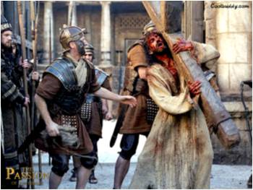
Isaac carries the wood of his own sacrifice – like Christ carrying his own cross

Slide 18
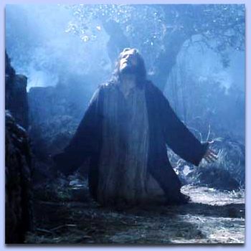
The submission of Isaac – insight into Christ’s obedience unto death

Slide 19
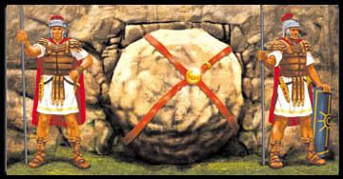
Isaac’s death of three days in the heart of his father – Jesus in the grave three days

Slide 20
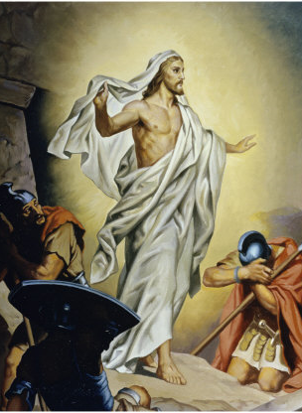
Isaac’s restoration to life with the staying of the knife – Jesus’ resurrection

Slide 21
The knife
Our sin - 2 Corinthians 5:21 For God made Christ, who never sinned, to be the offering for our sin, so that we could be made right with God through Christ.
Romans 8:32 He who did not spare His own Son, but delivered Him over for us all, how will He not also with Him freely give us all things?

Slide 22
John 8:56 Your father Abraham rejoiced as he looked forward to my coming. He saw it and was glad.”

Slide 25
IV.

