Slide 2
Perfecting Our Faith
Faith Required
My people shall live by faith
Without faith it is impossible to please God
Faith initiated
Faith challenged
Faith developed
or Faith abandoned
Examples of people and their successful response to the faith challenge
Examples and encouragement for our own faith challenges

Slide 3
Sarah and Her Baby
Perfecting Our Faith

Slide 4
Hebrews 11:11-12
By faith Sarah was able to have a child
Barren and too old
She believed God would keep his promise
So a whole nation came from Abraham

Slide 5
I. God Promises a Son
Genesis 15:1-6
Your servant will not be your heir
You will have a son of your own

Slide 6
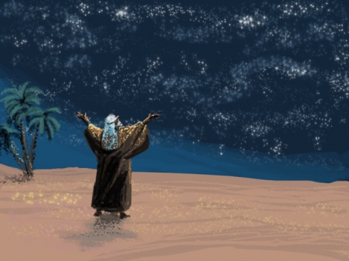
Countless descendents
Abraham believed God – counted as righteous because of his faith

Slide 7
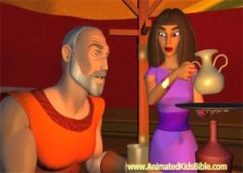
Genesis 16:1-5 – Sarah’s natural alternative
Sarah’s sacrifice of love - Sleep with my servant – I can have children through her
Abraham agreed
Servant’s contempt – all Abraham’s fault
The Lord will show who’s wrong

Slide 8
Commentary on Ishmael
Genesis 16:12 This son of yours will be a wild man, as untamed as a wild donkey! He will raise his fist against everyone, and everyone will be against him. Yes, he will live in open hostility against all his relatives.
Galatians 4:23, 29 ²³The son of the slave-wife was born in a human attempt to bring about the fulfillment of God’s promise. But the son of the freeborn wife was born as God’s own fulfillment of his promise. ²⁹But you are now being persecuted by those who want you to keep the law, just as Ishmael, the child born by human effort, persecuted Isaac, the child born by the power of the Spirit.

Slide 9
Genesis 17 – God renews the promise at 99 years old
Covenant by which I will guarantee countless descendants
Change name –
Abram – Father of Height (exalted father)
Abraham - Father of many nations
Romans 4:17 (as it is written, “I have made you a father of many nations”) in the presence of Him whom he believed—God, who gives life to the dead and calls those things which do not exist as though they did;

Slide 10
Sarai’s name changed to Sarah – Princess
My princess (one family) changed to a princess namely of multitudes
I will bless her
I will give you a son through her
Mother of many nations

Slide 11
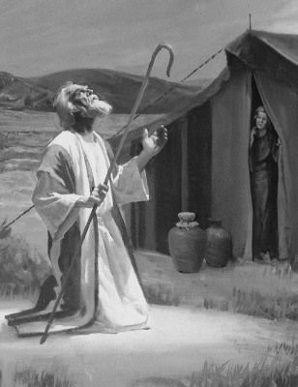
Abraham’s Faith Challenge

Slide 12
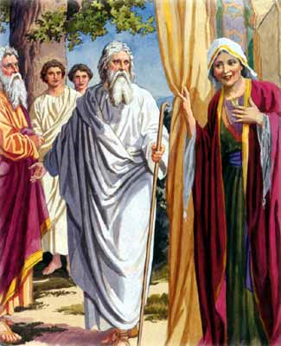
Genesis 18 - Sarah’s Faith Challenge

Slide 13
Jeremiah 32:17 “O Sovereign LORD! You made the heavens and earth by your strong hand and powerful arm. Nothing is too hard for you!

Slide 14
II. Increasing Faith
Romans 4:18-25
Hope with no reason for hope
Abrahams faith did not weaken – never wavered in believing God’s promise
Faith grew stronger – fully convinced that God is able to do whatever he promises

Slide 15
Sarah’s 3 month school of faith
This time next year Sarah will have a son
From laughing in disbelief to faith to conceive
3 months to conception
9 months for gestation

Slide 16
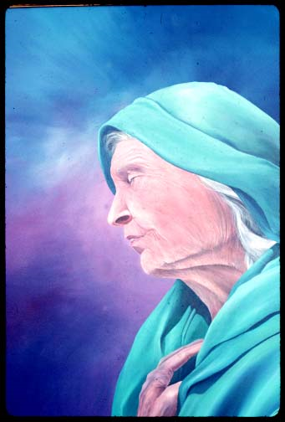
Hebrews 11:11 By faith even Sarah herself received ability to conceive, even beyond the proper time of life, since she considered Him faithful who had promised.

Slide 18
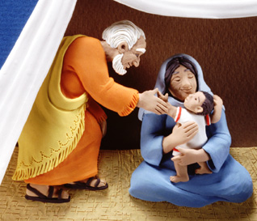
Genesis 21:1-7
The Lord kept his word and did what he had promised
Abraham named their son Isaac – God has brought me laughter

Slide 19
The key to increasing faith
Hearing the Word of the Lord - Romans 10:17 So then faith comes by hearing, and hearing by the word of God.
Coming into agreement with the Word of the Lord - Romans 4:21 and being fully assured that what God had promised, He was able also to perform.

Slide 20
Levels of Faith
Little – Matthew 6:30; 8:26; 14:31
Great – Matthew 8:10; 15:28;
Full – Acts 6:5; Acts 11:24;
Grew Strong – Romans 4:20
Shipwrecked – 1 Timothy 1:18, 19

Slide 21
III. Anything Too Hard?
The Abrahamic Application
Application is God will do the miraculous on your behalf just as he has for these Pioneers who blazed the trail
Get the word of the Lord on these promises

Slide 23
IV.

