Slide 1
Perfecting Our Faith
Faith Required
My people shall live by faith
Without faith it is impossible to please God
Faith initiated
Faith challenged
Faith developed
or Faith abandoned
Examples of people and their successful response to the faith challenge
Examples and encouragement for our own faith challenges

Slide 2
Abraham’s City Search
Perfecting Our Faith

Slide 3
Hebrews 11:8-10
By faith Abraham obeyed when God called him to another land
Given him as an inheritance
Without knowing where he was going
Lived there by faith
Looking forward to a city designed and built by God

Slide 4
I. Faith to Step Out
Genesis 12:1-9 – the call and the promise
I will make you a great nation
I will bless you
I will make you famous
You will be a blessing to others – all the families of the earth

Slide 5
Psalms 37:23 - 24 ²³The LORD directs the steps of the godly. He delights in every detail of their lives. ²⁴Though they stumble, they will never fall, for the LORD holds them by the hand.
Proverbs 16:3 Commit your actions to the LORD, and your plans will succeed.
Proverbs 16:9 We can make our plans, but the LORD determines our steps.
Proverbs 3:5 - 6 ⁵Trust in the LORD with all your heart; do not depend on your own understanding. ⁶Seek his will in all you do, and he will show you which path to take.
Psalms 37:4 Take delight in the LORD, and he will give you your heart’s desires.

Slide 6
John 7:17 Anyone who wants to do the will of God will know whether my teaching is from God or is merely my own.
Colossians 1:9 - 10 ⁹So we have not stopped praying for you since we first heard about you. We ask God to give you complete knowledge of his will and to give you spiritual wisdom and understanding. ¹⁰Then the way you live will always honor and please the Lord, and your lives will produce every kind of good fruit. All the while, you will grow as you learn to know God better and better.

Slide 7
II. Faith and Obedience
Hebrews 11:8 – by faith Abraham obeyed when God called him to leave home…
Romans 4:1-8
Abraham’s obedience did not make him right with God
Abraham was counted as right with God because of his faith
However, Abraham’s faith enabled and motivated his obedience

Slide 8
Romans 3:21-31
We are not made right with God by our obedience
We don’t want the wages our works would earn us

Slide 9
Galatians 3:8-13
So all who put their faith in Christ share the same blessing Abraham received because of his faith
Right with God
An eternal inheritance

Slide 10
III. Another City
Hebrews 11:13-16
These people died without receiving the promise
The promise was beyond this life
The promise was for eternity
They saw it from a distance – faith
A heavenly homeland
Aliens on earth

Slide 11
1 Peter 1:1 Peter, an apostle of Jesus Christ, To those who reside as aliens, scattered throughout Pontus, Galatia, Cappadocia, Asia, and Bithynia, Dodge Center, Hayfield, Kasson, Waltham, West Concord, Owatonna, Pine Island, Rochester, Mantorville, Sergeant, Claremont, who are chosen

Slide 12
Philippians 3:20 - 21 ²⁰But we are citizens of heaven, where the Lord Jesus Christ lives. And we are eagerly waiting for him to return as our Savior. ²¹He will take our weak mortal bodies and change them into glorious bodies like his own, using the same power with which he will bring everything under his control.
1 Peter 2:11 Beloved, I urge you as aliens and strangers (KJV – sojourners, pilgrims) to abstain from fleshly lusts which wage war against the soul.

Slide 13
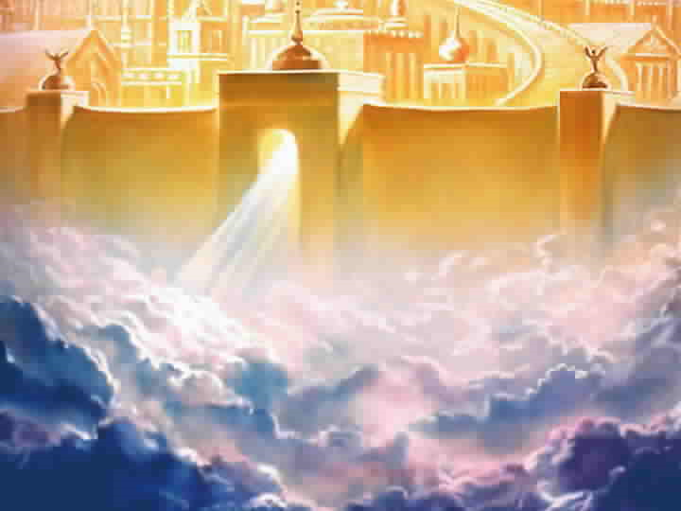
Revelation 21
Revelation 21

Slide 15
http://www.youtube.com/watch?v=0xwzItqYmII&feature=related

Slide 17
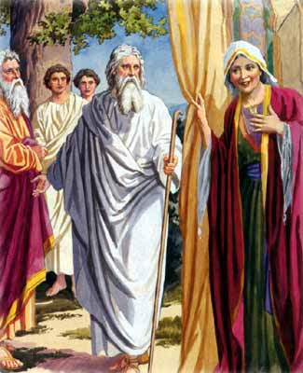

Slide 18
IV.

