Slide 1
Perfecting Our Faith - Review

Slide 2
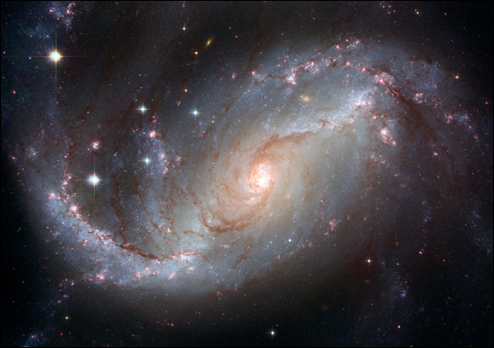

Slide 3
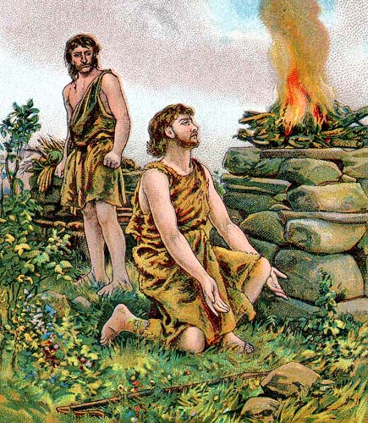

Slide 4
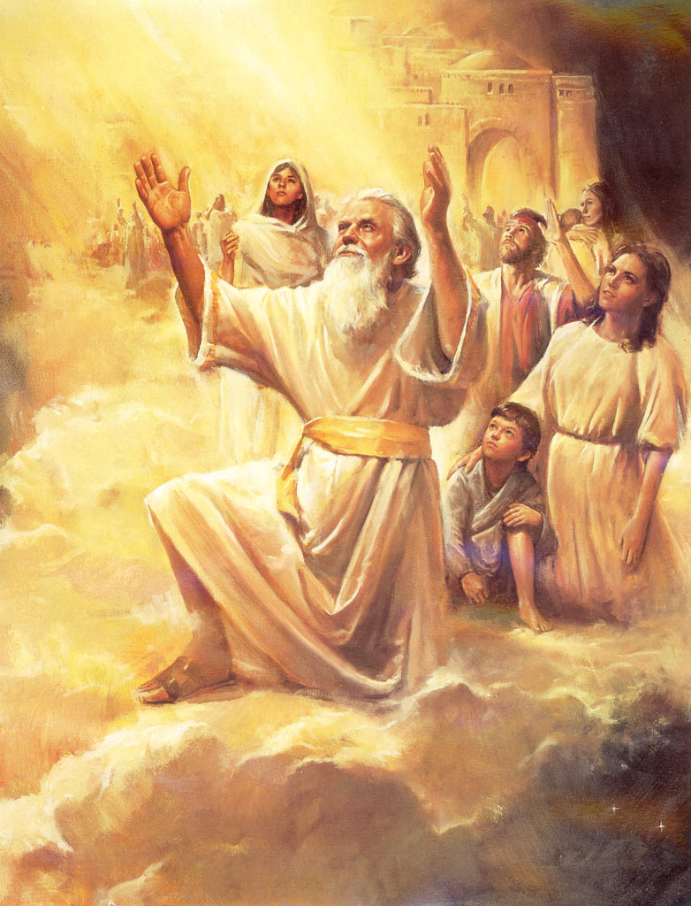

Slide 5
Noah and His Ark
Perfecting Our Faith

Slide 6
Hebrews 11:7
By faith Noah built an ark
Obeyed God
Warned about things that had never happened before
By faith he condemned the rest of the world
Received the righteousness that comes by faith

Slide 7
I. Noah Found Favor
Genesis 6:5-22
The earth had become corrupt
Noah, the only blameless person
Walked in close fellowship with God
Noah found favor (KJV – “Grace”) with God
Noah did everything God had commanded him (6:22; 7:5)

Slide 8
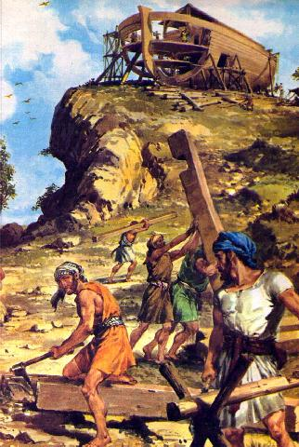
Faith
Things not yet seen
Obedience

Slide 9
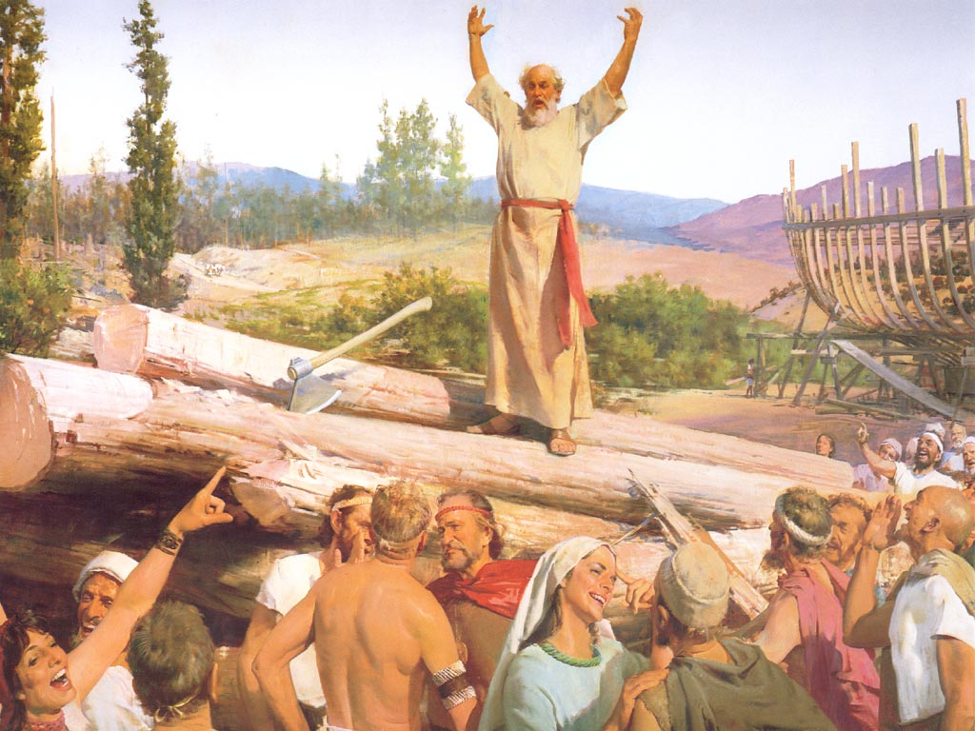

Slide 10
2 Peter 2:5 And God did not spare the ancient world—except for Noah and the seven others in his family. Noah warned the world of God’s righteous judgment (NASB - a preacher of righteousness). So God protected Noah when he destroyed the world of ungodly people with a vast flood.

Slide 11
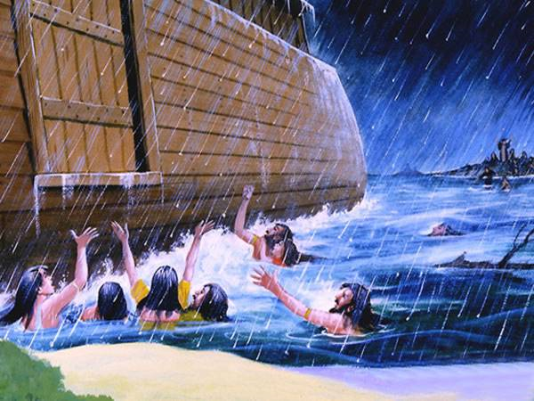
The Flood – Genesis 7:11-24

Slide 12
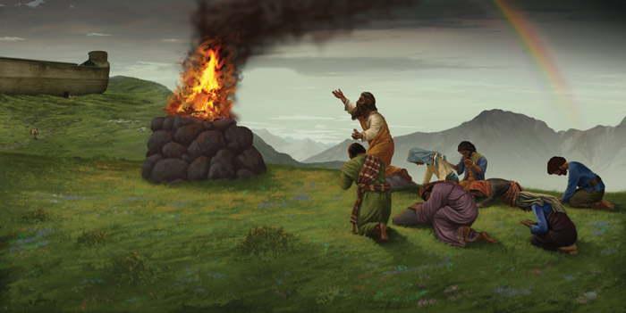
God Confirms His Covenant with Noah – Genesis 9:8-17
Never again will flood waters destroy the earth
Sign of the covenant - Rainbow

Slide 13
II. Like the Days of Noah
Matthew 24:37 - 39 ³⁷“When the Son of Man returns, it will be like it was in Noah’s day. ³⁸In those days before the flood, the people were enjoying banquets and parties and weddings right up to the time Noah entered his boat. ³⁹People didn’t realize what was going to happen until the flood came and swept them all away. That is the way it will be when the Son of Man comes.

Slide 14
Noah escaped the wrath of God
Walked in close fellowship with God
Noah did everything God had commanded him
Noah found favor (grace) with God
He received the righteousness that comes by faith
In contrast to Noah was the rest of the world in its wickedness

Slide 15
III. The Ark of Salvation
Refuge from the judgment of God

Slide 16
The ark is a type of Christ or the body of Christ, the church
Waterproofed - Genesis 6:15 - Waterproofed with tar (pitch – Hebrew KOPHER – literally a cover or coating, figuratively a redemption price) - 1 Peter 1:18 - 19 ¹⁸knowing that you were not redeemed with perishable things like silver or gold from your futile way of life inherited from your forefathers, ¹⁹but with precious blood, as of a lamb unblemished and spotless, the blood of Christ.
One door - John 10:7 So Jesus said to them again, “Truly, truly, I say to you, I am the door of the sheep.

Slide 17
Inside or Outside the Boat?
Outside? – Romans 2:5 But because of your stubbornness and unrepentant heart you are storing up wrath for yourself in the day of wrath and revelation of the righteous judgment of God
Inside? - Romans 5:8 - 9 ⁸But God demonstrates His own love toward us, in that while we were yet sinners, Christ died for us. ⁹Much more then, having now been justified by His blood, we shall be saved from the wrath of God through Him.

Slide 18
Faith – things not yet seen 2 Corinthians 5:7 for we walk by faith, not by sight—
Obedience – though mocked Matthew 5:11 - 12 ¹¹God blesses you when people mock you and persecute you and lie about you and say all sorts of evil things against you because you are my followers. ¹²Be happy about it! Be very glad! For a great reward awaits you in heaven. And remember, the ancient prophets were persecuted in the same way.

Slide 20
