Slide 1
Perfecting Our Faith
Faith Required
My people shall live by faith
Without faith it is impossible to please God
Faith initiated
Faith challenged
Faith developed
or Faith abandoned
Examples of people and their successful response to the faith challenge
Examples and encouragement for our own faith challenges

Slide 2
Enoch and His Ascension
Perfecting Our Faith

Slide 3
Hebrews 11:2, 5
Through their faith people of old earned a good reputation
By faith Enoch was taken up to heaven without dying
He had a reputation as a person who pleased God

Slide 4
I. Enoch Walked with God
Genesis 4:25-5:32 – the birth and lineage of Seth
Genesis 5:18-24
Enoch lived in close fellowship with God
Enoch walked in close fellowship with God

Slide 5
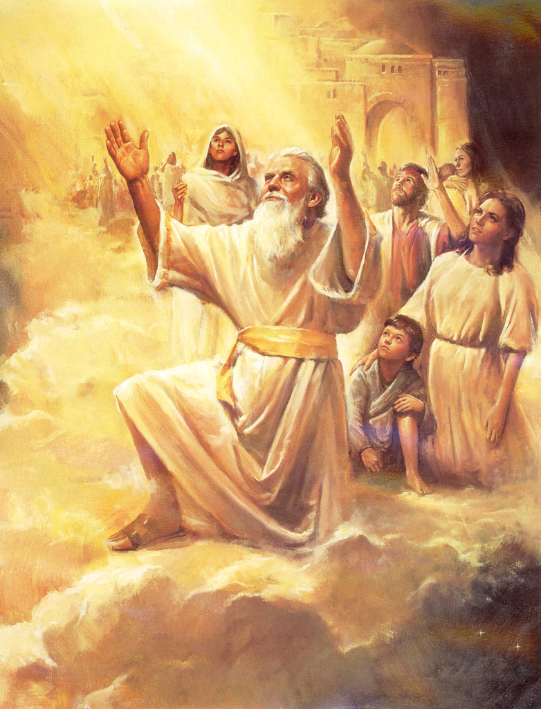
He disappeared because God took him

Slide 6
Adam
130
Seth
130
930
105
Enosh
235
1042
90
Kenan
325
1140
70
Mahalalel
395
1235
65
Jared
460
1290
Enoch
622
65
Methuselah
687
987
162
Enoch
622
187
Lamech
874
1656
183
Noah
1056
1651
500
Sons
1556
600
Flood
1656

Slide 7
Enoch spoke on God’s behalf – prophetic - Jude 14-15
The Lord is coming to execute judgment
Convict every person of all ungodly things
Enoch is faithful in the midst of a perverse generation

Slide 8
Enoch’s Faith
A trust in God that resulted in a close relationship
Close relationship resulted in the favor of God
The favor of God resulted in no death
Therefore – as a result of Enoch’s faith he was taken up to heaven without dying

Slide 9
Others who did not or will not experience death
Elijah – 2 Kings 2:11 – 12

Slide 10
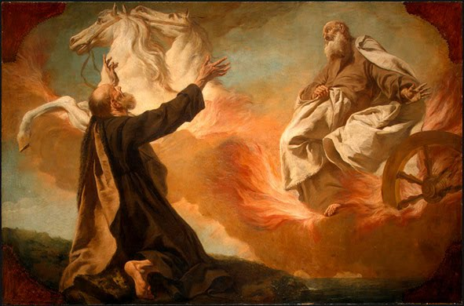

Slide 11
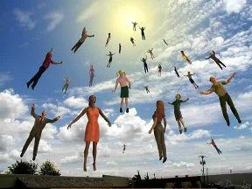
Those alive, in Christ, at his return – 1 Corinthians 15:51-53

Slide 12
II. Live to Please God
Walk/Live in close fellowship with God

Slide 13
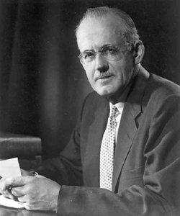

Slide 14
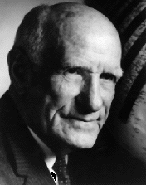

Slide 15
Colossians 3:1 – 4
Set your sights on the realities of heaven
Set your minds on things above where Christ is
Colossians 1:9-10
The way you live will always honor and please the Lord
Ephesians 4:1,17
Lead a life worthy of your calling
Walk in a manner worthy
Live (walk) no longer as the Gentiles for they are hopelessly confused (darkened in their understanding)

Slide 16
Ephesians 5:1-2
Imitate God
Live a life filled with love
Follow the example of Christ – he offered himself as a sacrifice

Slide 17
1 Thessalonians 4:1-18
Live in a way that pleases God
Live holy lives, not rejecting God
When the Lord returns we who are alive will be caught up to meet the Lord in the air
We will be with the Lord forever
Encourage one another with these words

Slide 18
Before Enoch was taken up he was known as a person who pleased God
“My son/daughter in whom _________________”

Slide 20
III.

Slide 23
IV.

