Slide 1
Introduction
  Faith Required
    My people shall live by faith
    Without faith it is impossible to please God
  Faith initiated
  Faith challenged
    Faith developed
    or Faith abandoned
  Examples of people and their successful response to the faith challenge
  Examples and encouragement for our own faith challenges

Slide 2
Living by Faith
Perfecting Our Faith

Slide 3
I. Faith Initiated
Hebrews 12:1-4
  Surrounded by a huge crowd of witnesses to the life of faith (MESSAGE - these pioneers who blazed the way)
  A race to be run with endurance
  Jesus the Champion initiates and perfects our faith
  Don’t become weary and give up

Slide 4
Hebrews 10:32-39 – the righteous will live by faith
  Think back on those early days
  Faithful even through difficulties
  Do not throw away your confident trust in the Lord
  Do not be among those who turn away

Slide 5
Hebrews 11 – Examples of those who lived by faith
  People earned a good reputation through their faith (v.2, v.39)
  Approved by God, but persecuted by men
  Pleased God
  Too good for this world (v.38)

Slide 6
II. Faith Defined
Hebrews 11:1
  Faith is the confidence that what we hope for will actually happen
  Faith gives us assurance about things we cannot see

Slide 7
Confidence –
  That which is placed under; foundation, support.
  Also “reality, substance, existence,” in contrast to what is unreal, imaginary, or deceptive
Assurance – seen in Greek business documents with the meaning “title deed.” Proof, evidence
Such confidence and assurance as to enable one to persevere through difficulties – giving substance to the hope that things will be different than what they are, things not yet seen

Slide 8
Hope - Romans 8:24 - 25 ²⁴For in hope we have been saved, but hope that is seen is not hope; for who hopes for what he already sees? ²⁵But if we hope for what we do not see, with perseverance we wait eagerly for it.

Slide 9
III. Faith Required
My people shall live by faith – Habakkuk 2:4, Romans 1:17, Galatians 3:11, Hebrews 10:38
Hebrews 11:6
  Impossible to please God without faith
  Must believe that God exists
  Must believe that God rewards those who sincerely seek him

Slide 10
God Rewards
  Long and satisfying life
  A good reputation and favor with God and people
  Direction for your life
  Healing and strength for your body
  Abundant provision
  Proverbs 3:1-10

Slide 11
God exists
  Romans 1:19 – 20 ¹⁹They know the truth about God because he has made it obvious to them. ²⁰For ever since the world was created, people have seen the earth and sky. Through everything God made, they can clearly see his invisible qualities—his eternal power and divine nature. So they have no excuse for not knowing God.

Slide 12
IV. The Universe Formed
Hebrews 11:3
  The universe formed at God’s command
  It did not come from anything that can be seen

Slide 13
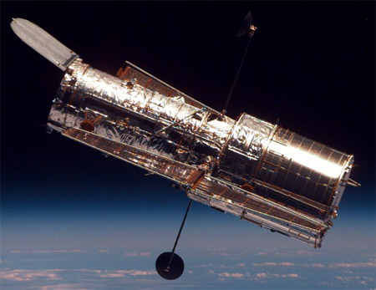
Observation via telescope

Slide 14
Francis Chan – Crazy Love – the Awe Factor of God
http://www.crazylovebook.com/videos_awe.html

Slide 15
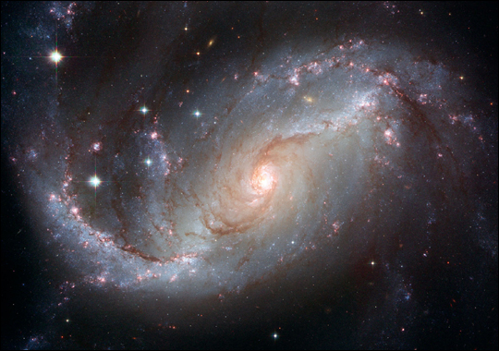

Slide 16
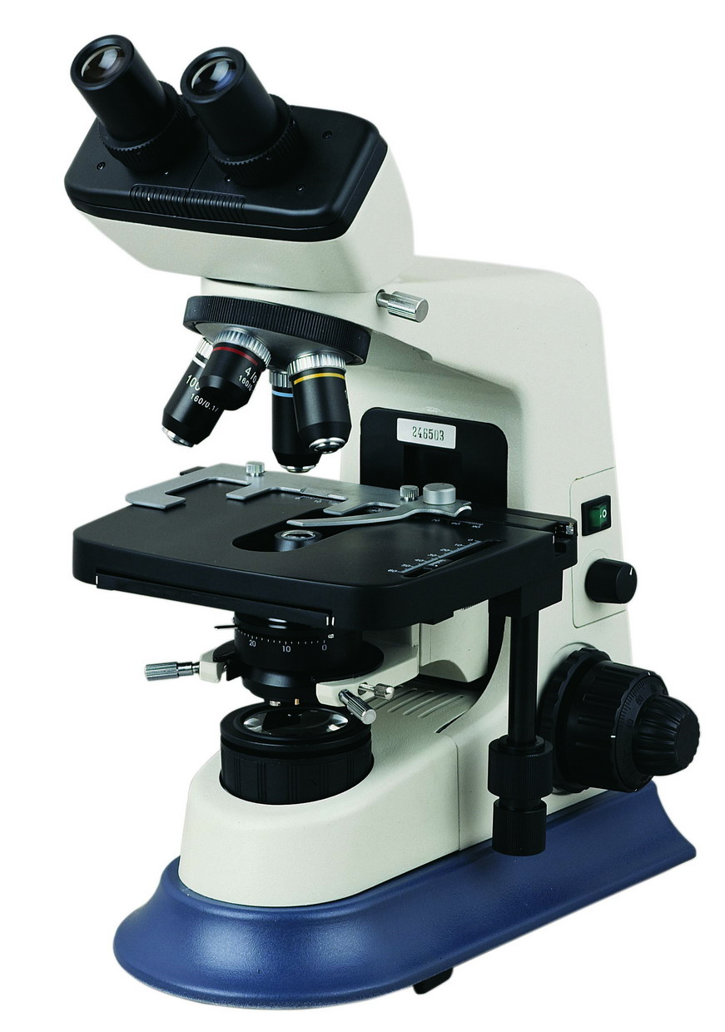
Observation via the Microscope

Slide 17
  A - Adenine
  G - Guanine
  T - Thymine
  C - Cytosine

Slide 18
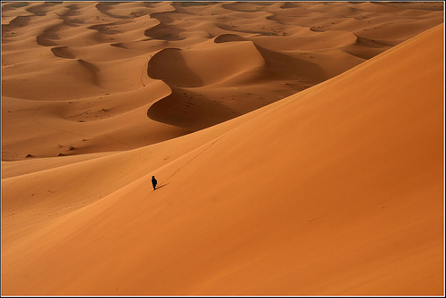

Slide 19
  “More than thirty years of experimentation on the origin of life in the fields of chemical and molecular evolution have led to a better perception of the immensity of the problem of the origin of life on Earth rather than its solution. At present all discussions on principle theories and experiments in the field either end in stalemate or in a confession of ignorance.” Biochemist Klaus Dose

Slide 20
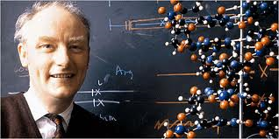
“The origin of life appears to be almost a miracle, so many are the conditions which would have had to be satisfied to get it started” Nobel Prize winner Sir Francis Crick, origin-of-life scientist

Slide 21
Genesis 1:1 - 3 (MESSAGE) ¹First this: God created the Heavens and Earth—all you see, all you don’t see. ²Earth was a soup of nothingness, a bottomless emptiness, an inky blackness. God’s Spirit brooded like a bird above the watery abyss. ³God spoke: “Light!” And light appeared.

Slide 22
Hebrews 11:3 (NASB) ³By faith we understand that the worlds were prepared by the word of God, so that what is seen was not made out of things which are visible.

Slide 23
Next week – by faith Abel…

Slide 24
IV.

