Slide 1
Psalm 138:2 AMPL – For you have exalted above all else Your name and Your Word and You have magnified Your word above all your name
Magnified in our view
Magnified in our speech
Today - Magnified in our action

Slide 2
God’s Word for Direction
The Magnified Word of God Series

Slide 3
I. Illumination
Psalm 119:129-136
The teaching of your word gives light
KJV - The entrance of your word
NASB - The unfolding of your word

Slide 4
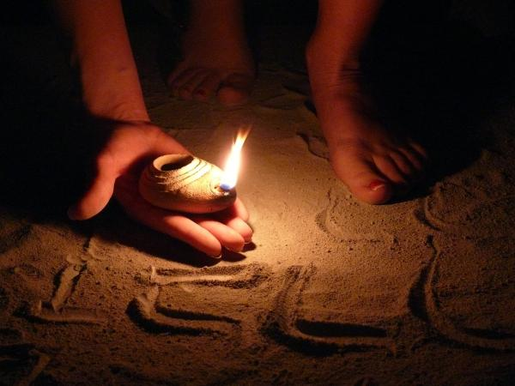
Even the simple can understand
119:105 – your word is a lamp to guide my feet and light for my path

Slide 5
I pant with expectation longing for your commands

Slide 6
119:72 – your instructions are more valuable to me than millions in gold and silver

Slide 7
Guide my steps by your word – so I will not be overcome by evil
God’s Word for the basics
God’s Spirit for the details

Slide 9
II. Basics and Details
God’s Word for the Basics – Hebrews 5:11-14
Should be teachers by now, but need to be taught the basics
The mature – skilled through training to recognize right and wrong

Slide 10
Basics Hebrews 6:1-3
Repentance from evil deeds
Faith in God
baptisms
Laying on of hands
Resurrection of the dead
Eternal judgment

Slide 11
Baptisms
Water – Mark 16:16 – anyone who believes and is baptized will be saved
Holy Spirit – Ephesians 5:18 – be filled with the Spirit
Faith in God
Salvation – Ephesians 2:8 – saved by grace through faith
Provision – Matthew 6:31-33 – don’t worry about these things…your heavenly father knows you need these things…seek first the kingdom of God and these things shall be added to you

Slide 12
God’s word for the basics – Faith for financial provision
Give and it shall be given to you – (Luke 6:38)
Plant a little, harvest a little…plant generously, get a generous crop (2 Corinthians 9:6)
Bring the tithe into the storehouse – open windows of heaven blessing (Malachi 3:10)

Slide 13
God’s Spirit for the details
Bread to eat and seed to the sow (2 Corinthians 9:10)
Discerning how much is for bread
Discerning what bread to buy

Slide 14
III. The Word – Final Authority
Acts 15:1-21 Salvation for the Gentiles
Pharisees vs. Apostles
Pharisees – can’t be saved without circumcision
Apostles – all saved by undeserved grace
Apostles share experiences
Experience is measured by the standard of the Word – “it is written”
Conclusion (Final Authority) is based on the Word of God

Slide 15
2 Peter 1:19-21 (NLT) ¹⁹ Because of that experience, we have even greater confidence in the message proclaimed by the prophets. You must pay close attention to what they wrote, for their words are like a lamp shining in a dark place—until the Day dawns, and Christ the Morning Star shines in your hearts. ²⁰ Above all, you must realize that no prophecy in Scripture ever came from the prophet’s own understanding, ²¹ or from human initiative. No, those prophets were moved by the Holy Spirit, and they spoke from God.

Slide 16
Among our statements of Faith
Praise Fellowship Church accepts the Scriptures as the revealed Will of God, the all sufficient rule of faith and practice…
The Bible is the inspired Word of God, a revelation from God to man, the infallible rule of faith and conduct, and is superior to conscience and reason, but not contrary to reason.
There is an absolute truth – the Word of God

Slide 17
2 Timothy 3:16 – 4:4
Scripture inspired by God
Teach us truth and to do what is right
Correct us when we are wrong
Preach the word
Correct, rebuke, and encourage with good teaching
People will reject truth and chase myths

