Slide 1
Psalm 138:2 AMPL – For you have exalted above all else Your name and Your Word and You have magnified Your word above all your name

Slide 2
Divided Loyalties
The Magnified Word of God Series

Slide 3
I. Thought Wars
Psalm 119:113-120
I hate those with divided loyalties (double minded)
I love your instructions
Get out – evil minded people
I intend to obey God’s commandments
I will meditate continually on your decrees
Those who stray – only fooling themselves

Slide 4
Psalm 1
Psalm 1:1 (NASB) How blessed is the man who does not walk in the counsel of the wicked…
Delight in the law of the Lord
Meditate day and night
Definition: to moan, growl, utter, speak, muse:--
Prosper in all they do
The path of the wicked leads to destruction

Slide 5
James 1:2-8
V.2-3 – the context – troubles come, faith tested
Ask for wisdom with faith in God only
Person with divided loyalty (double minded) unsettled (unstable)

Slide 6
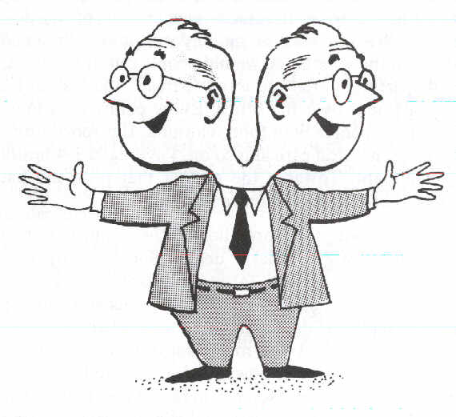
Loyalty divided between God and the world

Slide 7
II. Prisoners of War
2 Corinthians 10:3-6
Wage war with God’s mighty weapons
Knock down strongholds of human reasoning and false arguments

Slide 8
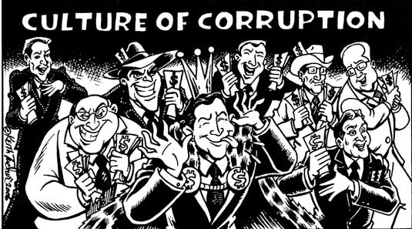
10:4 (NASB) for the weapons of our warfare are not of the flesh, but divinely powerful for the destruction of fortresses.

Slide 9
10:4 (MSG) The tools of our trade aren't for marketing or manipulation, but they are for demolishing that entire massively corrupt culture.

Slide 10
10:5 (NASB) We are destroying speculations and every lofty thing raised up against the knowledge of God, and we are taking every thought captive to the obedience of Christ,

Slide 11
10:5 (MSG) We use our powerful God-tools for smashing warped philosophies, tearing down barriers erected against the truth of God, fitting every loose thought and emotion and impulse into the structure of life shaped by Christ.

Slide 12
III. Strategic Battlefront - Relationships
Relationships - most treasured commodity – over money or possessions,
Trouble comes, faith tested – Scenario #1 You have been offended

Slide 13
Someone has offended you – thought war between human reasoning and God’s word
Human reasoning (warped philosophies) – Vengeance
Avoidance
Eye for an eye
Quarrel
Hatred, bitterness

Slide 14
God’s Wisdom – from God’s Word – Matthew 18:15
Go privately
Point out the offense
Listens and confesses
Win that person back

Slide 15
Trouble comes, faith tested – Scenario #2 You have offended someone - thought war between human reasoning and God’s word
Human Reasoning (Warped Philosophies) - Condescension
Grow up - If you weren’t so immature you wouldn’t get offended
Avoidance

Slide 16
God’s Wisdom from God’s Word – Matthew 5:23-24
Go and be reconciled
Then come and offer your sacrifice

Slide 17
Divided Loyalty (double minded)– between God and the World
Unstable
Walk in the council of the ungodly
Delight in the law (wisdom, council) of God
Bearing fruit in every season
Prosper in all they do

Slide 18
Psalm 119:165 (NLT) Those who love your instructions have great peace and do not stumble. (KJV - nothing shall offend them)
Psalms 119:73 You made me; you created me. Now give me the sense to follow your commands.

