Slide 2
Belief in Salvation
by Grace
Willing to Risk Everything for Christ
Exploring Christ
Growing
In
Christ
Close
to
Christ
Christ
Centered
I believe in God but I’m not sure about Christ.. My faith is not a significant part of my life
I believe in Jesus and I’m working on what it means to get to know him.
I feel really close to Christ and depend on him for daily guidance.
My relationship with Jesus is the most important relationship in my life. It guides everything I do.

Slide 3
Psalm 138:2 AMPL – For you have exalted above all else Your name and Your Word and You have magnified Your word above all your name

Slide 4
A Psalm 119 Revival
The Magnified Word of God Series

Slide 5
I. Why Revival?
Weary in well-doing
Hope deferred
Lost peace
Many afflictions
We wrestle

Slide 7
II. Revived by the Word – Psalm 119
25 – revive me by your word – I lie in the dust
28 – encourage me by your word – 29 keep me from lying to myself
37 – give me life through your word
50 – your promise revives me – it comforts me in all my troubles
114 – your word is the source of my hope
143 – as pressure and stress bear down on me, I find joy in your commands
156 – let me be revived by following your regulations

Slide 8
III. Application of the Reviving Word
Weary?
Psalm 119:143 – as pressure and stress bear down on me, I find joy in your commands
Nehemiah 8:10 This is a sacred day before our Lord. Don’t be dejected and sad, for the joy of the LORD is your strength!
Galatians 6:9 So let’s not get tired of doing what is good. At just the right time we will reap a harvest of blessing if we don’t give up.

Slide 9
Hebrews 6:11 - 12 ¹¹Our great desire is that you will keep on loving others as long as life lasts, in order to make certain that what you hope for will come true. ¹²Then you will not become spiritually dull and indifferent. Instead, you will follow the example of those who are going to inherit God’s promises because of their faith and endurance.

Slide 10
Hope deferred?
Psalm 119:114 – your word is the source of my hope
Romans 8:24 - 25 (NASB) ²⁴For in hope we have been saved, but hope that is seen is not hope; for who hopes for what he already sees? ²⁵But if we hope for what we do not see, with perseverance we wait eagerly for it.

Slide 11
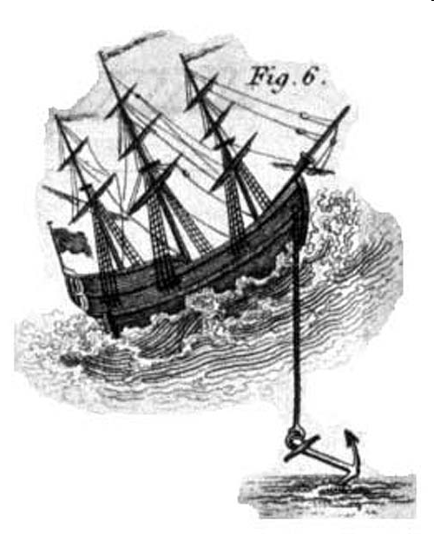
Hebrews 6:19 This hope is a strong and trustworthy anchor for our souls. It leads us through the curtain into God’s inner sanctuary.

Slide 12
Lost Peace
Psalm 119:28 – encourage me by your word – 29 keep me from lying to myself
Isaiah 26:3 You will keep in perfect peace all who trust in you, all whose thoughts are fixed on you!

Slide 13
Isaiah 55:8-11
My thoughts are nothing like yours
My thoughts are higher than yours
I send out my word
It accomplishes everything I want it to

Slide 14
Many Afflictions
Psalm 119:25 – revive me by your word – I lie in the dust
Psalm 119:50 – your promise revives me – it comforts me in all my troubles
John 16:33 I have told you all this so that you may have peace in me. Here on earth you will have many trials and sorrows. But take heart, because I have overcome the world.
Psalms 34:19 The righteous person faces many troubles, but the LORD comes to the rescue each time.

Slide 15
We wrestle
Psalm 119:143 – as pressure and stress bear down on me, I find joy in your commands
Psalm 119:156 – let me be revived by following your regulations

Slide 16
Ephesians 6:10-17
We are fighting against evil spirits
Put on God’s armor – able to resist
Take the sword of the Spirit which is the word of God
Matthew 4 – Temptation of Jesus
The scriptures say…
When the devil had finished every temptation, he left Him until an opportune time

Slide 17
Psalm 85:6-8
Psalms 119:73 You made me; you created me. Now give me the sense to follow your commands.

