Slide 1
Psalm 138:2 AMPL – For you have exalted above all else Your name and Your Word and You have magnified Your word above all your name
Magnify – to make larger to your view
Exalt – to raise in rank, honor, and power
Psalms 119:73 (NLT) You made me; you created me. Now give me the sense to follow your commands.
The alternative - Colossians 2:8 (NLT) Don’t let anyone capture you with empty philosophies and high-sounding nonsense that come from human thinking and from the spiritual powers of this world, rather than from Christ.

Slide 2
Proofs of God’s Word
The Magnified Word of God Series

Slide 4
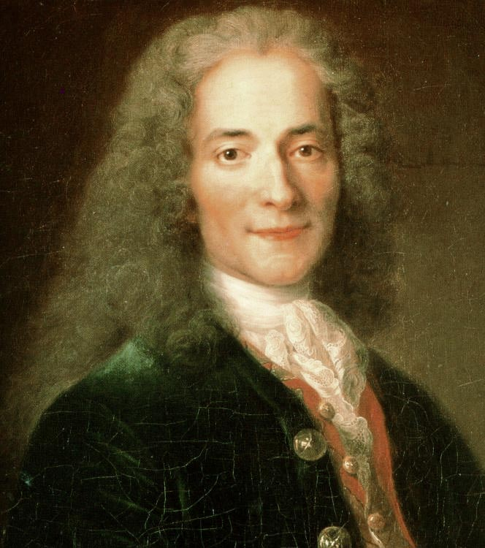

Slide 6
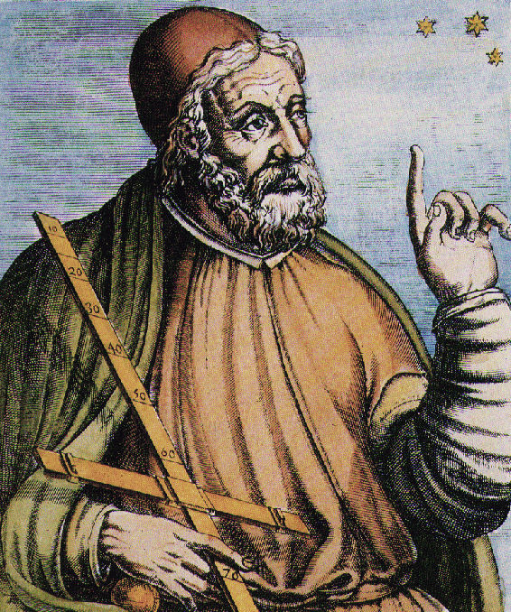

Slide 10
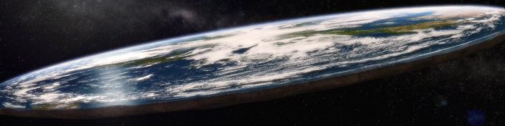

Slide 11
1 Peter 3:15 (NASB) but sanctify Christ as Lord in your hearts, always being ready to make a defense to everyone who asks you to give an account for the hope that is in you, yet with gentleness and reverence;

Slide 13
I.

Slide 14
II.

Slide 15
III.

