Slide 3
The Message of the Gospel
The continuing narrative of the ministry of Jesus through his followers, the church
Movement of the Gospel
Physical
Emotional
Intellectual
Spiritual

Slide 4
Moved by the Spirit
The Message of the Gospel

Slide 5
I. Anointing In You
John 16:12-15
Much more I want to tell you, but you can’t bear it now
When the Spirit comes, he will guide you into all truth
He will tell you about the future
He will tell you what he receives from me

Slide 6
Acts 2 – Peter’s message
This is that prophesied by Joel
Spirit poured out on all people
Sons and daughters
Young men and old
Men and women alike
No longer just prophets, priests, and kings

Slide 7
1 John 2:20,27 "But you have an anointing from the Holy One, and you all know."… "And as for you, the anointing which you received from Him abides in you, and you have no need for anyone to teach you; but as His anointing teaches you about all things, and is true and is not a lie, and just as it has taught you, you abide in Him."

Slide 8
II. Activity of the Spirit in the book of Acts
Doctrine Discerned
Acts 15
The testimony of experience
Aligned with the Word of God
Discernment of Seasoned leaders
Seemed good to the Holy Spirit and to us

Slide 9
Direction Discerned
Acts 8:26-29, 39
Philip directed to the chariot
Philip snatched away
Acts 11:12
Peter directed to Cornelius’ house

Slide 10
Acts 16:6-10
Spirit prevented them from preaching in Asia
Spirit prevented them from preaching in Bithynia

Slide 11
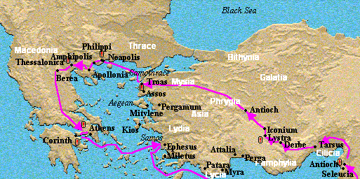
Vision at night
Concluding the Lord had called us to go to Macedonia

Slide 12
Proverbs 16:9 We can make our plans, but the LORD determines our steps.
Proverbs 16:3 Commit your actions to the LORD, and your plans will succeed.

Slide 13
Revealed things to come
Acts 21:7-13
Acts 9:15-16 "But the Lord said to him, "Go, for he is a chosen instrument of Mine, to bear My name before the Gentiles and kings and the sons of Israel; 16 for I will show him how much he must suffer for My name's sake.""
Acts 20:23 "except that the Holy Spirit solemnly testifies to me in every city, saying that bonds and afflictions await me."

Slide 14
III. Dependant on the Spirit
World’s perspective or God’s view
Doctrine – truth
Direction - plans
Preparation – things to come
Israel did not know the day of their visitation – Luke 19:44

Slide 15
Directed by the Holy Spirit
Romans 8:14 "For all who are being led by the Spirit of God, these are sons of God.”
Galatians 5:18 "But if you are led by the Spirit, you are not under the Law."

Slide 16
Revelation by the Holy Spirit
1 Corinthians 2:9-12
Eyes, ears, mind have not perceived what God has prepared for those who love him
God revealed these things by the Spirit
The Spirit shows us God’s deep secrets
We have received the Spirit so we can know the wonderful things God has freely given us

Slide 17
Developing your walk with the Spirit

Slide 18
IV.

