Slide 3
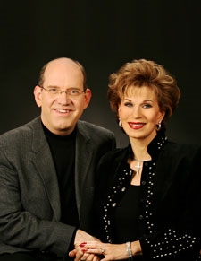
Rick and Denise Renner are committed to building a large, powerful church in Red Square, the very heart of Moscow and the church is growing quickly. Rick's TV show is broadcast in Ukraine, Belarus, Latvia, Moldova, Kazakhstan, Kyrgyzstan, Armenia, Georgia, and large parts of Russia, Azerbaijan, Estonia, Lithuania, Tajikistan, Uzbekistan, and Siberia. Instructor for AFCM-ITC

Slide 4
Apostolic Transformations 2
The Saul/Paul Call

Slide 5
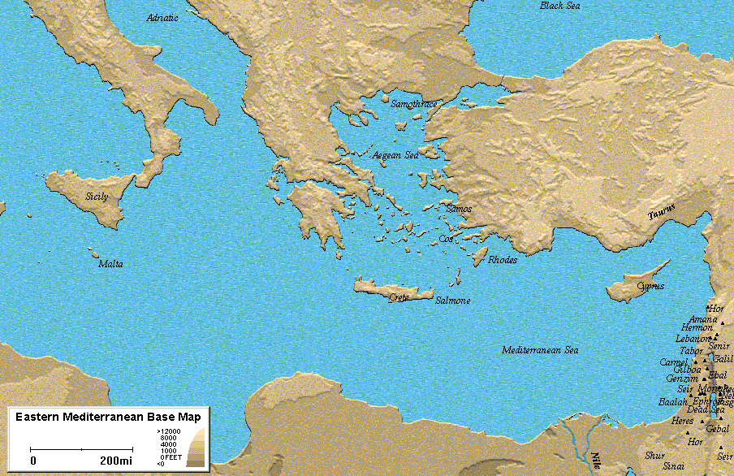

Slide 6
The Way:
Acts: 8:1-3 Paul before coming to Christ
1 Timothy 1:12 What Paul says about himself.
Blasphemer:
Persecutor:
Injurious:

Slide 7
Acts 26:11 Paul shares with King Agrippa II about himself.
Acts 9:1

Slide 8
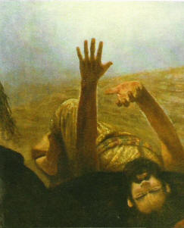
Acts 9:4-6 Paul’s vision in Luke’s account.

Slide 9
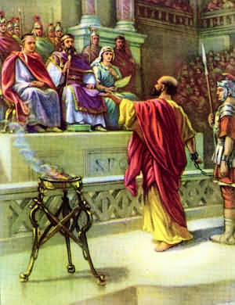
Acts 26:9-17 Paul’s vision given to King Agrippa II
“I am sending you” Greek: apostelo
Apo = away stelo = to send compound words means “to send away”
“An Apostle to the Dogs” “An Apostle to the Gentiles”

Slide 10
Philippians 3:5 Paul’s Pedigree
Circumcision-
Stock of Israel-
Tribe of Benjamin-
Hebrew of Hebrews-
Pharisee-
Zealot-
Righteousness-

Slide 11
Acts 9:10 Ananias called by Jesus to confirm His words to Saul.

Slide 12
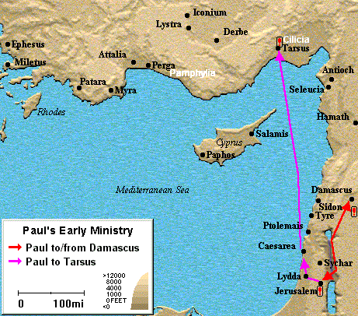
Acts 9:26-31 Paul in Jerusalem
Paul is sent home to Tarsus
Paul disappears for 3 years

Slide 13
Acts 13:1-3 The Hub of Activity moves to Antioch in Syria
Barnabas-
Simeon-
Lucius-
Manaen-
Saul-
Prophets: Teachers:

Slide 14
Acts 13:2 Barnabas and Paul are “sent forth“: Greek: Apostelo
Admiral of a fleet of ships
1 Corinthians 3 Paul describes the apostolic ministry given to him.
“according” to the grace given to me…
“wise master builder”
“wise”
“master builder”

Slide 15
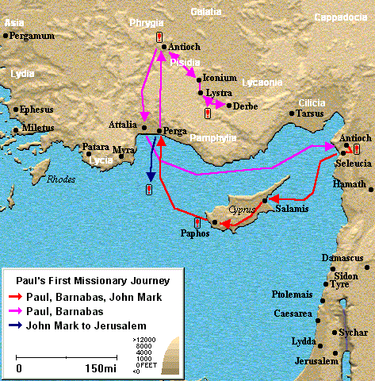
Paul and Barnabas sent off to work with the Gentiles?
Cyprus- Salamis
Antioch- Pisidia
Acts 14:1 Icomium, Lystra, Derbe

Slide 16
Acts 15 “The Debate” Gentiles must convert to Judaism

Slide 17
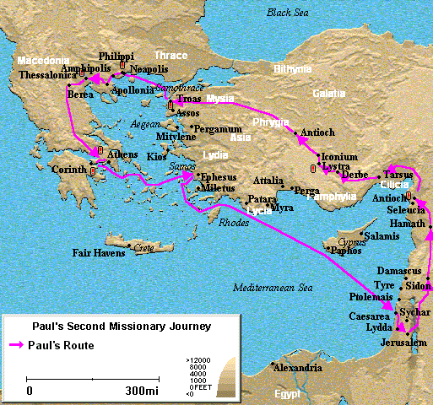
Acts 16:5 Second Missionary Journey strengthening the churches

Slide 18
Acts 17 – Thessalonica, Berea

Slide 19
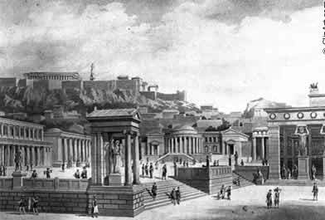
Paul to Athens…..

Slide 20
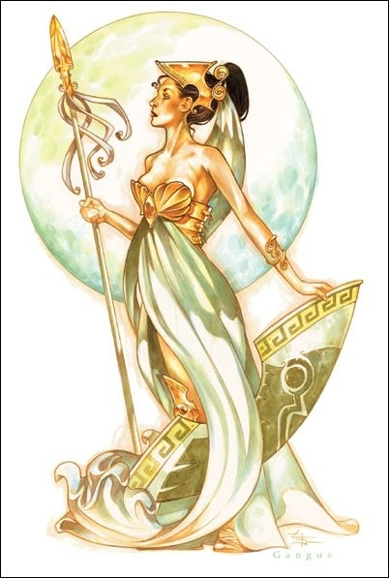
Immoral City of the goddess Athena

Slide 21
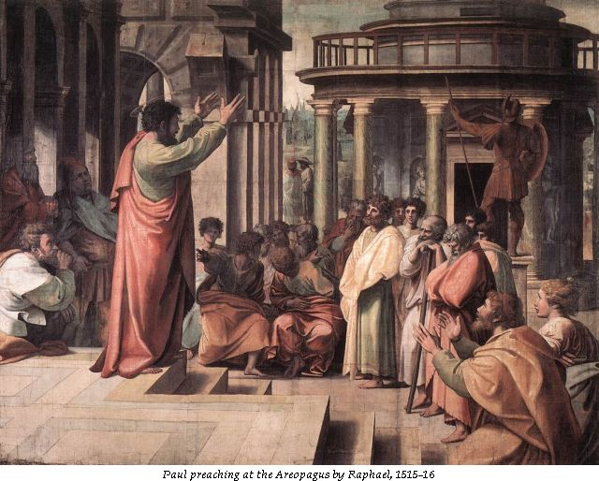
Message of the idol to the Unknown god.

Slide 22
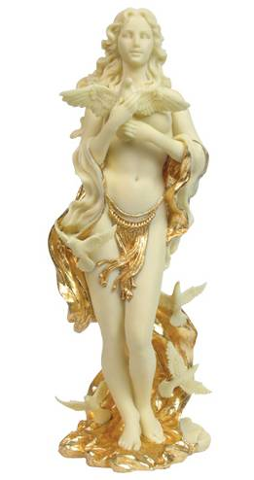
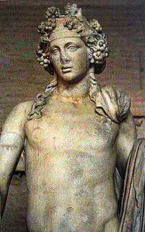
On to Corinth… If you think Athens was bad, wait till you arrive in Corinth.
Worship of Aphrodities and Dionysus

Slide 23
Meet Aquila and Priscilla
Establish a church and stays a year in Corinth
Silas and Timothy show up.

Slide 24
Acts 18:6 Paul finally declares what he has known all along. An Apostle to the Gentiles.
Acts 18:9 Another vision:

Slide 25
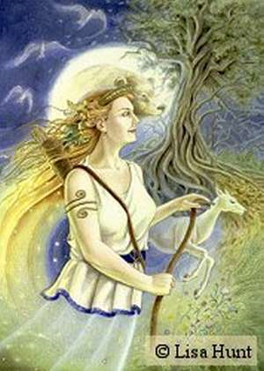
Ephesus Acts 19-20:1
Worship of the goddess Artemis

Slide 26
Establishes a large church
Demetrius Acts 19:23-41
Economy - verses 27-28

Slide 27
Timothy set in as Pastor of Ephesus
1 Timothy 1:3-5

Slide 29
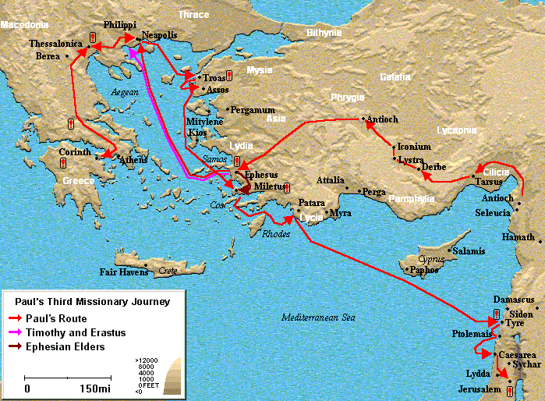

Slide 31
II.

Slide 33
III.

Slide 36
IV.

