Slide 1
The Message of the Gospel
The continuing narrative of the ministry of Jesus through his followers, the church

Slide 2
Apostolic Transformations
Peter, Peter, clean meat eater

Slide 3
I. Peter the Disciple
Impetuous - characterized by sudden or rash action, emotion

Slide 4
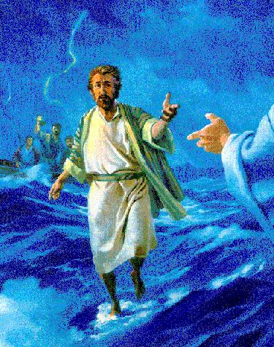

Slide 5
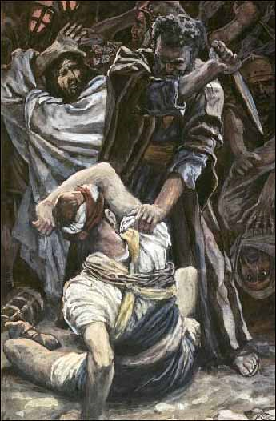

Slide 6
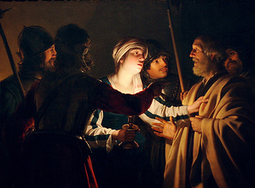

Slide 7
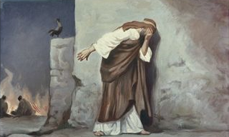
Repentant – remembered Jesus’ words and left the courtyard weeping bitterly

Slide 8
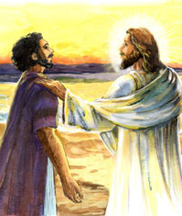
John 21:15-19
Do you love me? (3 times)
More than these?
Feed my sheep

Slide 10
II. Peter the Apostle
Filled with the Holy Spirit
Filled with boldness

Slide 11
Acts 4:13 commentary

Slide 12
III. Paradigm Shift
Acts 10
Cornelius – Roman Army Officer, Captain of the Italian Regiment

Slide 13
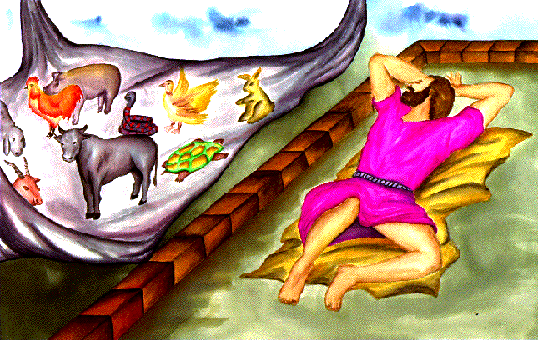
Peter’s trance

Slide 14
Mark 7:17 – 19 ¹⁷Then Jesus went into a house to get away from the crowd, and his disciples asked him what he meant by the parable he had just used. ¹⁸“Don’t you understand either?” he asked. “Can’t you see that the food you put into your body cannot defile you? ¹⁹Food doesn’t go into your heart, but only passes through the stomach and then goes into the sewer.” (By saying this, he declared that every kind of food is acceptable in God’s eyes.)

Slide 15
1 Timothy 4:1 - 5 ¹Now the Holy Spirit tells us clearly that in the last times some will turn away from the true faith; they will follow deceptive spirits and teachings that come from demons. ²These people are hypocrites and liars, and their consciences are dead. ³They will say it is wrong to be married and wrong to eat certain foods. But God created those foods to be eaten with thanks by faithful people who know the truth. ⁴Since everything God created is good, we should not reject any of it but receive it with thanks. ⁵For we know it is made acceptable by the word of God and prayer.

Slide 16
Peter’s revelation
Unlawful for me to enter your home or associate with you
But God has shown me that I should no longer think of anyone as impure or unclean
God has made them clean

Slide 17
Peter’s message
In every nation God accepts those who fear him
Jesus – healing all oppressed of the devil
Death on the cross and raised the third day
Everyone who believes in him will have their sins forgiven

Slide 18
Peter’s experience
Holy Spirit fell upon all who were listening to the message
Evidence – speaking in tongues and praising God
Peter’s Religious Critics – Acts 11
You entered the home of Gentiles and even ate with them
Peter’s Defense
Revelation from God
Who was I to stand in God’s way?

Slide 19
Peter’s Counsel – Acts 15
Counsel to the council to discern God’s will
God cleansed Gentiles through faith in undeserved grace
Peter’s setback – Galatians 2:11-16
Afraid of criticism from people who insisted on the necessity of circumcision
Withdrew from Gentiles
Bad influence

Slide 20
Peter’s mature apostolic transformation
Peter’s epistles
The trials that show your faith is genuine
Suffering for being a Christian
Caring for the flock that God has entrusted to you

Slide 21
IV. Relevance to the Ongoing Narrative
Who do you consider unclean?
Not much hope for them if any
What would they have to do to be okay?
In what ways do you switch from undeserved grace to behavior modification?
In what areas have you walked in revelation only to slip back into tradition?
Are you a person who will receive correction?

