Slide 2
2 Timothy 2:2 The things which you have heard from me in the presence of many witnesses, entrust these to faithful men who will be able to teach others also.
Equipping men
Enabling men to equip sons to be men

Slide 3
The Quest for Authentic Manhood
Reject passivity
Accept responsibility
Lead courageously
Expect a greater reward, God’s reward

Slide 4
1 Kings 2:1 - 3 ¹As David’s time to die drew near, he charged Solomon his son, saying, ²“I am going the way of all the earth. Be strong, therefore, and show yourself a man. ³“Keep the charge of the LORD your God, to walk in His ways, to keep His statutes, His commandments, His ordinances, and His testimonies, according to what is written in the Law of Moses, that you may succeed in all that you do and wherever you turn,

Slide 5
This Fall The Great Adventure
The Great Adventure explores a man and his world beyond the everyday. The 20-session study puts the roof on the house of masculinity and creates a vision for a man's future and destiny. This study will help men rediscover the adventure in life through a greater understanding of who they are. Men will uncover the uniqueness they have as a man and discover a satisfying life focus.

Slide 6
The message of the gospel
Good news
The power of God for salvation
Forgiven of sin
Changed lives
Commissioned
Pre-resurrection – the Kingdom of God
Post-resurrection – witnesses of the resurrection
The continuing narrative of the ongoing ministry of Jesus Christ through his people
Saved or condemned

Slide 7
Romans 10:14 - 15 ¹⁴But how can they call on him to save them unless they believe in him? And how can they believe in him if they have never heard about him? And how can they hear about him unless someone tells them? ¹⁵And how will anyone go and tell them without being sent? That is why the Scriptures say, “How beautiful are the feet of messengers who bring good news!”
You are either a “caller” or a “teller”

Slide 8
Empowered
The Message of the Gospel

Slide 9
I. Wait
Luke 24:44-49
Stay in the city until the Holy Spirit comes and fills you with power from heaven
Acts 1:1-8
In a few days you will be baptized with the Holy Spirit
You will receive power when the Holy Spirit comes upon you
You will be my witnesses

Slide 10
Acts 2
Pentecost – 50 days after Passover – a Jewish Festival – the Feast of Harvest
God draws a crowd

Slide 11
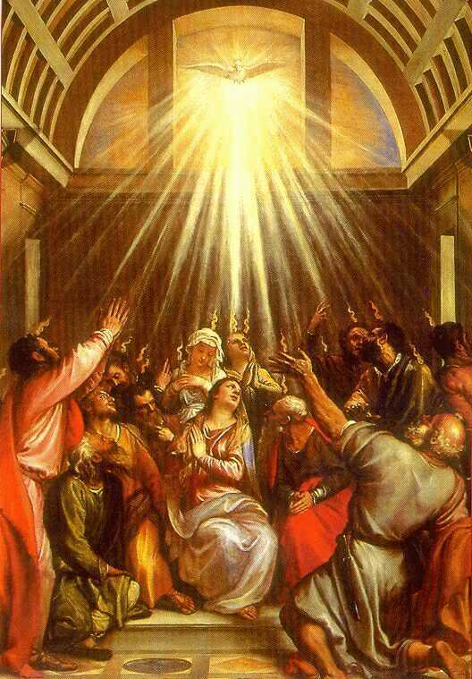
Sound of a rushing wind
Appearance of flames of fire
All present filled with the Holy Spirit
Speaking in other languages as the Spirit gave them the ability
Everyone came running

Slide 12
II. Filled With the Spirit
Acts 4:8,13, 29-31
Filled with the Spirit – resulted boldness
Repeated action of filling
Compare Ephesians 5:18 Don’t be drunk with wine, because that will ruin your life. Instead, be filled with the Holy Spirit, (AMPLIFIED – ever be filled and stimulated with the Holy Spirit)

Slide 13
Acts 5:29-32
Acts 6:1-7
Acts 7:51-57

Slide 14
A separate experience from salvation
Acts 8:4-8, 14-17
People believed and were baptized
The Holy Spirit had not yet come upon them
Acts 19:1-7
Have you received the Holy Spirit since you believed?

Slide 15
The purpose of being filled with the Holy Spirit
To be witnesses
The power to be witnesses
The equipment to be witnesses
Gifts of the Spirit – 1 Corinthians 12:4-11
Fruit of the Spirit – Galatians 5:22-23

Slide 16
III. Qualified
2 Corinthians 3:4-6
Confident of all this because of our great trust in God through Christ (boldness)
Our qualification comes from God
He has enabled us to be ministers of his new covenant
Witnesses of the Good News

Slide 17
Have you asked to be empowered/enabled to be a witness of the good news?
Asking for spiritual things – are you making yourself vulnerable to evil spirits?

Slide 18
Luke 11:11 - 13 ¹¹“You fathers—if your children ask for a fish, do you give them a snake instead? ¹²Or if they ask for an egg, do you give them a scorpion? Of course not! ¹³So if you sinful people know how to give good gifts to your children, how much more will your heavenly Father give the Holy Spirit to those who ask him.”
Who are you asking?
What are you asking for?

